Slide 1
2017-5-3
Phase 2:
美文5篇

Slide 2
Flying a kite
Kite flying is becoming increasingly popular. Young and old alike can be seen in parks enjoying this healthy outdoor recreation.
Some people enjoy watching the multicolored kites high up in the sky. Others find it thrilling to control a flying object. By tugging at the string the kite will ascend. A slack string will allow the kite to drift with the wind and descend. As far as I am concerned, flying a kite is fun because it gives me an excuse to laze away a sunny afternoon daydreaming while watching the delicate kites bobbing up and down.

Slide 3
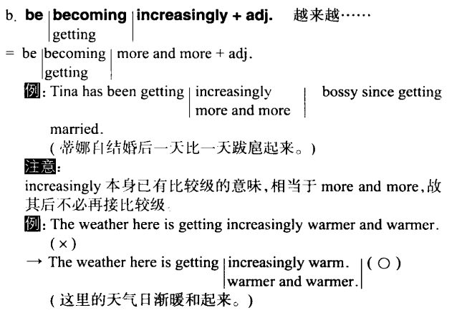

Slide 4
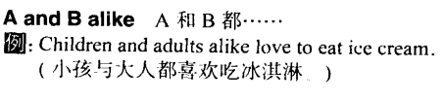
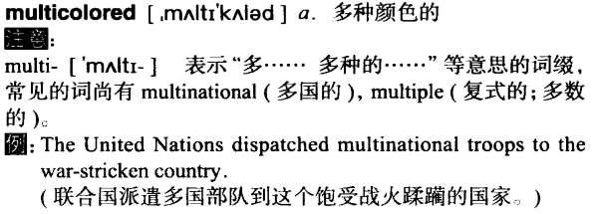

Slide 5
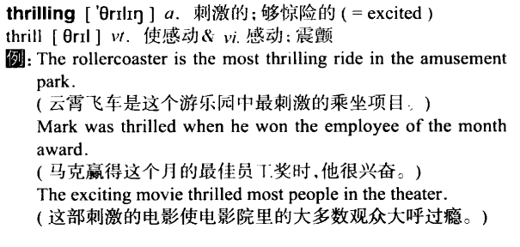


Slide 6
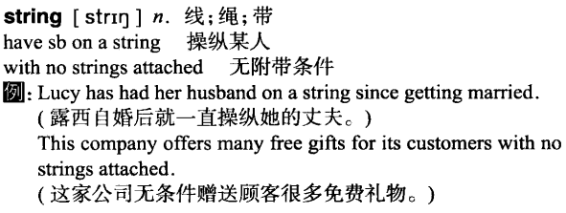

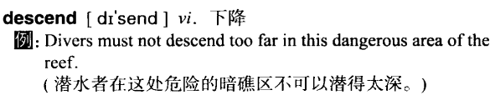

Slide 7
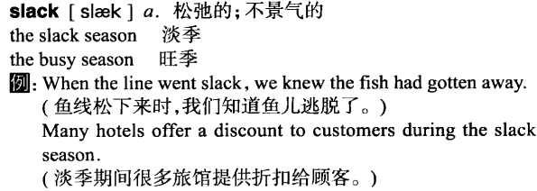
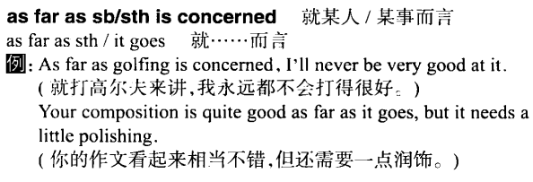

Slide 8
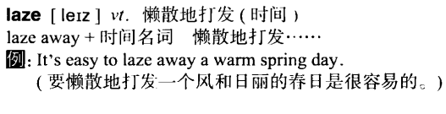
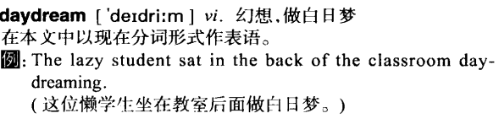
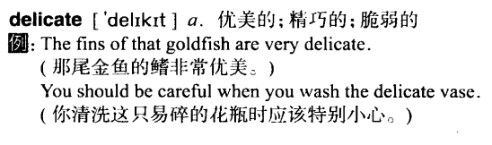

Slide 9

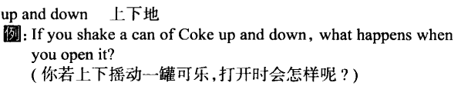

Slide 10
How I spend my weekends
I welcome weekends with open arms. After school on Fridays, I grab a bite to eat and then immediately take a long nap. God knows I need the sleep to recuperate. Friday evening is my favorite time of the week. That's the time when I usually listen to CDs. I dim the lights in my room and let my mind drift far away. On Saturdays, I enjoy eating out with my family. After that I might do some shopping with Mom. Invariably, I sleep late on Sunday mornings, and soon after I get up, I start preparing for another grueling week at school.
Although weekends aren't very adventurous, by mid-week I find myself longing for them.

Slide 11



let my mind drift far away

Slide 12
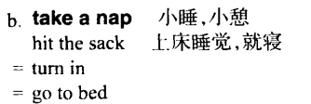


Slide 13


Slide 14
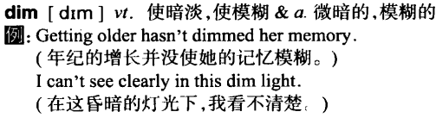

Slide 15
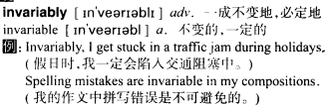

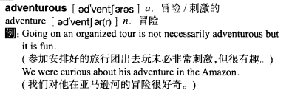

Slide 16
The joy of reading
Reading is to the mind what exercise is to the body. People who read are usually more open-minded and rarely bored. Through reading different kinds of books, you can broaden your mind and stimulate your imagination.
Furthermore, reading is not an expensive pastime. It doesn't cost you much money because you can easily borrow books from a library or friends. It is especially good for the whole family. For instance, my family likes to read. We often spend evenings together discussing literature and sharing insights from books. Hence, reading brings us closer together.

Slide 17


Slide 18
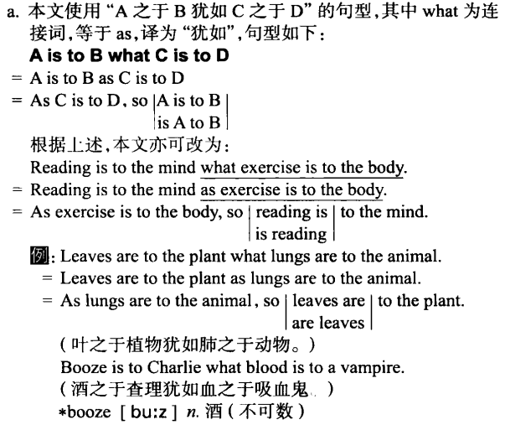

Slide 19

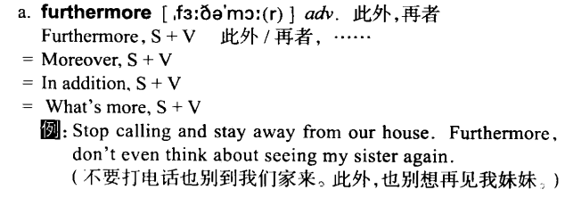

Slide 20
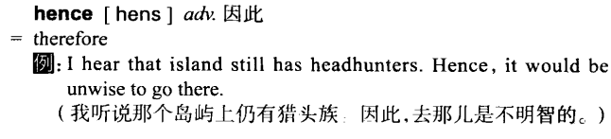

Slide 21
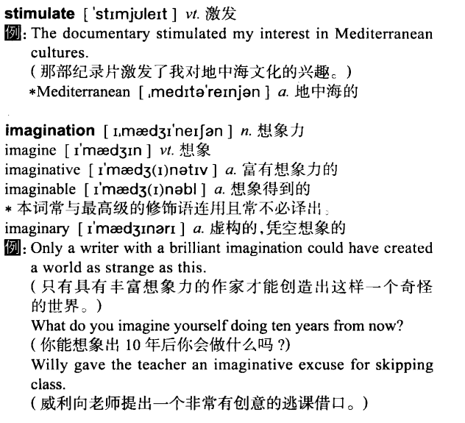

Slide 22
Why learn English?
There are many advantages of learning English. English is an international language. If you can speak it, you'll have little difficulty traveling anywhere. And if you can read it, you can acquire firsthand information about what is going on in the world. Mastering English, however, can't be done overnight. It takes time and patience.
To begin with, you should get yourself a good dictionary. Consult it when encountering a word you don't understand. Any reading material is fine, but make sure you study for at least two hours every day. Keep in mind that there are no shortcuts to learning English. It takes a lot of hard work, but the reward is well worth the effort.

Slide 23


Slide 24
One way to improve your English
My classmate, Lily, and I are the best students in our English class. Do you know how we improve our English? We meet twice a week in a coffee shop to practice. We spend the whole afternoon discussing a wide range of topics in English. Then once a week an American friend, Stan, does language exchange with us. We teach him Chinese and he teaches us English. In less than six months, we have improved by leaps and bounds.
We have also met other Americans through Stan. Now we have quite a few American friends. And of course, we always speak English with them. This way of learning English has worked wonders for us. Maybe it could work for you, too.

Slide 25

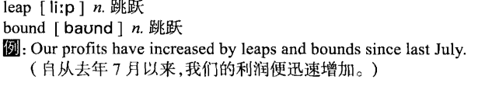

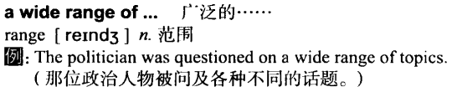

Slide 26
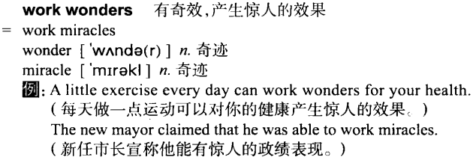

Slide 27
