Slide 1
Revision

Slide 2
Words and expressions
成就，功绩 n.
专家，专业工作者n.
连接，关系n.
作战，参加运动v.
运动，战役n.
举动，表现v.
值得的，值得做的adj.
achievement
specialist
connection
campaign
behave
worthwhile

Slide 3
observe
outspoken
respect
argue(argument)
support
intend
deliver
considerate
modest
观察，观测
直言的，坦诚
尊敬，尊重
讨论，争辩
支持,拥护
计划，打算
递送，接生，发表
考虑周到的
谦虚的

Slide 4
人
离开，启程，出发
过生活
涌上心头，涌入脑海
蔑视，瞧不起
查阅，参考
偶然遇见
继续，坚持
human being
move off
lead a… life
crowd in
look down upon/on
refer to
come across
carry on

Slide 5

Quiz I Translation
我们一行人准备按照简研究的黑猩猩的方法去森林里拜访他们。
Following Jane’s way of studying chimps,our group are all going to visit them.
2. 我们当天的首要任务是观察黑猩猩一家是如何醒来的。
Watching a family of chimps wake up is our first activity of the day.

Slide 6
3. 这意味着我们要返回到前一天晚上我们离开时黑猩猩一家睡觉的大树旁。
This means going back to the place where we left the family sleeping in a tree the night before.
4.大家坐在树阴下等待着，这时黑猩猩们睡醒了，准备离开。
Everybody sits and waits in the shade while the family began to wake up and move off.

Slide 7
5.它们向森林深处漫步而去，我们尾随其后。
We follow as they wander into the forest.
6.到傍晚时，我们觉得这一切都是值得的。
The evening makes it all worthwhile.
7.她花了很多年的时间来观察记录黑猩猩的日常活动。
She spent years observing and recording their daily activities.

Slide 8
8.她母亲头几个月过来帮忙，这才使她得以开始自己的计划。
Only after her mother came to help her for the first few months was she allowed to begin her project.
9.我一停下来，所有的一切都涌上心头。
Once I stop, it all comes crowding in .

Slide 9
10.知道有一天晚上坐在电脑旁研究中国已的伟大女性时，我才有了答案。
I didn’t know the answer until one evening when I sat down at the computer to do some research on great women of China.
11.很偶然地，我看到了一篇关于林的文章。
By chance I came across an article about a doctor called Lin…

Slide 10
12.我仔细地看了这篇文章，了解到那是为农村妇女写的。
I looked carefully at the text and realized that it was intended for women in countryside.
13.进一步阅读使我了解到，是苦干、决心和他的善良的天性使她走进医学院大门。
Further reading made her realize that hard work and determination as well as her gentle nature that got her into medical school.

Slide 11
14.后来使她成功的是她对所有的病人献出的爱心和体贴。
What made her succeed later on was the kindness and consideration she showed to all her patients.
15.为什么不像林一样去医学院学习，并继续她的事业呢？
Why not study at medical college like Lin and carry on her good work?

Slide 12
16.现在努力提高学习成绩，准备我的大学入学考试还不算晚。
It was still not too late for me to improve my studies, prepare for the university entrance examination…

Slide 13
Quiz II
Translation
1. 培养儿童用餐时举止得体是很困难的。
2. 警方一直监视着他的一举一动。
3. 一些人为反对自由贸易辩论。
It's hard to train children to behave
well at the table.
The police have been observing his movements.
Some people argue against free trade.

Slide 14


1.I observed two men in raincoat
______ the hall.
A. enter B. entering
C. entered D. to enter
2.He ____ that it had turned cloudy.
A.observed B. watched
C. felt D.notice

Slide 15

3.In this seaside resort , you can___ all the comfort and convenience of modern tourism.
enjoy B.apply
C.receive D.achieve

Slide 16
4. Peter’s jacket looked just the same as Jack’s , but it cost___ his.
A.as much twice as
B.twice as much as
C.much as twice as
D.as twice much as

Slide 17
5. A notice was ___ in order to remind the students of the changed lecture time.
A.sent up B. given up
C.set up D. put up

Slide 18
6.It took ___ building supplies to construct these energy-saving house. It took brains, too.
A.other than B.more than
C.rather than D.less than

Slide 19
7.A new___ bus service to Tianjin Airport started to operate two months ago.
A.normal B.usual
C.regular D.common

Slide 20
8.Reaching this agreement so quickly was a great ____ for the meeting.
A.appointment B.access
C.achievement D.approach

Slide 21
9.-I wonder how much you charge for your services.
-The first two are free___ the third costs 30 yuan.
A.while B.until C. when D.before

Slide 22
10.This special school accepts all disabled students,___ educational level and background.
A.according to B.regardless of
C.in addition to D.in terms of

Slide 23
11.Though having lived abroad for years , many Chinese still ___ the traditional customs.
A.perform B.possess
C.observe D.support

Slide 24
12.After studying in a medical college for five years, Jane___ her job as a doctor in the countryside.
A.set out B.took over
C.took up D.set up

Slide 25
13.We firmly believe that war never settles anything. It only___ violence.
A.runs into B.comes from
C.leads to D.begins with

Slide 26
14.____ in the fields on a March afternoon, he could feel the warmth of spring.
A.To walk B.Walking
C.Walked
D.Having walked

Slide 27
15.He is very popular among his students as he always tries to make them____ in his lectures.
A.interested
B.interesting
C.interest
D.to interest

Slide 28
16.The lawyer seldom wears anything other than a suit___ the season.
A.whatever B.wherever
C.whenever D.however

Slide 29
17.If you think that treating a woman means always ___ her permission for things , think again.
A.get B.got
C.to get D.getting

Slide 30
18.I prefer to stay at home doing nothing ____ go to the cinema to see a film.
A.rather than B.other than
C.or rather D.would rather

Slide 31
19.People in Chongqing are proud of___ they have achieved in the past ten years.
A.that B.which
C.what D.how

Slide 32
20.They use computers to keep the traffic ___ smoothly.
A.being run B.run
C.to run D.running

Slide 33

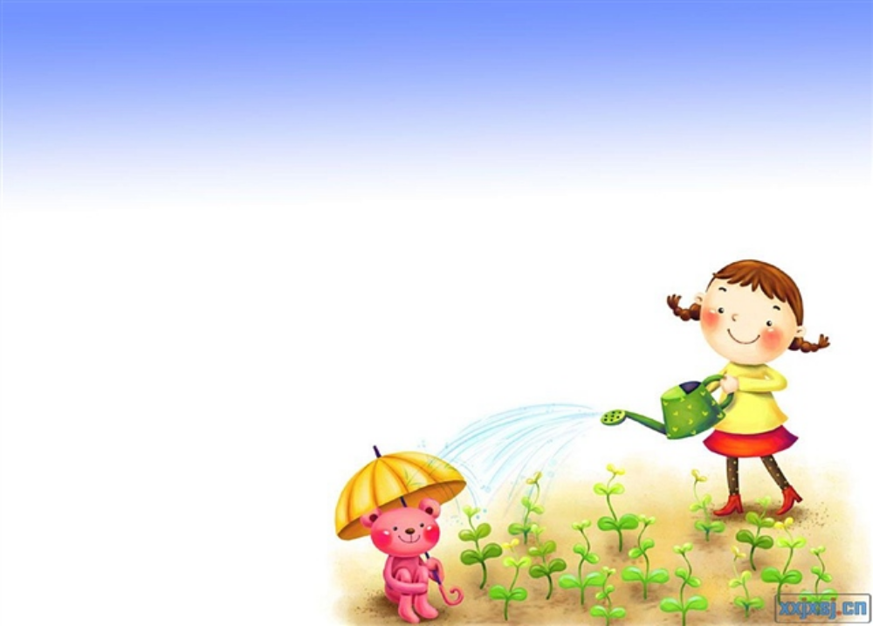

21. I failed in the final examination last term and only then ____ the importance of studies.
A. I realized
B. I had realized
C. had I realized
D. did I realize

Slide 34
22.He was an ____ poet at that time and his ____ poems spread through all the country.
inspired; inspired
B. inspiring; inspired
C. inspired; inspiring
D. inspiring; inspiring

