Slide 1

for Senior 1
2016-2017学年第31/32期总第 668期
Adventure in China begins (P4)
Not wrong to refuse (P6)
Not good to feel guilty (PVII)

Slide 2
for Senior 1
2016-2017学年第31/32期总第 668期
Adventure in China begins (P4)

Slide 3

Lead-in
Suppose you were a foreigner who came to Beijing from a tiny city for the first time, what might impress you most?

Slide 4
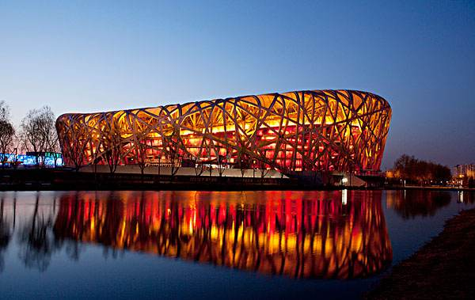
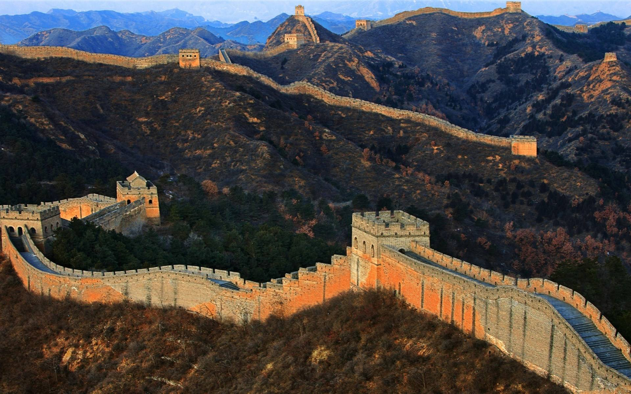
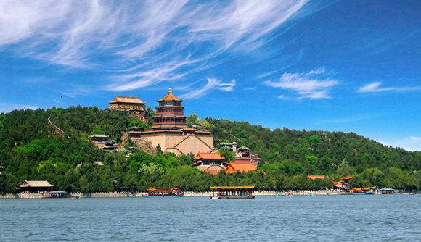
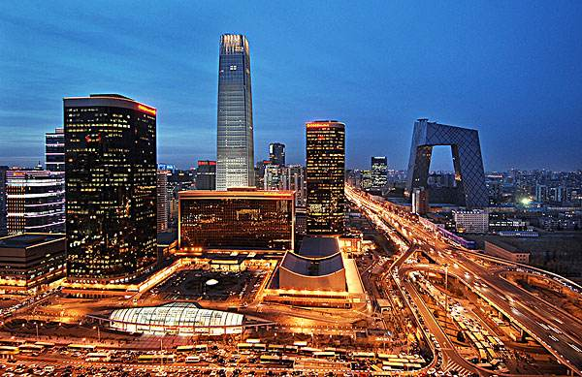
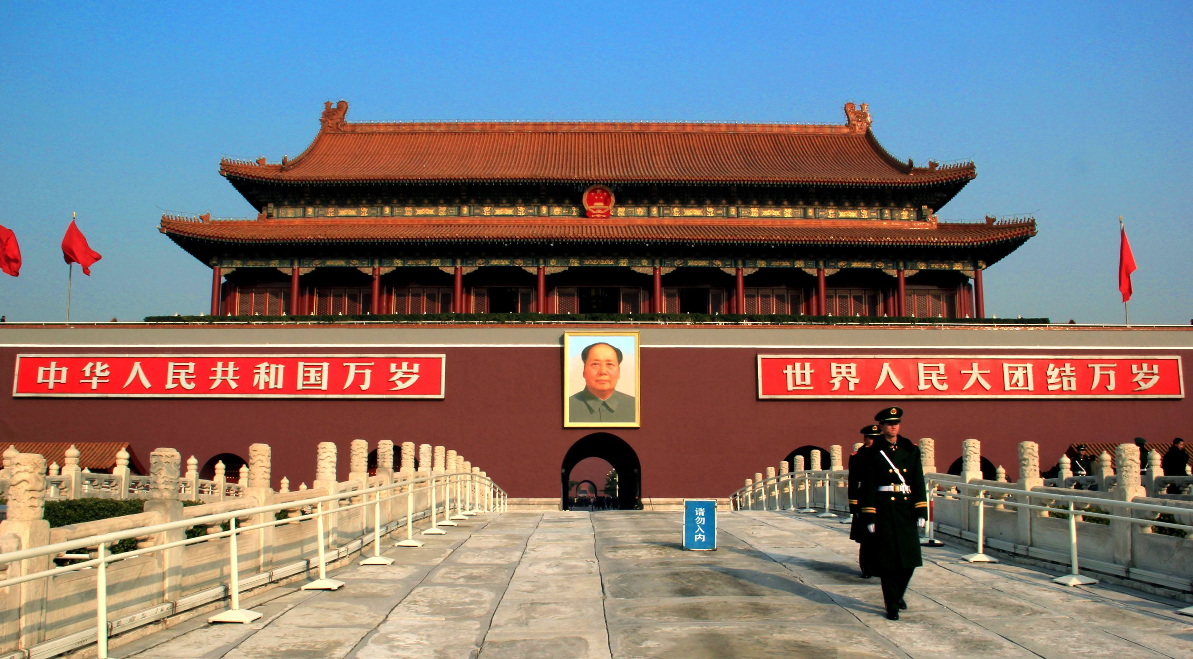
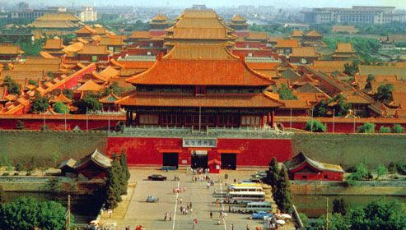
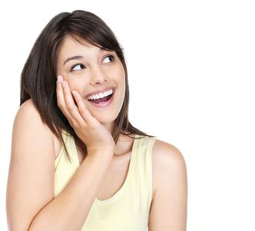
Lead-in
What might arouse your admiration?

Slide 5
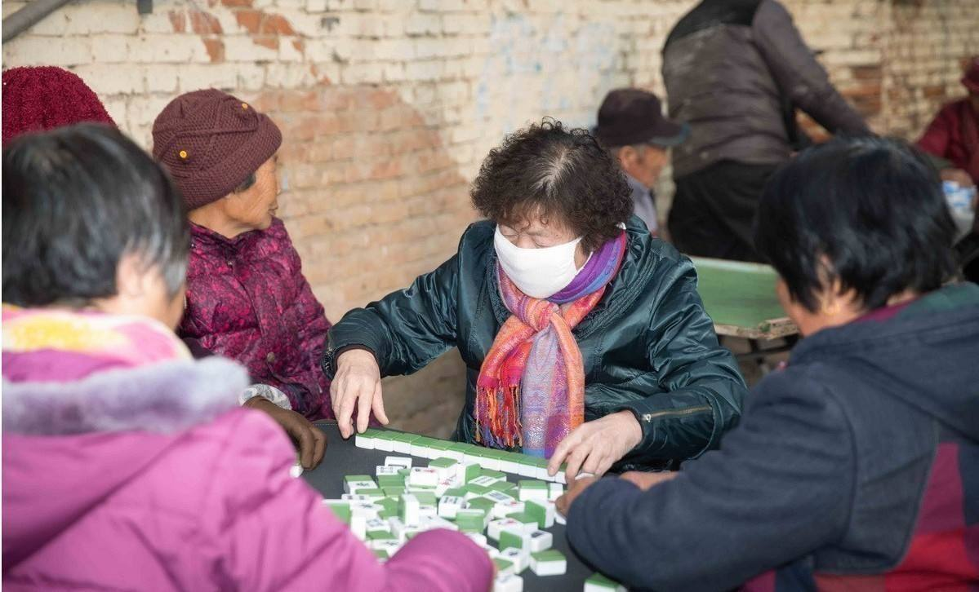
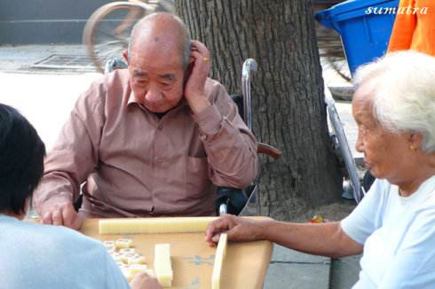
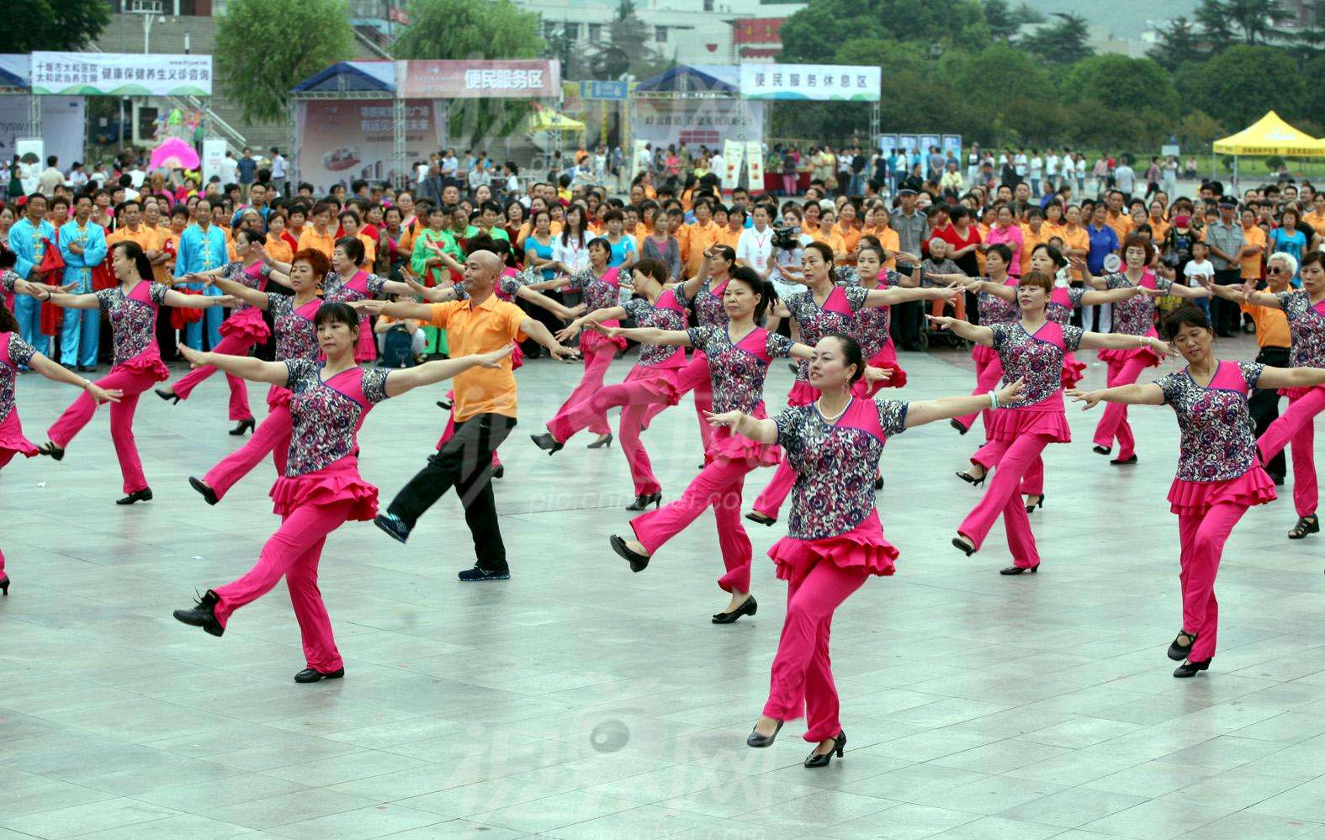

What might arouse your curiosity?

Slide 6
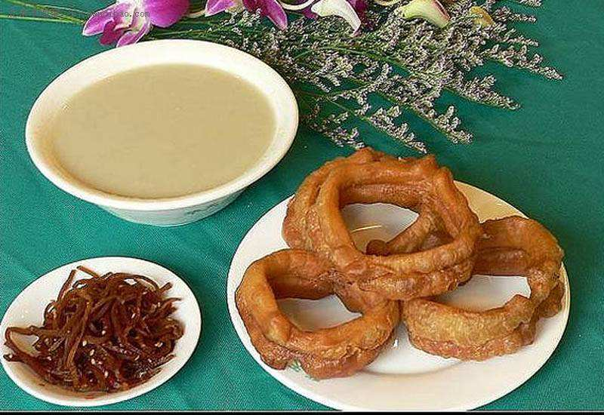
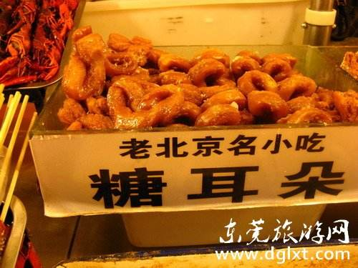
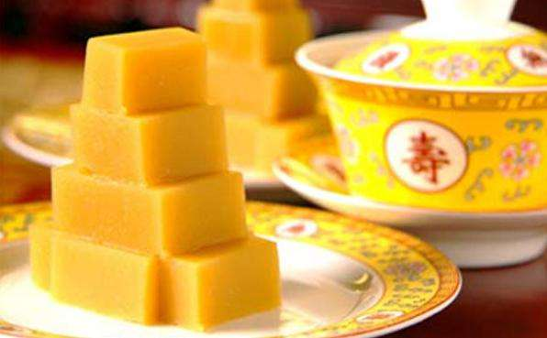
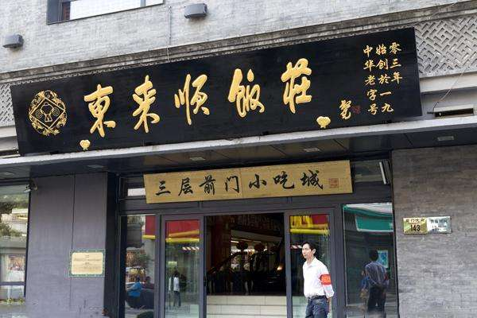
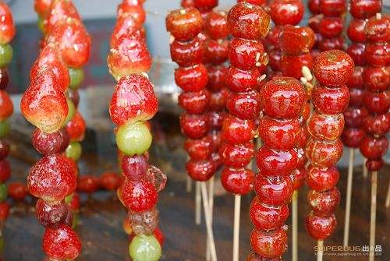
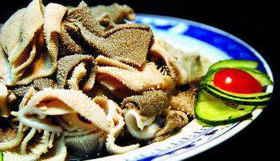
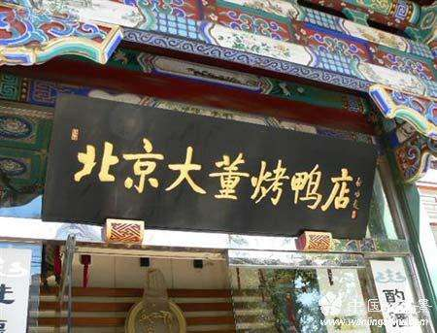
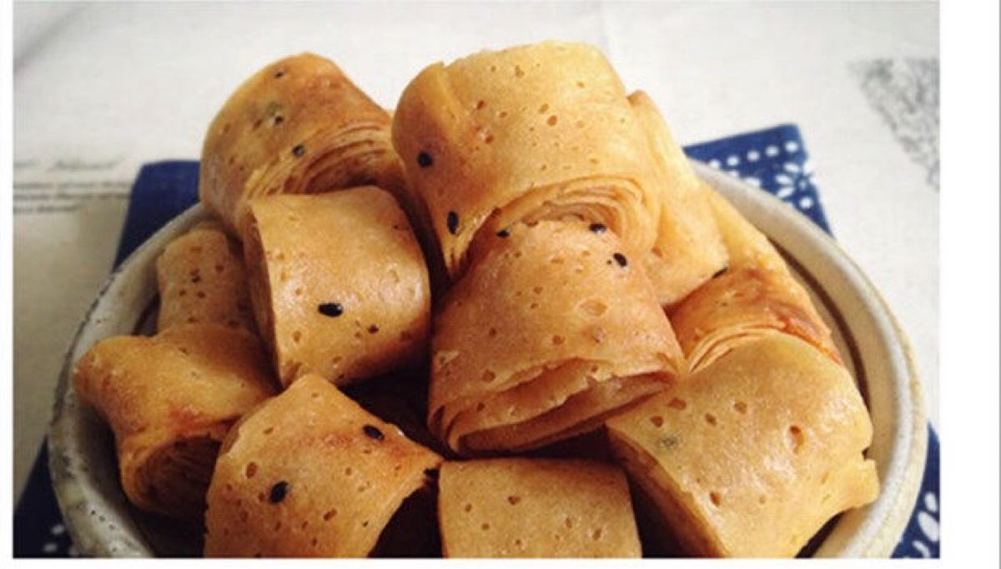

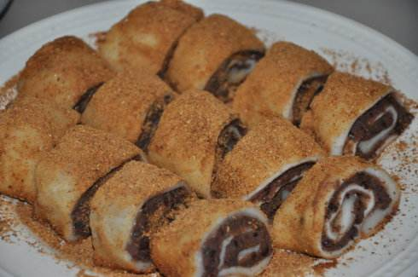
What might arouse your appetite?

Slide 7
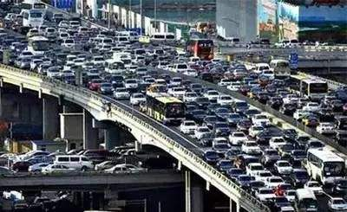
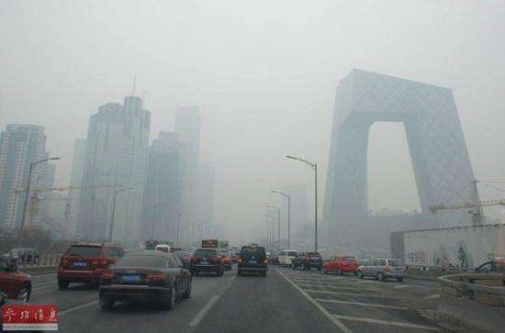
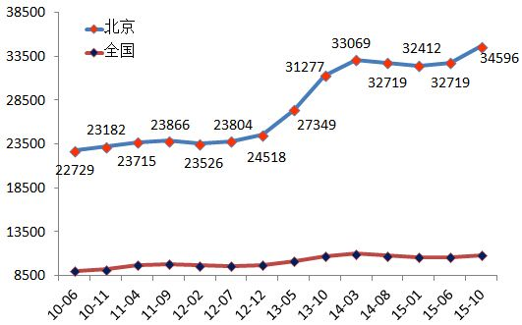
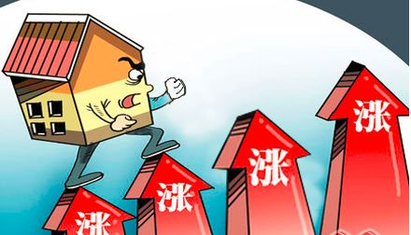
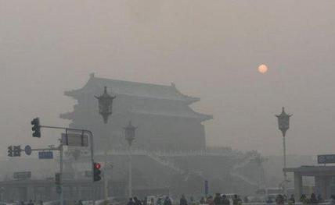
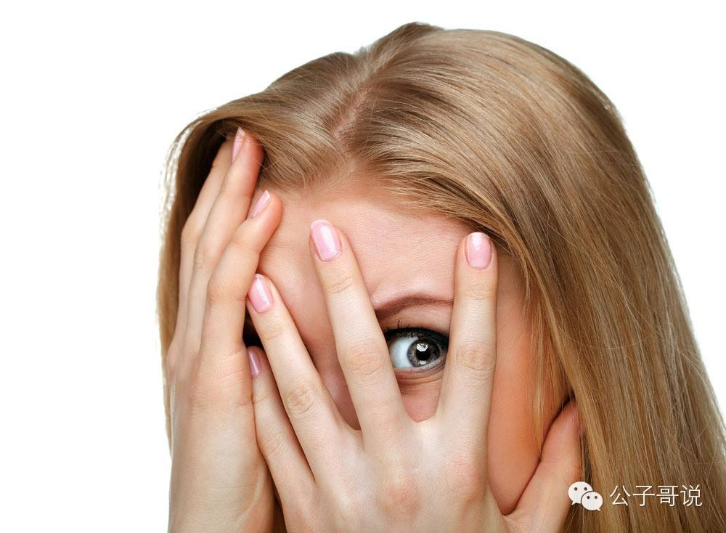
What might arouse fear?

Slide 8
While reading
Scanning:
Read the article and answer the following questions.
What did the author do when he first arrived in Beijing?
What did the author find strange?
Was he happy to be stared at by other people?

Slide 9
While reading
What did the author do when he first arrived in Beijing?
One of the first things I did was visit one of the city’s hutong. Strolling around the narrow streets, the warm air was filled with the smell of delicious food as people played mahjong and rode their old-fashioned bikes.

Slide 10
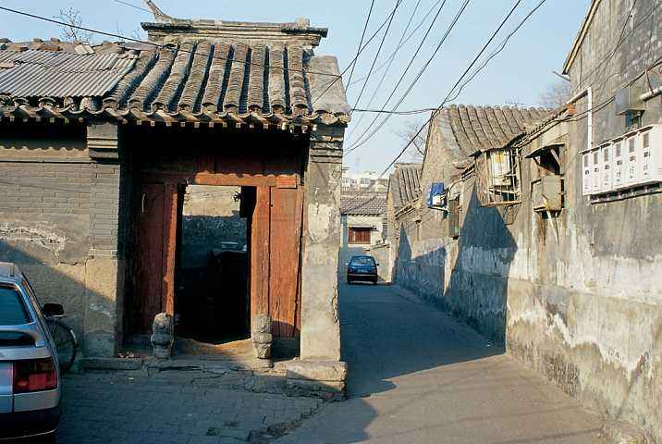
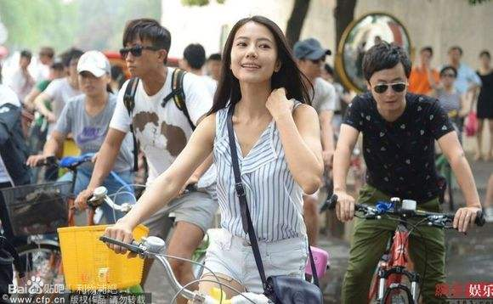
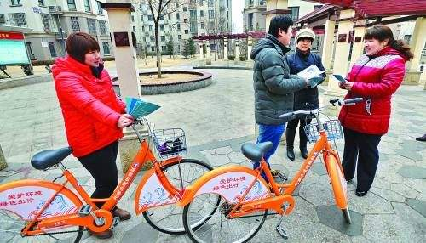
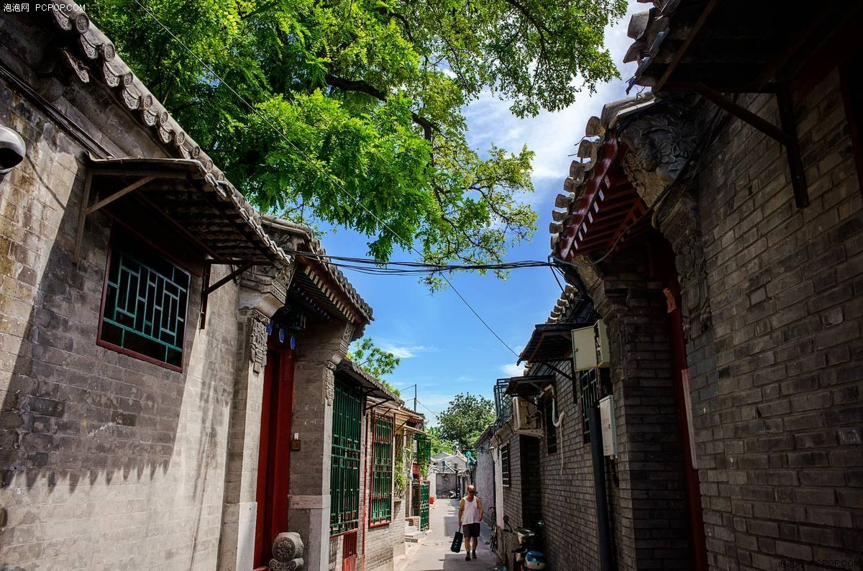
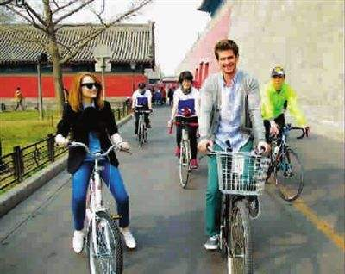
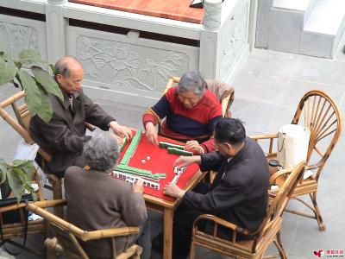
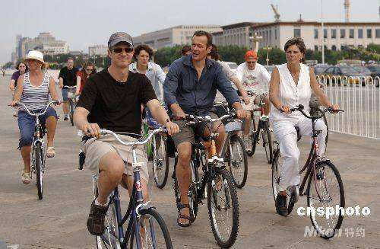
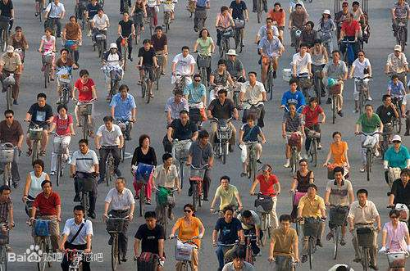

Slide 11
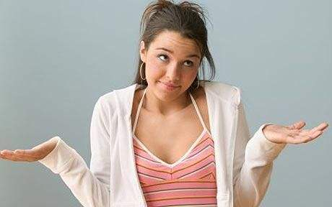
While reading
What did the author find strange?
First, hearing the slurping of Chinese diners or the throat-clearing sounds of colleagues was a funny culture shock at first. Next is the attention that being a foreigner brings. On the subway or in streets and restaurants, some people stare and try to take secret photos of me.

Slide 12
While reading
Was he happy to be stared at by other people?
It frustrates him. The author thinks it’s like being a celebrity but without the champagne-fuelled parties or millions of dollars in the bank.

Slide 13
While reading
Read the article again and decide whether the following statements are true (T) or false (F).
(T)
The author planned carefully before coming to Beijing.
2. The author found traveling in Beijing is risky.
3. The old-fashioned bikes are not typical in Beijing.
4. British people always make bodily noise.
5. The author’s favorite food has not been figured out.
6. Motorbikes are cheap so it’s the best way to travel around in China.
(F)
(F)
(F)
(T)
(F)

Slide 14

While reading
Read in depth. Read, think and answer the question.
What does “it” refer to in the sentence “It has one shopping street that’s around 500 meters”?
Beijing B. England
C. Preston D. Hutong

Slide 15
Language focus
Use other words to explain the underlined part.
1. Beijing couldn’t be more different to my home city.
2. There isn’t a great deal of choice when it comes to restaurants.
3. I still find some habits here quite strange and humorous.
4. To hear the slurping of Chinese diners or the throat-clearing sounds of colleagues was a funny culture shock at first.

Slide 16
1. Beijing couldn’t be more different to my home city.
2. There isn’t a great deal of choice when it comes to restaurants.
is very different from
when it is a question of/in regards to

Slide 17
3. I still find some habits here quite strange and humorous.
4. To hear the slurping of Chinese diners or the throat-clearing sounds of colleagues was a funny culture shock at first.
think; believe
a sense of confusion and uncertainty sometimes with feelings of anxiety that may affect people exposed to an alien culture or environment

Slide 18
Post-reading
Discuss in groups:
Do you know other forms of culture shock that foreigners suffer in China?
Do you make noise at table or clear your throat loudly in public? What do you think of such behavior?

Slide 19
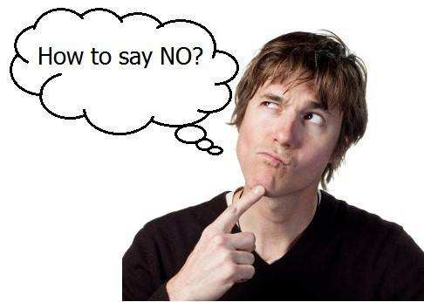
for Senior 1
2016-2017学年度第31/32期总第668期
Not wrong to refuse (P6)

Slide 20


I. Leading-in
Do you find it hard to say no to others?

Slide 21
II. Skimming
Look through the article and answer the question.
1. What is the article mainly about?
It explores the reasons why some people find it hard to say no. It tells us that we all have the right to say no, and that we should learn to say no gradually.

Slide 22
III. Scanning
Read the article and quickly find the answers to the following questions.
1. According to the writer, why do many of us find it hard to say “no”?
2. Did the writer’s friend like to say no? Why, and how did it affect her?
3. What can people do to change their mindset and say no more?
4. What is Paragraph 5 mainly about?

Slide 23
1. According to the writer, why do many of us find it hard to say “no”?
Many of us feel that if we say we’ll do something, we can’t change our minds and back out.
Not only do we feel as though we can't say no, but we feel as though if we do say no, we have to have an amazing reason for doing so, and the person we are saying no to has to somehow be okay with it, or we must feel guilty.

Slide 24
2. Did the writer’s friend like to say no? Why, and how did it affect her?
No, because she wanted to please the people around her.
It wasn’t long before she found herself exhausted and overworked, and ready to call it quits.

Slide 25
3. What can people do to change their mindset and say no more?
Make a list of requirements in order to say yes.
Decide to say no three times a week.
Remember that it is completely OK to say no to people, and they don’t have to justify why they’ve done so.
Start one step at a time.
4. What is Paragraph 5 mainly about?
Refusal does not happen overnight and it requires a process.

Slide 26
IV. Language study
Guess the meanings of the words in red based on the context and translate the sentences.
Many of us feel that if we say we’ll do something, we can’t change our minds and back out.
back out (of sth.): to decide that you are no longer going to take part in sth. that has been agreed 退出；撒手
e.g., He lost confidence and backed out of the deal at the last minute.
他失去了信心，在最后一刻退出了协议。

Slide 27
IV. Language study
2. It wasn’t long before she found herself exhausted and overworked, and ready to call it quits.
before引导时间状语从句，此处翻译为“不久就”
另：It will be three years before we meet again.
我们还要三年才能见面。
②overworked: made to work too much or too hard 工作过多的，劳累过度的
③call it quits了结；解除（婚约等）；暂停；停止；放弃
译文：没用多久她就觉得劳累过度，工作过量，准备不干了。

Slide 28
IV. Language study
3. If it is something that helps you - go ahead and make a list of requirements in order to say yes.
If引导条件状语从句。
go ahead: 开始做某事/毫不犹豫地去做
译文：如果这能帮到你，你可以列个清单，写上一些要求，对方同意这些要求才能答应。

Slide 29
IV. Language study
4. I think this is something that trips up a lot of people, myself included.
trip up:绊倒，羁绊
e.g. Your own lies will trip you up.

Slide 30
IV. Language study
5. Not only do we feel as though we can’t say no, but we feel as though if we do say no, we have to have an amazing reason for doing so, and the person we are saying no to has to somehow be OK with it, or we must feel guilty.
not only…提到句首，属于表否定意义的词或短语在句首，句子需要部分倒装。we are saying…是定语从句，省略了引导词whom/ that。
译文：我们不仅感觉不能说不，而且感觉如果说了不，我们还要有个绝佳的解释，而对方还得坦然接受我们的拒绝，不然我们一定会感到愧疚。

Slide 31
IV. Language study
6. Today, I challenge you to say no to something that you would normally say yes to.
challenge sb. to sth./ to do sth.:
to invite sb. to enter a competition, fight, etc.
向某人挑战
to suggest strongly that sb. should do sth. (especially when you think that they might be unwilling to do it) （尤指在对方不情愿时）强烈建议某人做某事
Can you make up a sentence with this phrase?

Slide 32

V. Discussion
After reading the article, do you agree with the writer’s opinion? Give your reasons.

Slide 33
Homework
Write an article explaining your idea of an ‘ideal Beijing’. What aspects would you improve/change?

Slide 34
For Senior 1
2016-2017学年第31/32期总第 668期
Not good to feel guilty (PVII)

Slide 35
I. Warming up
1. How do you usually feel when you make a mistake?
2. Would you feel guilty if your family members were ill or had disabilities?
Read the article and see whether you have similar experiences.

Slide 36
II. Skimming
Read the article quickly and summarize its main idea.
What is the article mainly about?
The author’s own experiences of feeling guilty and how she deals with it.

Slide 37
III. Scanning
Read the article again and answer the following questions.
1. Why did the author feel happy when she walked out of the doctor’s office?
2. Why did she feel guilty afterward?
3. How did the author feel when her first husband died? Why?
4. How does the author deal with guilt?

Slide 38
II. Skimming
1. Why did the author feel happy when she walked out of the doctor’s office?
2. Why did she feel guilty afterward?
Because she was told that her eyes were perfect.
She thought of her brother who was born blind, and she thought it was unfair that she can see and her brother can’t.

Slide 39
III. Scanning
3. How did the author feel when her first husband died? Why?
4. How does the author deal with guilt?
She felt guilty because she could experience the good things in their children’s life, but her husband couldn’t.
She turns guilt into action and tries her best to live well.

Slide 40
III. Scanning
Read again and check whether the statements are true (T) or false (F).
The author is responsible for her brother’s blindness.
The author’s brother always felt life was unfair to him.
The author felt great pressure due to her brother’s blindness.
The author sometimes felt it was difficult to describe things for her brother.
The author lives well, mostly for other people.
F
F
T
T
F

Slide 41
IV. Language study
1. Have you ever tried to put into words things that can only be described with feelings that come from the heart?
句中的两个that均引导定语从句，分别修饰先行词things和feelings。
put your feelings/thoughts etc into words 表示“用言语清楚地表达”，此处因为宾语things that … 较长，所以使用了宾语后置用法，避免头重脚轻。
e.g. I chose as my birthday gift an iPhone 6 which is worth 5,000 yuan. （I chose an iPhone 6 as my birthday gift.）

Slide 42
IV. Language study
2. I’d describe the sun that warmed his face or the birds that flew across the sky as best I could.
warm原为形容词，这里活用为动词，意为“使……暖和”。
More examples:
This is an inspirational tale that will warm your heart.
He was blinded by the bright light. (使看不见)
It’s just a working model; we haven‘t perfected it yet. （使完善）

Slide 43
IV. Language study
其他常见的词类活用还有名词活用为动词。
For example:
He had already fathered five kids by the time he was 30 years old. （抚养）
Hard work shapes our success.（塑造，使成形）

Slide 44
V. Homework
Can you think of a time you experienced a negative feeling? What caused it? Did you turn it into something good? Write an article about it.

