Slide 1



Slide 2


Slide 3



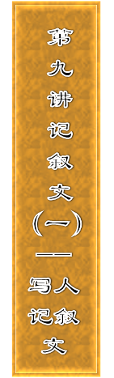










Slide 4


Slide 5
[题目要求]
(2012·衡水模拟) 你校组织了以“读书、进步”为主题的“英语读书月”活动，请你根据下面信息写一篇短文，介绍你们班的“读书明星”李华同学。要点如下：
姓名：李华 性别：女 年龄：18 所在班级：高三6班
特点：

Slide 6
1．积极参加读书月活动，喜欢阅读英文报刊杂志和原著；
2．有良好的读书习惯和方法，已写了三本读书笔记；
3．很好合作，乐于助人。
获奖情况：
1．学校“模拟联合国(Model UN)”辩论赛一等奖；
2．省中学生英语演讲比赛第一名。

Slide 7
感言：阅读使人进步，英语让我快乐！
参考词汇：模拟联合国辩论赛 the debate of Model UN
原创的 original
要求：100字左右
____________________________________________________
____________________________________________________
____________________________________________________
____________________________________________________

Slide 8
[技法指导]
以写人为主的记叙文，应该注意肖像描写、行动描写、语言描写、心理描写以及对细节的描写。考生应根据写作的要求，灵活掌握、突出重点。写作过程中要注意以下几个方面的问题：

Slide 9
1．人物写作通常需要介绍人物的姓名、年龄、外貌、学历、
  经历、专业、爱好、特长、事迹、性格等多个方面，但考试时需要严格按照写作要求来写，包括所给的全部信息点，既不能遗漏，也不能随意添加。

Slide 10
2．对题目所给的信息要进行适当重组，安排好写作顺序，
  突出重点信息。重点信息通常是写作的目的所在，比如求职要重点突出学历、经历；新闻报道要重点突出事迹；介绍自己的老师、朋友要突出他们的特点等。
3．注意运用正确的时态。描写人物的外貌、性格、兴趣等
  常用一般现在时；而描写人物的出生、教育背景、经历、事迹常用一般过去时。

Slide 12
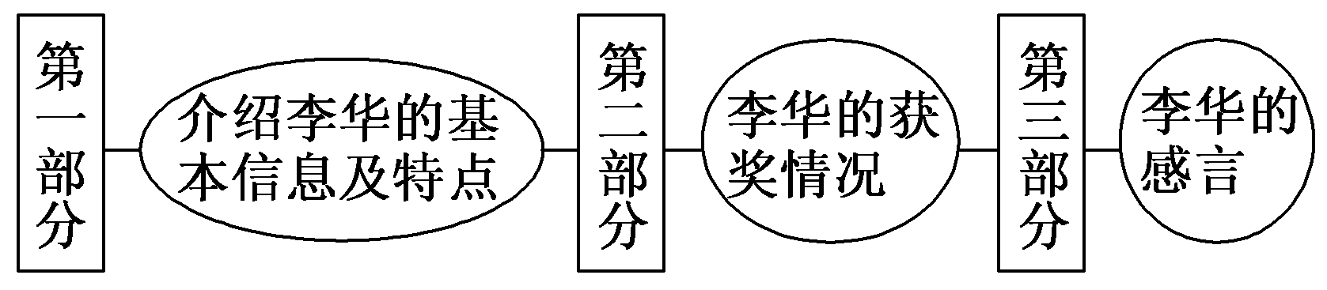
第一步 构建框架，清晰行文
[谋篇布局]

Slide 13
[黄金模板]
Li Hua, an ________ (年龄) girl from ________ (地点), loves ________ (爱好) and has made 3 copies of notes, which shows her proper reading methods and good habits. She is always ready to ________ (特点). Li Hua is expert at ________ (特点) and she is also a ________ (特点).

Slide 14
In this “Reading and Progress” activity, she ________ (获什么奖) in ________ (在什么活动中).
“Reading can make me progress and English can make me happy！” that is what she has learnt from reading.

Slide 15
第二步 打造亮句，增色文章
1．李华，女，18岁，高三6班学生，喜欢阅读英文报刊杂志和原著，并且已经写了三本读书笔记。
►Li Hua, who is an 18­year­old girl from Class 6, Senior 3, enjoys reading English magazines, newspapers and even original English novels. She has made 3 copies of notes so far.

Slide 16
►Li Hua, an 18­year­old girl from Class 6, Senior 3, loves reading books, such as English magazines, newspapers and even original English novels and has made 3 copies of notes.
2．李华很好合作，在各种阅读活动中都很积极踊跃。
►It's very easy to cooperate with Li Hua. She takes an active part in various reading activities.
►Li Hua is expert at communicating and she is also a cooperative girl who is very active in all kinds of reading activities.

Slide 17
第三步 串句成文，保证流畅
Li Hua, an 18­year­old girl from Class 6, Senior 3, loves reading books, such as English magazines, newspapers and even original English novels and has made 3 copies of notes, which shows her proper reading methods and good habits. She is always ready to help her fellow classmates improve their reading. Li Hua is expert at communicating and she is also a cooperative girl who is very active in all kinds of reading activities.

Slide 18
In this “Reading and Progress” activity, she won the first prize in the debate of Model UN and the first place in the Provincial Middle School Students English Speech Contest.
“Reading can make me progress and English can make me happy！” that is what she has learnt from reading.

Slide 20
请根据下表内容，用英语写一篇介绍法国著名的作家和诗人莫泊桑的短文。词数120左右。
姓名和国籍 | 莫泊桑(Guy de Maupassant), 法国
经 历 | 学生时代开始写小说，30多岁成名，43岁因病去世
成 就 | 一生共写了六部长篇小说，300多篇中篇小说和短篇小说
代 表 作 | 短篇小说《项链》，主要描写中小资产阶级的生活

Slide 21
参考词汇：中篇小说 novelette 中小资产阶级 middle and petty bourgeoisies
参考范文：
Guy de Maupassant is a famous French writer and poet, who is considered as the greatest short story writer in the French history. When he was a student, he began to write novels and became known to the French people in his thirties.

Slide 22
In all his life, Guy de Maupassant wrote six long novels and more than three hundred novelettes and short stories. His novels mainly reflect the social life of middle and petty bourgeoisies. He was good at writing typical details from common things and his best­known short story — The Necklace is considered to be the best in this area. He died at the age of 43 because of illness.

