Slide 1



Slide 2

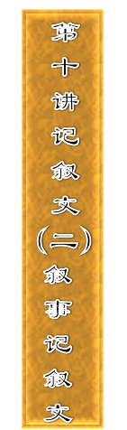










Slide 4
[题目要求]
(2010·湖北高考)请你根据以下提示，结合生活中的一个事例，用英语写一篇短文，谈谈微笑的作用。
The best example of universally understood body language may be the smile. A smile can help us get through difficult situations and find friends in a world of strangers. A smile can open doors and tear down walls.

Slide 5
注意：①无须写标题；
②内容只需涉及一个方面；
③词数为100左右。
___________________________________________________
___________________________________________________
___________________________________________________
___________________________________________________

Slide 6
[技法指导]
1．明确“五个W和一个H”。
  要写好记叙文，首先要确定先写什么，再写什么，最后写什么，然后开始布局谋篇。我们可以借用英语新闻写作中经常用到的“五个W和一个H”的概念，即what(什么事)，who(什么人)，when(什么时候)，where(什么地点)，why(什么原因)，how(怎么样)。整个写作内容的确定、写作材料的筛选，都要围绕这五个W和一个H进行。

Slide 7
2．确定以第几人称及以何种顺序展开叙述。
  ①一般来说，英语记叙文要以第一人称(I/we)和第三人称(he/she/it/they)来展开叙述。第一人称是从“参与者”的角度进行叙述；第三人称是以“观察者”的身份展开叙述，要根据具体情况合理选用。

Slide 8
②在确定了人称之后，要确定展开记叙的顺序。在英语记叙文中，最常用的是按事情发生的时间或空间顺序进行记叙。就目前中学生的实际英语水平而言，最值得练习的记叙方法还是按时间顺序，因为这种记叙顺序无论从时态，还是连接词、过渡词等方面都比较容易掌握。

Slide 9
3．在塑造人物、展开情节上下功夫。
  我们记叙的任何事情都是由人来进行的，人物塑造的好坏是衡量记叙文好坏的一个重要标准。因此，表达人物的动作、语言以及展开情节时，使用哪些句型、短语、词汇都应该仔细推敲。

Slide 10
一般说来，叙事类记叙文的话题通常和中学生的生活阅历有关，如校园生活、旅游、交通、交友等，平时要注意积累这方面的词汇和短语。

Slide 11
4．注意文章的完整性。
  整篇文章要完整，内容全面，详略得当，层次分明，重点突出。英语记叙文的时态通常为一般过去时，但如果是经常性的事件或自然现象、社会现象，则常用现在时。
  另外，所述事情的情节展开要突出重点、详略有致。可有意识地采用类似“设置悬念”“前后呼应”等的写作手法，以吸引读者的兴趣。好的记叙文具有描述事件具体、人物形象逼真、故事生动感人的特点。

Slide 13
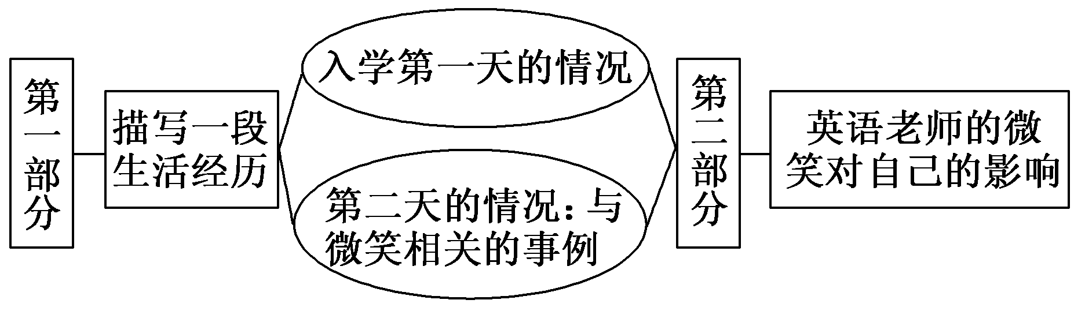
第一步 构建框架，清晰行文
[谋篇布局]

Slide 14
[黄金模板]
I still remember how ________________________ (心情) I was ________________________ (事件发生的时间), when I ________________________ (什么事件).

Slide 15
________________________ (事件发生的过程). The smile shone in the whole day and the following days. A week later, ______________________ (事件的结果).
Thanks to _____________________， I ___________
_____________ (谈谈自己的看法).

Slide 16
第二步 打造亮句，增色文章
1．老师整堂课都讲英语，那完全不同于我以前所上的课。
►Our English lessons were totally different from the ones I had taken before, for the teacher spoke English throughout the class.
►The teacher spoke English throughout the class, which was totally different from the lessons I had taken before.

Slide 17
2. 第二天上午上课时，我和其他同学一样正在大声读课文时，英语老师走向我。
►In the class of the following morning, the English teacher came towards me. I was reading the text aloud as other students then.
►In the morning class the next day, the English teacher came to me while I was reading the text aloud as other students.

Slide 18
第三步 串句成文，保证流畅
I still remember how nervous I was on my first day in the new school three years ago, when I found it difficult to follow my teacher in the first English class. The teacher spoke English throughout the class, which was totally different from the lessons I had taken before.

Slide 19
In the morning class the next day, the English teacher came to me while I was reading the text aloud as other students. After listening to me for a while, she gave me a big smile and said she liked my voice very much. The smile shone in the whole day and the following days. A week later, I volunteered to take charge of English study in my class.
Thanks to the comforting smile from my English teacher, I began to be confident.

Slide 21
(2012·南京模拟) 一年一度的寒假即将来临，《中学生英语》杂志准备出版专刊“快乐寒假”。请你为此写一篇英文稿件。你的叙述须包括下列要点：
1．往年寒假难忘的一件事(过程及感想)；
2．今年寒假的打算(至少3点，娱乐、学习等)；
3．你的愿望。
要求：1.可适当增加细节，以使行文连贯；

Slide 22
2．词数150词左右，短文开头已为你写好，不计入总词数。
  The winter holiday we are looking forward to is drawing near. The past holidays brought me many wonderful memories.
  _______________________________________________
  _______________________________________________
  _______________________________________________
  _______________________________________________

Slide 23
参考范文：
The winter holiday we are looking forward to is drawing near. The past holidays brought me many wonderful memories. The most unforgettable experience is the party held two days before the Spring Festival last year to celebrate the golden wedding anniversary of my grandparents. Before the party, I made a careful plan for it

Slide 24
with my parents. All our relatives got together for this special occasion when my cousins and I gave my grandparents some nice handmade presents. My grandparents were so happy that they sang and danced like young couple.

Slide 25
As a Senior 3 student, the coming winter holiday is sure a busy one. I'll make good use of it to work hard at my lessons, getting ready for the college entrance examinations. I'll also try to spare some time to do some exercise to keep fit. In addition, I can watch my favorite TV programmes

Slide 26
with my parents, especially on the eve of Spring Festival. During the Spring Festival, I'll visit my grandparents and help them prepare food for the family get­together.
I hope I'll have a joyful and fruitful holiday.

