Slide 1



Slide 2











Slide 3


Slide 4
[题目要求]
(2011·江西高考) 假设你是星光中学的李华，将参加主题为“Let's Ride Bicycles”的英语演讲比赛。 请撰写一份演讲稿，主要内容包括：
1．目前汽车带来的空气污染和交通堵塞等问题；
2．骑自行车的益处，如节能环保、 有利健康等。

Slide 5
参考词汇：低碳生活 low­carbon life 节能 energy saving
注意： 1. 词数： 120词左右；
2．演讲稿开头和结尾已给出， 且该部分不计入总词数。
Good morning, everyone,

Slide 6
I am Li Hua from Xingguang Middle School.The topic of my speech is “Let's Ride Bicycles”．
____________________________________________________
____________________________________________________
Thank you !

Slide 7
[技法指导]
演讲稿是人们在工作和社会生活中经常使用的一种文体，它是在较为隆重的仪式上和某些公众场所发表的讲话文稿。写好演讲稿，应注意以下三点：

Slide 8
1．格式
  演讲稿一般由三部分组成，即：称呼语(Greetings)、正文(Body)和结束语(Closing)。常见的称呼语有Ladies and gentlemen, Friends, Boys and girls等，一般称呼语前不使用Dear。

Slide 9
2．内容
  演讲稿的主题部分应该阐述清楚事情的缘由、结果和要求。第一部分的内容应该以详细完整地介绍事情为主，具体地讲，包括事情的发生、发展及结局。第二部分的内容应该提出发言稿的主题，如欢迎、欢送、号召、建议、个人看法等。

Slide 10
3．语言
  演讲稿以简单句为主要的表达形式。同时，演讲稿的语言必须有感染力，所以演讲稿可以使用祈使句、感叹句、强调句等句式来达到这种目的。写作时要注意适当地使用关联词承前启后，用词要得体，符合语言环境。

Slide 12
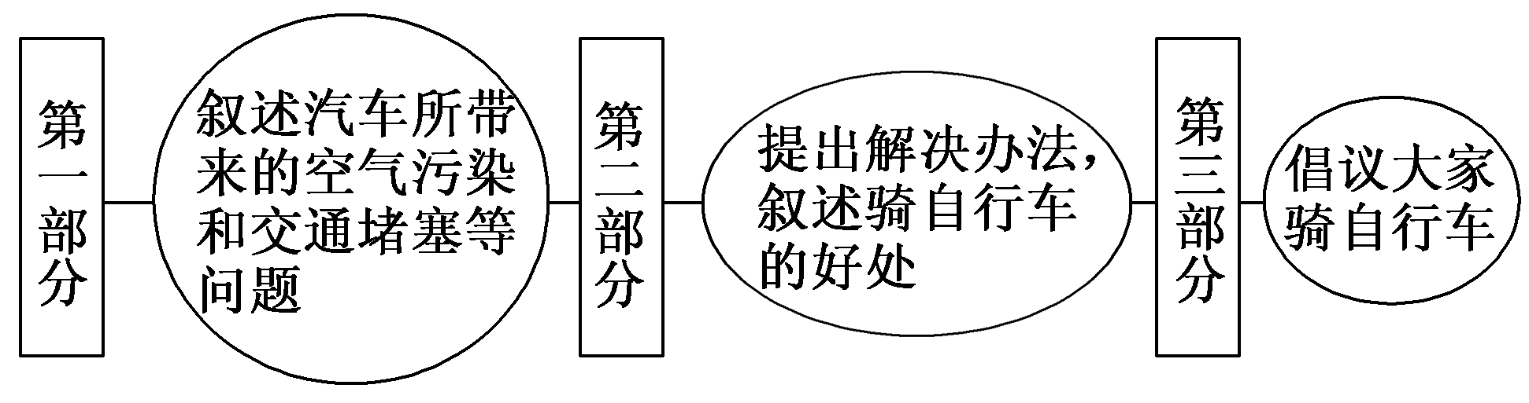
第一步 构建框架，清晰行文
[谋篇布局]

Slide 13
[黄金模板]
Boys and girls/Ladies and gentlemen,
It's a great honor for me to stand here and give my speech. My name is ________________________(自我介绍). The topic of my speech is ________________________(发言主题)．

Slide 14
To begin with, many people suggest that ... Secondly, ... Thirdly ...(话题或现象列举)．
What I want to stress is that ________________________(重申主题). For one thing, ... For another, ... Besides, ...(原因或重要性列举). In a word, ________________________(总结)．
Thank you for your listening./Thank you.

Slide 15
第二步 打造亮句，增色文章
1．我认为，骑自行车是一个好的解决办法。
►In my opinion, it is a good solution to ride bicycles.
►As far as I'm concerned, riding bicycles is a good solution.

Slide 16
2．众所周知，随着人们生活水平的提高，汽车已经成为一种很受欢迎的交通方式。
►It's known to all that with the improvement of people's living standards, cars have become a popular means of transport.
►As is known to all, with the improvement of people's living standards, cars have become a popular means of transport.

Slide 17
第三步 串句成文，保证流畅
Good morning, everyone,
I'm Li Hua from Xingguang Middle School. The topic of my speech is “Let's Ride Bicycles”.

Slide 18
As is known to all, with the improvement of people's living standards, cars have become a popular means of transport, bringing great convenience to our life. However, they have also caused some problems such as air pollution and traffic jams.

Slide 19
How can we solve these problems then? As far as I'm concerned, riding bicycles is a good solution. For one thing, bicycles don't need any petrol and they are energy­saving. For another, bicycles are environmentally friendly because they won't give off waste gas. What's more, riding bicycles is a good way for us to exercise and it is beneficial to our health.

Slide 20
Therefore, let's take the responsibility to build up a lowcarbon city by riding bicycles. Come on and join us!
Thank you!

Slide 22
(2012·日照模拟) 假定你是某学校学生会主席，你校将选拔学生参加模特大赛。请你按以下内容要点准备一篇英文发言稿，谈谈你的看法，并鼓励大家积极参与。
1．实现梦想；
2．学会生活；
3．促进学习。
注意：1.词数120—150；

Slide 23
2．可以适当增加细节，使行文连贯；
3．发言稿的开头与结束语已为你写好(不计入总词数)。
Good morning, everyone! It's known that our school will choose some students to attend the model contest.

Slide 24
In my opinion, ______________________________________
____________________________________________________
____________________________________________________
____________________________________________________
Thank you for listening.

Slide 25
参考范文：
Good morning, everyone! It's known that our school will choose some students to attend the model contest.
In my opinion, it's a good idea for us students to enter for the model contest. Some of us are fond of fashion and modeling. We want to be fashion designers or professional models. We may well seize the opportunity to make our dreams come true. Besides, not only do we show our

Slide 26
figures and intelligence on the stage, but we also learn how to be independent, how to behave in society and what to do for others while preparing for the competition. However, some of our parents think it possible for us to miss lessons and fall behind in study. No! On the contrary, being student contestants or prize winners, we are encouraged to study even harder and make rapid progress.
Thank you for listening.

