Slide 1



Slide 2











Slide 3


Slide 4
[题目要求]
(2011·陕西高考)假定你是中学生李华。在一位名叫TigerMom的学生家长博客上，你看到如下内容。请你根据 、 和 ，给这位家长回复。
博客内容
写作要点
要求

Slide 5
I'm the mother of a fourteen­year­old. I have a rule for my daughter: be among the top 5 students or get punished in one way or another. She has been doing very well in school, but some friends of mine keep telling me that I put too much pressure on her. Am I wrong?

Slide 6
写作要点：
1．表明自己的看法；
2．陈述自己的理由(可举例说明)；
3．提出至少两条建议。
要求：

Slide 7
1．短文须写在答题卡的指定区域。
2．短文词数不少于100(不含已写好的部分)。
3．内容充实，结构完整，语意连贯。
4．书写需清晰、工整。
Hi, TigerMom,

Slide 8
What puzzles you is actually a puzzle for many parents in China. My idea is ____________________________________________________
____________________________________________________
____________________________________________________
____________________________________________________

Slide 9
[技法指导]
议论文是用来论述某个道理、阐明某种观点的一种文体。它通过摆事实、讲道理、辨是非来表达作者的见解和主张。议论文可分为许多种类，但中学英语书面表达所要求的议论文是一种限定的写作，其论点、论据和论证都比较明确。

Slide 10
有的文章提出问题，如：……为什么？……怎么办？……该采取什么措施？考生可以结合问题要求，阐述相关的观点，切忌随意发挥。近几年的高考书面表达中，其主要命题形式是以表格式和提纲式来呈现写作材料的。

Slide 11
基本要求：
1．文章直接阐述事物的道理，明确表露作者的思想观点。
2．表达方式以议论为主，辅之以说明、叙述等方式。议论
  文中的记叙和描写是为论点提供根据的。因此，记叙应该是概括的，描写应该是简要的。
3．内容重在说理，坚持摆事实、讲道理。

Slide 12
4．议论文主要包括三个要素：论点、论据和论证方法。论
  点是指需要证实的问题；论证是指阐述道理以理服人；论据就是用于论证的具有说服力的事实和证据。论点解决“证明什么”，论据解决“用什么来证明”，论证解决“怎样证明”。
5．观点正确，论据充分，语言精练，论证合理，有严密的
  逻辑性。
6．语言应该简练、准确；尽可能避免使用口语，多用书面
  语。

Slide 14
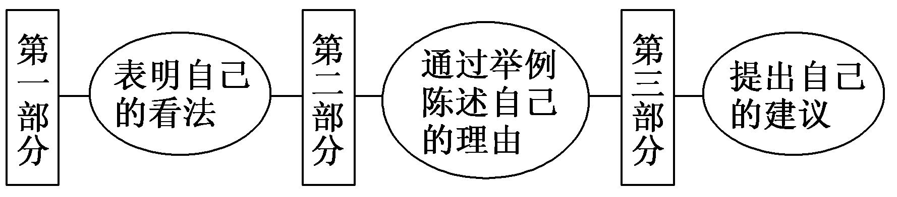
第一步 构建框架，清晰行文
[谋篇布局]

Slide 15
[黄金模板]
Hi, TigerMom,
What puzzles you is actually a puzzle for many parents in China. My idea is that ______________________(表明自己的观点).

Slide 16
Although high grades are an important factor in evaluating students and for their future university admission, development in wisdom, emotion, health, and life attitude should never be ignored. There are many examples around us. ________________________ (举例陈述自己的理由).

Slide 17
So I suggest that ________________________ (提出自己的具体建议).

Slide 18
第二步 打造亮句，增色文章
1．而且，惩罚绝不是帮助他们身心发展的明智选择。
►What's more, punishment isn't a wise choice of helping them grow up mentally and physically at all.
►Furthermore, punishment is by no means a wise choice to help them grow up mentally and physically.

Slide 19
2．因此，我建议你采取你朋友们的建议。
►Therefore, I advise you to take your friends' advice.
►So I suggest that you take your friends' advice.

Slide 20
第三步 串句成文，保证流畅
Hi, TigerMom,
What puzzles you is actually a puzzle for many parents in China. My idea is that it is not quite right for you to do so.
Although high grades are an important factor in evaluating students and for their future university admission, development in wisdom, emotion, health, and life attitude

Slide 21
should never be ignored. There are many examples around us. Some all­A students in school have turned out not to be as successful in society as they were expected. The reason is often that the pressure from their parents allows them almost no time for other activities. Furthermore, punishment is by no means a wise choice to help them grow up mentally and physically.

Slide 22
So I suggest that you take your friends' advice. More importantly, let her live like a lovely girl; let her have more friends and social activities; and let her make mistakes of her own as we teenagers often do.

Slide 24
作为一名中学生，平时你是否愿意和自己的老师交流？你认为良好的师生关系应该是什么样的？如何才能建立这种关系？请写一篇120～150词的短文，就这一话题谈谈自己的看法。

Slide 25
注意：
1．可以使用一些具体的事例支持你的论点；
2．标题自拟。
___________________________________________________
___________________________________________________
___________________________________________________
___________________________________________________

Slide 26
参考范文：
Love and Concern Make an Ideal Relationship
Students are becoming unwilling to confess to their teachers because they are not equal in position and teachers lay too much emphasis on the study of the students.

Slide 27
But I am willing to share my inner thoughts with my teachers. They show love and concern for their students and are good listeners. I always find it easy to seek support and advice from them, from which I benefit and learn a lot.

Slide 28
In this case, an ideal relationship between teachers and students is very important. In my opinion, this relationship should be one filled with love, care, understanding, and respect, so they can exchange ideas freely. To build a relationship of this kind, teachers should become friends of students while students ought to trust their teachers and give voice to their feeling frankly. Only by joint efforts can we enjoy a warm relationship between teachers and students.

