Slide 1
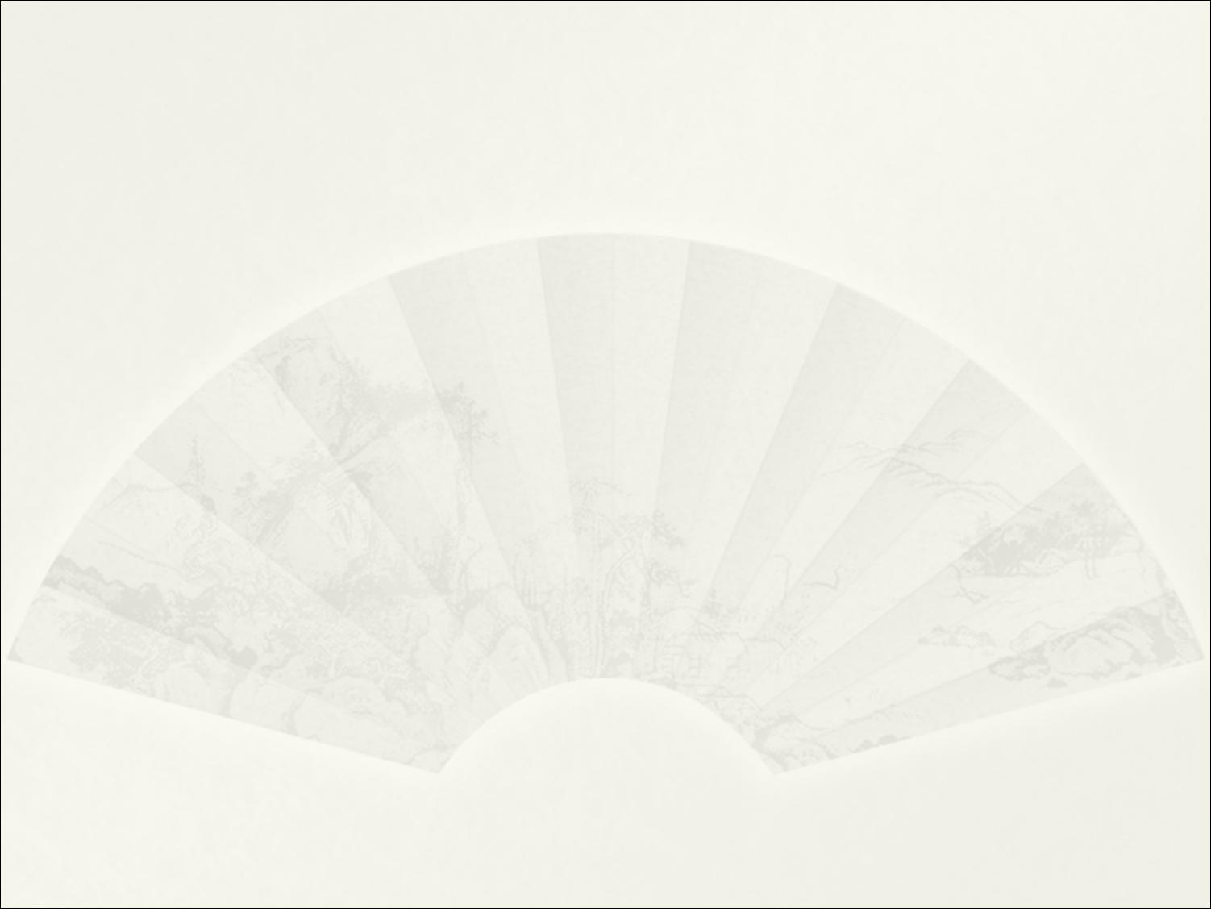
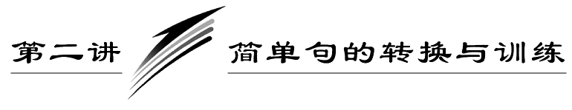

Slide 2










Slide 4
在一篇短文中，如果句子结构要么是“主谓宾”，要么是“主系表”，则显得很单调，读起来乏味。若对简单句进行一下转换，使其主语灵活，句子结构活泼，则给人的感觉就大不一样。
简单句之间的转换有下面三种方法：

Slide 5
一、转换句子结构
[例] 李东住在南方。他的家乡经常下雨。
一般： Li Dong lives in the south.It often rains in his hometown.
较好： Li Dong is from the south.There is a lot of rain in his hometown.

Slide 6
[分析] “一般表达”中的两个句子均是“主谓”结构，比较单调。把它们分别转换为“主系表”结构和there be句型后，句子就显得比较活泼。

Slide 7
[例] 你每天帮我学英语。你太好了！
一般： You help me study English every day. You are very kind.
较好： It's very kind of you to help me learn English every day.
较好： How kind of you to help me learn English every day!

Slide 8
[分析] “一般表达”句子之间的关系松散，转换为it作形式主语或感叹句后句子读起来很流畅。

Slide 9
二、转换句型
写作中常用于转换的三个重点句型：
1．there be句型
  there be句型也是简单句中的一种常用句型，在作文中经常使用。在there be句型中，有时there be还可以换用there seems/seemed to be(似乎有)，there happened to be(碰巧有)，there may/might be(也许有)，there must be(肯定有)，there can‘t be(不可能有)，there ought to/should be(应该有)等。

Slide 10
我家有五口人。
There are five people in my family.
操场上碰巧有很多人。
There happened to be a lot of people on the playground.

Slide 11
2．感叹句
  感叹句是作文中很有用的一种句型，常见的感叹句有两种：
  [句型1] What＋(冠词)＋形容词＋名词＋主谓结构＋感叹号
  [句型2] How＋形容词或副词＋主谓结构＋感叹号
  What an interesting film (it is)!
  ＝ How interesting a film (it is)!

Slide 12
3．强调句型
  强调句型也是作文中常用的一种句型，强调句型的结构是：
  It is/was＋被强调部分＋that/who＋原句其他部分。
  I met my friend in the street yesterday.
  →It was I who/that met my friend in the street yesterday.
  (强调主语)

Slide 13
→It was my friend that I met in the street yesterday. (强调宾语)
→It was in the street that I met my friend yesterday. (强调地点状语)
→It was yesterday that I met my friend in the street. (强调时间状语)
注意：强调时间和地点时，不能用when或where，要用that。

Slide 14
三、转换词语
[例] 杰克是我们学校的学生。他学习特别努力。
一般： Jack studies in our school. He studies very hard.
较好： Jack studies in our school. He works hard at his lessons.
[分析] “一般表达”中的谓语重复使用study，显得呆板。词语转换后，句子就“活”起来了，读起来有滋有味。

Slide 15
[例] 妈妈匆匆忙忙去上班，连早餐都没吃。
一般：Mother went to work in a hurry. She didn't have breakfast.
较好：Mother went to work in a hurry without having breakfast.
[分析] “一般表达”中的两个简单句之间关系松散，使用介词短语进行转换后使句子内部结构紧凑，读起来一气呵成。

Slide 17
Ⅰ.简单句转换(转换词语或句型)
1．有时一些人根据穿着判断一个人。
  原句： Sometimes some people judge a person by the clothes he wears.
  转换： (1)Sometimes some people judge a person by ________ he wears.
  (2)Sometimes some people judge a person by ________ clothes.
  答案：(1)what (2)his

Slide 18
2．同学们曾经把大多数时间花在做作业上。
  原句： The students once put the most of their time into their homework.
  转换： (1)The students once ________ the most of time doing their homework.
  (2)Doing their homework once ________ the students the most of time.
  答案：(1)spent (2)took

Slide 19
3．多吃蔬菜和水果有益健康。
  原句： It's good for our health to eat more fruit and vegetables.
  转换： (1)Eating more fruit and vegetables ________ good for our health.
  (2)Eating more fruit and vegetables does ________ our health.
  (3)We benefit more ________ fruit and vegetables.
  答案：(1)is (2)good to (3)from

Slide 20
4．汤姆努力学习中文。他想在中国找份工作。
  原句： Tom studies Chinese very hard.He wants to find a job in China.
  转换： (1)Tom studies Chinese very hard ________ find a job in China.
  (2)Tom studies Chinese very hard ________________________ finding a job in China.
  答案： (1)in order to/so as to (2)with the purpose of

Slide 21
Ⅱ.根据“一般表达”的意思，完成“较好表达”中的句子(使用简单句)
1．一般表达
  Yao Ming is a famous basketball player. He is tall and handsome. He played in NBA. He has a talent for basketball. He plays very hard every time. He wants to realize his dream. We Chinese like him very much. The foreigners like him too.

Slide 22
较好表达
Yao Ming is famous ________ a basketball player in the world. The big man from China is 2.26m ________. As a superstar, he also ________ great skill and speed. In the Houston Rockets he acted ________ a center and ________ no effort in each game so as to live his dream. Not only Chinese ________ foreigners like Yao Ming very much.
答案：as; tall; has; as; spared; but (also)

Slide 23
2．一般表达
You don't want to spend your vacation on a bus, in a hotel or sitting on the beach. You may want to try hiking. You travel happily. You will get close to nature and take exercise at the same time. You can do hiking easily and you needn't spend a lot of money. You can hike close to home or travel to other places. You need the basic equipment: good shoes, clothes, and a backpack. You can hike in the mountains, in a forest or along a river. You can also go for a hike in the city.

Slide 24
较好表达
Instead of ________ your vacation on a bus, in a hotel or sitting on the beach, you may want to try hiking. ________ is a great way to travel. You will get close to nature and take exercise at the same time. Hiking is easy to do and doesn't ________ to be very expensive. You can hike close to home or travel to other places. The basic equipment ________ simple:

Slide 25
good shoes, clothes, and a backpack. You can hike in the mountains, in a forest or along a river. Hiking in the city ________ also one of your choices.
答案： spending; It; have; is; is

