Slide 1

Super
Chinglish

Slide 2
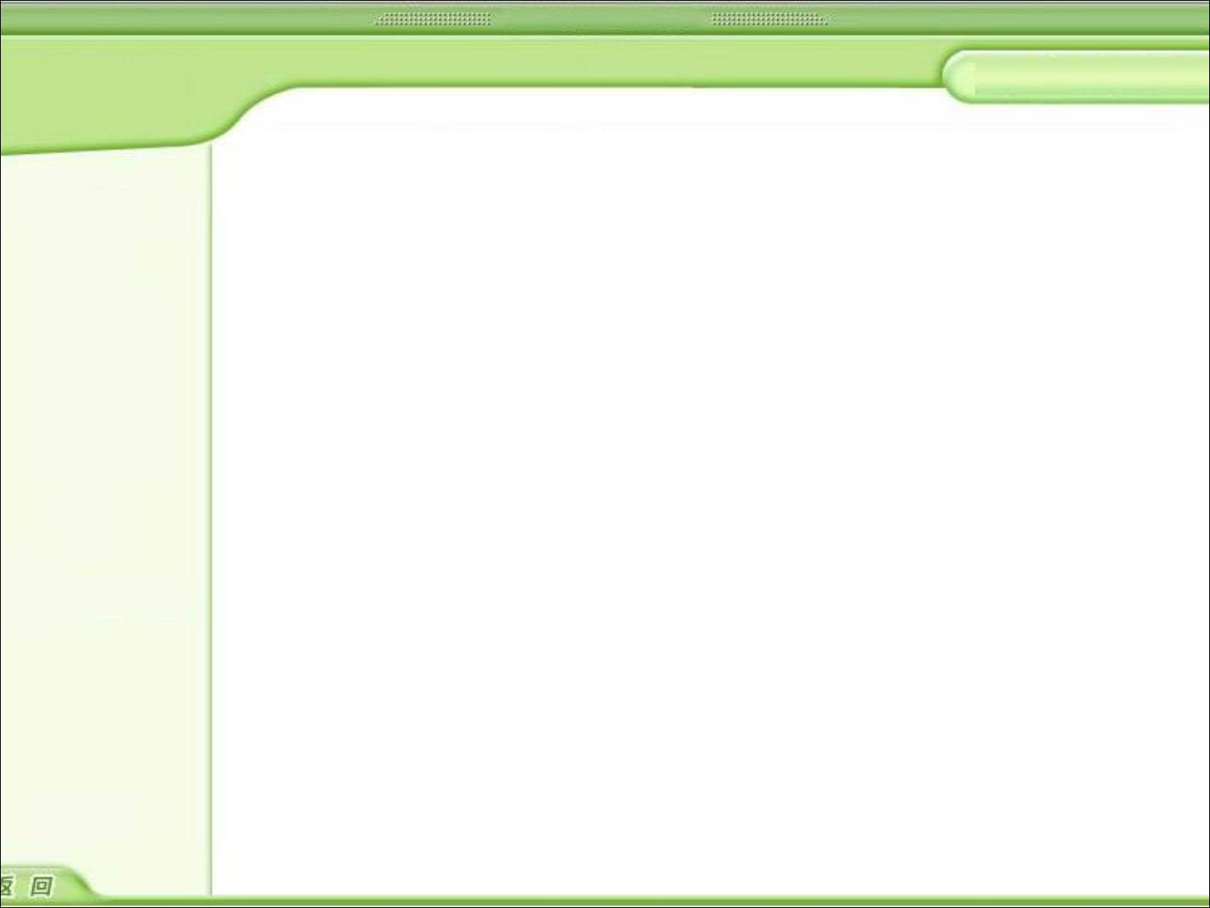
1．we two who and who？
2．how are you ? how old are you?
3．you don't bird me, I don't bird you
4．you have seed I will give you some color to see see, brothers ！ together up ！
5．you me you me
6．You Give Me Stop!!
7．know is know no know is no know
8．WATCH SISTER
9．American Chinese not enough?
10．heart flower angry open
11．go past no mistake past
12．you have two down son.

Slide 3

我俩谁跟谁。
怎么是你？怎么老是你？
你不鸟我，我不鸟你。
你有种，我给你点颜色瞧瞧，兄弟，一起上。
彼此彼此。
你给我站住。
知之为知之，不知为不知。
表妹
美中不足
心花怒放
走过不要错过
你有两下子。

