Slide 1
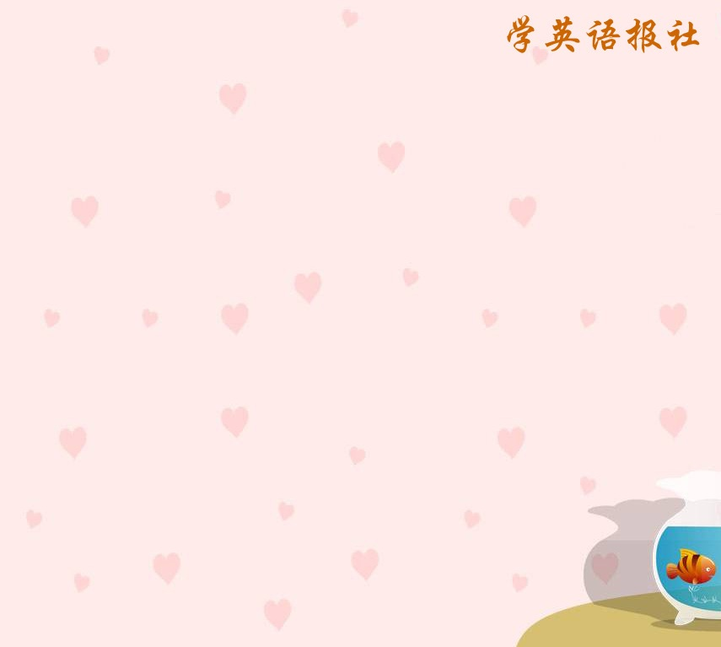
Listening

Slide 2
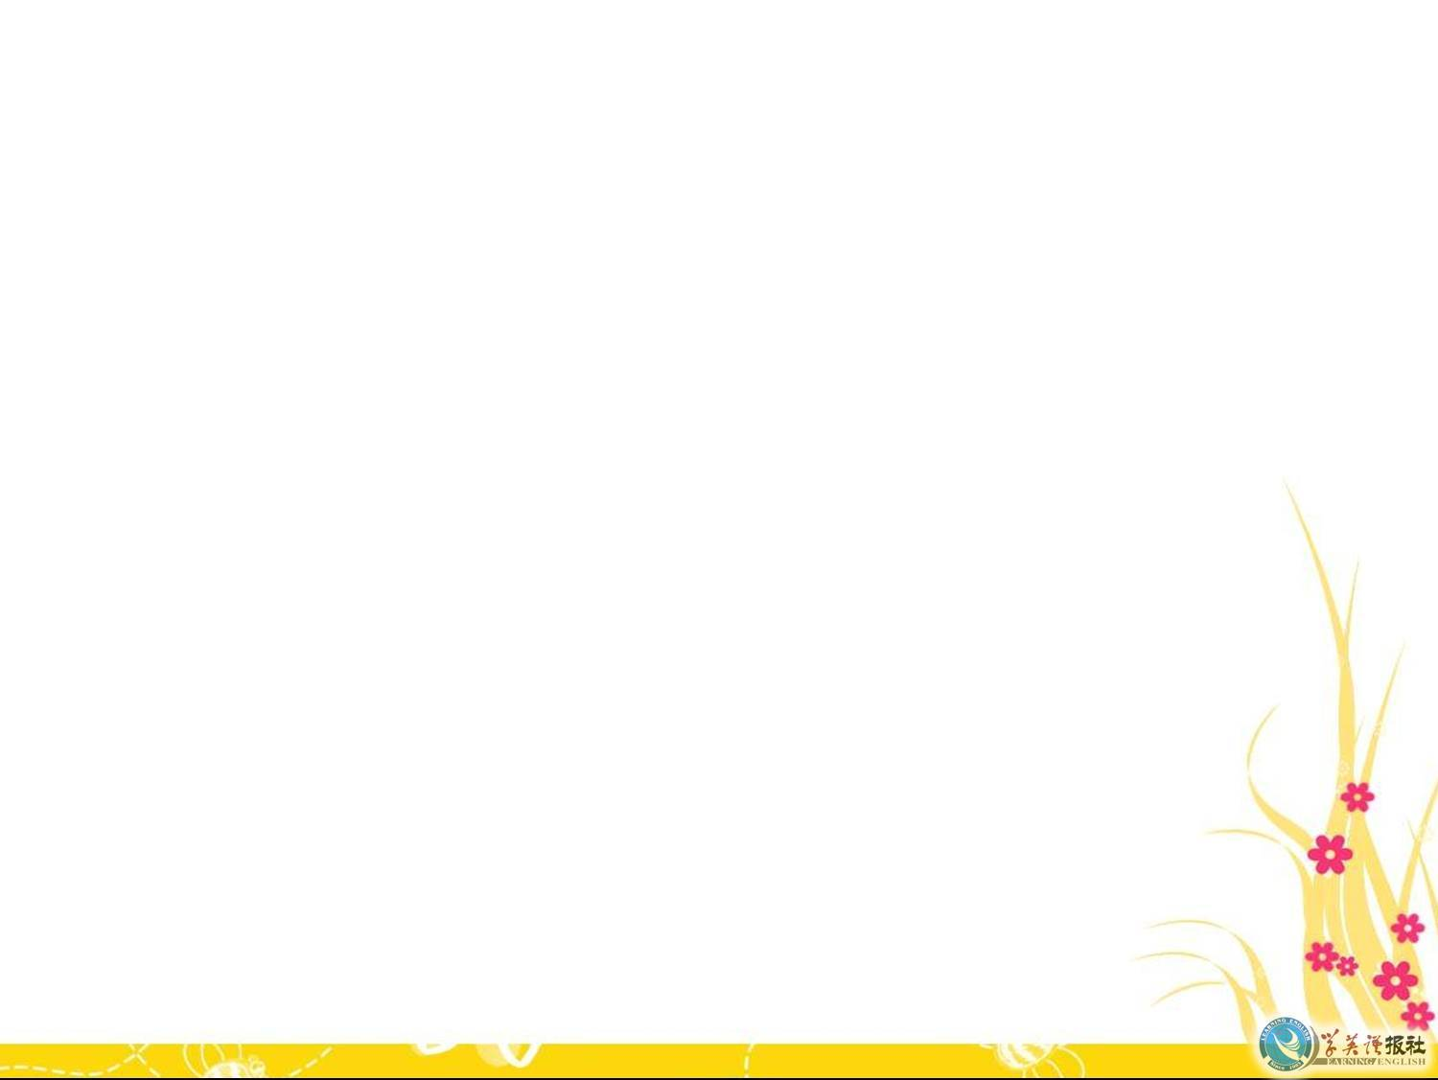
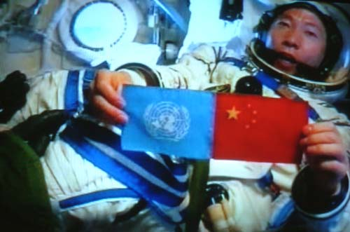
Listening task on P62

Slide 3

Before listening, discuss in pairs what space travel has taken place so far. Which countries have sent people into space? What have they achieved.

Slide 4

Listen to the tape and write down the main idea.
The main idea is the excitement of
space travel and the qualifications
and experience needed to become
an astronaut.

Slide 5

Listen to Part 1 again and make notes of the answers to the questions.
Questions | Yang Liwei’s answers
When was the most exciting moment?
What surprised him?
What did he do?

Slide 6
Questions | Yang Liwei’s answers
When was the most exciting moment?
What surprised him?
What did he do?
When his spaceship lifted off the ground
he knew he was really
on his way into space.
The beauty of space.
He watched all his
instruments and stayed
calm.

Slide 7
Listen to Part 2 and fill in the form.
 | Information on Yang Liwei
Education
Training
Physical qualities
Personal qualities

Slide 8
 | Information on Yang Liwei
Education
Training
Physical qualities
Personal qualities
He got his degree.
He trained for ten years to fly airplanes and then to fly a spaceship.
Smaller than 170cm; less than 70 kg.
Calm, hard-working.

Slide 9
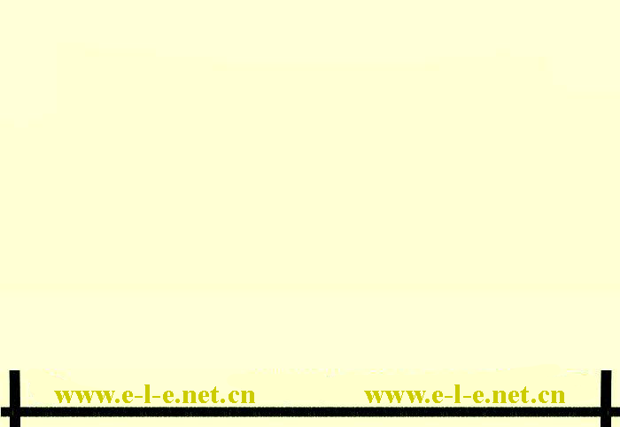
Fill in the blank in the passage below.
dreamed
Well, I_________ if it when I was
_______, but I never thought
my_____ would come_____ It all
happened very__________. If there
was an___________ I’d ____ to go the
moon one day.
young
wish
true
gradually
opportunity
love

Slide 10
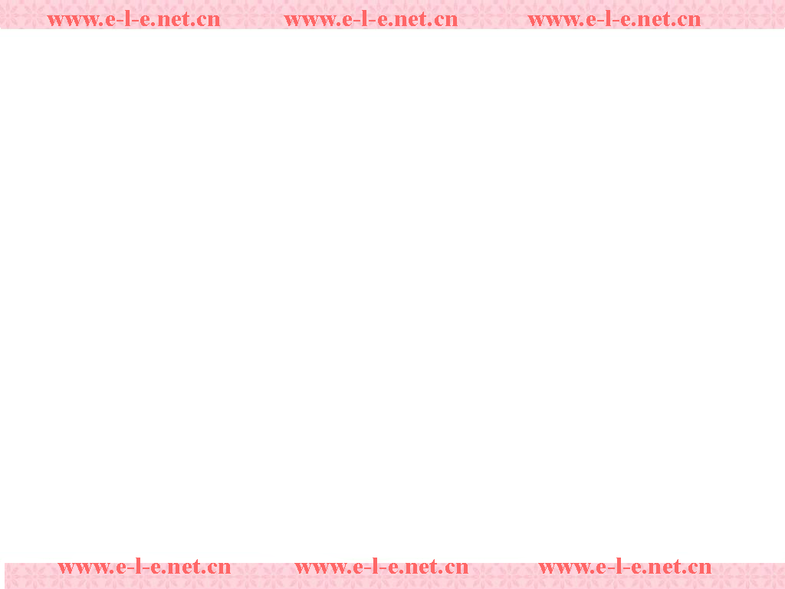
AN INTERVIEW WITH YANG LIWEI
R = Mr Renault Y = Yang Liwei
Listening text
Part1
R: Thank you so much, Mr Yang, for coming to talk to us today about your experience in space.
Y: Not at all. I’m happy to be here.

Slide 11
R: Please can you tell us your most exciting moment?
Y: Well, that was when the spaceship began to lift off the ground. Then I knew I was really on my way and that China would become the third country to send people into space.
R: Did you feel afraid?

Slide 12
Y: No, because I was trained not to worry. So I watched all my instruments and stayed calm.
R: What surprised you?
Y: The beauty of space. I’d never realized how lovely the earth looks till I was going round it.

Slide 13
Part2
R: Did you always want to be an astronaut?
Y: Well, I dreamed of it when I was young,
but I never thought my wish would
come true. It all happened gradually.
First I got my degree and then I trained
for ten years to fly airplanes and then to
fly a spaceship.

Slide 14
R: I see. Did you have to be a certain size
and weight?
Y: Yes. An astronaut has to be smaller
than 170cm and weigh less than 70 kg.
R: So you were the perfect choice! But of
course you had to work very hard.
Would you like to go into space again?

Slide 15
Y: Yes, I would if there was an
opportunity. I’d love to go to the
moon one day.
R: I hope we’ll be talking to you again
after you’ve finished that trip! Good-
bye, Mr Yang. Thank you for taking
to us.
Y: It was my pleasure.

Slide 16

Listening task on page 65
Before listening discuss in pairs
what you know of the problems of
making a space walk. Make a list.
Then listen to the tape and check if
you were right.

Slide 17
to protect your skin: a spacesuit that
can supply you with warm if it’s too
cold on the moon and cool water if the
temperature is too hot.
to stop you flying off into space: a rope
to tie you to the spaceship.
to stop you food floating away: liquid
space food that you can keep in the
tube and eat with a straw.

Slide 18

In pairs read the words below and then discuss what you know about the new vocabulary. Then listen to the tape again and number the words as you hear them.
Hubble telescope
oxygen
waist
gravity boots
engines
weigh
tiring
feathers

Slide 19

Listen to the tape
and make notes to
answer the questions
below.

Slide 20

Questions | Notes
1 Why did Li Yanping have to repair the Hubble telescope?
2 Which two days does his spacesuit protect him in space?
3 How does he move about in space?
4 What does it feel like in space?
5 What happens if you fly too far from the spaceship?
6 Was the repair successful?

Slide 21
Questions | Notes
1 Why did Li Yanping have to repair the Hubble telescope?
2 Which two days does his spacesuit protect him in space?
3 How does he move about in space?
It needed cleaning so
that it would work
better.
1 It carries oxygen.
2 It carries hot and cold
water to warm him of it’s
too cold and cool him if
it’s too hot.
He used small engines.

Slide 22
Questions | Notes
4 What does it feel like in space?
5 What happens if you fly too far from the spaceship?
6 Was the repair successful?
Strange because you do
not weigh anything. You
can fly around like feathers.
You would continue into
space and never get back
to the spaceship.
Yes. The Hubble telescope
works well now.

Slide 23
You have been sent a spacesuit
for a space walk from the Space
Exploration Center and you need
to identify the different parts.
Listen to the tape again. Pick out
The information and draw lines
from the list to where the things
are on the suit of the astronaut.

Slide 24
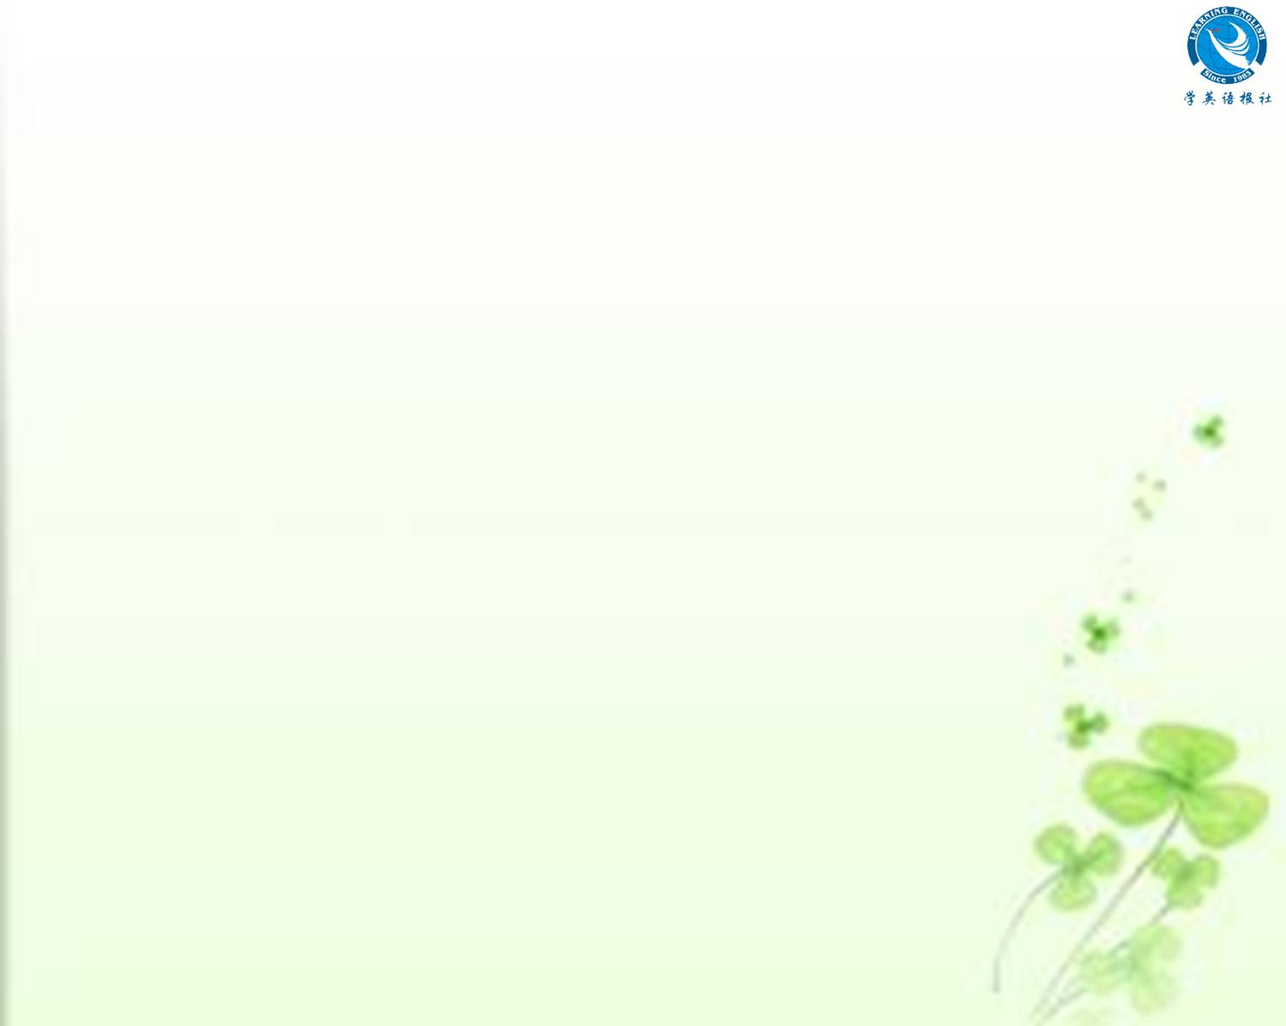
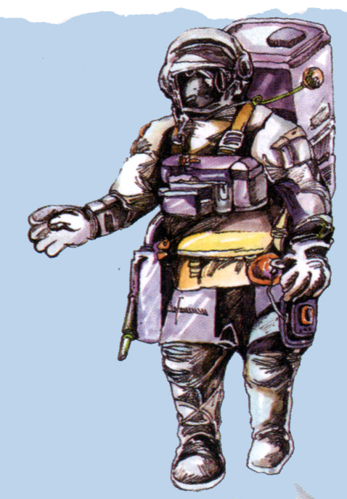
Oxygen can
Water system
Left engine
Right engine
Tool kit
Gravity boots

Slide 25

Listening text
AN INTERVIEW WITH LI YANPING
W = Wallis L = Li Yanping
W: Mr Li , would you please tell us about your space walk?
L: Yes. I’d be happy to. We cleaned and repaired the Hubble telescope.
W: Oh, and is that when you did your space walk?

Slide 26
L: Yes.
W: How did you prepare for it?
L: First we had to get into spacesuits.
They’re very thick and carry all the
oxygen we need to breathe. The suit
also has hot and cold water so it can
warm us if it’s too cold or cool us if it’s
too hot. So it’s very heavy.

Slide 27
W: Is it dangerous to leave the spaceship?
L: Yes, indeed. When we leave, we go
into a small room. We have to wear
gravity boots to walk there. We close
the door behind us and then we open
the door to space. Then our gravity
boots stop working and we fly out of
the door.

Slide 28
W: How do you move about in space?
L: We use small engines to move around.
To go left we push the right engine
and to go right we push the left one.
We move slowly because we don’t
weigh anything. We can fly around
like feathers.
W: What does it feel like in space?

Slide 29
L: Very strange. There is no gravity so
doing any job is very tiring.
W: What happens if you fly too far from
the spaceship?
L: You’d never get back so we tie
ourselves to the spaceship with a
special rope.
W: How did you repair the Hubble
telescope?

Slide 30
L: We used some special tools tied
round our waists. That way we
didn’t lose them. We did a good job.
The telescope works fine now.
W: Thank you very much, Mr Li.

Slide 31

Homework
You can write an article telling
your teacher and classmates
about your ideas and hopes for
travelling in space. There is an
example on page 67.

