Slide 1
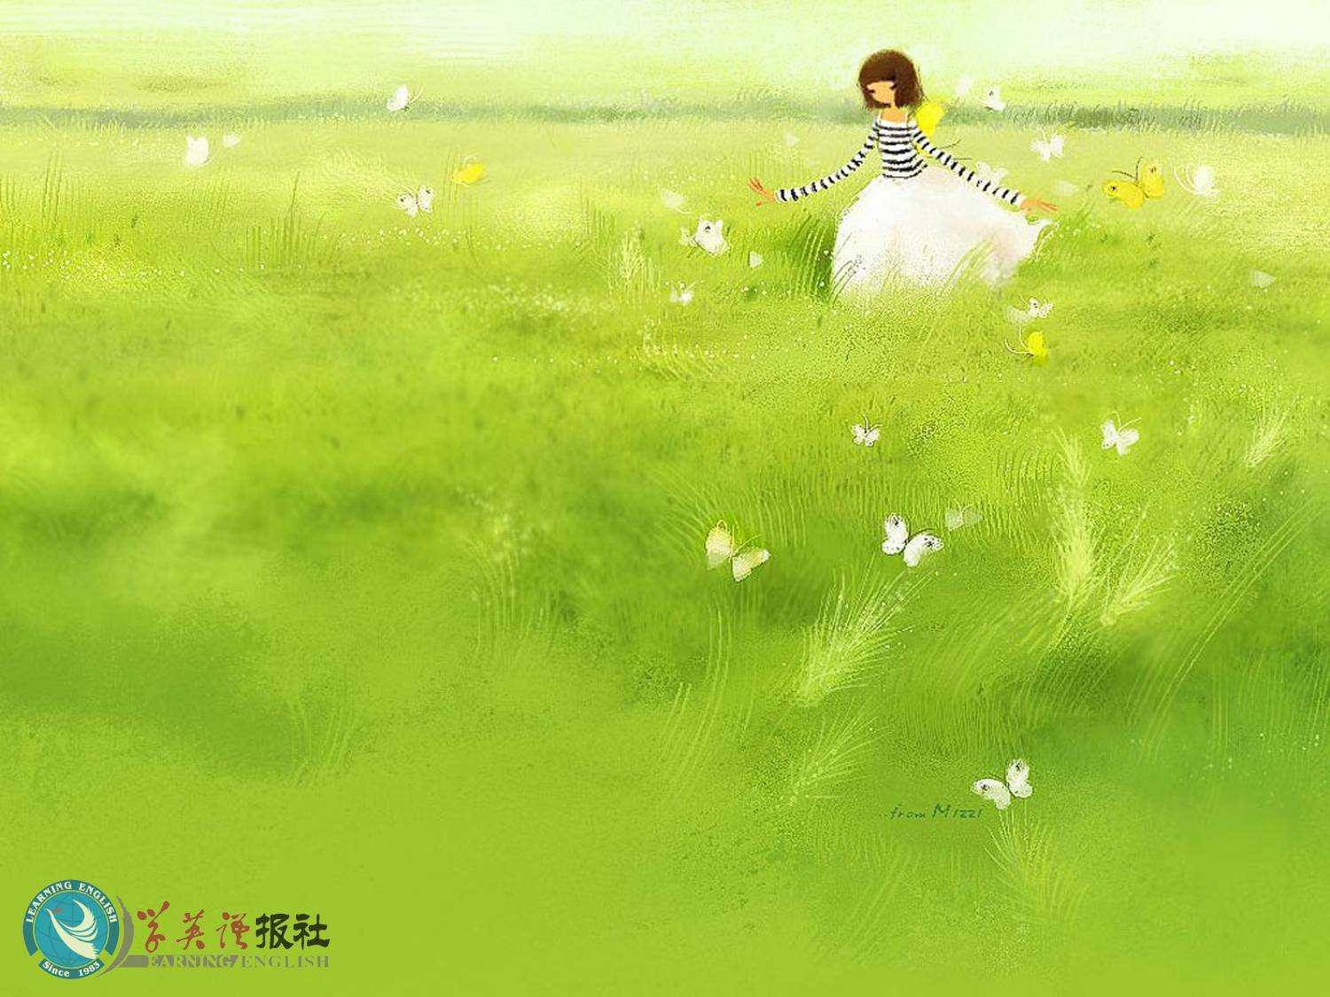
Listening

Slide 2


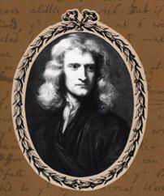
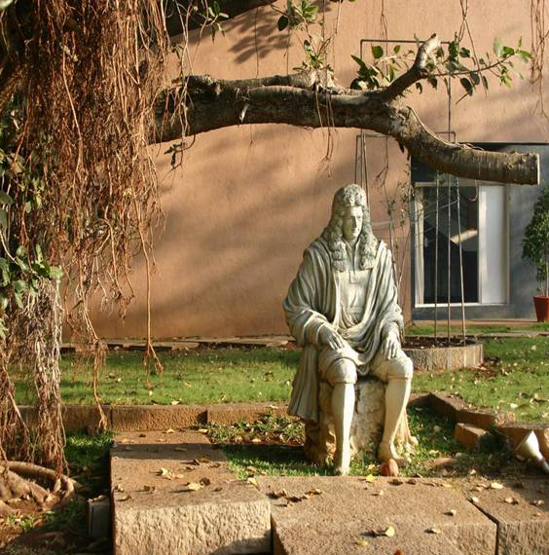
Pre-listening
Isaac Newton 1642～1727 英国物理学家

Slide 3
经典物理学理论体系的建立者。
1665年创立微分；1666年开始研究积分。 1666年,开始想到研究重力(gravity)问题，苹果落地的传说，也是在此时发生的轶事。其一生的重大科学思想是在这两年期间（22至23岁）岁形成的。1669年，把《自然哲学的数学原理》，《宇宙体系》)等手稿送到剑桥大学图书馆收藏。晚年研究宗教。

Slide 4
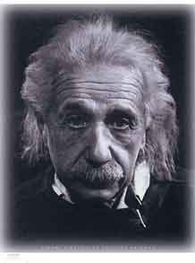
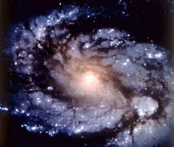
Albert Einstein（1879～1955）

Slide 5
质量(m)和能量(E)的相当性：E＝mc2
爱因斯坦在量子论、分子运动论、相对论(Theory of Relativity)等物理学的三个不同领域取得了历史性成就，特别是狭义相对论的建立和光量子论的提出，推动了物理学理论的革命，他对社会进步事业也有重要贡献。

Slide 6
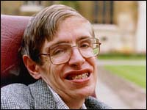
霍金 born in 1942

Slide 7
斯蒂芬·藿金是当今科学界的一位传奇性人物。这不仅仅因为他是一位被誉为继爱因斯坦后最著名的科学思想家和最杰出的理论物理学家，还在于他是在常人无法想象的身体状况下进行研究和创造性工作的。

Slide 8
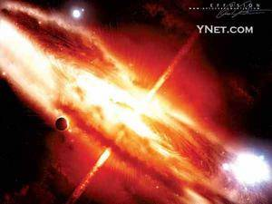
black hole 黑洞

Slide 9
黑洞并非只是吞噬物质。除了会在星系形成的过程中扮演重要角色外，在经过一段相当漫长的时间后，黑洞也会把一些曾被它吸入的物质信息向外界释放出来。

Slide 10


Listening
Choose the best summary.
Summary B is correct because it gives a clear idea of what the listening passage is about.
Summary A is not true. The three scientists wanted to explain how the universe worked and not how it began.
Summary C is too general and does not give enough detail about what the listening passage is about.

Slide 11
 | Isaac Newton | Albert Einstein | Stephen Hawking
Idea
In space large objects make space and time bend; the larger the object, the further space and time bends
Black holes have a very large mass and pull things towards them towards their edge.
Large bodies have a force which pulls things towards them

Slide 12
 | Isaac Newton | Albert Einstein | Stephen Hawking
Development
The bigger the object the stronger the gravity.
Time goes slower in very strong gravity.
If you go over the edge, you cannot get out; but if you do not, you may be able to escape.

Slide 13

Listening text
THEORIES OF GRAVITY
Michael Jones of the New Space Magazine is talking with space traveller Li Yanping about changes in the theory of gravity.
LY = Dr Li Yanping
MJ = Dr Michael Jones

Slide 14
Part 1
MJ: Hello, Dr Li Yanping. It’s so good of you to talk to me . Some students ask us why things always fall back to earth if you throw them up in the air. Could you explain it?

Slide 15
LY: Well, at first people thought it was because the earth was the centre of the universe. Of course that was wrong. One day lsaac Newton watched an apple fall to the ground. He said that something else must be pulling the apple back to Earth. He called it “gravity”.

Slide 16
MJ: I see. Did people accept his idea?
LY: They did. Later they worked out that bigger objects (like the sun) have stronger gravity than smaller in deep space, you couldn’t fall back to the earth . You’re just too far away.

Slide 17
Part 2
MJ: Does it mean there’s no gravity in space?
LY: No. In a spaceship you would feel the pull as it got closer to such an object. You would travel faster and faster towards it.
MJ: Until you hit it?

Slide 18
LY: Not exactly. You may pass it very fast and then it would throw you out into space again. After that you would slow down to the usual speed.
MJ: How do you know this?
LY: In 1905 Einstein said that in space large objects make space-time bend; the larger the object,

Slide 19
the further space-time bends. So time goes slower in very strong gravity.
MJ: What a bout black holes?
LY: That’s a place in space which has such a strong mass that nothing can escape from its gravity. There is a kind of edge around this mass .

Slide 20
If you cross over this edge around this mass. If you cross over this edge, it’s impossible for you to get back. However, if you don’t cross this edge, you can still escape. Stephen Hawking has done a lot of research into black holes. He has shown that they “spit ” things out as well as “eat” them.

Slide 21

Listening on P62
What space travel has taken place so far?
Which countries have sent people into space? What have they achieved?

Slide 22
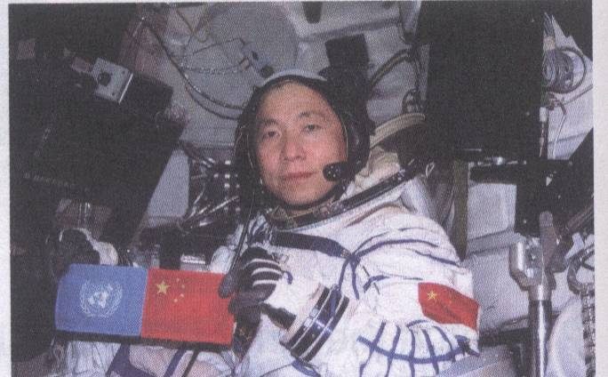
杨利伟，男，汉族，辽宁绥中县人，中共党员，大学文化。1965年6月出生，1983年6月入伍，1988年9月入党，现为中国人民解放军航天员大队三级航天员，正团职，中校军衔，1992年、1994年两次荣立三等功。

Slide 23
Listening
Listen to the tape and write down the
main idea.
The main idea is the excitement of space
travel and the qualifications and
experience needed to become an
astronaut.

Slide 24
Listen to the Part 1.
Questions | Yang Liwei’s answers
When was the most exciting moment?
What surprised him?
What did he do?
When his spaceship lifted off the ground he knew he was really on his way into space.
The beauty of space.
He watched all his instruments and stayed calm.

Slide 25
Listen to the Part 2.
 | Information on Yang Liwei
Education
Training
Physical qualities
Personal qualities
He got his degree.
He trained for ten years to fly airplanes and then to fly a spaceship.
Smaller than 170cm, less than 70kg
Calm, mature, hard-working

Slide 26
Answer key for exercise 5:
dreamed, young, wish, true, gradually, opportunity, love

Slide 27


Listening text
AN INTERVIEW WITH YANG LIWEI
R = Mr Renault Y = Yang Liwei
Part 1
R: Thank you so much, Mr Yang, for coming to talk to us today about your experience in space.
Y: Not at all. I’m happy to be here.

Slide 28
R: Please can you tell us what was your most exciting moment?
Y: Well, that was when the spaceship began to lift off the ground. Then I knew I was really on my way and that China would become the third country to send people into space.
R: Didn’t you feel afraid at all?

Slide 29
Y: No, because I was trained not to worry. So I watched all my instruments and stayed calm.
R: What surprised you?
Y: The beauty of space. I’d never realized how lovely the earth looks till I was going round it.

Slide 30
Part 2
R: Did you always want to be an
astronaut?
Y: Well, I dreams of it when I was young, but I never thought my wish would come true. It all happened gradually. First I got my degree and then I trained for ten years to fly airplanes and then to fly a spaceship.

Slide 31
R: So you were the perfect choice! But of course you had to work very hard. Would you like to go into space again?
Y: Yes, I would if there was an opportunity. I’d love to go to the moon one day.

Slide 32
R: I hope we’ll be talking to you again after you’ve finished that trip! Goodbye, Mr Yang. Thank you for talking to us.
Y: It was my pleasure.

Slide 33

After listening True or False
1. Yang Liwei became an astronaut by chance.
2. Nobody over 170cm can be an astronaut.
3. Yang Liwei trained for 10 years to become a pilot.
F
F
T

Slide 34
 | Information on Yang Liwei
The exams he passed
Experience
Physical qualities
Excellent degree and 10 years’ training
Pilot for the air force of the PLA
Smaller than 170cm, less than 70kg

Slide 35

Listening task
1. Why did Li Yanping have to repair
the Hubble telescope?
It needed cleaning so that it would
work better.
2. Which two ways does his spacesuit protect him in space?
It carries oxygen.
It carries hot and cold water to warm him if it’s too cold and cool him if it’s too hot.

Slide 36
3. How does he move about in space?
He used small engines.
4. What does it feel like in space?
Strange because you do not weigh anything. You can fly around like feathers.

Slide 37
5. What happens if you fly too far from the spaceship?
You would continue into space and never get back to the spaceship.
6. Was the repair successful?
Yes. The Hubble telescope works well now.

Slide 38
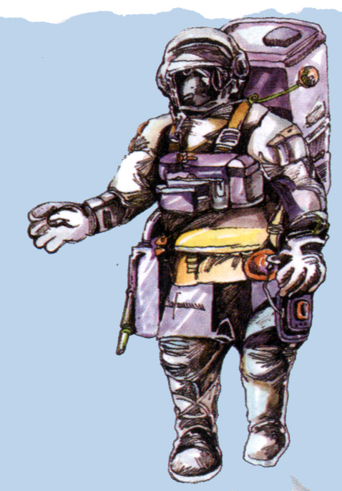
oxygen can
Water system
Left engine
Right engine
Tool kit
Gravity boots

Slide 39
Listening text
W = Wallis L = Li Yanping
W: Mr Li Yanping, would you please tell us about your first space walk?
L: Yes. I would be very happy to do
so. We repaired the Hubble telescope.

Slide 40
W: Oh, and is that when you did your space walk?
L: Yes.
W: How did you prepare for it?
L: First we had to get into spacesuits. They’re very thick and carry all the oxygen we need to breathe. The suit also has hot and cold water so it can warm us if it’s too cold or cool us if it’s too hot. So it’s very heavy.

Slide 41
W: Is it dangerous to leave the spaceship?
L: Yes, indeed. When we leave, we go into a small room. We have to wear gravity boots to walk there. We close the door behind us and then we can open the door to space. Then our gravity boots stop working and we can fly out of the door.

Slide 42
W: How do you get about in space?
L: We use small engines to move around. To go left we push the left engine and to go right we push the right one. We have to go very slowly because we don’t weigh anything in space. We can fly around like feathers.

Slide 43
W: What does it feel like in space?
L: Very strange. There is no gravity so doing any job is very tiring.
W: What happens if you fly too far from the spaceship?

Slide 44
L: You’d never get back so we tie ourselves to the spaceship with a special rope.
W: How did you repair the Hubble telescope?

Slide 45
L: We used some special tools tied round our waists. That way we didn’t lose them. We did a good job. The telescope works fine now.
W: Thank you very much, Mr Li.

Slide 46
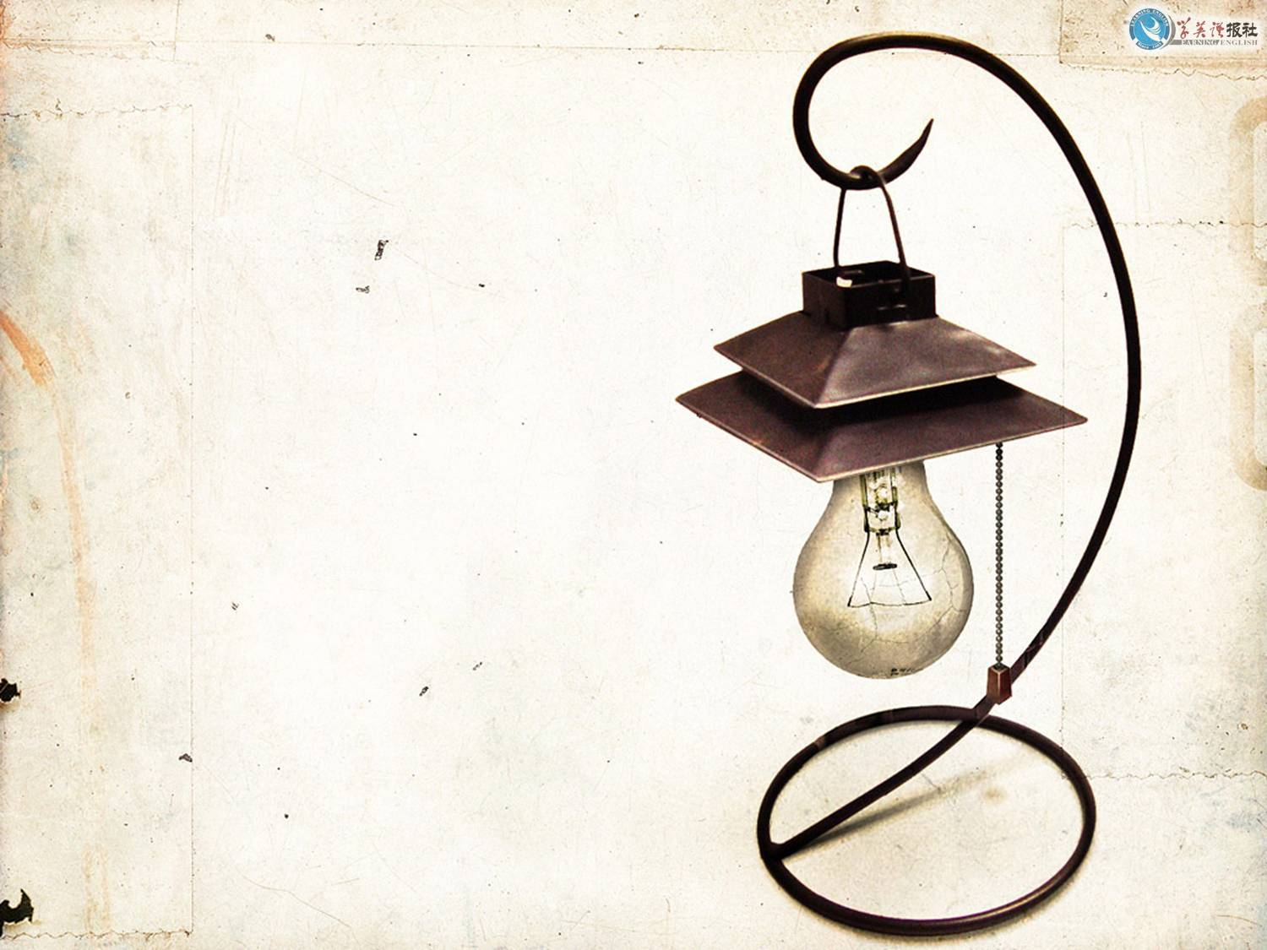
Thank you.

