Slide 1


Using Language

Slide 2

Words preview
spaceship
pull
float
mass
n. 宇宙飞船
n.&vt. (拉）力；拖；牵引力
vi.&vt. （使）浮动或漂浮
n. 漂浮物
n. 质量；团；块；大量
（复）群众

Slide 3
Expressions preview
cheer up
now that
break out
watch out
感到兴奋；感到高兴
既然
突发；爆发
密切注视；当心；提防

Slide 4

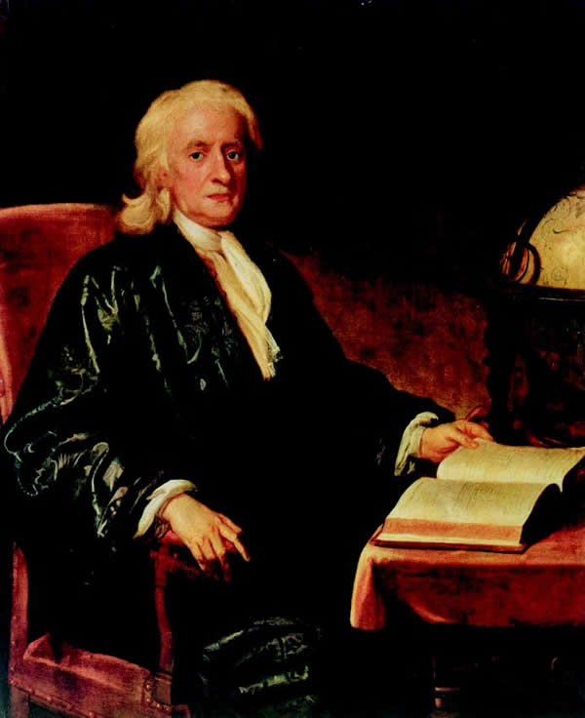
Listening on page 30
Isaac Newton
1642～1727

Slide 5
牛顿经典物理学理论体系的建立者。
1665年创立微分；1666年开始研究积分。1666年,开始想到研究重力(gravity)问题，苹果落地的传说，也是在此时发生的轶事。其一生的重大科学思想是在这两年期间（22至23岁）岁形成的。1669年，把《自然哲学的数学原理》，《宇宙体系》)等手稿送到剑桥大学图书馆收藏。晚年研究宗教。

Slide 6
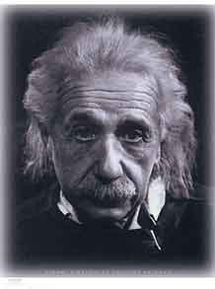
Albert Einstein
（1879～1955）

Slide 7
爱因斯坦在量子论、分子运动论、相对论(Theory of Relativity)等物理学的三个不同领域取得了历史性成就，特别是狭义相对论的建立和光量子论的提出，推动了物理学理论的革命，他对社会进步事业也有重要贡献。

Slide 8
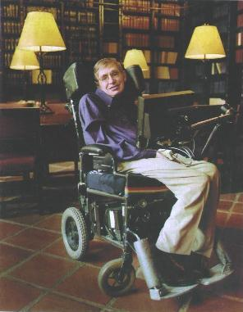
Stephen Hawking born in 1942

Slide 9
斯蒂芬·霍金是当今科学界的一位传奇性人物。这不仅仅因为他是一位被誉为继爱因斯坦后最著名的科学思想家和最杰出的理论物理学家，还在于他是在常人无法想象的身体状况下进行研究和创造性工作的。

Slide 10


Listen to the tape and choose the best summary of the listening text.
A The text is about how three scientists wanted to find out about the beginning of the universe.
B The text is about how the idea of gravity has developed over a long periods of time.
C The text is about the important of three scientists and their work.

Slide 11
Listen to the tape again and fill the
chart below
 | Isaac Newton | Albert Einstein | Stephen Hawking
Idea
Development

Slide 12
 | Isaac Newton | Albert Einstein | Stephen Hawking
Idea
In space large objects make space and time bend; the larger the objects; the further space and time bends.
Black holes have a very large mass and pull things towards them towards their edge.
Large bodies have a force which pulls thing towards them.

Slide 13
 | Isaac Newton | Albert Einstein | Stephen Hawking
Develop-ment
If you go over the edge, you cannot get out; but if you do not, you may be able to escape.
The bigger the object the stronger the gravity.
Time goes slower in very strong gravity.

Slide 14

Listening text
THEORIES OF GRAITY
Michael Jones of New Space Magazine is talking with space traveller Li Yanping about changes in the theory of gravity.
LY=Dr Li Yanping
MJ=Dr Michael Jones

Slide 15
Part 1
MJ: Hello, Dr Li Yanping. It’s so good of you to talk to me. Some students ask us why things always fall back to earth if you throw them up in the air. Could you explain it?
LY: Well, at first, people thought it was
because the earth was the center of the
universe. Of course that was wrong.

Slide 16
One day Isaac Newton watched an apple fall to the ground. He said that something else must be pulling the apple back to Earth. He called it “ gravity”.
MJ: I see. Did people accept his idea?
LY: They did. Later they worked out that bigger objects (like the sun) have stronger gravity than smaller objects (like our planets). If you’re travelling in deep space,

Slide 17
you couldn't fall back to the earth. You’re just too far away.
Part 2
MJ: Does it mean there’s no gravity in space?
LY: No. In a spaceship you would feel the pull as it got closer to such an object. You would travel faster and faster towards it.
MJ: Until you hit it?

Slide 18
LY: Not exactly. You may pass it very fast and then it would throw you out into space again. After that you would slow down to the usual speed.
MJ: How do you know this?
LY: In 1905 Einstein said that in space large objects make space-time bend; the larger the object, the further space-time bends. So time goes slower in very strong gravity.

Slide 19
MJ: What about black holes?
LY: That’s a place in space which has such a strong mass that nothing can escape from its gravity. There is a kind of edge around this mass. If you cross over this edge, it’s impossible for you to get back. However if you don’t cross this edge, you can still escape.

Slide 20
Stephen Hawking has done a lot of research into black holes. He has shown that they “spit” things out as well as “eat “ them.

Slide 21

A VISIT TO THE MOON

Slide 22

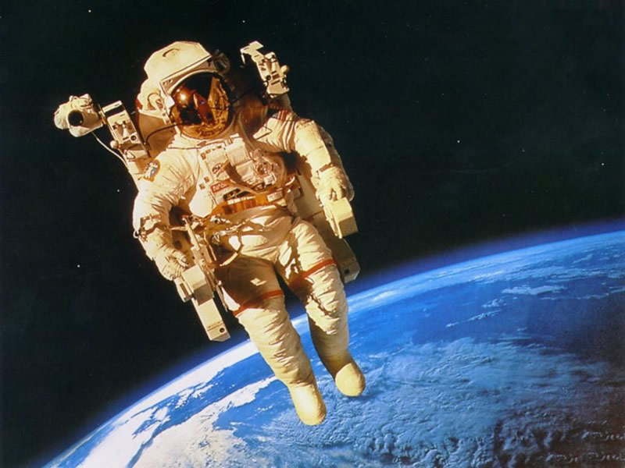
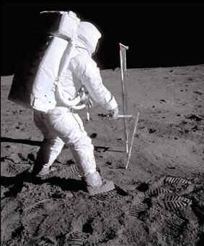
spacewalk

Slide 23
Read the passage and fill in the form.
 | On the earth | In space | On the moon
The gravity
The weight
very
strong
very
light
disappeared
no weight and could float around like a feather
about one-sixth of his weight on the earth
very heavy

Slide 24

Language points
1 …because we are trying to escape the pull of the earth’s gravity.
pull n.拉；拖；扯
He gave a pull on the rope.
他拉了一下绳子。
(自然）引力
the moon's pull on the sea
月球对海洋的引力

Slide 25
2 I cheered up immediately and floated weightlessly around in our spaceship cabin watching the earth become smaller and the moon larger.
cheer up: cause (somebody) to feel happier or more cheerful;
感到振奋, 感到高兴
She tried to cheer up the disappointed child when he failed to win the game.

Slide 26
float: to rest or move in a liquid,
the air 浮动，漂浮
Wood floats on water.
木头漂浮在水上。
A feather floated down on the wind.
一根羽毛随风飘落。
on the float 漂浮着
  float off (搁浅的船)浮起

Slide 27
3. But when I tried to step forward, I found I was carried twice as far as on the earth and fell over.
1). “A + be + 倍数 + as +形容词原级 + as + B”.
This tree is three times as tall as that one.
His father is twice as old as he.
2). “A + be + 倍数 +形容词比较级 + than + B ”

Slide 28
The Yangtze River is almost twice longer than the Pearl River.
长江差不多比珠江长两倍。
The number of students in our school is three times larger than that in theirs.
我们学校的学生数量比他们学校的多三倍。

Slide 29
3). “A + be + 倍数 + the +名词 (size, length, amount) + of + B”
The newly broadened square is four times the size of the previous one.
新扩建的广场是未扩建时的四倍大。

Slide 30
4. Walking does need a bit of practice now that gravity has changed.
now that, 既然
Now that I am free, I can enjoy music for a while.
既然有空，我可以享受一下音乐。
now that同since相似，语气较弱，强调人
们已知的事实。

Slide 31
5. We watched, amazed as fire broke out on the outside of the spaceship as the earth’s gravity increased.
break out
它与happen, take place, come out等词的用法一样，是不及物动词，不能带宾语，不能用于被动语态。

Slide 32
1) 战争爆发
The American Civil War broke out in 1861.
美国内战爆发于1861年。
2) 发生争吵
A quarrel broke out between them.
他们之间发生了争吵。

Slide 33
3) (火灾)发生
A fire broke out in his house last
night.
昨晚他家里失火了。
与break相关的短语:
break down
打破; 毁掉; 破除; 坍塌; 坏掉
break in
破门而入; 打断

Slide 34
break away from
脱离政党; 打破陈规
break through
突围; 突破; 冲垮; 克服
break up
打碎; 拆散; 分裂; 分解
break one's word/promise
食言; 说话不算数

Slide 35

Thank You

