Slide 1
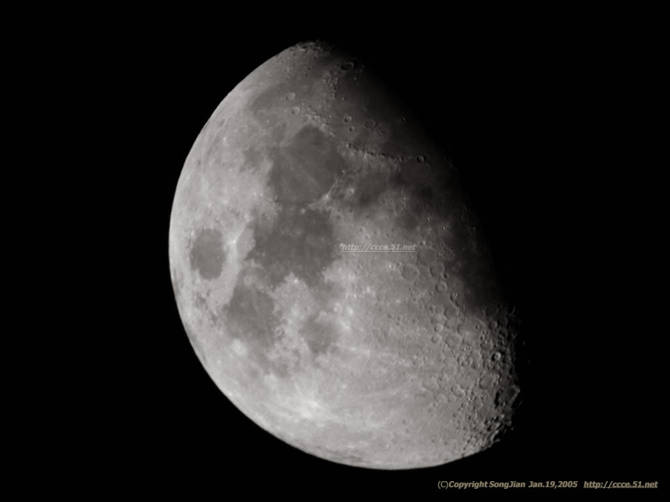

Reading 2
a visit to the moon

Slide 2
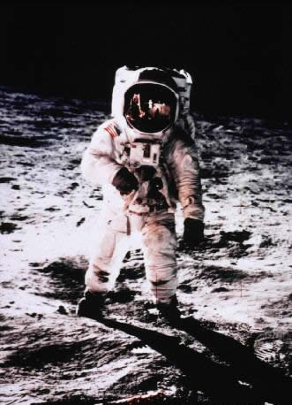
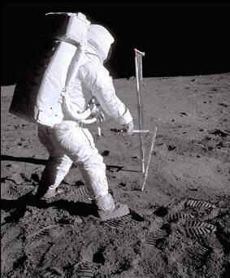
★Look at the pictures! ★
spacewalk

Slide 3
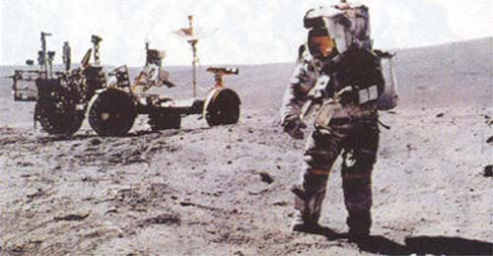
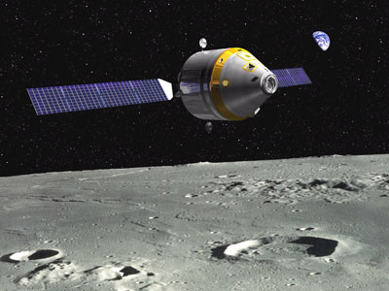

Slide 4
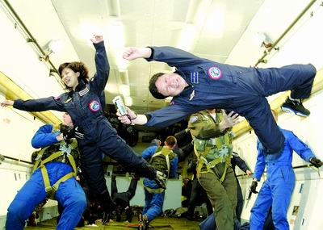

Slide 5
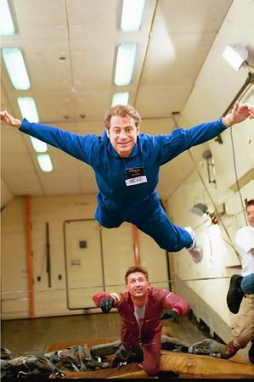
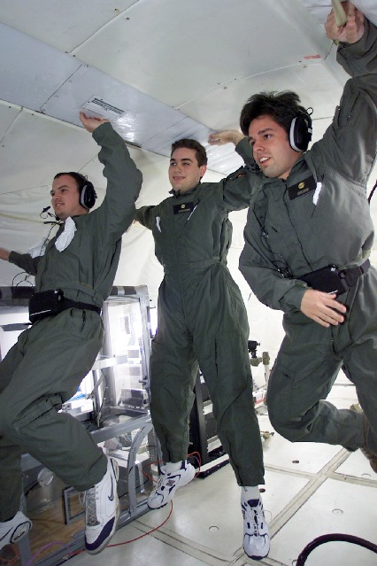

Slide 6
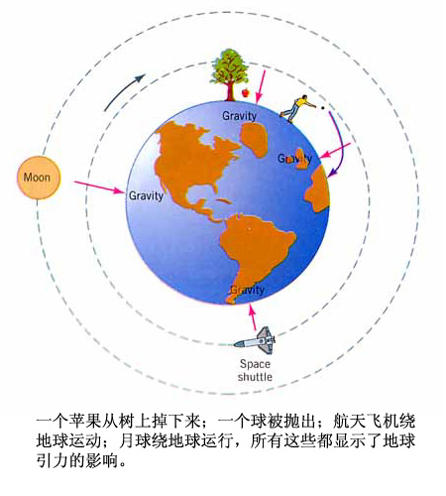
Reading I----scanning& skimming (2m)
Write down the three ways in which gravity
changed for Li Yanping.

Slide 7
 | The way gravity changed
Left the earth
In space
On the moon
The gravity became very strong.
2. The gravity disappeared.
3. It became very light.

Slide 8
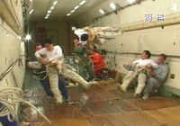
His weights changed three times too.
Now write them down.

Slide 9
 | The weight changed
Left the earth
In space
On the moon
He became very heavy.
He had no weight and could float around like a feather.
He was about one-sixth of his weight on the earth.

Slide 10
1. ... “walking does need a bit of practice now that gravity has changed.”
......既然引力改变了，走路也的确需要练一练了。
now that同since相似，语气较弱，强调人们已知的事实。

Slide 11
Translation:
1. 既然你忙, 就让我给你做吧。
Now that you are busy, let me do it for you.
2. 既然人都齐了, 咱们开始干吧。
Now that everyone is here let’s start work．

Slide 12
2. We watched, amazed as fire broke out on the outside of the spaceship as the earth’s gravity increased.
break out
它与happen, take place, come out等词的用法一样，是不及物动词，不能带宾语，不能用于被动语态。

Slide 13
1) 战争爆发
The American Civil War broke out in 1861.
美国内战爆发于1861年。
2) 发生争吵
A quarrel broke out between them.
他们之间发生了争吵。

Slide 14
3) (火灾)发生
A fire broke out in his house last
night.
昨晚他家里失火了。
与break相关的短语:
break down
打破; 毁掉; 破除; 坍塌; 坏掉
break in
破门而入; 打断

Slide 15
7. cheer up; cheer sb. up
感到高兴振奋
8. masses of 许多，大量
9. get the hang of 熟悉,掌握,理解
10. exhausting (sth); exhausted (sb)

Slide 16
3. But when I tried to step forward I found I was carried twice as far as on the earth and fell over.
1). “A + be + 倍数 + as +形容词原级 + as +
B”.
This tree is three times as tall as that one.
His father is twice as old as he.
2). “A + be + 倍数 +形容词比较级 + than +
B ”

Slide 17
The Yangtze River is almost twice longer than the Pearl River.
长江差不多比珠江长两倍。
The number of students in our school is three times larger than that in theirs.
我们学校的学生数量比他们学校的多三倍。

Slide 18
3). “A + be + 倍数 + the +名词 (size, length, amount) + of + B”
The newly broadened square is four times the size of the previous one.
新扩建的广场是未扩建时的四倍大。

Slide 19
— Do you regret _______(pay) 100 dollars for the painting?
— No, I would gladly have paid __________ (两倍那么多了)for it.
( paying; twice as much)

Slide 20
查看某物运作
4.get the hang of sth.
了解…..的意义
我一直想知道这部新的打字机的用法.
get the hang of
I’ve been trying to ______________ this new typewriter.
我不十分了解你的论据的意义.
get the hang of
I don’t quite __________________ your argument.

Slide 21
We watched amazed as fire broke out
on the outside of the spaceship
as the earth’s gravity increased.
5.amazed 是过去分词，此处做状语用
他进来的时候没有人注意到.
He came in _________ .
unnoticed
6.break out (战争,争吵,疾病等)爆发
在深夜,突然有人吵架.
_________________ suddenly at midnight.
A quarrel broke out

Slide 22
Reading 2
a visit to the moon

Slide 23
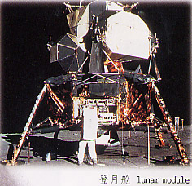
Warming up----Brainstorming (2m)
Do you want to visit the moon?
July 20th
1969

Slide 24
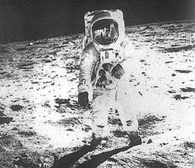
The photo from the moon

Slide 25
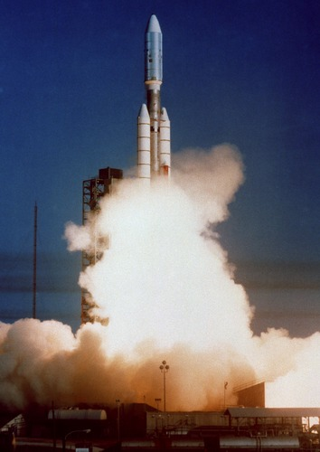

Slide 26
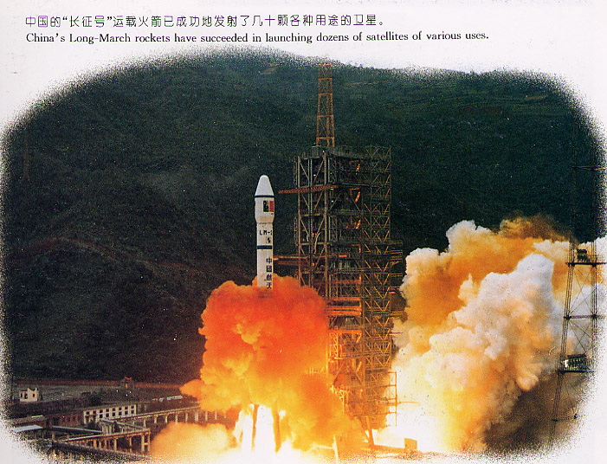

Slide 27
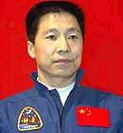
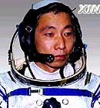
Do you know who he is?
P62 listening

Slide 28
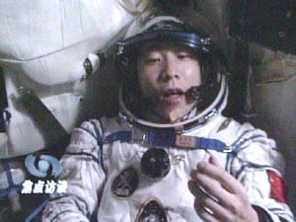
China’s first astronaut--------Yang Liwei

Slide 29
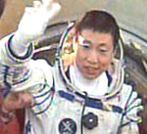
杨利伟小档案（来源：解放军报）
民族：汉出生年月：1965年6月21日
籍贯：辽宁省绥中县
政治面貌：中共党员
身高：168厘米
体重：65公斤
家庭成员：妻子张玉梅，儿子杨宁康
简历：1983年6月入伍，1987年毕业于中国人民解放军空军第八飞行学院，历任空军某师飞行员、中队长，曾飞过强击机、歼击机等机型，安全飞行1350小时，被评为一级飞行员，现为中国人民解放军航天员大队三级航天员；1996年，参加航天员初选，入围；1998年1月，从800多名入围者中脱颖而出，成为中国首批航天员之一；在“神舟”五号载人飞船发射准备阶段，经专家组无记名投票，入选“3人首飞梯队”，并被确定为首席人选。

Slide 30
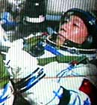
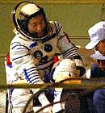
New words in the listening
Gobi Desert 戈壁沙漠
PLA=People’s Liberation Army 中国人民解放军
Air force 空军

Slide 31
1. Who’s Yang Liwei?
He’s our hero who traveled into space on October15, 2003.
2. What’s the name of the spaceship?
Shenzhou V.
3. Do you know what education and experience you need to become an astronaut?
No.

Slide 32
True or False
1. Yang Liwei became an astronaut by chance.
2. Nobody over 170cm can be an astronaut.
3. Yang Liwei trained for 10 years to become a pilot.
F
F
T

Slide 33
4. If Yang Liwei had problems in space, there were ways to save him.
5. China is the third country to send people into space just like Russia and the USA.
6. Yang Liwei thinks he was lucky to be China’s first man in space.
T
T
T

Slide 34
 | Information on Yang Liwei
The exams he passed
Experience
Physical qualities
Personal qualities
Excellent ________and __________training
degree
10 years’
______for the _______of the PLA
Pilot
air force
Smaller than_______, less than__________
170cm
70kg
________, mature, hard-working
Calm

Slide 35

What have they built into the spaceship to help Yang Liwei if he has difficulties?
There are __________if Yang Liwei needs them and _____________connecting to rescue rockets if necessary.
escape seats
special doors

Slide 36
★Look at the pictures! ★
spacewalk

