Slide 1
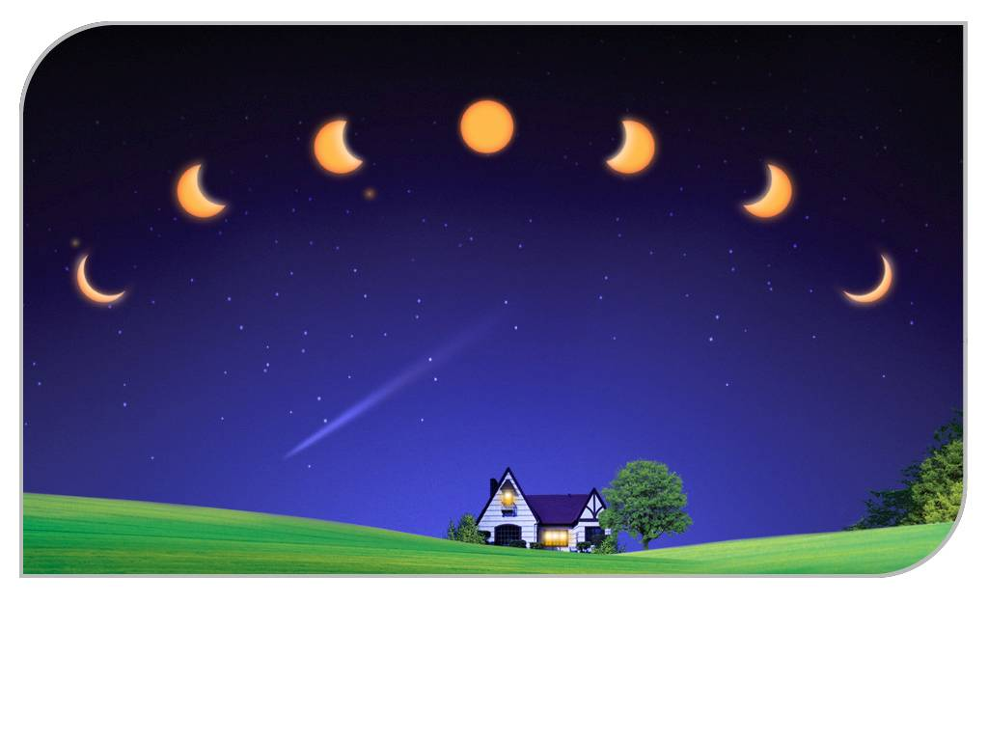
Unit 4
A visit to the moon

Slide 2



Slide 3
Which country first sent people up to space?
1
A. USA B.the Soviet Union C. China
Who is the first Chinese astronaut to go into space?
2
Yang Liwei
So far, how many countries have succeeded in
sending people up to space?
3
Three

Slide 4
What was the date when China launched Chang’e I successfully?
October 24th,2007
November 5th, 2007
C. November 22nd,2007
4
5
Who is the first man landing on the moon?
Armstrong (America, 1969)

Slide 5
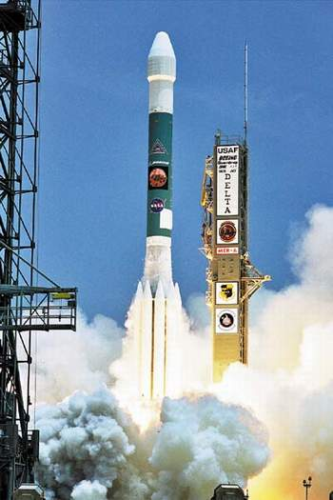
rocket

Slide 6
A VISIT TO THE MOON

Slide 7
Task 2. scanning
Li Yan Pin , an astronomer
1. Who do I have a chance to travel to the moon with ?
2. How did we travel to the moon?
3. What’s the writing order in this text?
4. How many times would the force of gravity change on our journey?
Which change would be the most powerful?
by spaceship
Three times ,
the first time

Slide 8
Careful reading
Leaving for the moon

Slide 9
Careful reading
Please read Para.2 and underline the sentences about the gravity and our weight during the journey?

Slide 10
The change of gravity
on the moon
disappearing
in space
gravity
strong
on the earth
very light

Slide 11
The change of my weight
on the moon
heavy
weight
in space
no weight
on the earth
one-sixth

Slide 12
Careful reading
Walking on the moon
What happened to me when I tried to step forward? Why?
I was carried twice as far as on the earth and fell over.
Because the gravity has changed.

Slide 13
Careful reading
Returning to the earth
1.Why was returning to the earth very frightening?
Because fire broke out on the outside of the spaceship as the earth’s gravity increased.
2.How did I feel?
I was very exhausted but very excited too.

Slide 14
Discussion
Supposing you were the first Chinese astronaut walking on the moon.
What will you say to the world?
(at least 2 sentences)
In group of four
Spokesman
Time limit :2min

Slide 15
What is the writing form ?
story B. Travel journal
C. essay D. biography
What is the writing order of the text ?
before
Time order (structure)
while
after
places
What should we write in detail?
activities
feelings

Slide 16
where
Before going
when
who
Time order
While visiting
what
After visiting
how

Slide 17
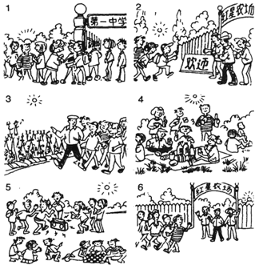
出发
参观农作物
野餐
参观期间
唱歌，跳舞，下棋
返回

Slide 18
Composition
Today we visited the Hongxing Farm. In the early morning, we started from our school.
When arriving, we were warmly welcomed by the farmers there. The header of the farm led us to the fields where we saw all kinds of crops growing well and we all felt very excited. In the middle of the day, we had an picnic lunch there and we all enjoyed it very much. After that, we sang and danced to our hearts’ content. Some of us even played chess and told interesting stories.
In the afternoon, we left the farm. I’ll never forget the memorable day!

Slide 19
Homework
南湖 游记
出发 | 学校
 | 南湖
 | 乘公交巴士
 | 上午在湖上划船
 | 中午在湖滨餐馆用餐
 | 下午爬山
游玩期间
返回
感受

Slide 20

Thank you.

