Slide 1
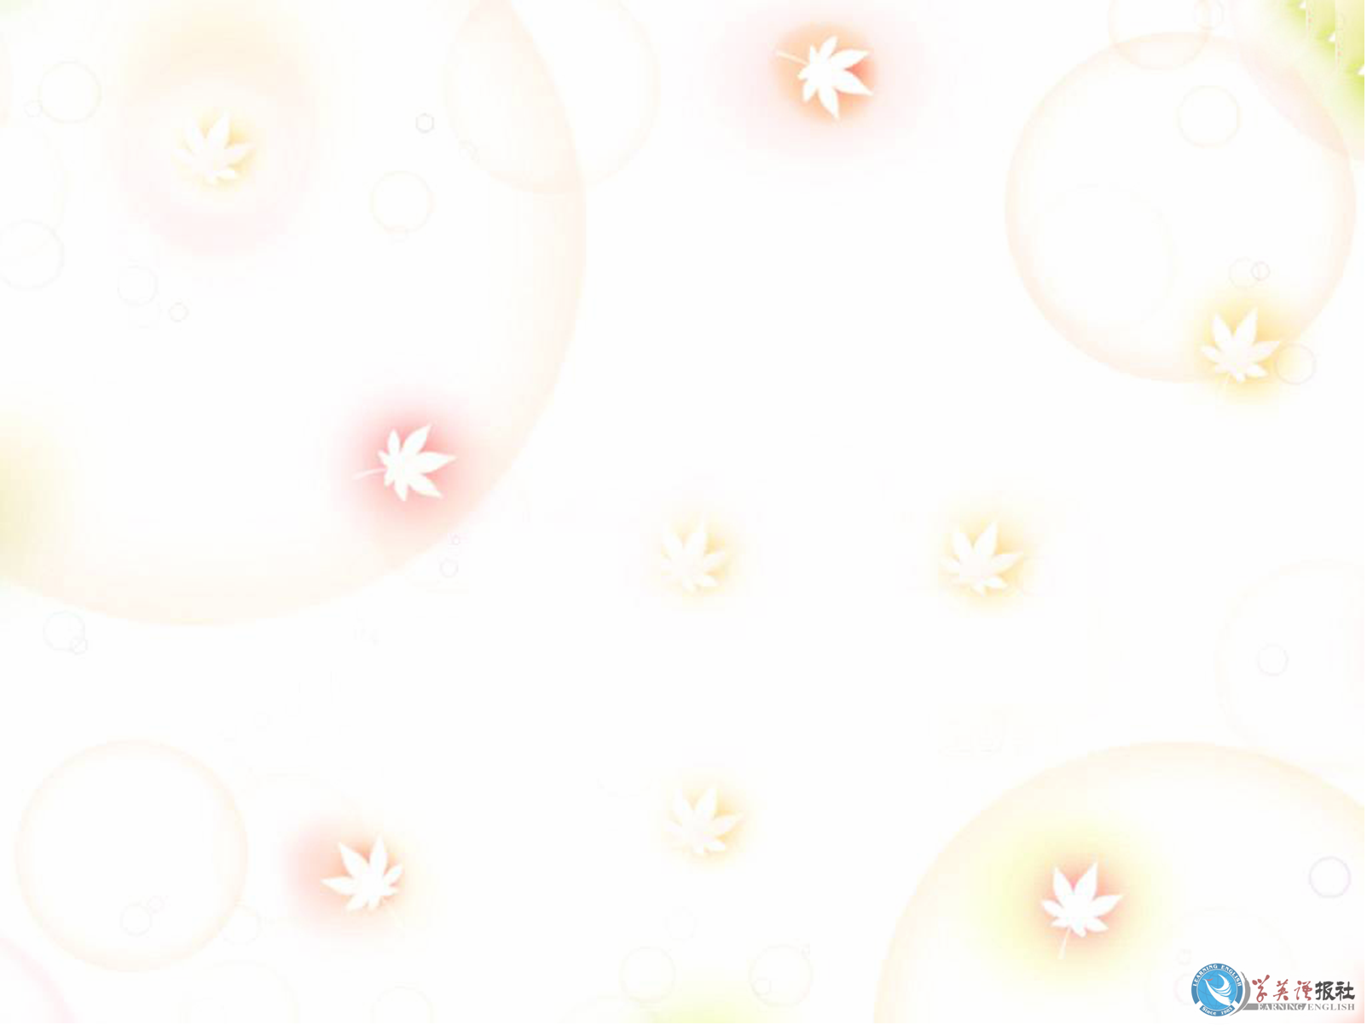
How many planets are there in the Solar System?
How much do you know about the universe?
What are they?

Slide 2

Mars
The Planet is named after the Roman god of war. It's distinctive rust color is red .Its surface features many mountains, canyons and even polar ice caps that look a lot like those here on Earth. We are doing some research to find out whether there is life forms on it.

Slide 3

Mercury
Since it has no protective atmosphere, the temperature on the surface ranges from extremely hot on the side facing the Sun to extremely cold on the side that faces away from the Sun. It is the closest planet to the Sun.

Slide 4

Venus
It is named after the Roman goddess of love and beauty,but the surface is a very unpleasant place featuring very high temperatures, winds that blow hundreds of miles per hour and an atmosphere of sulfuric acid.

Slide 5

Jupiter
It has at least sixty-one moons and features the Great Red Spot, which is a huge "storm" that has been observed from here on Earth for over three hundred years. It is the largest planet in our solar system.

Slide 6

Saturn
It has a fascinating system of rings .It has so many moons that it is like a miniature solar system.

Slide 7

Uranus
It is one of the giant gas planets in the solar system. It has a very faint ring system that we didn't know existed until the planet was visited by the Voyager spacecraft.

Slide 8

Neptune
It was the last stop the Voyager mission made before if left our solar system. It has winds that blow hundreds of miles per hour and a moon that features "geysers" of nitrogen that erupt and leave dark marks on the surface.

Slide 9

Pluto
Pluto is so far away that the Sun is just a dim point of light that looks a lot like any other star. It is the smallest and most mysterious planet in our solar system. It has one moon, Charon, that is almost as big as the planet itself.

