Slide 1
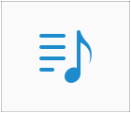

Slide 2












creative

Slide 3
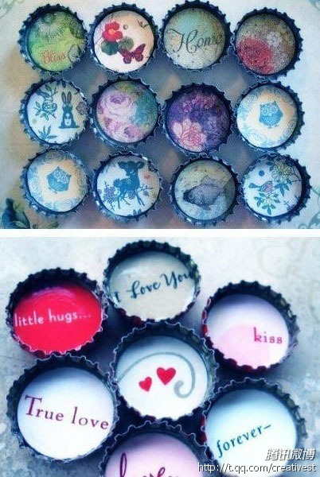
Foreign soda bottle caps.

Slide 4
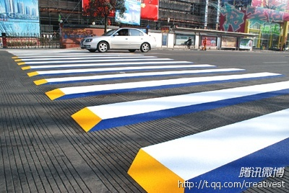
Zhejiang taizhou´s 3D zebra crossing .Looking from a distance, it looks like obstacles, then the drivers will decelerate speed immediately and avoid a red light .

Slide 5
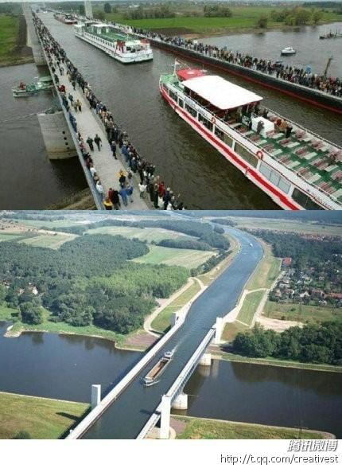
This is Germany magdeburg′s water bridge,
Let a person eye-opening

Slide 6
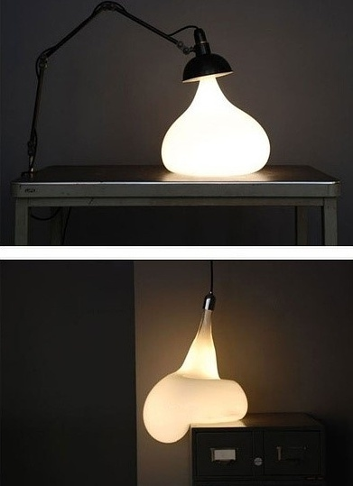
Over time the light bulb will deformation(变形）.
remember to turn off the lights and save electricity

Slide 7
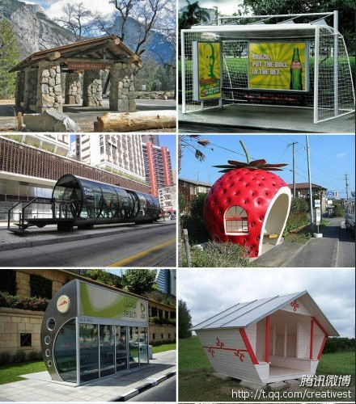
Foreign transit site
while waiting for the bus is interesting

Slide 8
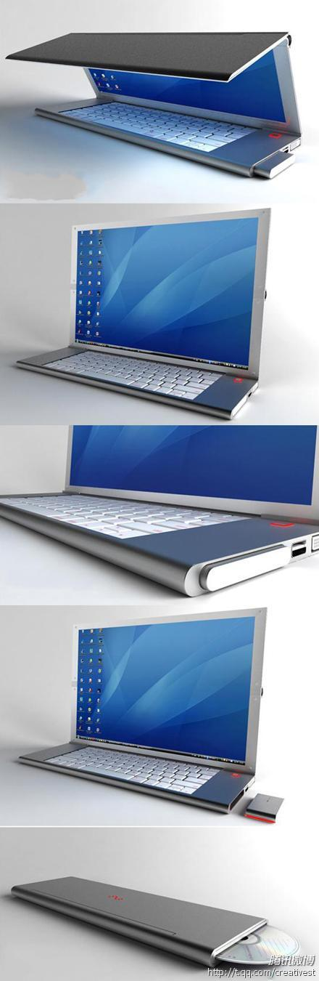
Feno folding notebook
designer:
Niels van Hoof

Slide 9
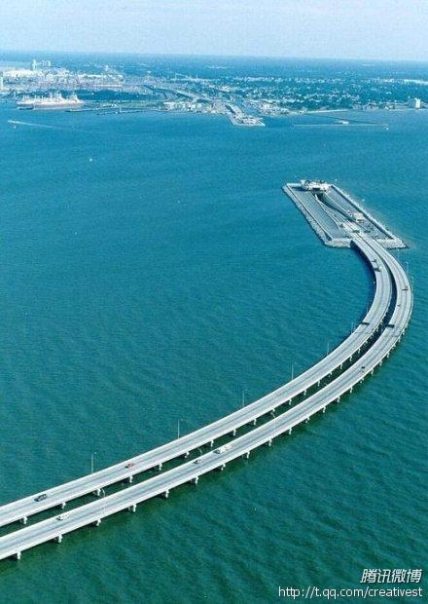
连接丹麦瑞典的跨海大桥（或隧道）一半在海面一半在海面以下，为了方便船只通行！
Join Denmark and Sweden‘s cross-sea bridge (or tunnel)
In order to convenient for ships to traffic,it is half in sea and half in below.

Slide 10
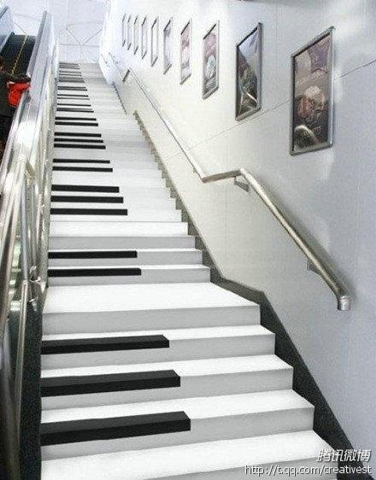
The first Piano stair appeared in Nanjing metro. 2

Slide 11
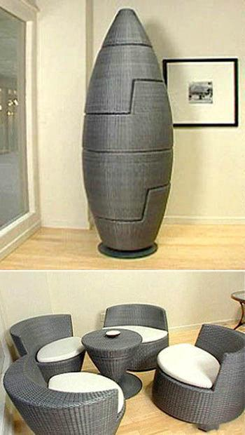
Assorted sofa —— save a space and a personality
组合沙发——既节省空间又有个性

Slide 12
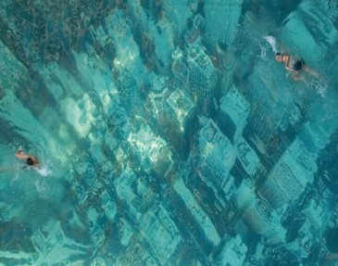
水下纽约“英国汇丰银行做了一件有趣的事情，他们在游泳池底部贴了一张巨幅纽约空中俯视图，看起来像是纽约陷入了海底，以此提醒人们关注因气候变化而引起的海平面上升等问题。
Underwater New York “British HSBC ”did something interesting things in the swimming pool, they stuck a huge New York bottom top viewport, looks like New York air into the bottom of the sea, reminding people to concern climate problems such as rising sea levels.

Slide 13
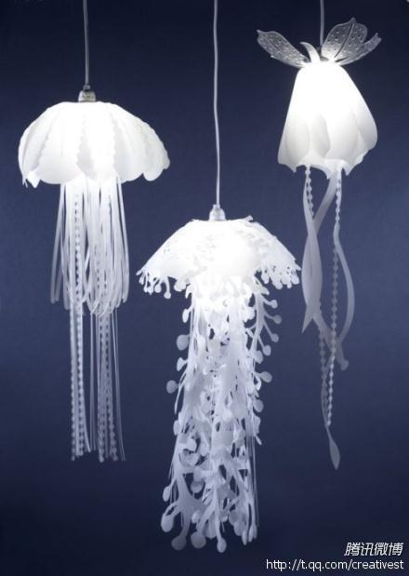
U.S. indoor designer - Towry Roxy Russell designs jellyfish droplight

Slide 14
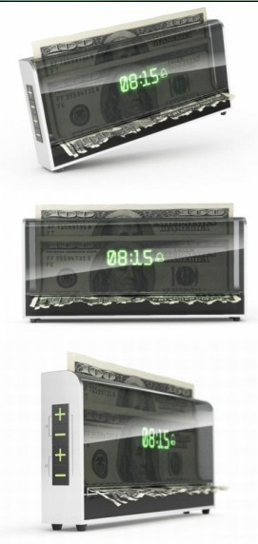
This is a new alarm clock. It will not work unless you put a note inside.
To ensure effect, you should better put 100 yuan into it.
When the alarm went off, if you don‘t stop it quickly, it will begin to shear this note...
Time is money，you should remember this sentence before you go to sleep

Slide 15
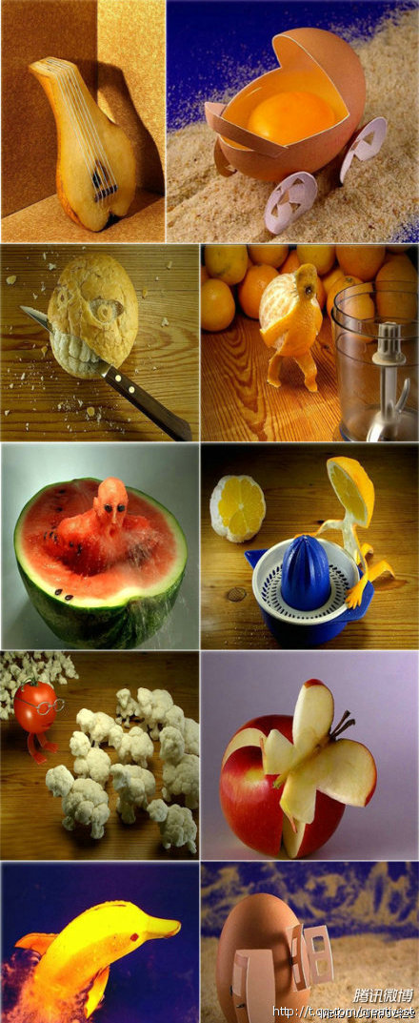
Creativity
comes
from
life ~~!!

Slide 16
THANKS!

