Slide 1

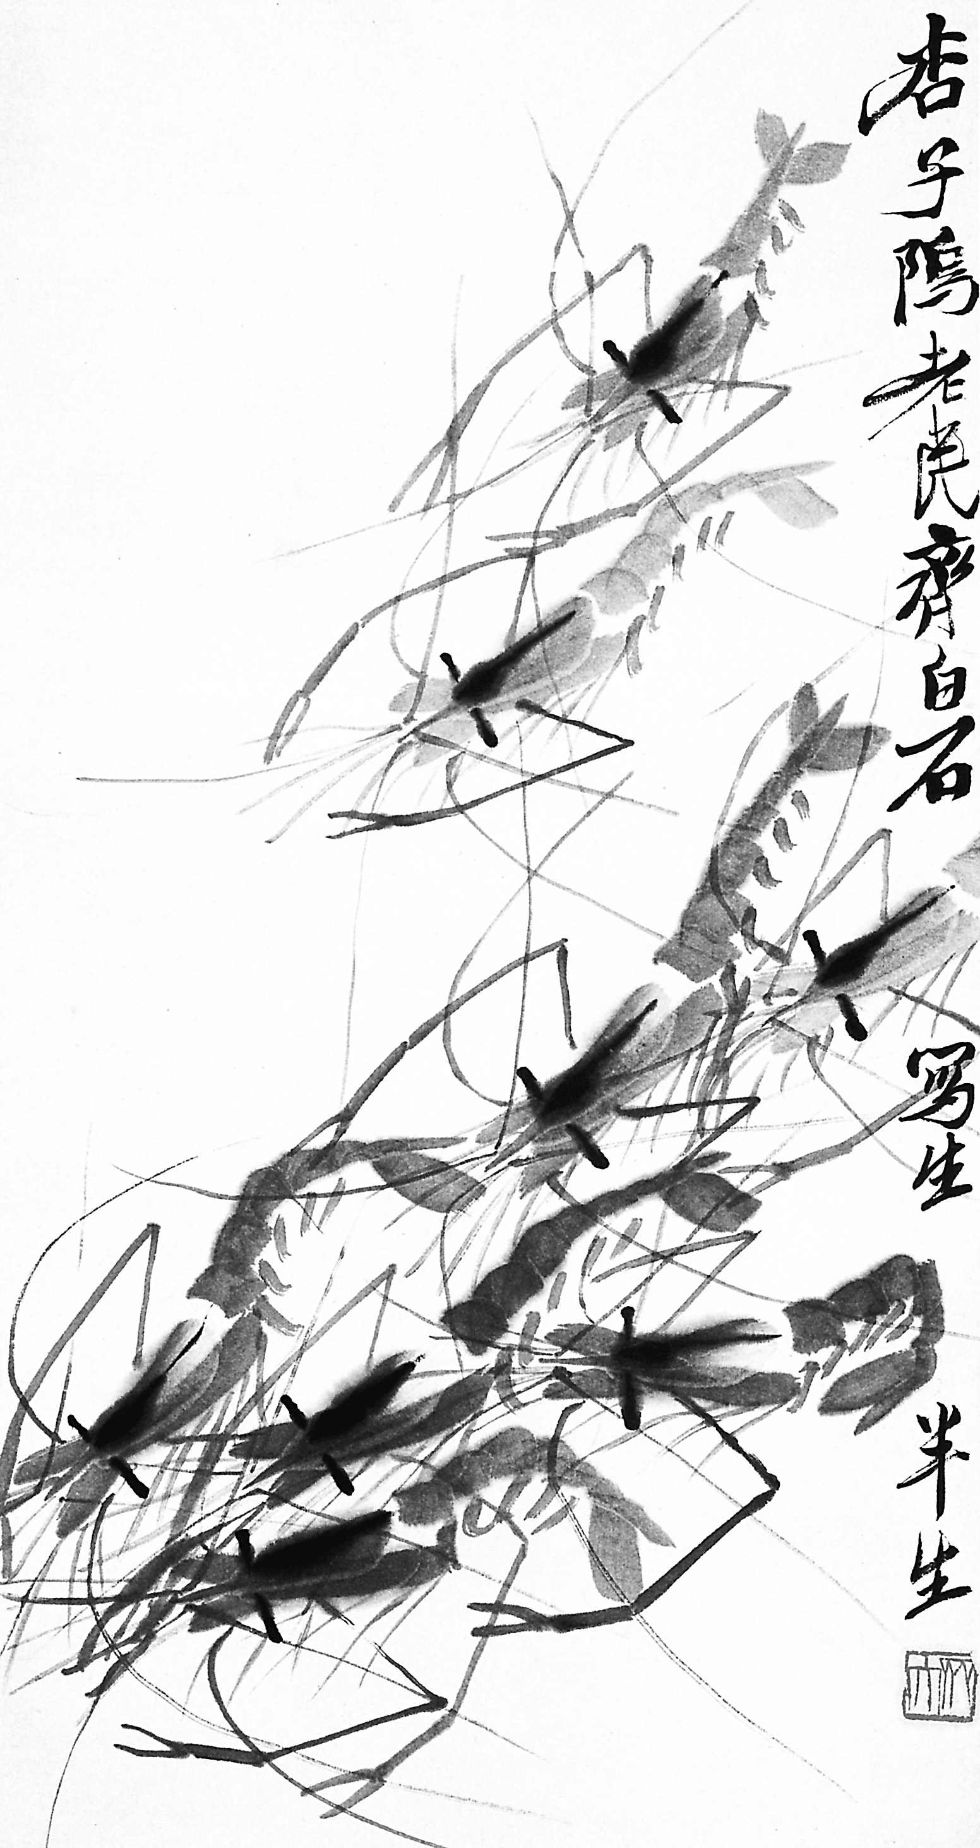

高中第二册
Module 4
Fine Arts - Western, Chinese, and Pop Arts

Slide 2


Everyday English
1. You’ve got it right means ____.
(a) You’re correct (b) Turn right
2. Don’t change a thing means ___.
(a) Change people not things
(b) Don’t change anything
3. I’m not half as good as you means ___.
(a) You’re much better than me
(b) I’m almost as good as you

Slide 3
4. What do you make of (it)? means ___.
(a) What have you made?
(b) What’s your opinion of it?
5. There’s (an exhibition) on means ___.
(a) There’s an exhibition happening at the moment
(b) An exhibition is starting soon
6. Thanks for the compliment means ___.
(a) Thanks for saying something nice about me
(b) Thanks for doing that

Slide 4

