Slide 1

外研版
高中英语
第二册
M O D U L E 4
Fine Arts—
Western, Chinese
and Pop Arts

Slide 2
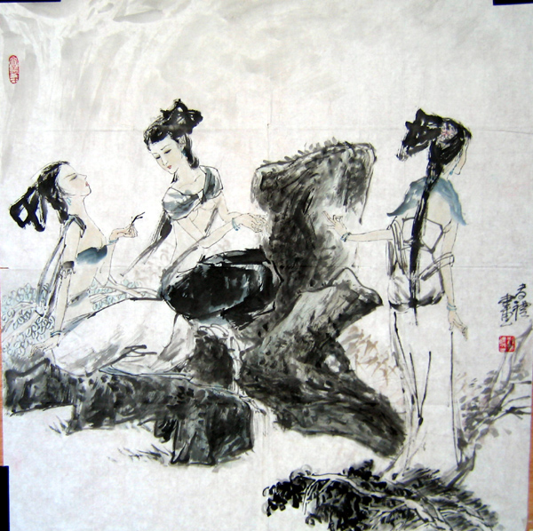
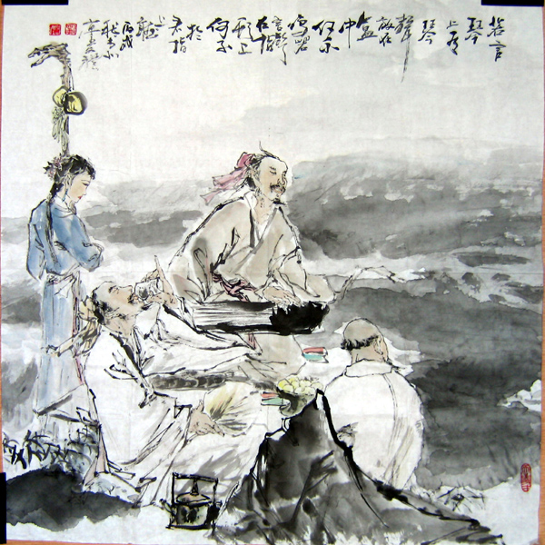
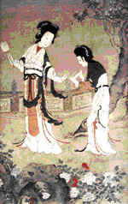
Warming up by showing some paintings

Slide 3
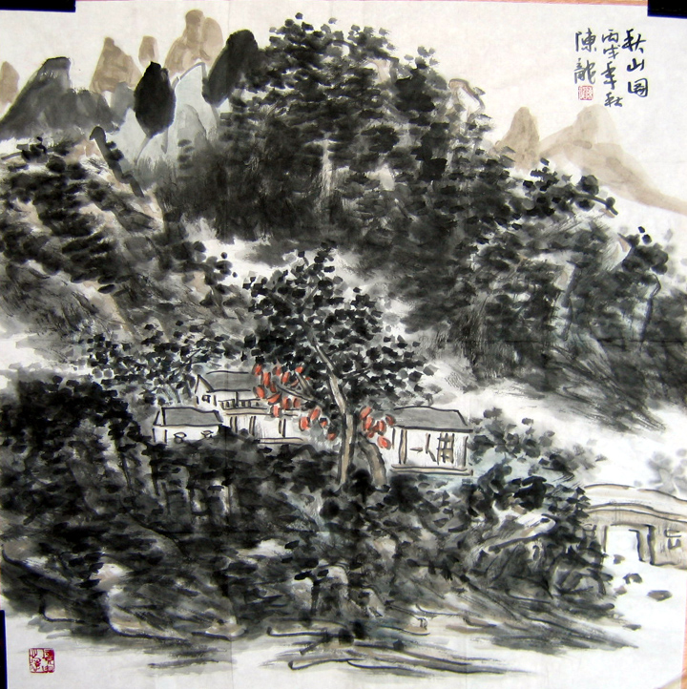
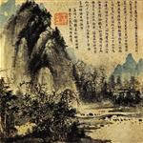
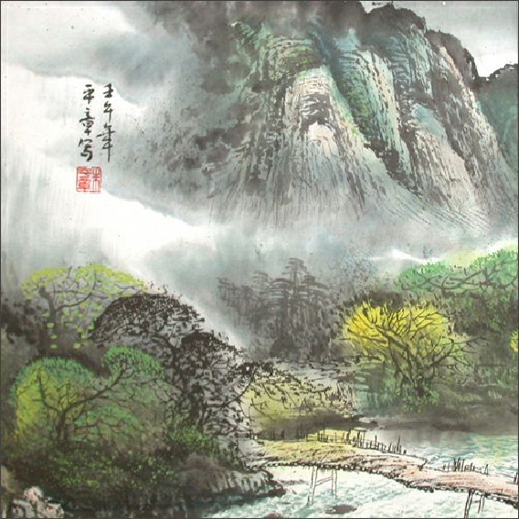
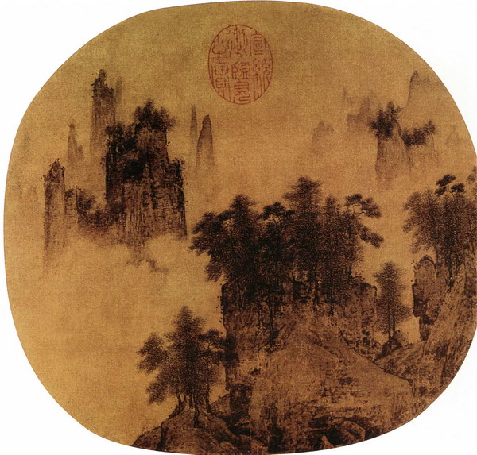

Slide 4
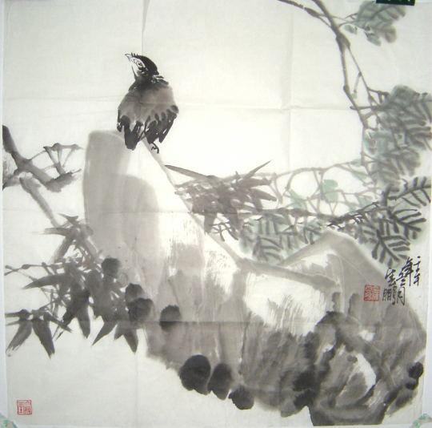
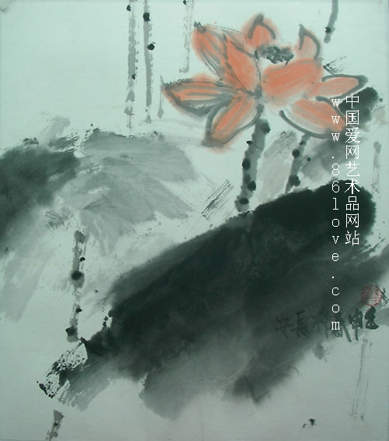
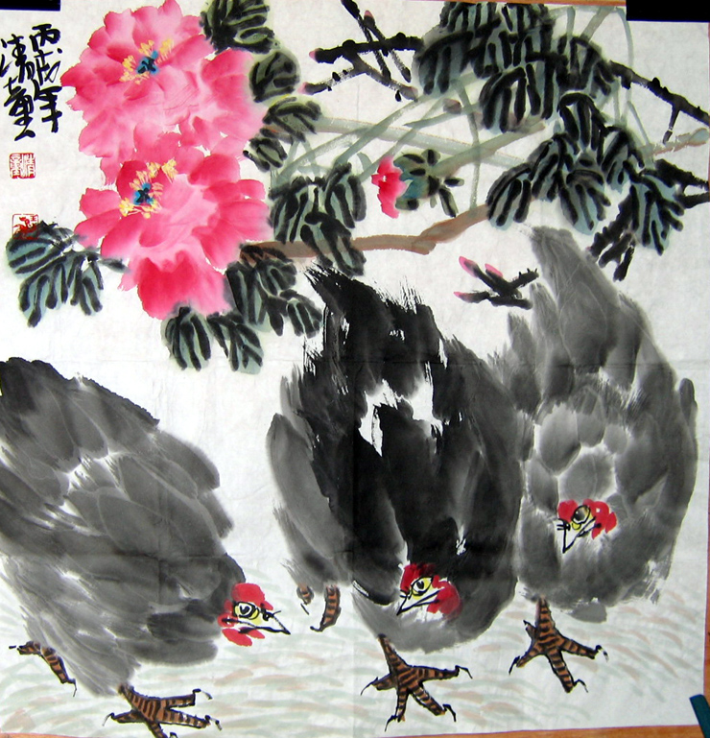

Slide 5
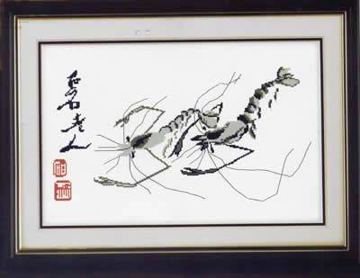
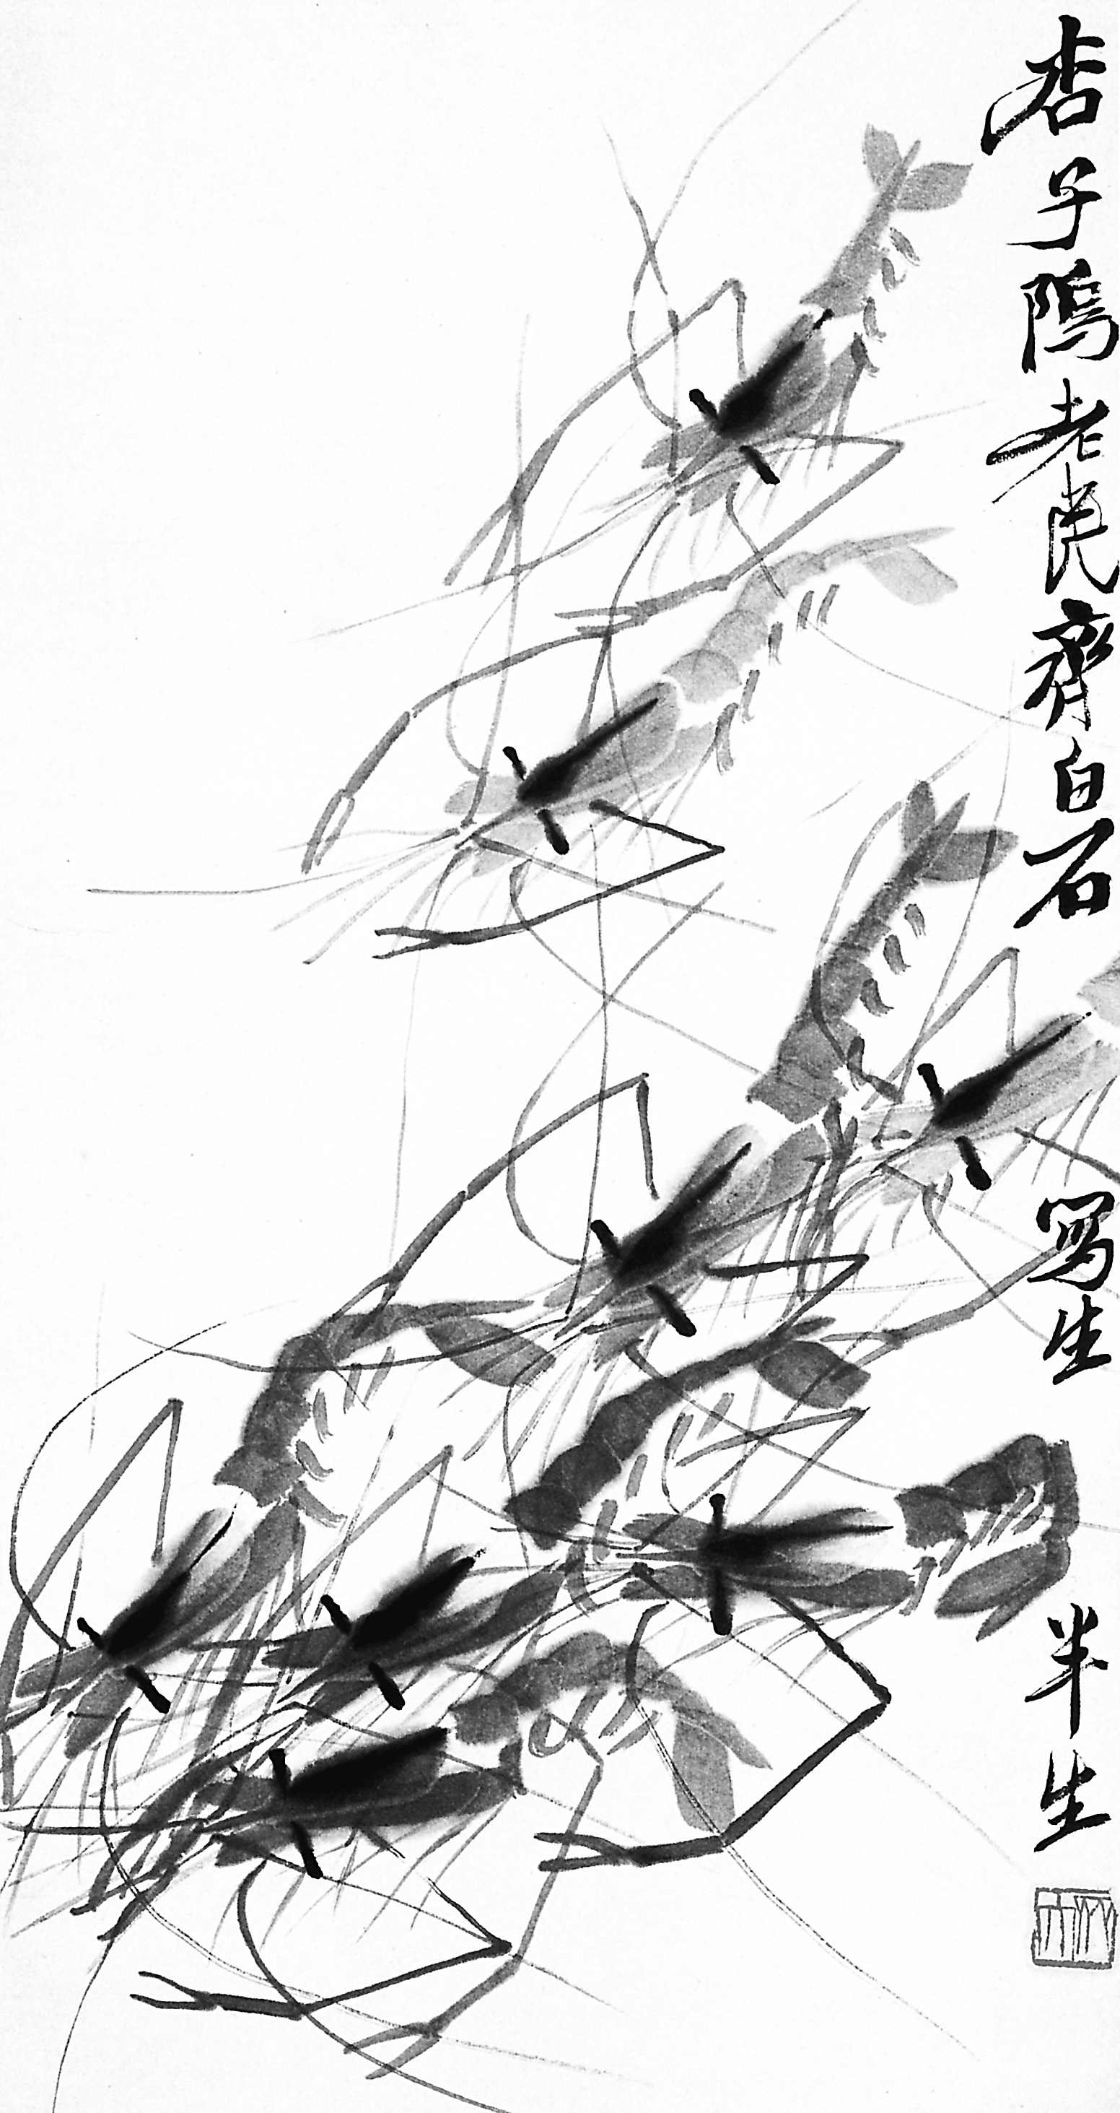
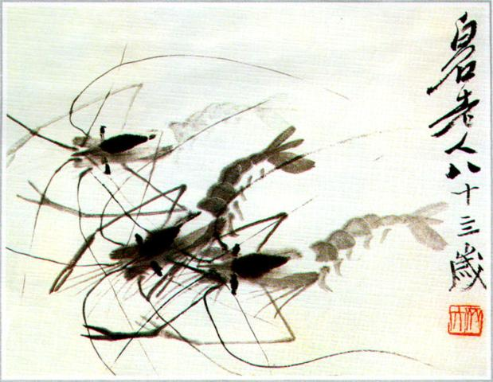
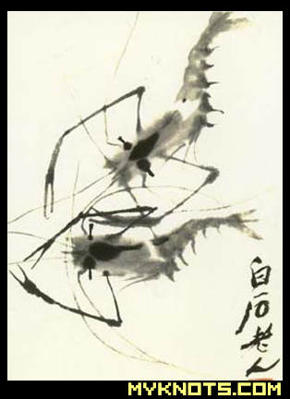

Slide 6
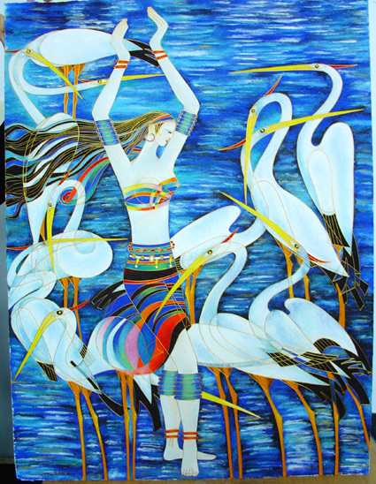
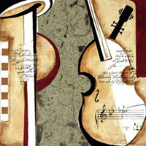
Some other art works

Slide 7
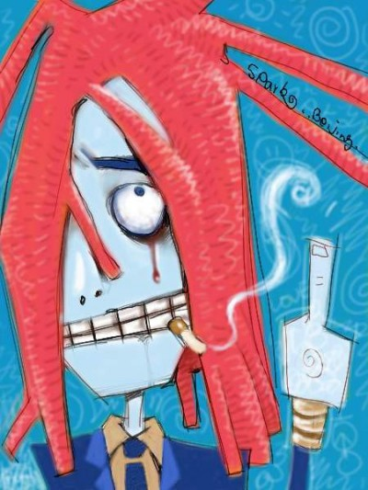
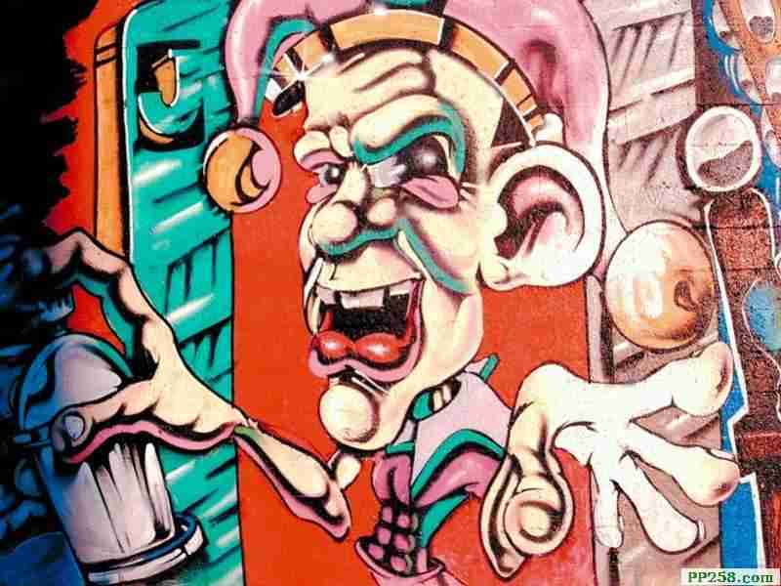


Slide 8
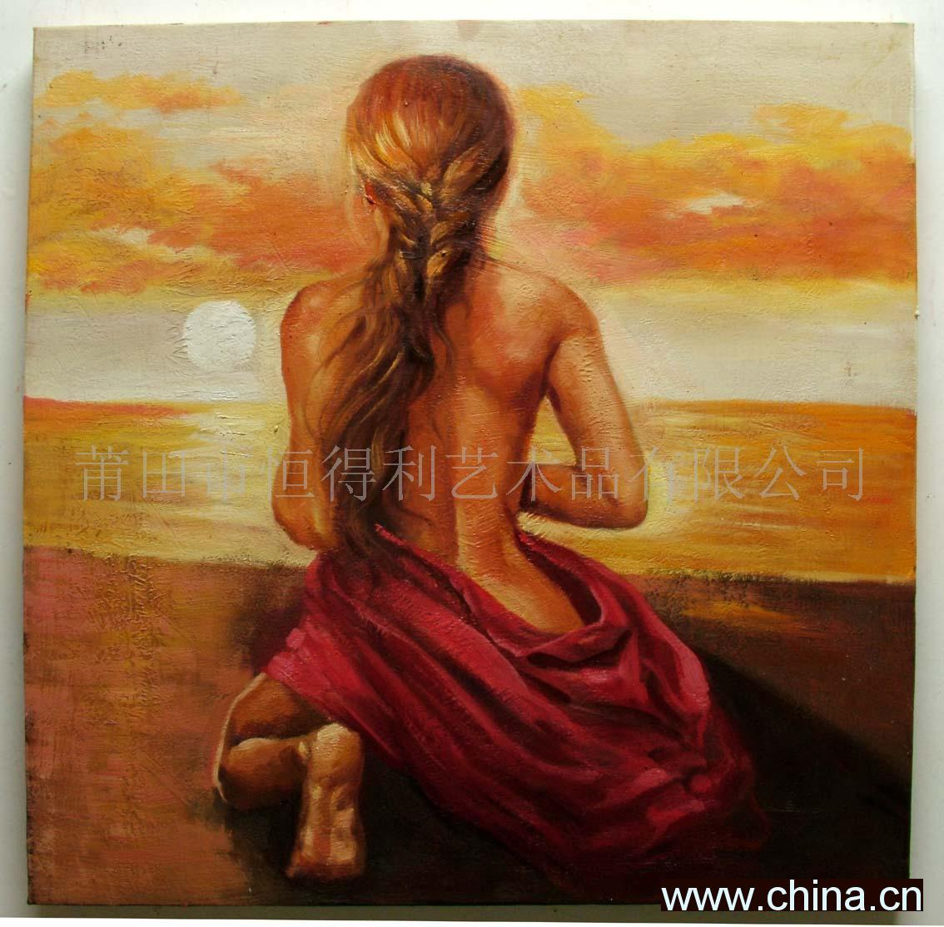
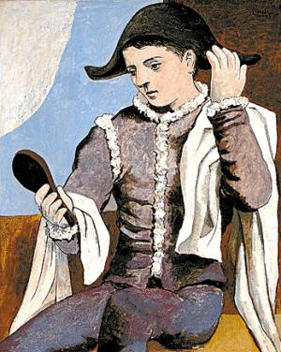
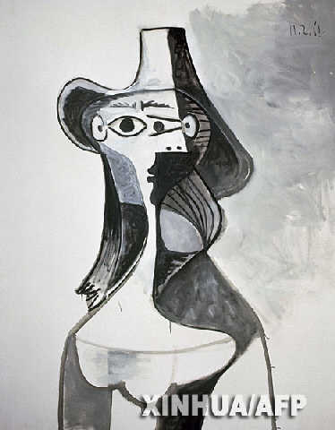

Slide 9
1) Do you like traditional Chinese arts using brush and ink?
2) Which one do you prefer?
3) Are you interested in art?
4) What do you think of these painting? Can you give them titles each?

Slide 10
V O C A B U L A R Y
alive aspect
imitate (art) movement
observe ordinary
reality style

Slide 11
1. they way in which something is done ________
2. to watch carefully ________
3. a style of painting adopted by a group of artists __________
4. to copy ________
style
observe
movement
imitate

Slide 12
5.living or full of life _______
6.not special or unusual _______
7.one of the separate parts of something _______
8.the way something really is _______
alive
ordinary
aspect
reality

Slide 13
Fast reading to get general understanding
1.How many artists the text refers?
Five: Pablo Picasso, George Braque, Roy Lichtenstein, Qi Baishi, Xu Beihong

Slide 14
2. How many kinds of arts the text refers?
Three: Cubism, Pop art, Chinese painting

Slide 15
Careful reading for a box graph of the text
Paragraph A:
Picture 2
Paragraph F:
Picture 2,3
Paragraph B:
Picture 4
Fine arts
Paragraph E:
Picture 1,4
Paragraph C:
Picture 1
Paragraph D:
Picture 3

Slide 16
1) Try to repeat the text.
2) Try to describe a painting to your class orally.
3) Learn the new words again, using the dictionary if necessary.
Homework

Slide 17
Thank you

