Slide 1

同步教学辅助课件
必修1

Slide 2
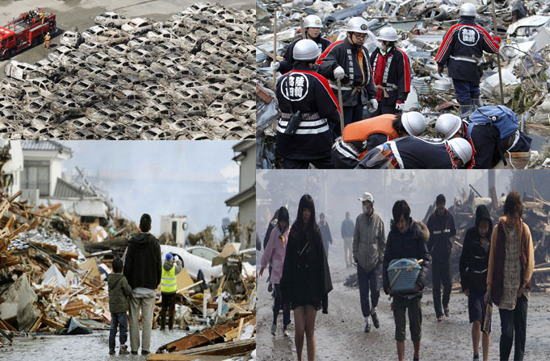
Unit 4
Earthquakes

Slide 3

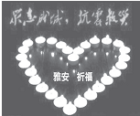
GUIDED WRITING
【写作任务与要求】
本次写作要求写一篇描述自然灾害的文章。
【写作任务】
请根据以下信息为班级墙报写一篇有关雅安地震的短文。

Slide 4
时间 | 2013年4月20日 上午8:02 (北京时间)
地点 | 四川省雅安市芦山
震级 | 里氏7.0级 (汶川地震以来最大的一次)
人员 伤亡 | 死亡和失踪：200多人； 受伤：1万多人
损失和 影响 | ★ 大量建筑物严重受损； ★ 通讯、电力系统一度中断；
灾后 工作 | ★ 中央和当地政府奔赴灾区指导救 援和灾后重建*工作； ★ 救援人员开始了72小时“黄金救援**”。
* 灾后重建 post-disaster reconstruction
** 黄金救援 golden window

Slide 5
【写作要求】
只能用5个句子表达全部内容。
【写作分析与指导】
一、写作分析
1. 写作思路：这是一篇新闻报道，介绍四川雅安地震的有关情况。写作前，我们可根据所提供的信息首先列出所需要的单词和短语；然后把这些词语扩充成句子；最后根据所给信息，使用适当的过渡词把这些句子连成一段话。
2. 时态与人称分析：时态：描写发生过的事情要用一般过去时；人称：第三人称。

Slide 6
二、词句储备
1. 写作中可能使用的词语有：
(1) 严重受损 ___________________
(2) 伤害 (v.) ___________________
(3) 毁坏 (v.) ___________________
(4) 救援 _________ (5) 电力 _________
(6) 损失，损害 ___________________
(7) 指导 ___________________
(8) 丧生 _____________________
(9) 失踪的 ___________________
(10) 通讯系统 ____________________
(11) 中断 ___________________
(12) 幸存者 ___________________
in ruins
injure
destroy
rescue
electricity
damage
guide
lose one’s life/be killed
missing
communication system
cut off
survivor

Slide 7
2. 写作中可能使用的句子有：
(1) 2013年4 月20日上午北京时间8:02，四川
省雅安市芦山发生了强烈的地震。
___________________________________
___________________________________
___________________________________ (2) 这次地震震级为里氏7.0级，是汶川地震
以来四川省发生的最大的一次地震。
___________________________________
___________________________________
___________________________________
___________________________________
___________________________________
At 8:02 am (Beijing Time), on April 20, 2013, a powerful earthquake hit Lushan, Ya’an, Sichuan Province.
The earthquake, which measured 7.0 on the Richter scale, is the strongest of the earthquakes that have happened in Sichuan Province since Wenchuan earthquake.

Slide 8
(3) 这次地震死亡和失踪共计200多人，受
伤10000多人。
___________________________________
___________________________________
___________________________________
(4) 在这次地震中，大量建筑物严重受损，
通讯、电力系统一度中断。
___________________________________
___________________________________
___________________________________
___________________________________
In the earthquake, more than 200 people lost their lives or were missing and over 10,000 people were injured.
In the earthquake, a great number of buildings were destroyed and
communication and power systems were cut off at one time.

Slide 9
(5) 地震发生后不久，中央和当地政府奔赴
灾区指导救援和灾后重建工作，救援小
组和自愿者开始了72小时的“黄金救
援”。
__________________________________
__________________________________
__________________________________
__________________________________
__________________________________
__________________________________
__________________________________
Shortly after the earthquake, the central and local government rushed to the stricken areas to guide the rescue and post-disaster reconstruction and rescue teams and volunteers began the rescue before the end of the 72-hour “golden window” for survivors.

Slide 10
三、下笔成文
At 8:02 am (Beijing Time), on April 20,
2013, a powerful earthquake took place in Lushan, Ya’an, Sichuan Province.
The earthquake, which measured 7.0 on the Richter scale, is the strongest of the earthquakes that have happened in Sichuan Province since Wenchuan earthquake.

Slide 11
In the earthquake, more than 200 people
lost their lives or were missing and over 10,000 people were injured. In addition, a great number of buildings lay in ruins and communication and power systems were cut off at one time.
Shortly after the earthquake, the central and local government rushed to the stricken areas to guide the post-disaster reconstruction and rescuers began the rescue before the end of the 72-hour
“golden window” for survivors.

Slide 12
【点评】
本篇习作要点齐全，层次分明，结构紧凑，使用了不少高级词汇，如powerful, take place, in addition, a great number of, in ruins, cut off, rushed to等；另外，运用了复杂句式结构如：定语从句和并列句；有效地利用语句间的连接成分把零散的信息巧妙地整合起来，值得推荐！

