Slide 1
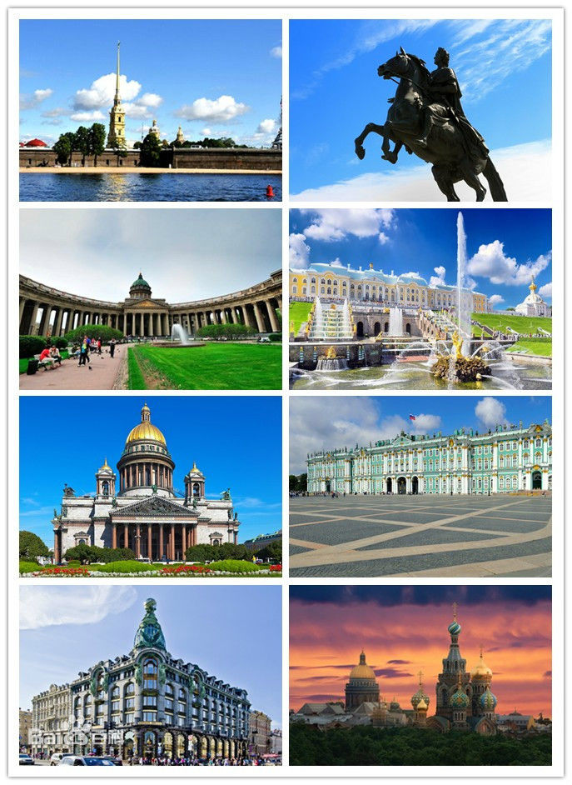
St Petersburg

Slide 2
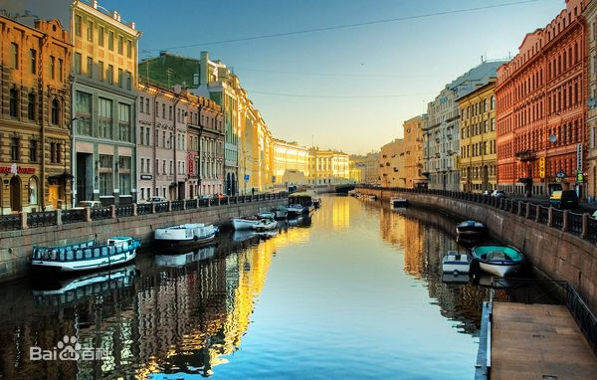
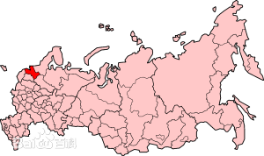
Location
St Petersburg, with hundreds of canals and bridges ,is considered to be the Northern Venice .It is the second-largest Russian city located in the northwestern Russia ,near Baltic Sea.

Slide 3
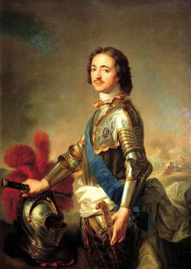
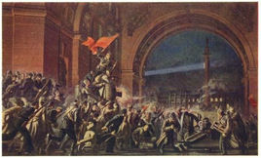
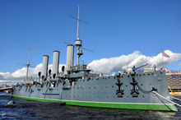
History
The building of it was started in 1703 by Peter the Great ,and the city had served as the capital of Russia for 200 years until the revolution in 1917. After the death of Lenin ,the city was called Leningrad in memory of him.

Slide 4
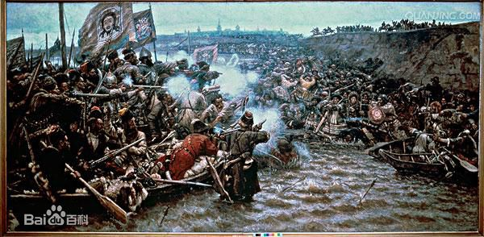
During the second world war, the city suffered from attacks of German Nazis. many people were starved to death, and a lot of old palaces were badly damaged. However, it recovered soon after the war and remained its beauty.

Slide 5
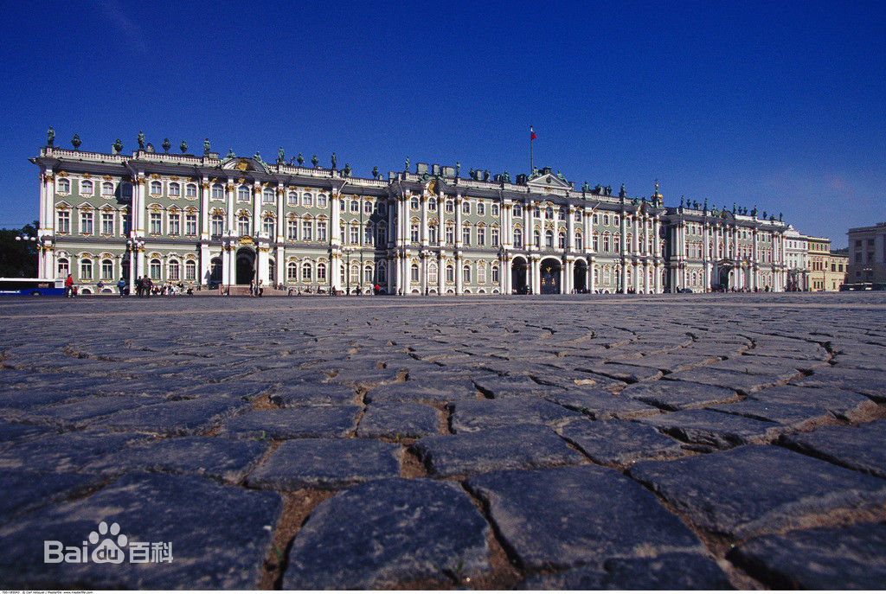
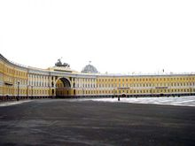
Places of interest
The winter palace
It was the palace for Russian emperors and had been the tallest building at that time .after the revolution, it has been used as a museum where famous works of art from all over the world were displayed

Slide 6
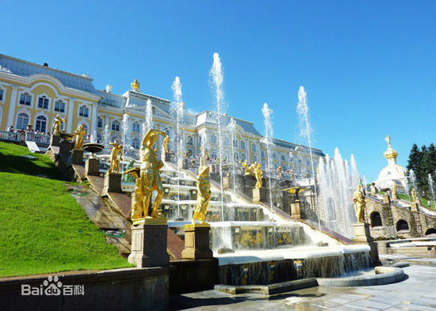
The summer palace
It is a palace outside the city where the emperors spend their summer. The building is elegant and luxury, especially its inside. the fountain is another highlight of the palace .

Slide 7
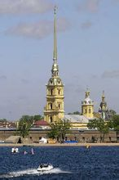
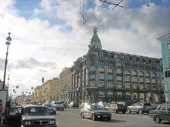
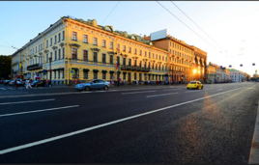
The Neva street
This is a historical place in which houses still remain the style of 18～20 century. many opera houses, librarys are on the sides of the streets. you can visit former homes of some famous people ,such as Tchaikovsky , Gogol-Anovskii .

Slide 8
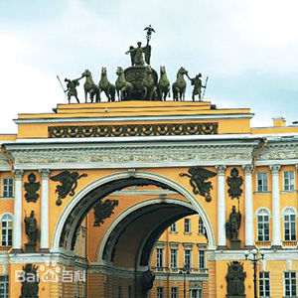
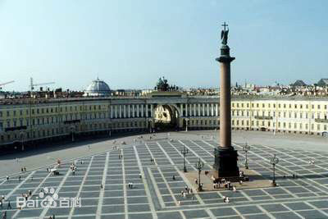
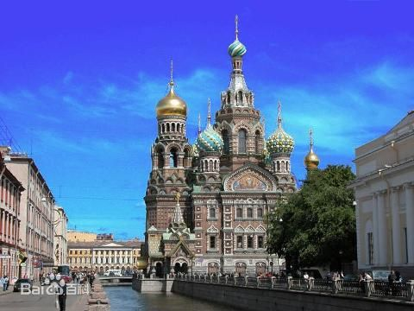
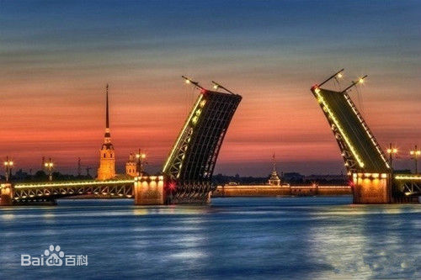
St Petersburg,with hundreds of canals and brigdes,is considered to be the Northern Venice.it is located in the northwestern russia ,near Baltic Sea

