Slide 1

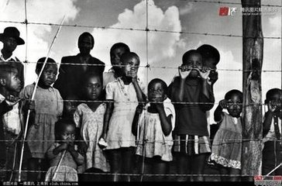
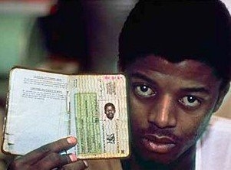
Unit 5 Reading
ELIAS’ STORY

Slide 2
Words review
lawyer
guidance
legal
fee
passbook
hopeful
youth
league
n. 律师
n. 指导；领导
adj. 法律的；依照法律的
n. 费（会费；学费等）；酬金
n. 南非共和国有色人种的身份证
adj. 怀有希望的；有希望的
n. 青年；青年时期
n. 同盟；联盟；联合会

Slide 3
Words review
stage
vote
attack
violence
equal
willing
unfair
n. 舞台；阶段；时期
vt. & vi. 投票；选举
n. 投票；选票；表决
vt. 进攻；攻击；抨击
n. 暴力；暴行
adj. 相等的；平等的
adj. 乐意的；自愿的
adj. 不公正的；不公平的

Slide 4
Match
事实上
青年团
工作中
使充气; 爆炸
失业
求助于; 致力于
在危险、受罚、痛苦、忧虑等的处境中
out of work
Youth League
as a matter of fact
blow up
in trouble
turn to

Slide 5

1. To summarize the main idea and retell the passage — Elias’ story
2. To get more information about Nelson Mandela

Slide 6
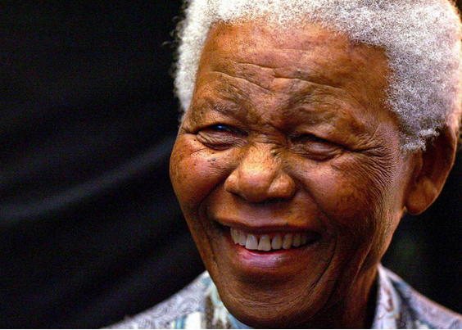

What do you know about him?

Slide 7

Skimming for general idea

Slide 8
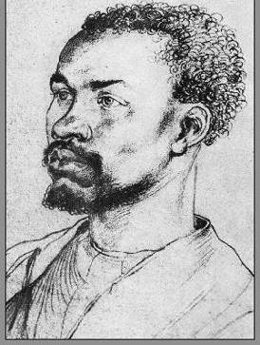
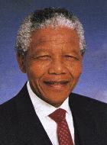
Who is Elias? What’s the connection between them?
?
Elias
Nelson Mandela

Slide 9
Skim the passage and fill in the blanks.
Elias:
black worker
a poor _____ ______ in South Africa
Nelson Mandela:
a _____ _______ who offered guidance to poor black people in South Africa
black lawyer
The text tells us about _____ life and what he did with _______________ to fight
for _____ people.
Elias’
Nelson Mandela
black

Slide 10
Scanning for specific information

Slide 11
Read the passage and answer the questions.
1. Why did Elias visit Nelson Mandela?
2. What did Mandela do to help black people?
3. Why did Elias said it is the happiest day of his life in para. 3?
4. What was the unfair situation black people faced？
5. Why did Nelson Mandela turn to violence to make black and white people equal?

Slide 12
Why did Elias visit Nelson Mandela?
Elias visited Nelson Mandela because he needed legal help. He was not legally allowed to work without a passbook. He did not have one because he was not born in Johannesburg. Nelson Mandela was able to help him get the passbook.

Slide 13
2. What did Mandela do to help black people?
Mandela helped black people by offering guidance to him on legal problems. This prevented them from being badly treated by the government.
3. Why did Elias said it is the happiest day of his life in para. 3?
Because with Mandela’s help, Elias could stay in Johannesburg. He became more hopeful about his future.

Slide 14
4. What was the unfair situation black people faced？
They could not vote or choose their leader.
They could not choose where to live, their jobs or their homeland outside the city.
5. Why did Nelson Mandela turn to violence to make black and white people equal?
Because he felt there was no other way of changing this unfair situation.

Slide 15
Changes of Elias’ life and feelings
Before E met M
M helped E
E joined ANC

Slide 16
African National Congress (ANC)
The ANC is a national liberation organization. It was formed in 1912. The ANC’s key objective is the creation of a united, non-racial, non-sexist and democratic society.
南非非洲人国民大会(简称非国大)建立于1912年。1960年被南非当局宣布为非法，主要领导人流亡国外。1961年决定开展武装斗争，并成立民族之矛军事组织，由曼德拉任司令员。1962年曼德拉被捕入狱。非国大主张摆脱一切形式的歧视和民族压迫，建立统一、民主和种族平等的南非。1994年4月，南非举行历史上首次多种族民主大选，非国大以近2/3的绝对优势获胜。曼德拉作为该党主席出任总统。

Slide 17
Stage 1. Before Elias met Mandela:
What was Elias’ life like?
1. He had to leave school because his family could not pay the school fees and the bus fare.
1. His family
2. His ability
2. He could not read or write well.
3. He might lose his job because he didn’t have a passbook to live in Johannesburg.
3. His job

Slide 18
Stage 1. Before Elias met Mandela:
Adjectives to describe Elias’ life
Poor
Difficult
Worrying
Adjectives to describe Elias’ feelings
Hopeless
Sad
Worried

Slide 19
Stage 2. The day Mandela helped Elias:
What help did Mandela offer to Elias? (Para 3)
He told Elias how to get the correct papers to get the passbook to stay in Johannesburg.
Which adj. did Elias use to describe the day?
Happiest
How did Elias feel about his future then?
Hopeful

Slide 20
Stage 3. After Elias joined the ANC Youth League:
Adjectives to describe Elias’ life (Last Para)
Dangerous but meaningful
He blew up some government buildings, and if he was caught, he could be put in prison.
What he did helped the black people achieve their dream of making black and white people equal.
Adjective to describe Elias’ feelings
Proud

Slide 21
Changes of Elias’ life and feelings
sad, hopeless, worried
difficult, worrying, poor
Before E met M
happiest
M helped E
hopeful
dangerous, meaningful
E joined ANC
proud

Slide 22



Choose the best answer.
1. According to the text, what was not the situation for black people in South Africa at that time?
A. Black people had no right to vote.
B. They couldn’t get the jobs they wanted.
C. They could choose where to live.
D. They were sent to the poorest areas
where no one could grow food.

Slide 23
2. Why did Elias turn to Nelson Mandela for help?
A. He didn’t have a passbook to live in
Johannesburg.
B. He was badly treated by his cruel
boss.
C. He was thought to have stolen some
gold.
D. He had a fight with a white boy.

Slide 24
3. Why did Elias help Mandela blow up some government buildings?
A. Because he liked violence.
B. Because it was not dangerous.
C. Because he thought it was a way to
make black people and white people
equal.
D. Because he wanted to be famous.

Slide 25
Make a timeline of Elias’ life.
1940:
1946:
1948:
1952:
1963:
Elias was born.
Elias began school.
Elias left school.
Elias went to Nelson Mandela for advice.
Elias helped Mandela blow up some government buildings.

Slide 26
Complete the passage with proper words, which will help you retell the text.
Elias had to leave school at an early age because his family couldn’t continue __________ the school fees and bus fare. Later he found a job in a gold
mine, but he was worried about ________he would become __________ because he had no passbook. So he ________ Mandela, the black lawyer, for
to pay for
whether
out of work
turned to

Slide 27
guidance
_________ on legal problems. Mr. Mandela told him ______ to do and he became ______________ about his future. Elias joined his organization and helped him ___________ some government buildings. Elias was happy to help Mandela because he knew Mandela would help them ________ their dreams of _________ black and white people ______.
what
more hopeful
blow up
achieve
making
equal

Slide 28
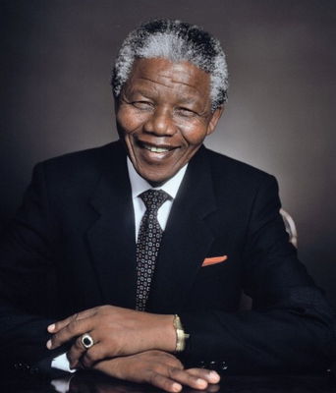
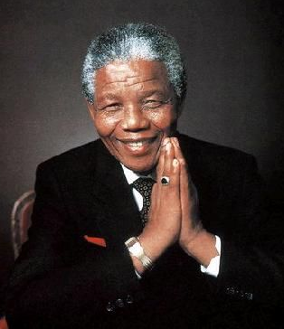
A great person is someone who devotes his life to helping others.

Slide 29
An old man dies in Africa, and the world grieves (悲痛). In this troubled world, people are taking time to reflect on the significance (意义) of his extraordinary (非凡的) life. The world, not just South Africa, where he was to become its first black president after spending 27 years in prison for wanting all people to be equal regardless of color, will not be the same after his fine example of statesmanship (政治才能). Instead of the expected (预期的) bloodbath (大屠杀) that some commentators (评论员) predicted (预计) after he took office (就职), Mandela was able to reconcile (调和) the country through personal forgiveness (宽恕) of the very people who had once persecuted (迫害) and incarcerated (监禁) him.

Slide 30
As US President Barack Obama recently said, Nelson Mandela now belongs not just to our age, but to all ages. We can regard him as similar in stature (精神、道德等的高度) to other modern saintly figures, such as Mahatma Gandhi who helped make India free through non-violent resistance and Mother Teresa, who served the poorest of Calcutta.
Mandela lived through times of great strife (冲突) at home and abroad. It is his legacy (遗赠) of extraordinary moral and physical courage that makes him universally admired. He was magnanimous (宽容大量的) in victory, even including some of his former enemies in his government. The freedom and equality he won for people did not come easily.

Slide 31

Homework
1. Find more information about Nelson Mandela.
2. 发挥想象，连词成文(50-100字).
guidance, hopeful, youth, stage, vote, attack, violence, as a matter of fact, blow up, equal.
3. Read the following passage and copy it into your note-book. Pay attention to the coloured words.

