Slide 1

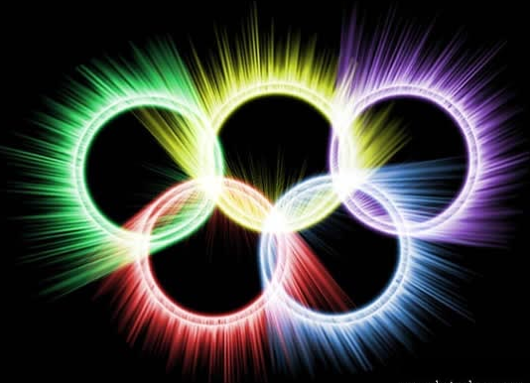
The Olympic Games

Slide 2
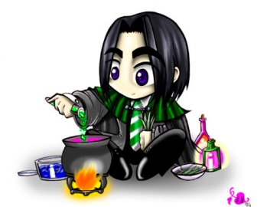
Words and
Expressions
Greece
Greek
magical
volunteer
homeland
n. 希腊
adj. 希腊(人)的；希腊语的
n. 希腊人；希腊语
adj. 巫术的；魔术的；有魔力的
n. 志愿者；志愿兵
adj. 志愿的；义务的
vt. & vi 自愿
n. 祖国；本国

Slide 3
Words and
Expressions
regular
basis
athlete
admit
slave
nowadays
stadium
adj. 规则的；定期的；常规的
n. (pl bases)基础；根据
n. 运动员；运动选手
vt. & vi. 容许；承认；接纳
n. 奴隶
adv. 现今；现在
n. (露天大型)体育场
(pl stadiums/stadia)

Slide 4
Words and
Expressions
gymnasium
as well
host
responsibility
replace
motto
swift
charge
n. 体育馆；健身房
也；又；还
vt. 做东；主办；招待
n. 主人
n. 责任；职责
vt. 取代；替换；代替
n. 座右铭；格言；警句
adj. 快的；迅速的
vt. & vi 收费；控诉
n. 费用；主管

Slide 5
Words and
Expressions
in charge
physical
fine
advertise
glory
bargain
one after another
deserve
主管；看管
adj. 物理的；身体的
n. 罚款
vt. & vi. 做广告；登广告
n. 光荣；荣誉
vi. 讨价还价；讲条件
n. 便宜货
陆续地；一个接一个地
vt & vi 应受……；值得

Slide 6
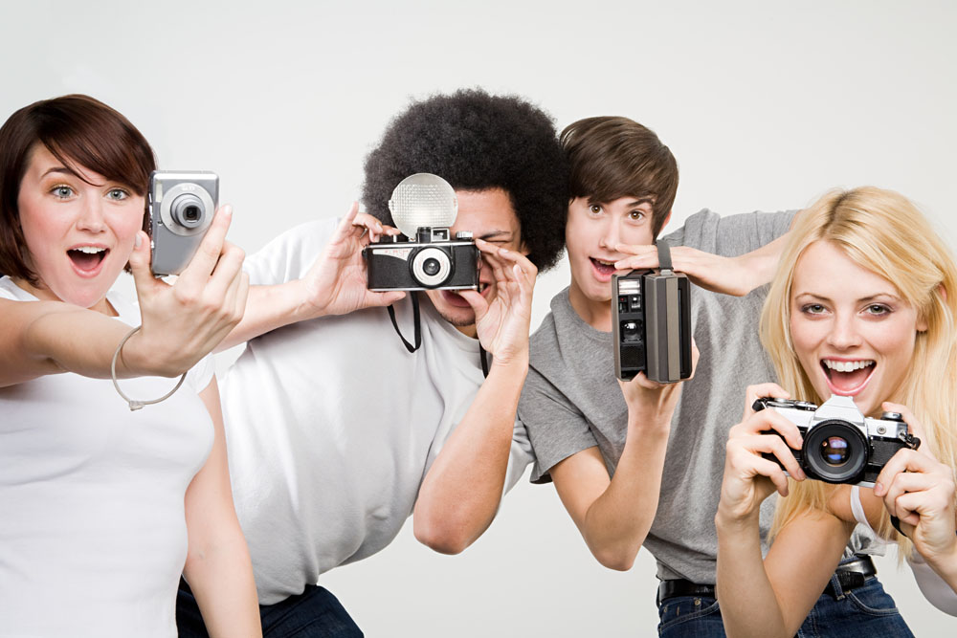
AN INTERVIEW

Slide 7


To learn about the similarities and differences between the ancient and modern Olympic Games
To know the spirit of Olympic Games
To learn some useful words, expressions and patterns in the passage

Slide 8
Focus on
Words:
volunteer, regular, admit, nowadays, host, responsibility, replace, motto, swift
Expressions:
find out, as well, as a matter of fact
Patterns:
That’s why …
It’s a great responsibility …

Slide 9
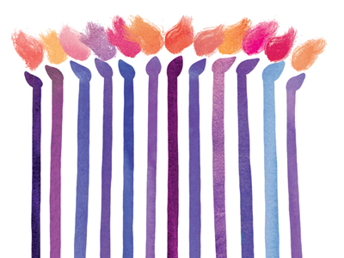
Skimming for general idea

Slide 10

(1) Choose the best answer.
This interview is mainly about ______.
A. the story of a Greek writer Pausanias
and a Chinese girl Li Yan
B. a magic journey by Pausanias
C. the similarities and differences about
the ancient and modern Olympics
D. the ancient Olympic Games in Greece

Slide 11
Scanning for specific information

Slide 12



True or false
Just Greece could take part in the
ancient Olympic Games.
2. Slaves and women used to join in the
Olympic Games.
3. The Winter Olympics are usually held
two years before the Summer Olympics.
4. There are many events like ice skating
and volleyball which need snow and ice
in the Winter Olympics.

Slide 13
5. The modern Olympic Games is hosted
by different countries.
6. Both the Summer and Winter Olympics
are held every two years.
7. There are running races in the Winter
Olympics.
8. Every athlete can take part in the new
Olympics.
9. The Olympics were born in Greece.

Slide 14


(2) Choose the best answer.
1. Where do all the competitors live?
A. A hotel.
B. A place hired by competitors.
C. A restaurant.
D. A special village.

Slide 15

2. Which of the following is included in
the Winter Olympic Games?
A. Skiing and ice skating.
B. Running and races.
C. Horse riding.
D. Swimming.

Slide 16
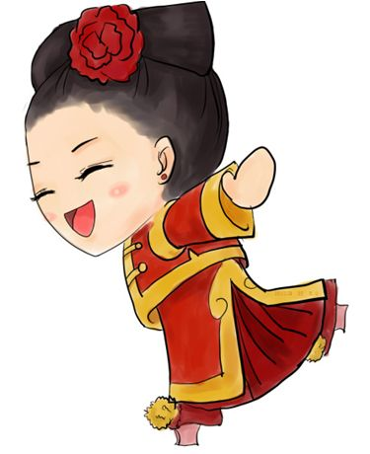
3. Why do so many countries want to
host the Olympic Games?
A. To run faster, jump higher and
throw further.
B. To get a great honor.
C. To make the country famous.
D. To make money.

Slide 17

4. How does Pausanias feel when he
hears the Olympic Games are also
about being able to run faster, jump
higher and throw further?
A. Surprised.
B. Happy.
C. Sad.
D. Astonished.

Slide 18
P111
(3) Find out the characteristics and similarities of the ancient and modern Olympics.
Ancient Olympics
1 one set of Games
2 no women or slaves can take part
3 only competitors from Greece

Slide 19
Modern Olympics
1 two main sets of Games
2 anyone can take part if they reach
the standard
3 competitors from all over the world
4 more than 250 events

Slide 20
Differences | Ancient | Modern
Any Winter Olympics?
competitors from?
Men/Women athletes
Prizes
Any Olympic villages?
(more/fewer) events
No
Yes
all over the world
only in Greece
only men
both
olive wreath
medals
No
Yes
Fewer events
More events

Slide 21
Similarities
1 have running races
2 held every 4 years
3 no prize money for winners
4 seen as most important competition

Slide 22
(4) Read the passage carefully and answer
the following questions.
1 What amazes Pausanias about the Olympic Games?
2 Why does he think Athens and Beijing should feel proud?
3 Why does he think people may be competing for money in the modern Olympic Games?
P112

Slide 23
1 What amazes Pausanias about the
Olympic Games?
Pausanias is amazed that many
countries take part in the Olympic
Games and women too and there are
two sets of Games – the Winter and the
Summer Olympics.

Slide 24
2 Why does he think Athens and Beijing should feel proud?
Because Li Yan has explained that it is a
great honour to host the Olympic Games.
3 Why does he think people may be competing for money in the modern Olympic Games?
He thinks that so many things have
changed in the Olympic Games that he
fears that the spirit of the Olympics may
have changed too.

Slide 25

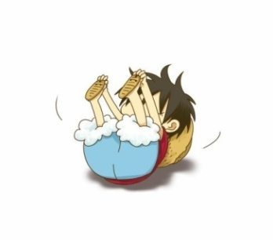
Discussion
Why do many countries want to host
the Olympic Games while others do
not? Use the mind map below to
help you.

Slide 26
P113
a great honour
great responsibility
tourism
Reasons to host the
Olympic Games
new
investment
national pride
new sports facilities

Slide 27
too expensive
much planning
accidents/ attacks
pressure/ stress
Reasons not to host
the Olympic Games
accommodation
many stadiums

Slide 28

Hot links to Websites Related to
the Olympics on the Internet:
http://www.olympic.org
http://www.specialolympics.org

Slide 29



Slide 30
I. Complete the passage with proper words, which will help you retell the text.
There are two sets of the Olympic Games — the Summer Olympics and the Winter Olympics, both of ________are held every four years. Athletes who have reached the ________(agree) standard
will be admitted as competitors. In Winter
Olympics, there are ___________(compete) like skiing and ice skating _______snow and ice are needed.
which
agreed
competitions
where

Slide 31
And that is _______they are called the Winter Olympic Games. While in Summer Olympic Games, athletes compete ______ the running races, swimming, sailing and all the team sports. For each Olympics, a
special village _________(build) for athletes to live _____. Every country wants the opportunity to host the Olympics, because ______is thought to be a great honor ___________(choose). The motto of the Olympic Games is “Swifter, Higher and Stronger.”
why
in
is built
in
it
to be chosen

Slide 32
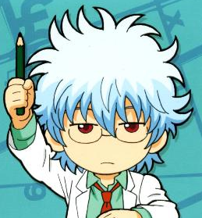
II. Task-based reading.
Read the passage and answer the following questions.
1. How many times has London been a
host city for the Olympics?
Three times.

Slide 33
2. What event is the one introduced to
the Olympic Games for the first time?
3. What is the most important meaning
of the Olympic Games?
Women’s boxing.
Friendship and respect among athletes, the audience and nations.

Slide 34


After the class
TIME FOR REFLECTION
It’s time to stop the class for us to look back in silence.
Think in English
Think about what we’ve just learnt today.
Study without reflection is a waste of time.

Slide 35

Homework
1. Surf the Internet to find more information about the Olympics.
2. 发挥想象，连词成文(50-100字)。
magical, regular, admit, nowadays, as well, host, responsibility, replace, motto, swift.

