Slide 1
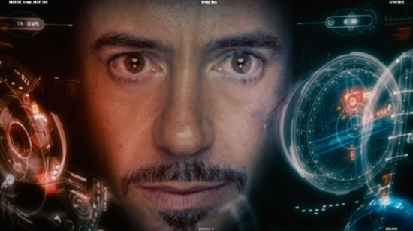
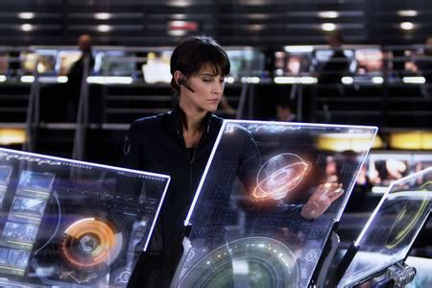
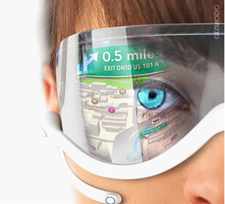
Computers

Slide 2

Words and
Expressions
calculate
universal
vt. 计算
adj. 普遍的；通用的；
宇宙的

Slide 3
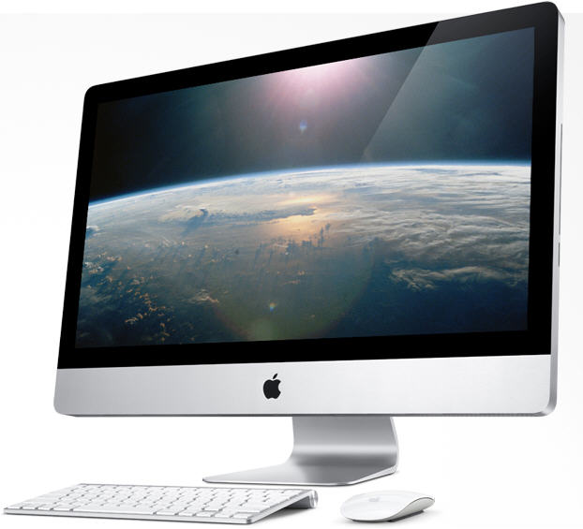
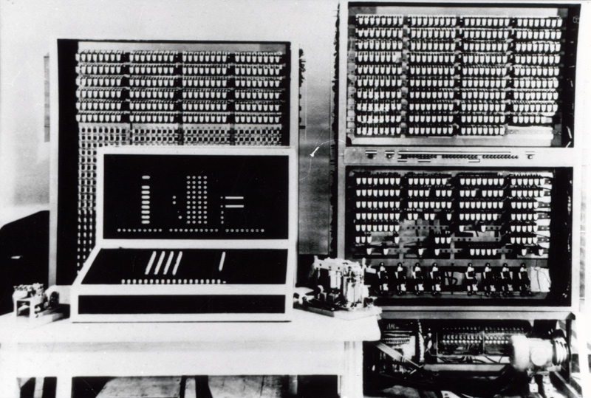
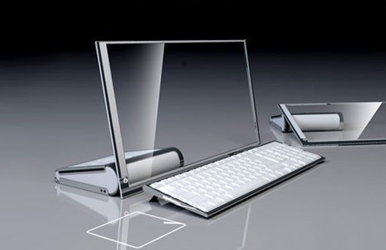

Computers

Slide 4


1. To know the history and development of computers
2. To know the applications of computers

Slide 5


Let’s play a game！

Slide 6

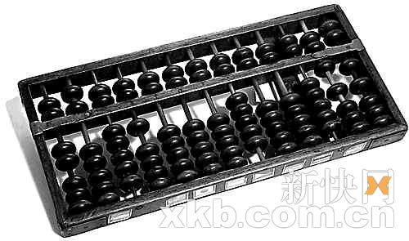
Riddles (谜语)
I am very old now. I was born in China. Many people used me for calculating in the past, but now I am a bit lonely because they don’t like me now.
Do you know who I am?
abacus

Slide 7
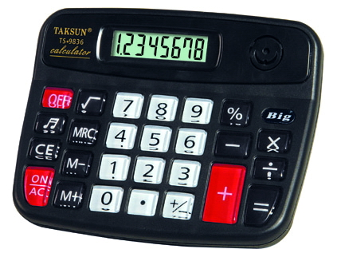

I am very small. I can be used for calculating. In China, a lot of students use me when solving mathematical problems.
Do you know who I am?
calculator

Slide 8
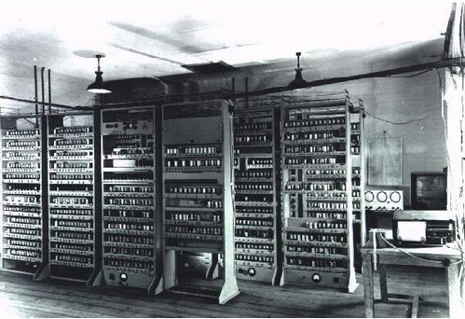
I am very big. Scientists use me to solve some mathematical problems.
Do you know who I am?
huge computer

Slide 9
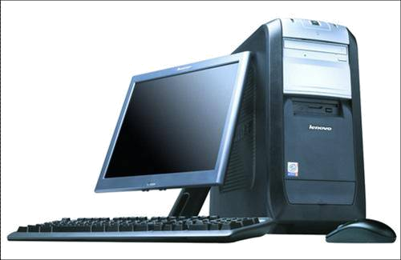
I’m a small, relatively inexpensive computer designed for an individual user. I’m based on the microprocessor technology. At home, people use me to surf the Internet and play games.
Do you know who I am?
PC
Personal Computer

Slide 10
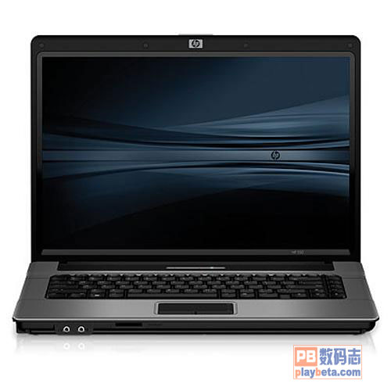
I can be used for calculating. Besides, I can also be used for watching DVD, sending e-mail and communicating through the Internet. However, I am not a PC, because I’m small enough for you to take me with you.
Do you know who I am?
laptop

Slide 11
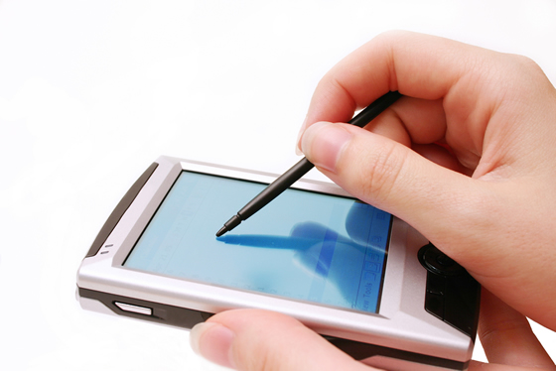
I am so small in size that I can fit in your hand. I usually have a small screen usually bigger than a digital phone, however smaller than the smallest laptop, I’m a great way to store telephone numbers, access the Internet, make calculations, and so on.
Do you know who I am?
PDA
Personal Digital Assistant

Slide 12
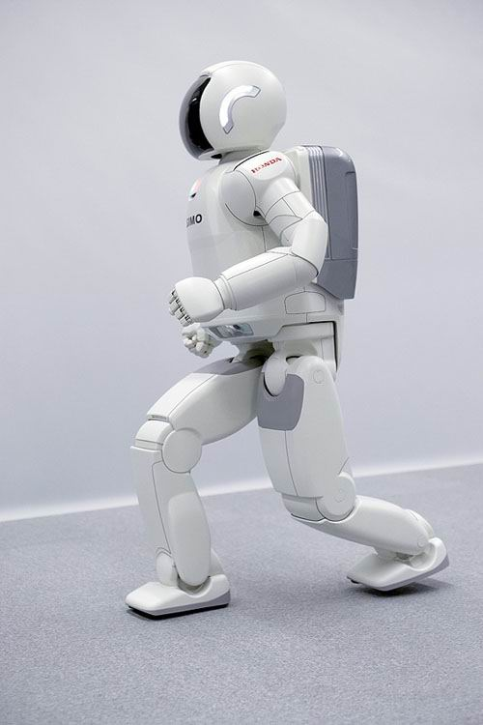
I’m a machine that works automatically.
I can do a wide variety of tasks, especially suitable for doing jobs too boring, difficult,
or dangerous for human beings.
Do you know who I am?
robot

Slide 13

Discussion
In pairs discuss what they have in
common.
1. They can be used for calculating.
2. They can deal with maths problems.
3. They are our friends.
4. They are useful and helpful.

Slide 14
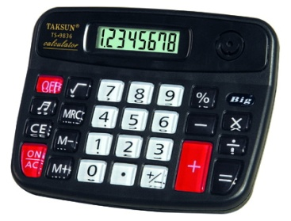
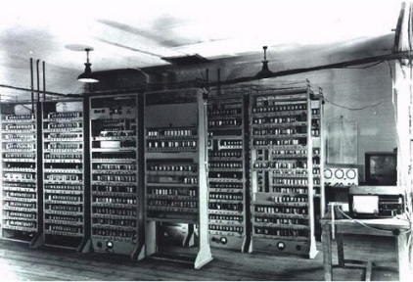


Can you tell the development of computers?
huge
computer
abacus
calculator
PC
What’s
next?
robot
PDA
laptop

Slide 15

What do you think will be the next development?
高速超导计算机
量子计算机
生物计算机
未来高性能
计算机
分子计算机
DNA计算机
激光计算机
神经元计算机

Slide 16


Do you know in what ways computers
are used today?
Work out a list and compare it with
your partner.

Slide 17
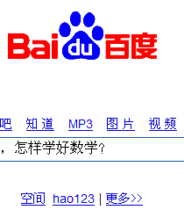
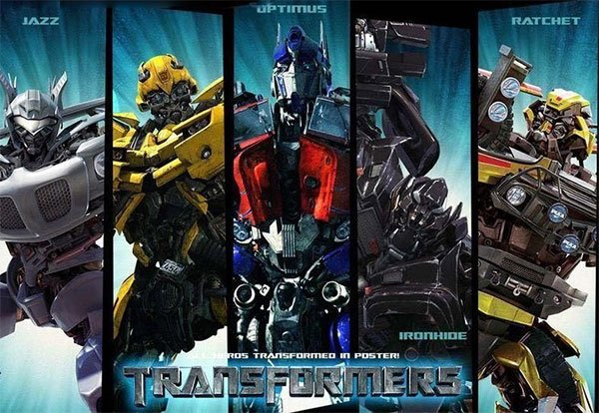
search for …
see movies

Slide 18
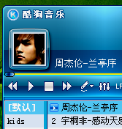
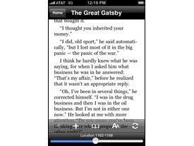
listen to music
read books and magazines

Slide 19
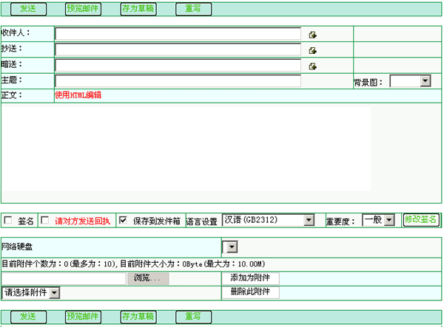
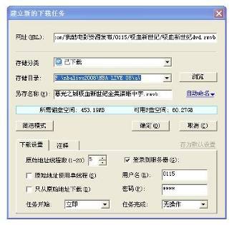
send emails to friends
download music
and films

Slide 20
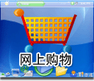
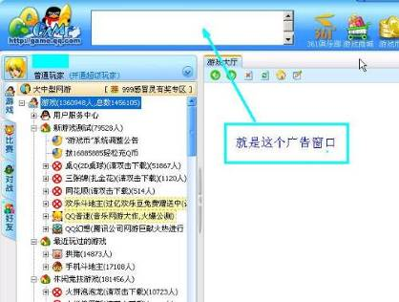
buy things online
play games on
the computer

Slide 21
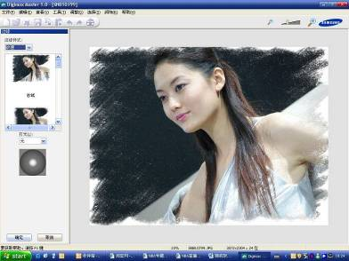
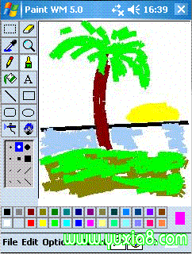
look at photographs
on the computer
draw pictures

Slide 22
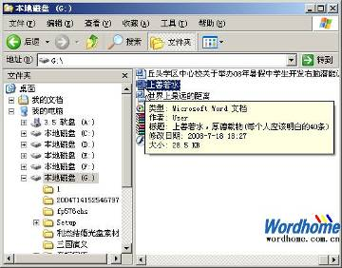
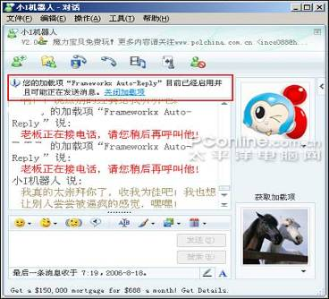
use a computer
for school work
take part in
chat groups

Slide 23


Can you give us the English names of a computer components (组件)?

Slide 24
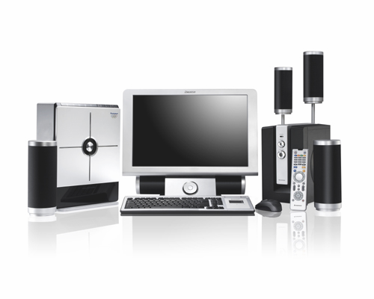
components of a computer
monitor 显示器
screen 屏幕
host
主机
speaker 音响
keyboard 键盘
mouse 鼠标

Slide 25
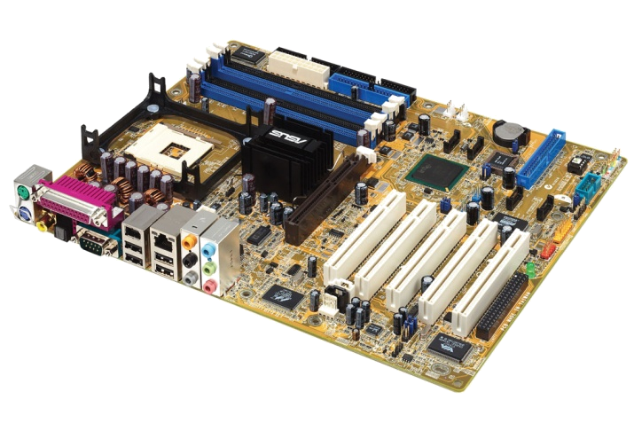
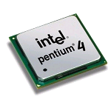
main board
CPU (central processing unit)

Slide 26
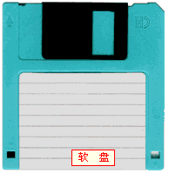
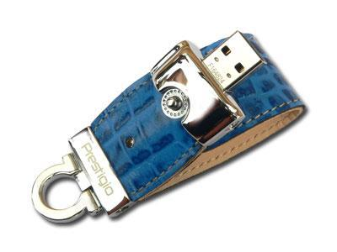
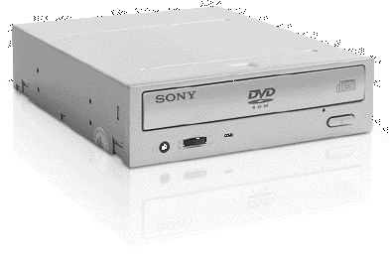
floppy disk
USB flash disk
DVD ROM

Slide 27
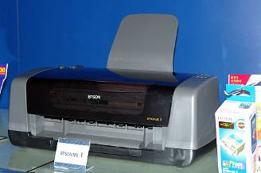
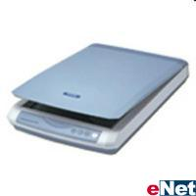
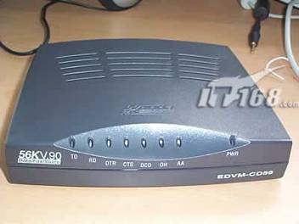
printer
scanner
modem

Slide 28
Match
1. the part of the computer that looks like a television
2. the part of the monitor that you look at
3. something you use to click on things (files, etc.)
4. the part of the computer that you type on
5. the part of a computer that stores information
6. the part of computer that we can put a CD in
screen
keyboard
mouse
monitor
DVD-ROM
hard disk

Slide 29

Homework
1. Write a passage to talk about the functions of a computer or a robot in about 80 words.
2. Preview the Reading:
WHO AM I?

