Slide 1
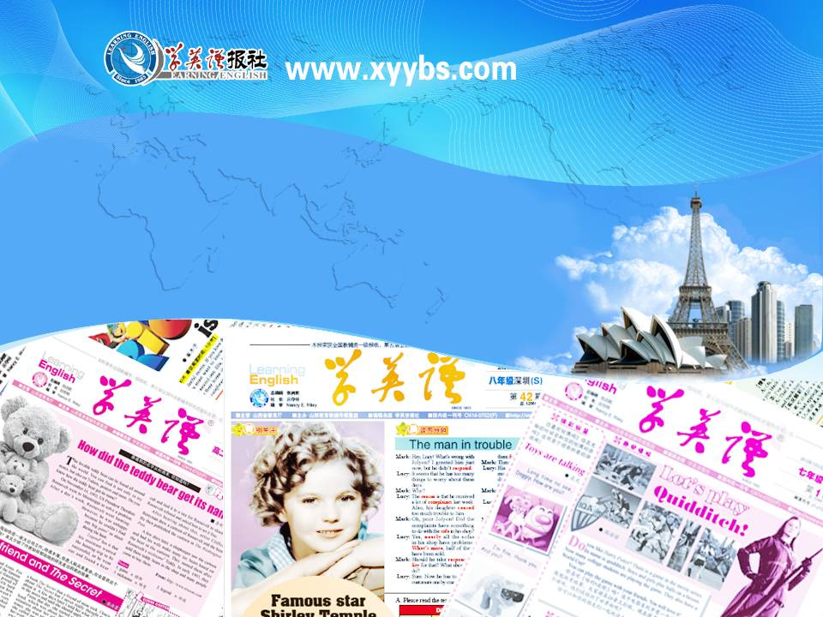
英语课标教学课件
选修6

Slide 2
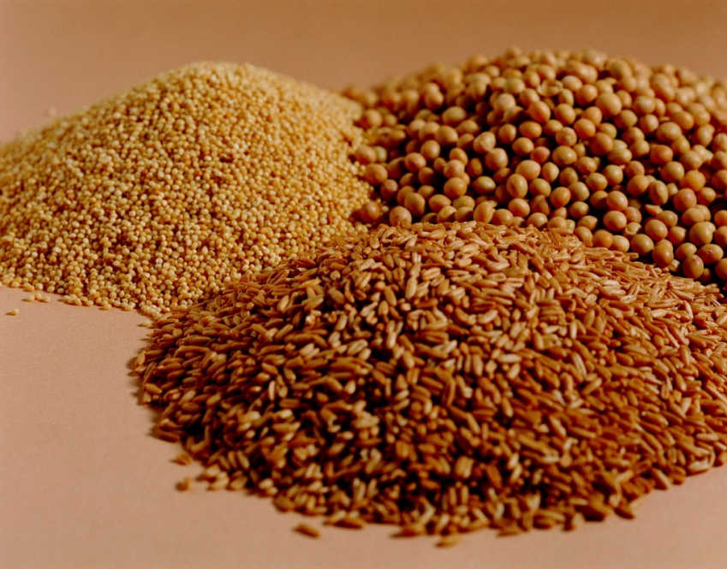
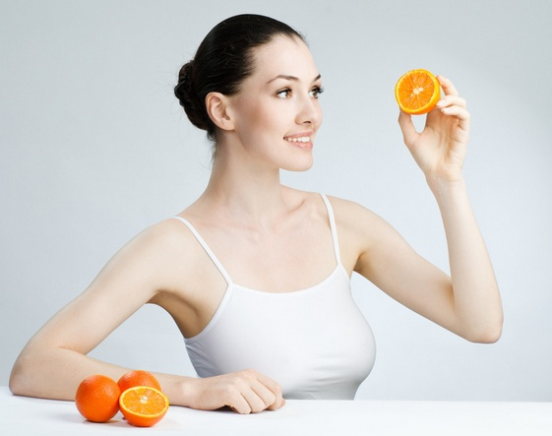

A healthy life

Slide 3
owed as a debt or as a right; expected to happen, arrive, etc. at a particular time
adj. 欠款的; 预定的; 到期的
due
having or causing problems or difficulties; demanding that particular rules be obeyed and showing a lack of sympathy for any problems or suffering that this may cause
adj. 困难的; 强硬的
tough

Slide 4
spending all your free time doing sth. because you are so interested in it; unable to stop taking harmful drugs, or using or doing sth. as a habit
adj. 入了迷的; 上了瘾的
addicted
to make yourself familiar with new conditions
vt. 使习惯于
accustom
familiar with sth.
adj. 惯常的; 习惯了的
accustomed

Slide 5
the act of moving or taking sth. away or back; the period of time when sb. is getting used to not taking a drug that they have become addicted to, and the unpleasant effects of doing this
withdrawal
n. 收回; 撤退; 戒毒(或脱瘾)过程
done or happening without thinking; having controls that work without needing a person to operate them
adj. 无意识的; 自动的
automatic

Slide 6
If you do sth. automatically, you do it without thinking about it; If a machine or device does sth. automatically, it does it independently, without human control
adv. 无意识地; 自动地
automatically
relating to the mind, or involving the process of thinking
adj. 精神的; 智力的
mental
connected with or related to the mind
adv. 精神上; 智力上
mentally

Slide 7
to stop doing sth. or leave a job or a place
vt. 停止(做某事); 离开
quit
the result of a particular influence
n. 结果; 效力
effect
either of the two organs in the chest with which people and some animals breathe
n. 肺
lung
(of a woman and some female animals) having young developing inside the womb
adj. 怀孕的
pregnant

Slide 8
different from what is usual or average, esp. in a way that is bad
adj. 畸形的; 异常的
abnormal
not able to breathe easily
adj. 气喘吁吁的; 屏息的
breathless
not suitable or healthy; not fit
unfit
adj. 不健康的; 不合适的; 不合格的
to make sth. stronger or more effective, or to become stronger or more effective
vt. 加强; 巩固; 使坚强
vi. 变强
strengthen

Slide 9
a small paper or cardboard container in which a number of small objects are sold
n. 小包; 小盒
packet
feeling or showing that you have little hope and are ready to do anything without worrying about danger to yourself or others
desperate
adj. 绝望的; 拼命的
a person whose job is to prepare and sell medicines in a shop;
n. 药剂师

Slide 10
a person who studies chemistry, or a scientist who works with chemicals or studies their reactions
n. 化学家
chemist
unhappy because someone or sth. was not as good as you hoped or expected, or because sth. did not happen
adj. 失望的; 沮丧的
disappointed
feeling guilty or embarrassed about sth. you have done or a quality in your character
adj. 感到惭愧或羞耻的
ashamed

