Slide 1
Data Avenue
Akos Hajnal, Istvan Marton
2020

Slide 2
Data Avenue? Never heard before...
Data Avenue is a multi-protocol storage client with GUI
ftp client, s3 client, hdfs client, … all-in-one
you can perform all common operations: list, mkdir, delete, rename, upload, download file
all storages represented uniformly: files and directories
lots of common cloud storages supported: http, https, sftp, gsiftp, srm, lfn, irods, s3, cassandra, gss, hdfs (google drive, dropbox under development)
Data Avenue is a data transfer manager server
it can transfer files or folders from one storage to another in the background (s3 -> hdfs)
without having any size- or transfer time limitation (TBs, weeks to transfer)
Data Avenue is a REST API bridge for storage resources
any storage operation on any storage can be done using REST API calls
programmatically (curl or any other tools)
scheduled (cron)
Data Avenue is open source (https://github.com/SZTAKI-LPDS/data-avenue)

Slide 3
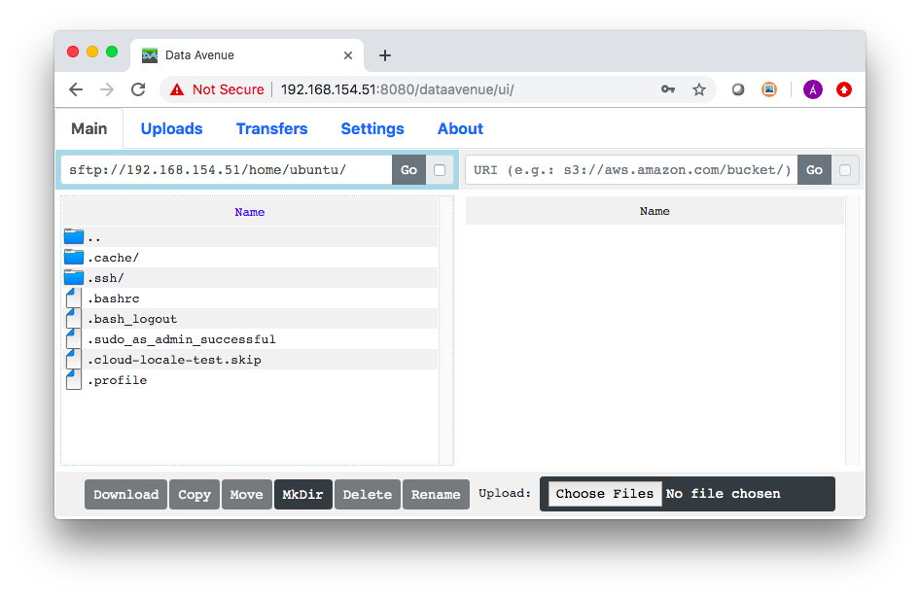
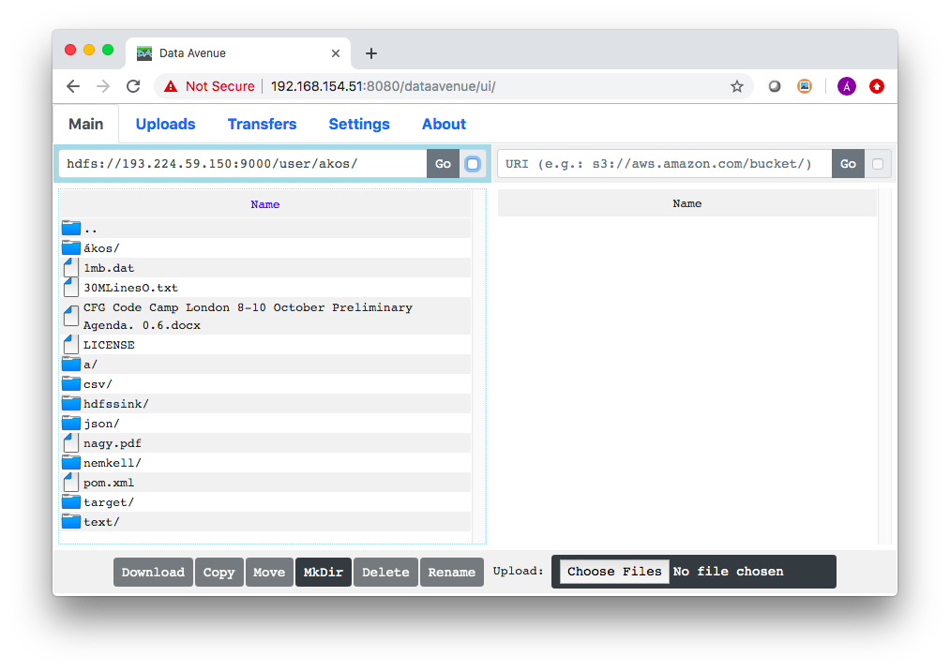
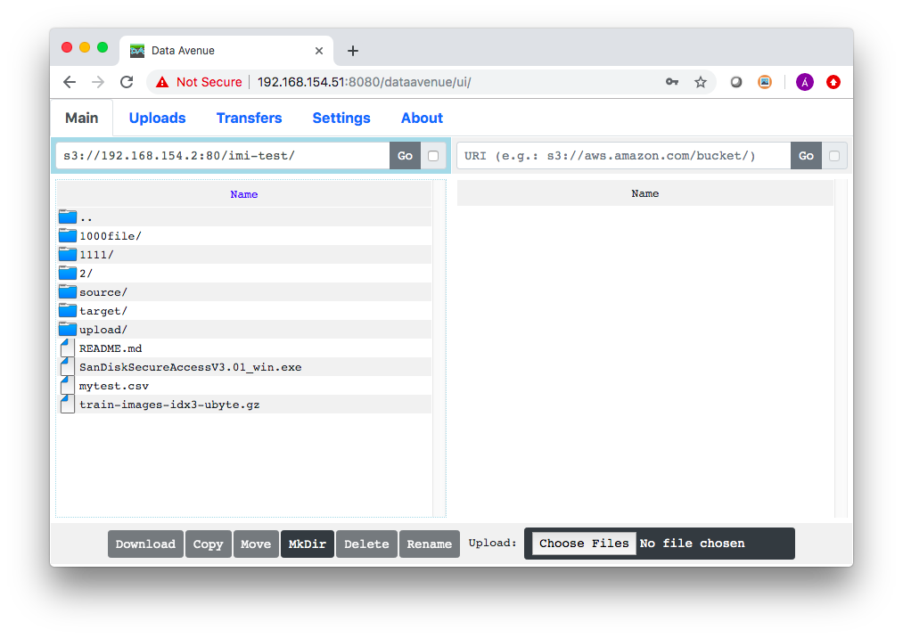
Multi-protocol storage client
sFTP
Apache HDFS
Amazon S3

Slide 4
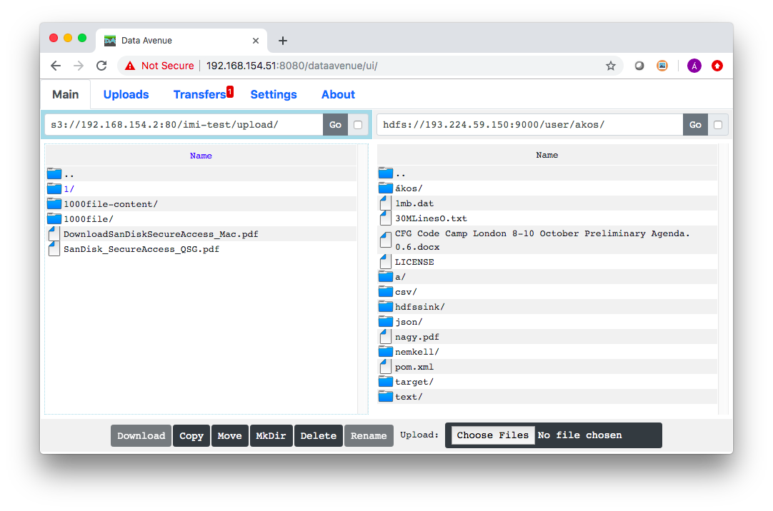
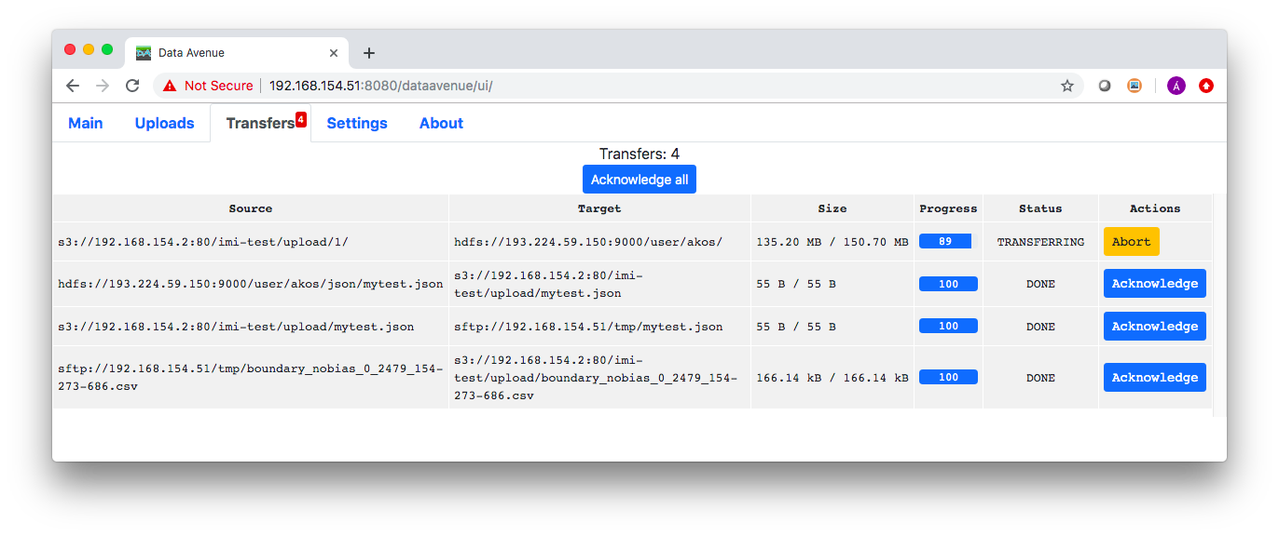
Data transfer manager server
copy (or move) files (or directories)
from one storage to another
transfers done/monitored by the server
in the background

Slide 5
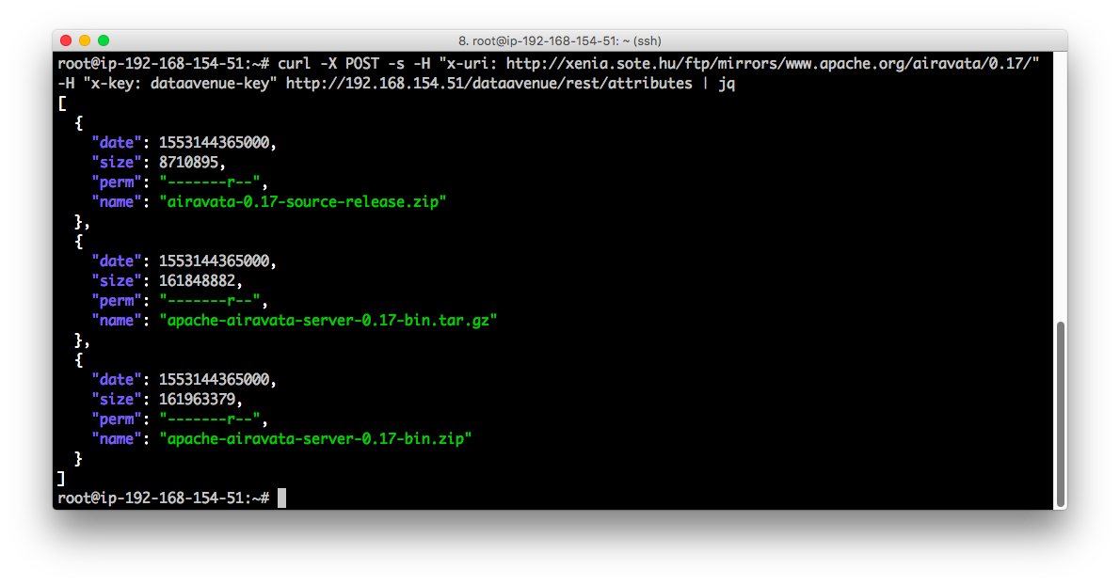
REST API bridge
REST API call from shell (curl)
to list a http:// directory

Slide 6
Main features
fast (Java implementation, multithreaded, listing thousands of entries)
efficient (third-party transfers, no disk space requirements, moderate memory footprint)
robust (runs for years without resource leaks)
fault tolerant (retry on failure)
secure (no credentials stored anywhere, secure connections to storages)
lightweight GUI (pure javascript/angular, running in most browsers)
support multi-user usage (access key-system)
transfer logs (traceability)
dockerized (easy deploy anywhere)
maven (easy compile)

Slide 7
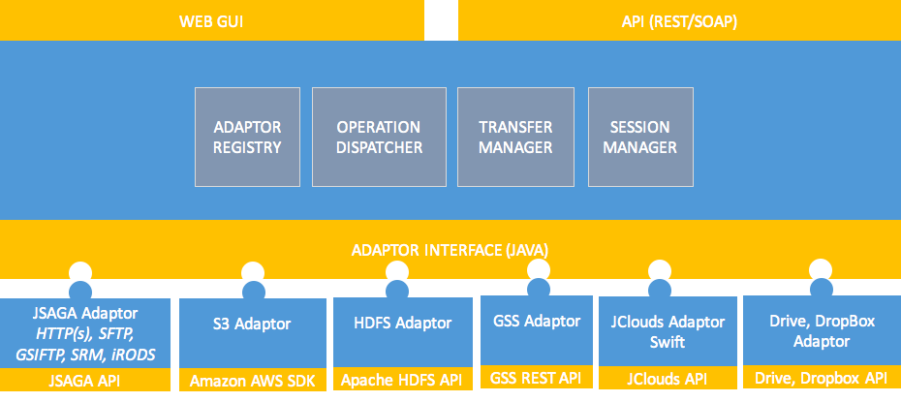
Plugin architecture - Data Avenue “framework”
rapid development time to extend (plugin developer can focus on a single storage, freely define authentication form, implement “plugin” interface)
all other services provided automatically (GUI, transfer between other storages, monitoring, session, etc.)

Slide 8
Latest improvements
new GUI
from scratch brand new pure JavaScript UI (Angular)
uses REST API of the backend (no GUI backend, no Liferay, no Java client needed)
intuitive, clear, simple design (notifications, panels, enters, selections, lots of other improvements, ...)
better performance (list thousands of files)
flexible (adaptor-defined) authentication forms
HDFS adaptor
HDFS widely used in Apache Big Data frameworks (Hadoop, Spark, Ignite, …)
you can transfer data from/to other storages (S3)
Lots of invisible but important changes (adaptor interfaces, refactoring, bugfixes, REST interface re-design, web service API removed, …)

Slide 9
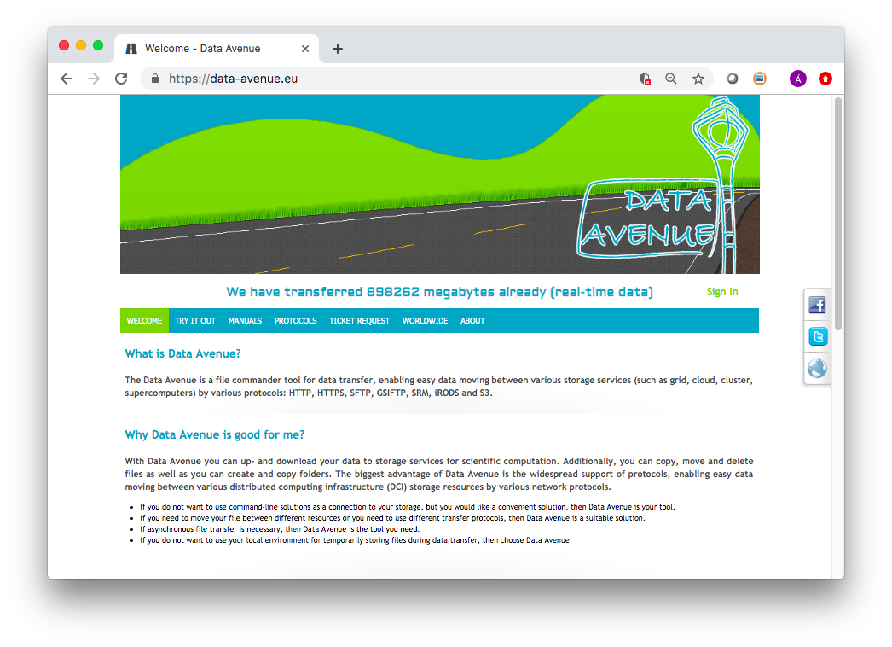
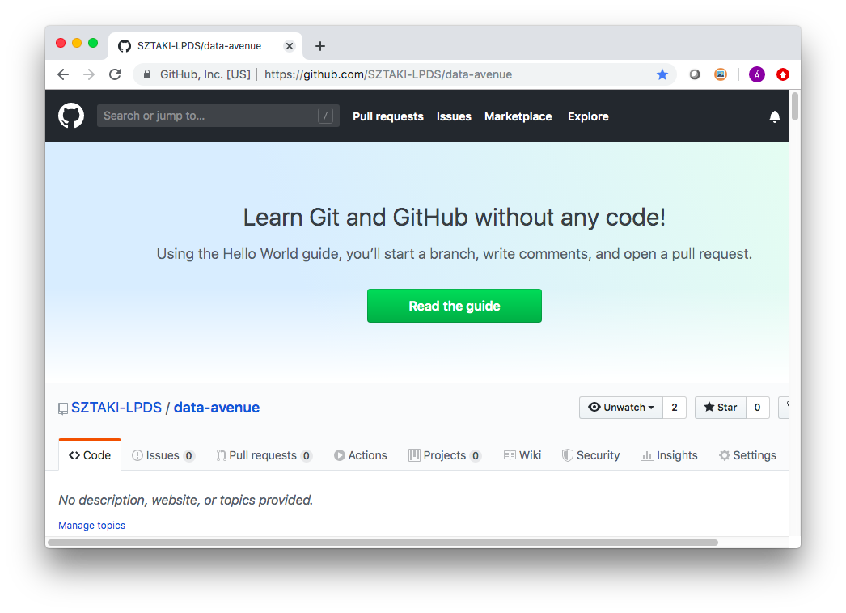
last deployment: July 2014; Oct. 2017 (dev)
Release v1.0 May 7 2020

Slide 10
Publications
https://github.com/SZTAKI-LPDS/data-avenue
Akos Hajnal, Eniko Nagy, Peter Kacsuk and Istvan Marton: Data Migration for Large Scientific Datasets in Clouds, Azerbaijan Journal of High Performance Computing, Vol 1, Issue 1, 2018, pp. 66-86, https://doi.org/10.32010/26166127.2018.1.1.66.86
Hajnal A, Marton I, Farkas Z, Kacsuk P: Remote storage management in science gateways via data bridging, CONCURRENCY AND COMPUTATION: PRACTICE AND EXPERIENCE 27:(16), pp. 4398-4411, 2015
Hajnal A, Farkas Z, Kacsuk P, Pinter T: Remote Storage Resource Management in WS-PGRADE/gUSE. In: Kacsuk P (ed.), Science Gateways for Distributed Computing Infrastructures: Development Framework and Exploitation by Scientific User Communities. 301 p., Springer, 2014, pp. 69-81. (ISBN:978-3-319-11267-1)
Hajnal, A., Farkas, Z., and Kacsuk, P. Data Avenue: Remote Storage Resource Management in WS-PGRADE/gUSE, 6th IEEE International Workshop on Science Gateways (IWSG), pp. 1-5, 2014

