Slide 1
CSCI-SHU 220: Algorithms
Huffman Coding
Fall 2020 @ NYU Shanghai

Slide 2
Part I: The Problem

Slide 3
SendingTexts Online
abcd
Encode
0101111111000
Decode
abcd

Slide 4
The Straightforward Encoding
represent each letter using bits
consider alphabet {a, b, c, …, z}
how many bits needed for each letter?
Standard way: ⎡log 26⎤ = 5 bits

Slide 5
The Straightforward Encoding
a -> 00000
Encode “love”?
b -> 00001
01100011111011000101
c -> 00010
d -> 00011
Decode “0111101011”?
……
ok
z -> 11010

Slide 6
Shorter Encoding?
No,
if each letter appears equally likely.

Slide 7
Different Frequencies?
“c” 3%
“b” 2%
“a” 10%
…
more frequent letters: fewer bits
less frequent letters: more bits

Slide 8
Variable-Length Encoding Schemes
Encode “bad” ?
a -> 01
00101110
b -> 001
Decode “00101110” ?
c -> 011
bad
d -> 110
Ambiguity!!
e -> 10
bce

Slide 9
Avoid Ambiguity: Prefix Codes
a -> 11
Decode “001110001001” ?
b -> 000
cabed
c -> 001
d -> 01
No encoding string is a prefix of
another encoding string
e -> 10

Slide 10
The Decoding Tree
a -> 11
root
0
1
b -> 000
0
0
1
1
c -> 001
0
1
d
e
a
d -> 01
b
c
e -> 10
Decode “001110001001” ?
Each prefix code <=> a binary decoding tree

Slide 11
Average Length of Encoding A Letter
root
Given frequencies of letters
0
1
0
0
f_{a}=0.8, f_{b}=f_{c}=f_{d}=f_{e}=0.05
1
1
0
d
e
a
Average length of a letter
b
c
0.8*2+0.05*3+0.05*3+0.05*2+0.05*2=2.1
Minimal average length of all prefix codes?

Slide 12
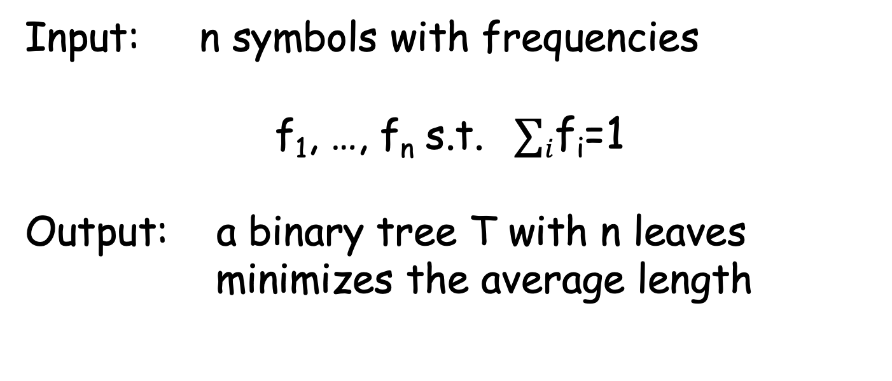
Optimal Prefix Codes
Input: n symbols with frequencies
f₁, …, f_{n} s.t. $∑i$f_{i}=1
Output: a binary tree T with n leaves
minimizes the average length
$∑i$ f_{i} depth_{T}(i)

Slide 13
Part II: The Algorithm

Slide 14
n=2
Frequencies f_{a} = 0.3, f_{b} =0.7
a
b
Average length 1

Slide 15
n=3
Frequencies f_{a} = 0.3, f_{b} =0.3, f_{c}=0.4
a
c
c
a
b
b
Average length 1.7
Average length 1.6

Slide 16
n=4
Frequencies f_{a} = 0.2, f_{b} =0.2, f_{c}=0.3, f_{d} = 0.3
a
b
c
d
Average length 2

Slide 17
n=4
Frequencies f_{a} = 0.2, f_{b} =0.2, f_{c}=0.3, f_{d} = 0.3
0.2
0.2
0.3
0.3
0.3
0.2
0.3
0.2
0.2
0.3
0.3
0.2
0.2
0.3
0.2
0.3
1) 0.2*1+0.2*3+0.3*3+0.3*2
3) 0.3*1+0.2*3+0.2*3+0.3*2
2) 0.2*1+0.3*3+0.3*3+0.2*2
4) 0.3*1+0.3*3+0.2*3+0.2*2

Slide 18
Another Look at the Best Solution
Frequencies f_{a} = 0.2, f_{b} =0.2, f_{c}=0.3, f_{d} = 0.3
Observations:
best to put two smallest frequencies
at the lowest level
0.3
0.3
moreover, we can make them siblings
0.2
0.2
0.3*1+0.2*3+0.2*3+0.3*2 = 1.5

Slide 19
n=5
Frequencies f_{a} = 0.1, f_{b} =0.1, f_{c}=0.2, f_{d} = 0.3, f_{e} = 0.3
A lot of shapes and combinations

Slide 20
Recall the Observation:
Frequencies f_{a} = 0.1, f_{b} =0.1, f_{c}=0.2, f_{d} = 0.3, f_{e} = 0.3
…
there is an optimal solution with
two smallest frequencies at the lowers level (as siblings)
…
…
0.1
0.1
treat this as a single “big” leaf

Slide 21
Reduce to 4 frequencies
Frequencies f_{a} = 0.1, f_{b} =0.1, f_{c}=0.2, f_{d} = 0.3, f_{e} = 0.3
Observations:
…
The new tree is a solution for
f’_{a} = 0.2, f’_{b} =0.2, f’_{c}=0.3, f’_{d} = 0.3
…
…
0.1
0.1
Moreover, it is an optimal solution
(prove it in next lecture)
treat this as a single “big” leaf

Slide 22
Huffman’s Algorithm
1. make two variables with smallest frequencies siblings
2. merge these two variables into a new variable
(with frequency as sum of their frequencies)
3. repeat until only one variable left

Slide 23
Example I
Frequencies f_{a} = 0.1, f_{b} =0.1, f_{c}=0.2, f_{d} = 0.3, f_{e} = 0.3
1
0.4
0.2
0.6
0.1
0.1
0.2
0.3
0.3
Average length: 0.1 * 3 + 0.1 * 3 + 0.2 * 2 + 0.3*2 + 0.3 *2
Another way to calculate it: 0.2 + 0.4 + 0.6 + 1 = 2.2
Notes:
we count one frequency for k level time, k is the level the freq lies in the tree

Slide 24
Example II
Frequencies f_{a} = 0.1, f_{b} =0.2, f_{c}=0.4, f_{d} = 0.2, f_{e} = 0.2
1
0.7
0.3
0.4
0.1
0.2
0.4
0.2
0.2
Average length: 0.3 + 0.7 + 0.4 + 1 = 2.4

Slide 25
Try It by Yourself?
Minimal average length of prefix codes for
f_{a} = 0.15, f_{b} =0.15, f_{c}=0.1, f_{d} = 0.2, f_{e} = 0.25, f_{g} = 0.15 ?

Slide 26
Time Complexity
Data structure: priority queue (min-heap)
Main operations: repeat n times,
dequeue two minimal values,
enqueue their sum
Time complexity: O(n log n)

Slide 27
Summary
Optimal Prefix Codes
Huffman’s Algorithm

