Slide 1
CSCI-SHU 220: Algorithms
Huffman Coding
Fall 2020 @ NYU Shanghai

Slide 2
Part I: Problem & Algorithm

Slide 3
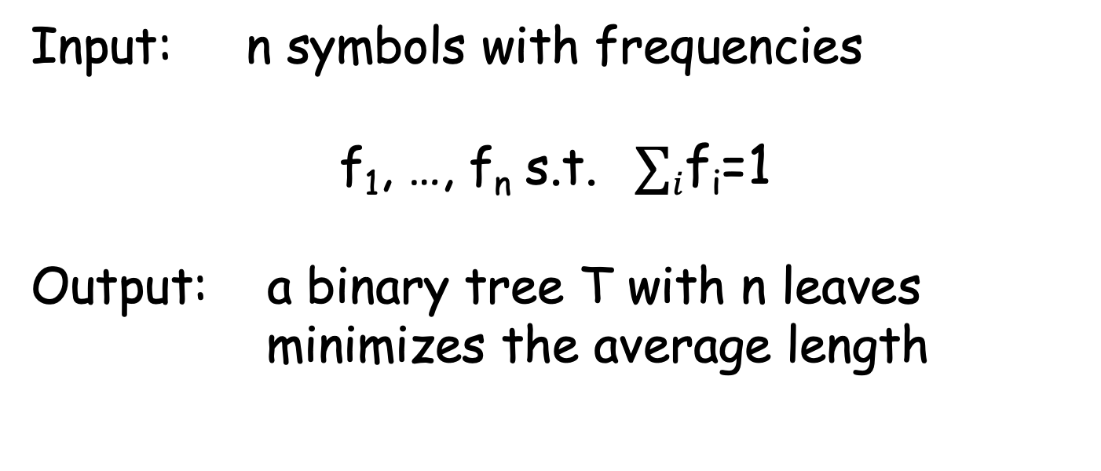
Optimal Prefix Codes
Input: n symbols with frequencies
f₁, …, f_{n} s.t. $∑i$f_{i}=1
Output: a binary tree T with n leaves
minimizes the average length
$∑i$ f_{i} depth_{T}(i)

Slide 4
Main Observation 1
An optimal solution should be a full binary tree
(every internal node has two children)
u
u
v
w
w
otherwise, directly connecting v’s (single) child
to its parent gives a better solution

Slide 5
Corollary
there are two leaves with maximal depth
that are siblings
v
w
otherwise, it is not a full binary tree

Slide 6
Main Observation 2
There is an optimal solution in which two symbols with lowest frequencies are assigned to leaves at the maximal depth as siblings
Corollary => siblings at maximal depth
u
v
w
otherwise, exchanging with symbols with two lowest frequencies is still optimal

Slide 7
Main Idea
Merge two lower frequencies as one
Reduce the problem size by one
Solve it recursively

Slide 8
Huffman’s Algorithm (Recursion)
a set of S of n symbols, with f₁,…,f_{n}
an optimal binary tree with leaves
associated to symbols in S

Slide 9
Huffman’s Algorithm (|S|=2)
Base case: |S|=2
Root
₀
₁
S₁
S₂
Encode one symbol using 0 and another using 1

Slide 10
Huffman’s Algorithm (|S|>2)
Let y,z be two symbols with lowest frequencies f_{y}, f_{z}
Remove y, z and add w to S with frequency f_{w} = f_{y} + f_{z}
Solve this problem recursively and get back T’
In T’, add two leaves y,z to leaf w (so w is internal)

Slide 11
Open the Recursion
Repeat until only one variable left:
1. Make two variables with smallest frequencies siblings
2. Replace them by their parent node

Slide 12
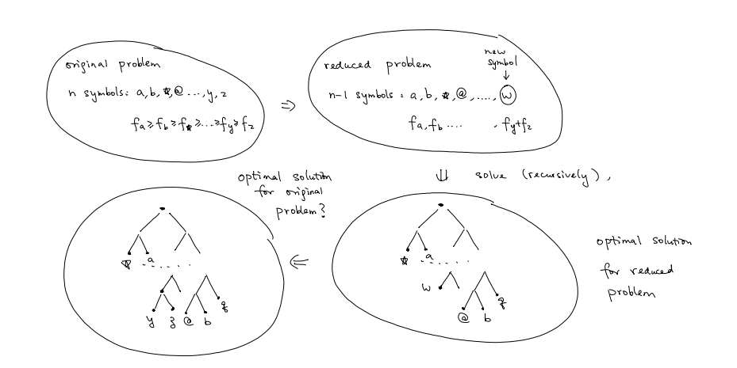
Huffman’s Algorithm

Slide 13
Part II: Correctness

Slide 14
Prove By Induction
Base case
(optimal for only two symbols)
Inductive Step
(optimal solution for n-1 symbols
=> optimal solution for n symbols)

Slide 15
Base Case
Huffman’s algorithm returns
Root
₀
₁
S₁
S₂
Optimal

Slide 16
Inductive Step
Lemma: suppose T_{n-1} is an optimal solution for
f₁,f₂, …, f_{n-2}, f’_{n-1} := f_{n-1}+f_{n}
then T_{n} is an optimal solution for
f₁,f₂, …, f_{n-1}, f_{n}
where f_{n-1}, f_{n} are two smallest numbers among f₁,…,f_{n},
T_{n} is obtained by adding leaves f_{n-1}, f_{n} to f’_{n-1}

Slide 17
Comparing Average Length
f’_{n-1}
f_{n}
f_{n-1}
AL(T_{n-1}) = f₁ D₁ + … + f’_{n-1} D_{n-1}
AL(T_{n}) = f₁ D₁ + … + f_{n-1} (D_{n-1} + 1) + f_{n} (D_{n} + 1)
AL(T_{n-1}) = AL(T_{n}) - f_{n-1} - f_{n}

Slide 18
Optimality of T_{n-1} => Optimality of T_{n}
If T_{n} is not optimal for f₁,…,f_{n-1},f_{n}
(AL(T*_{n}) < AL(T_{n}))
there exists an optimal T*_{n} for f₁,…,f_{n-1},f_{n} with f_{n-1}, f_{n} as siblings
consider T*_{n-1} for f₁,…,f’_{n-1}
f’_{n-1}
f’_{n-1}
f_{n-1}
f_{n}
AL(T*_{n-1}) = AL(T*_{n}) - f_{n-1} – f_{n} < AL(T_{n}) - f_{n-1} – f_{n} = AL(T_{n-1})
then T_{n-1} is not optimal for f₁,…,f’_{n-1}

Slide 19
Part III: Ternary Huffman

Slide 20
Ternary Huffman
”ternary” hard disks:
each cell on a disk can store values 0,1,2
instead of just 0 or 1
optimal prefix codes over 0,1,2?

Slide 21
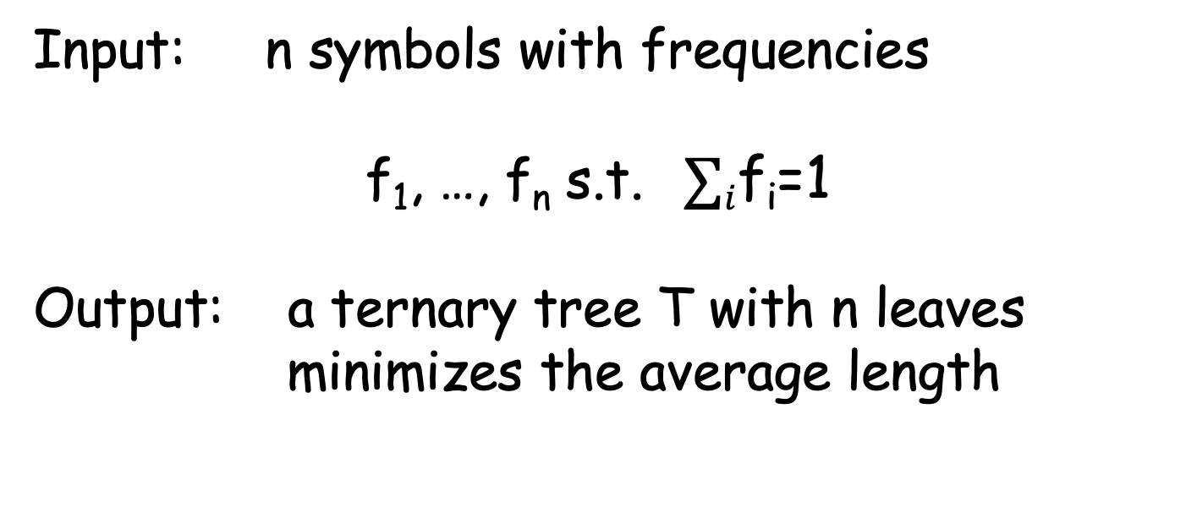
Optimal Prefix Codes over {0,1,2}
Input: n symbols with frequencies
f₁, …, f_{n} s.t. $∑i$f_{i}=1
Output: a ternary tree T with n leaves
minimizes the average length
$∑i$ f_{i} depth_{T}(i)

Slide 22
Modify Huffman Algorithm?
Algorithm?
Time complexity?
Proof of correctness?

Slide 23
Summary: Huffman Coding
Huffman’s Algorithm
(recursion)
Correctness
(prove by induction)
Ternary Huffman

