Slide 1
CSCI-SHU 220: Algorithms
Midterm Review I
(week 1-3)
Fall 2020 @ NYU Shanghai

Slide 2
Algorithms: Solving Problem Efficiently
This Course:
How to design algorithms?
How to analyze algorithms?
(correctness, efficiency)

Slide 3

Asymptotic Time Complexity: measure & compare efficiency
How to measure:
asymptotic number of required basic operations
How to compare:
asymptotic growth ratios

Slide 4
Recurrence / Divide and Conquer
Design:
reduce to smaller instances of the same problem
Analyze:
solving recurrence

Slide 5
Main Goals of Week 1-3
Asymptotic time complexity
measure efficiency of given algorithms
compare order of growth of functions
Solving recurrence
familiar with main techniques
(master theorem, recursion tree, substitution method)
Recurrence/Divide and Conquer
familiar with this idea through examples
apply to new problems

Slide 6
Goal I: Time Complexity

Slide 7
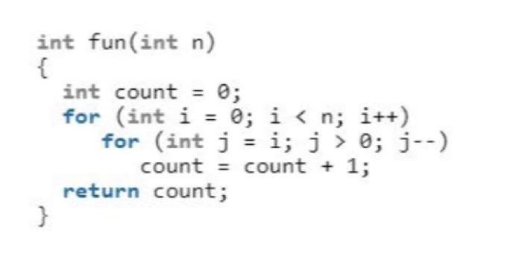
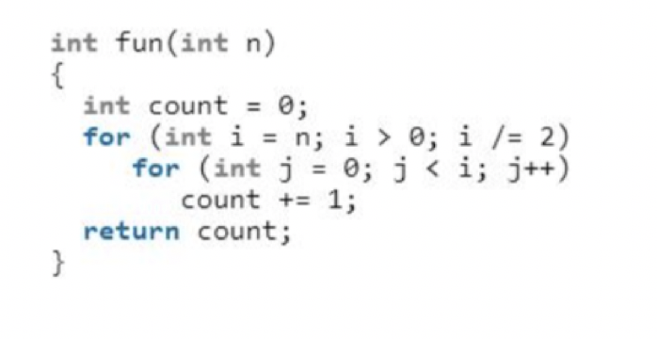
1.1 Measure Efficiency of Given Algorithms
Count (asymptotic) number of basic operations
(ignore multiplicative constant factors & lower order terms)
O(n²)
O(n)

Slide 8
1.2 Compare Order of Growth
For two positive functions f(n) and g(n), we say f is an asymptotic upper bound of g, denoted as,
g(n) = O(f(n))
If either
lim _{n->+∞} g(n) /f(n) = c (for some constant c>=0)
or there exists c, n₀ >0 s.t. for any n>=n_{0,}
g(n) <= c f(n)
(upper bound on a function to within a constant factor)

Slide 9
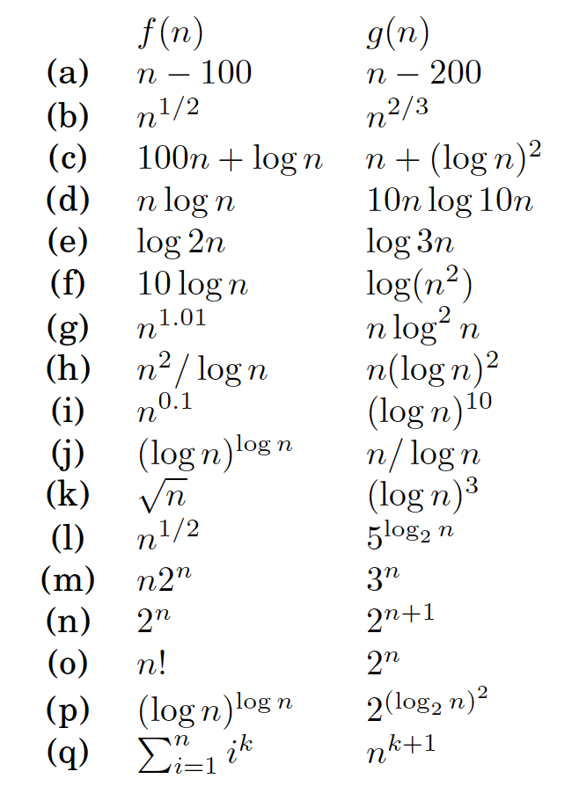
Is g(n) = O(f(n)) ?

Slide 10
Goal II: Solving Recurrence

Slide 11
Main Techniques
Master Theorem
Recursion Tree (expand the recurrence)
Substitution Method (guess & check)

Slide 12
Recurrences
T(n)= T(n/2) + 1
T(n)= T(7n/10)+T(n/5) + n
T(n)= 2T(n/2) + n
T(n)= 3T(n/2) + n
T(n)= 7T(n/2) + n²
T(n)= 2T(n/2) + log n
T(n)= T(n-1) + n

Slide 13
Goal III: Divide and Conquer

Slide 14
Divide and Conquer
Divide (分):
breaking into subproblems
Conquer (治):
recursively solving subproblems
Combine (合):
combining their answers

Slide 15
Reduce to Two Subproblems
Merge Sort
Maximal Subarray
Counting Inversions
Closest Pairs ([KT 5.4])

Slide 16
Reduce to Three Subproblems
Integer Multiplication

Slide 17
Reduce to Seven Subproblems
Matrix Multiplication

Slide 18
Reduce to Two Subproblems of Different Size
Finding Median ([CLRS] 9.3)

Slide 19
Other Problems
3 SUM
Computing Fibonacci Number

Slide 20
FAQ
Master Theorem: when cannot apply & why
Closest Pairs: why 11 boxes?
Finding Median: what’s algorithm doing?

Slide 21
Summary
Time Complexity
Solve Recurrence
Divide and Conquer

Slide 22
More Details in the Reference Book
Time Complexity [CLRS] Chapter 3.1
Solving Recurrence [CLRS] Chapter 4.3-4.5

