Slide 1
CSCI-SHU 220: Algorithms
Dynamic Programming
Fall 2020 @ NYU Shanghai

Slide 2
Compute n-th Fibonacci Number
Input: n
Output: the n-th Fibonacci Number

Slide 3
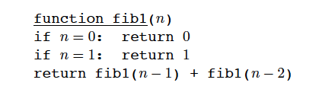
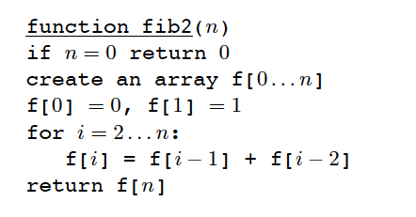
Two Programs
A recursive program using definition
T(n) = T(n-1) + T(n-2) + O(1)
T(n) = O(1.618^{n})
memorize intermediate values using a table
O(n)

Slide 4
Dynamic Programming (动态规划)
Store intermediate values
(programming: tabular method)
Use a recurrence relation
with only polynomially many subproblems
The key: come up with the right recurrence
(=> efficient algorithm)

Slide 5
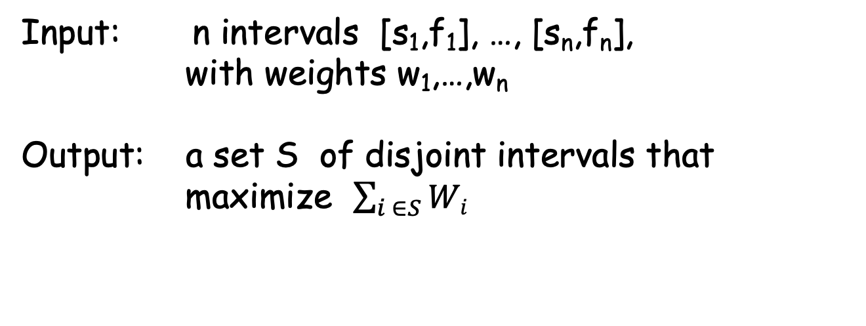
Problem 1: Weighted Interval Scheduling
Input: n intervals [s₁,f₁], …, [s_{n},f_{n}],
with weights w₁,…,w_{n}
Output: a set S of disjoint intervals that
maximize $\sum_{i ∈S}{Wi}$
Room scheduling with payments
(no known greedy algorithm)

Slide 6

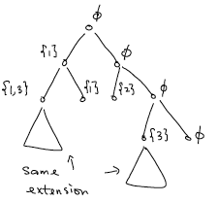
Exhaustive Search
Choose 1 or not
Only the last interval in
the partial solution matters
Keep track of the boundary of the partial solutions

Slide 7

Better Recurrence
sort: s₁<=s₂<=…<=s_{n}
next[i]: first non-overlapping interval on the right of i
(:=n+1 if not exist)
Opt(i): maximum income that we can earn using intervals from i to n
what we want
not choose 1
choose 1
= max { , }
Opt(2)
Opt(next[1])+w₁
Opt(1)

Slide 8
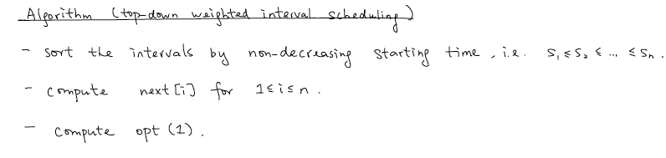
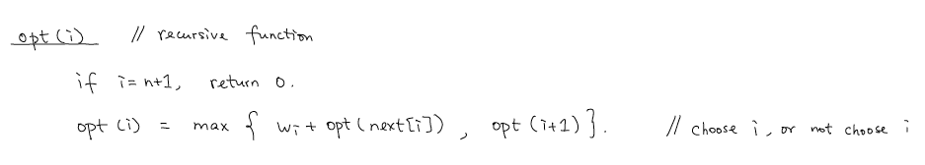
Algorithm (top-down)
_{O(n log n)}
_{O(n)}
_{Time Complexity: O(n logn)}

Slide 9
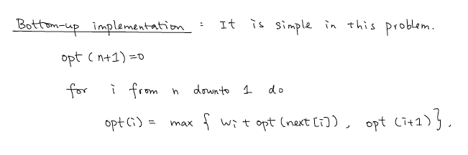
Bottom-up Implementation
_{O(n log n)}
_{O(n)}

Slide 10
3 Questions
What to store:
Opt(i): optimal value using intervals i to n
Recurrence:
Opt(i) = max { Opt(next[i])+w_{i}, Opt(i+1) }
Goal: Opt(1)

Slide 11
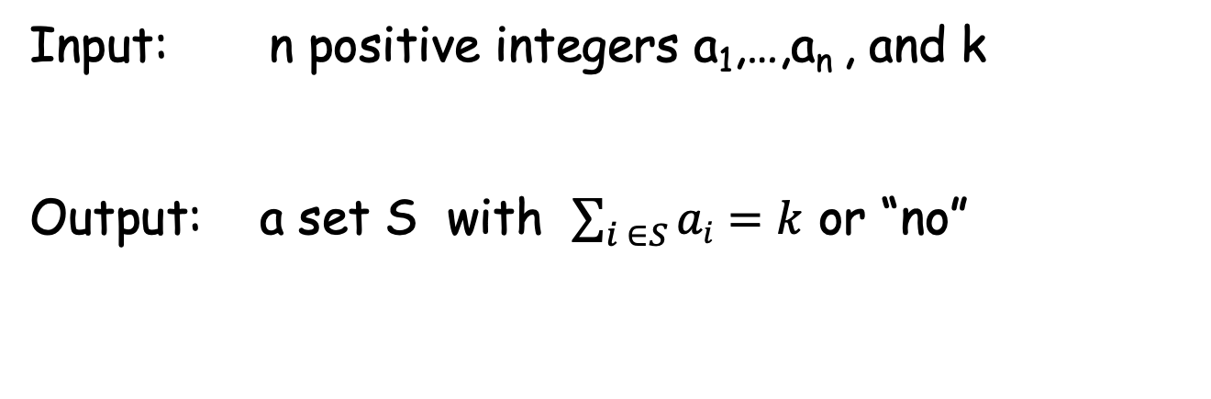
Problem 2: Subset-Sum
Input: n positive integers a₁,…,a_{n} , and k
Output: a set S with $\sum_{i ∈S}{ai}=k$ or “no”
Example: {1,3,10,12,14}, k=27

Slide 12
Recurrence
Choose a₁
Not choose a₁
??? subset from {a₂,…,a_{n}} with sum k-a₁
??? subset from {a₂,…,a_{n}} with sum k

Slide 13
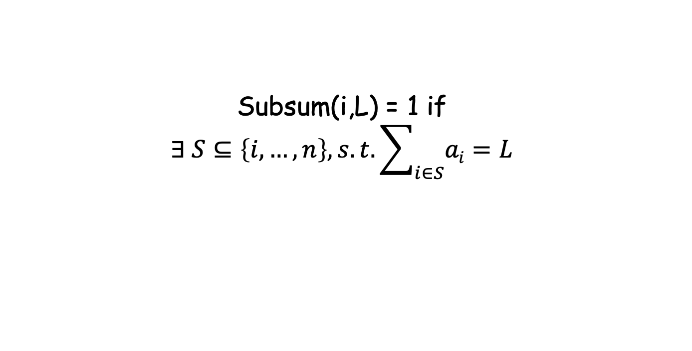
3 Questions
What to store:
Subsum(i,L) = 1 if
$$∃ S⊆\left\{i,…,n\right\}, s.t. \sum_{i∈S}{ai=L}$$
Recurrence:
Subsum(i,L) = Subsum(i+1, L-a_{i}) or Subsum (i+1,L)
Goal: Subsum(1,k)

Slide 14
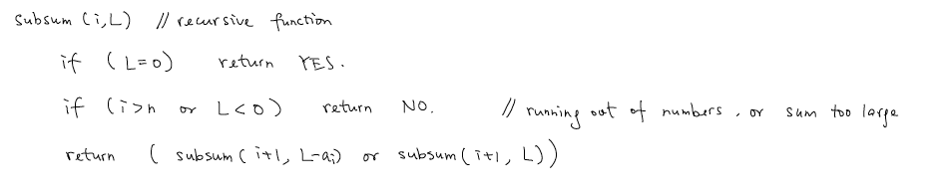
Algorithm (top-down)
Time Complexity: O(nk) (with memorization)
Pseudorandom-polynomial time
Tracing a solution?

Slide 15
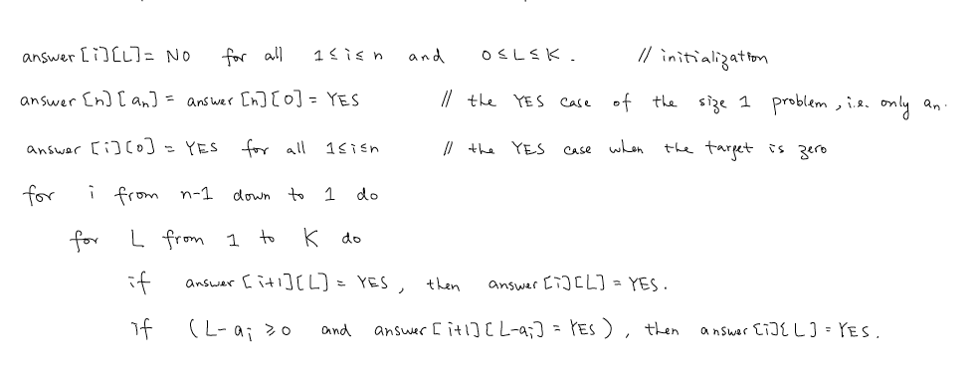
Bottom-up Implementation
Space can be reduced n*k to 2*k

Slide 16
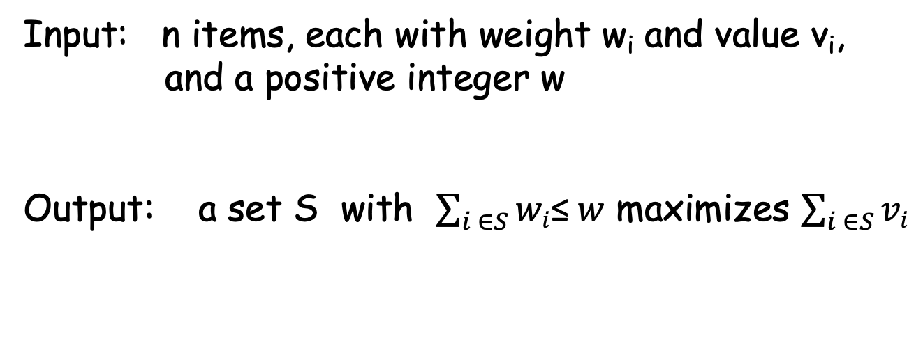
Problem 3: Knapsack
Input: n items, each with weight w_{i} and value v_{i},
and a positive integer w
Output: a set S with $\sum_{i ∈S}{wi}$≤$w$ maximizes $\sum_{i ∈S}{vi}$

Slide 17
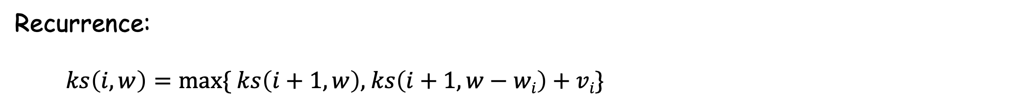
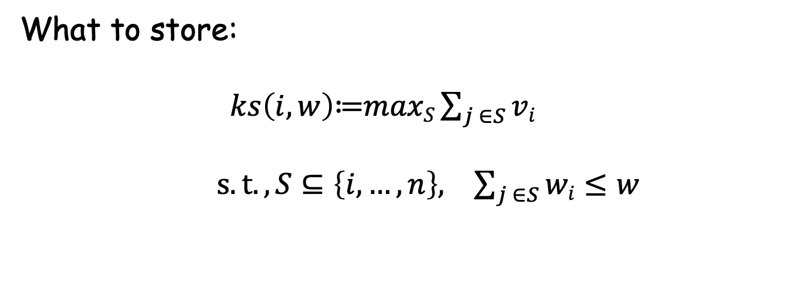
3 Questions
What to store:
$ks\left(i,w\right)$≔$maxS\sum_{j ∈S}{vi}$
$s.t.,S⊆\left\{i,…,n\right\}, \sum_{j ∈S}{wi≤w}$
Recurrence:
$ks\left(i,w\right)=max\{ ks\left(i+1,w\right),$ $ks\left(i+1,w−wi\right)+vi$}
Goal: $ks\left(1,w\right)$

Slide 18
Summary
Dynamic Programming
(tabular method, recurrence)
3 Problems
(weighted interval scheduling, subset sum, knapsack)

