Slide 1
CSCI-SHU 220: Algorithms
Dynamic Programming II
Fall 2020 @ NYU Shanghai

Slide 2
Dynamic Programming (动态规划)
Store intermediate values (tabular method)
Come up with the right recurrence

Slide 3
Longest Increasing Subsequence

Slide 4
Subsequence
A sequence: a₁, …, a_{n}
A subsequence: a_{i1} , …, a_{ik} where 1 ≤ i1 ≤ … ≤ ik ≤ n
An increasing subsequence:
a_{i1} < … < a_{ik}

Slide 5
Longest Increasing Subsequence (LIS)
Input: a₁,…,a_{n}
Output: longest increasing subsequence
Example: 5, 2, 8, 6, 3, 6, 9, 7
2,3,6,9

Slide 6
Trivial Algorithm?
Enumerate all subsequences, then check
Total number of subsequences: 2^{n}
Time complexity: O(n 2^{n})

Slide 7
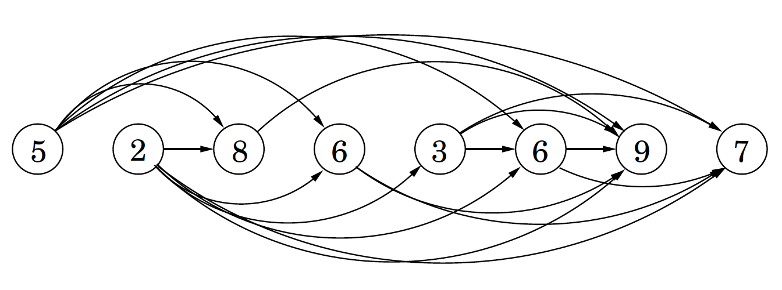
Look At the Problem Differently
5, 2, 8, 6, 3, 6, 9, 7
add a directed edge (i,j) whenever i <j and a_{i} < a_{j}
a DAG: directed and acyclic graph
linearized: arranged in a line that all edges go from left to right
LIS in the sequence <=> longest path in the DAG
Notes:
acyclic: no cycle in the graph

Slide 8
Longest Path in the DAG
The length of longest path starting at
7
9
6
3
6
8
2
5
The length of longest path is
Notes:
7:1
9:1
6：2
3：3（if 3 goes to 6 we know the longest path starting from 6 is 2, so its 3）
6': 2
8: 2
2: 4
5: 3

Slide 9
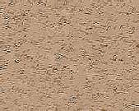
DP for LIS
What to store: L[i]
length of LIS/longest path starting at i
Recurrence:
L[i] = 1 + max{L[j]| i<j<=n, a_{j}>a_{i}}
Goal: max{L[1],…,L[n]}

Slide 10
Compute L[1],…,L[n]?
L[i] = 1 + max{L[j]| i<j<=n, a_{j}>a_{i}}
3, 8, 7, 2, 6, 4, 12, 14, 9
L values: 4, 3, 3, 4, 3, 3, 2, 1, 1
Print out the solution?

Slide 11

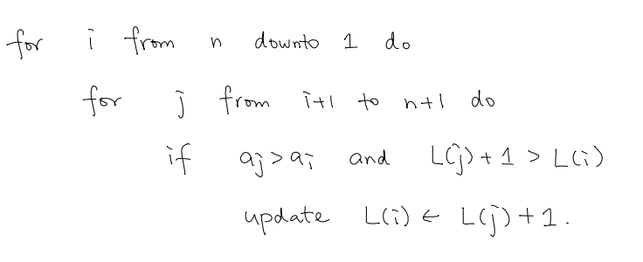
Bottom Up Implementation
Time complexity: O(n²)

Slide 12
DP & DAG
identifying a collection of subproblems
tackling them one by one (small, large, whole)
nodes: subproblems
“implicit” DAG
edges: dependencies between subproblems

Slide 13
Longest Common Subsequence

Slide 14


Longest Common Subsequence
Input: a₁,…,a_{n} , and b₁,…,b_{m}
Output: the largest k s.t. there exists
i₁<i₂<…<i_{k} and j₁<j₂<…<j_{k} with a_{it} = b_{jt}
_{Example:}

Slide 15
LIS and LCS
3, 8, 7, 2, 6, 4, 12, 14, 9
2, 3, 4, 6, 7, 8, 9, 12, 14
(LCS)
3, 8, 7, 2, 6, 4, 12, 14, 9 (LIS)
LIS is a special case of LCS

Slide 16
Recurrence
C[i,j]: length of LCM between
a_{i}, …, a_{n}
b_{j}, …, b_{m}
used both a_{i} and b_{j}
a_{i} not used
b_{j} not used
Notes:
1: when ai = bj

Slide 17
DP for LCS
What to store: C[i,j]
length of LCS between a_{i},…,a_{n} and b_{j},…,b_{m}
Recurrence:
C[i,j] = max{ 1+ C[i+1,j+1], C[i+1,j], C[i,j+1]}
Goal: C[1,1]
only if a_{i}=b_{j}
not use a_{i}
not use b_{j}
O(nm)

Slide 18
Edit Distance

Slide 19
Edit Distance
Input: a₁,…,a_{n} , and b₁,…,b_{m}
Output: minimal k so that k add/delete/change
operations transform one to another
Example: SNOWY and SUNNY

Slide 20
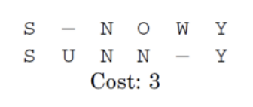
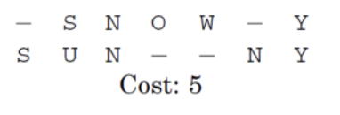
Two Ways of Editing SNOWY to SUNNY

Slide 21
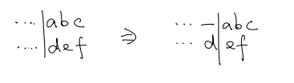
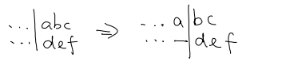

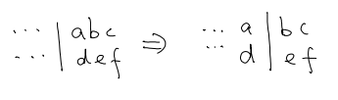


Recurrence
D[i,j]: edit distance between
a_{i}, …, a_{n}
b_{j}, …, b_{m}
add b_{j}
delete a_{i}
change
match

Slide 22
DP for Edit Distance
What to store: D[i,j]
edit distance between a_{i},…,a_{n} and b_{j},…,b_{m}
Recurrence:
add b_{j}
delete a_{i}
change
match
Goal: D[1,1]
1+D[i,j+1]
1+D[i+1,j]
min = D[i,j]
1+D[i+1,j+1]
D[i+1,j+1]
O(nm)

Slide 23
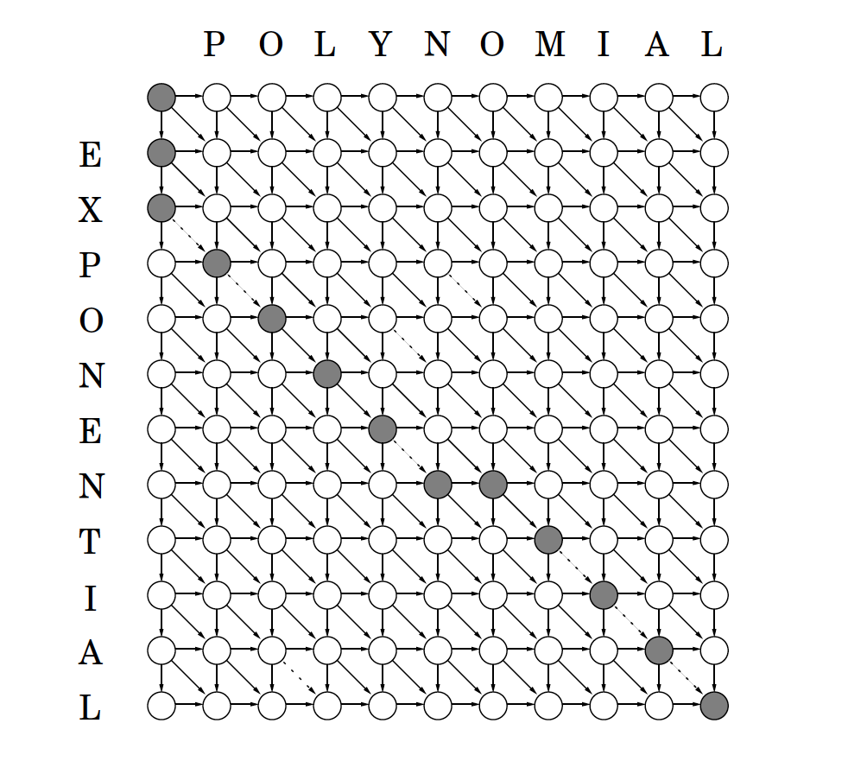
The Underlying DAG

Slide 24
Summary
3 problems
(LIS, LCS, Edit Distance)
DP & DAG

