Slide 1
CSCI-SHU 220: Algorithms
Dynamic Programming II
(continued)
Fall 2020 @ NYU Shanghai

Slide 2
Dynamic Programming (动态规划)
Store intermediate values (tabular method)
Come up with the right recurrence

Slide 3
Edit Distance

Slide 4
Edit Distance
Input: a₁,…,a_{n} , and b₁,…,b_{m}
Output: minimal k so that k add/delete/change
operations transform one to another
Example: SNOWY and SUNNY

Slide 5
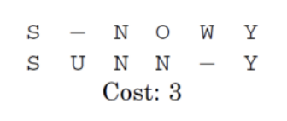
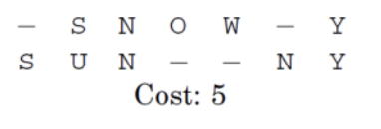
Two Ways of Editing SNOWY to SUNNY
Add “S”
Add “U”
Change “S” to “U”
Change “O” to “N”
Delete “W”
Delete “O”
Delete “W”
Is 3 the minimal cost?
Add “N”

Slide 6
A Trivial Algorithm
Edit distance between
“EXPONENTIAL”
“POLYNOMIAL”
Enumerate all possible changes to transform one to another
How?
Add “P”
& Transform “EXPONENTIAL” to “OLYNOMIAL”
Delete “E”
& Transform “XPONENTIAL” to “POLYNOMIAL”
Change “E” to “P”
& Transform “XPONENTIAL” to “OLYNOMIAL”

Slide 7
A Recursive Program
ED(i, j) // edit distance between a_{i}, …, a_{n} and b_{j}, …, b_{m}
//base case
if (i=n+1) return m+1-j.
if (j=m+1) return n+1-1.
//add b_{j}
D1 = ED(i,j+1) + 1,
//delete a_{i}
D2 = ED(i+1,j) + 1,
//change or match, diff(a_{i},b_{j}) =1 if a_{i} != b_{j}
D3 = ED(i+1,j+1) + diff(a_{i},b_{j}),
return min{D1,D2,D3}.
Time complexity: O(3^{n+m})

Slide 8
DP for Edit Distance
What to store: D[i,j]
edit distance between a_{i},…,a_{n} and b_{j},…,b_{m}
Recurrence:
add b_{j}
delete a_{i}
change/match
Goal: D[1,1]
1+D[i,j+1]
1+D[i+1,j]
min = D[i,j]
Diff(a_{i},b_{j})+D[i+1,j+1]

Slide 9
Top-Down (Recursion with memorization)
Initialize D[i,j] = infinity for 1<=i<=n, 1<=j<=m
_{Compute ED(1,1)}
ED(i, j) //recursive program
If (D[i,j] ! = infinity) return D[i,j]
//memorization
if (i=n+1)
D[i,j] =m+1-j
//base case
else if (j=m+1)
D[i,j] =n+1-i
else
//recurrence
D[i,j]= min{ ED(i,j+1) + 1, ED(i+1,j) + 1, ED(i+1,j+1) + diff(a_{i},b_{j})}
return D[i,j]

Slide 10
Bottom Up Implementation
_{for i} _{= 1,…,n;} _{D[i,m+1] = m+1-j}
_{for j} _{= 1,…,m;} _{D[n+1,j] = n+1-i}
_{for i = n ,…, 1}
_{for j = m,…, 1}
D[i,j]= min{ D[i,j+1] + 1, D[i+1,j] + 1, D[i+1,j+1] + diff(a_{i},b_{j})}
_{Return D[1,1]}
Time complexity: O(nm)

Slide 11
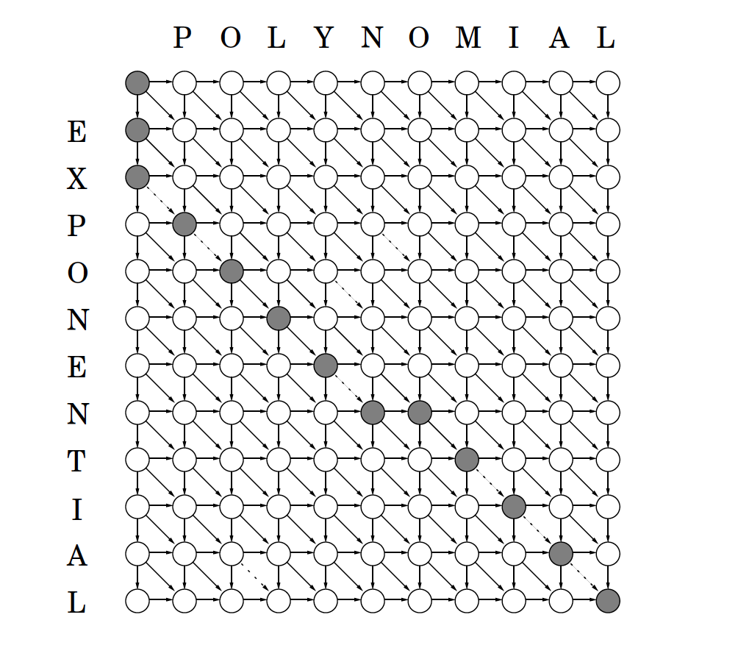
The Underlying DAG
nodes <=> subproblems: positions in the table
edges <=> recurrence: (i,j) -> (i,j+1), (i+1,j), (i+1,j+1)
shortest path <=> final answer
(go down -> add, go right->delete)

Slide 12
Longest Increasing Subsequence

Slide 13
Longest Increasing Subsequence (LIS)
Input: a₁,…,a_{n}
Output: longest increasing subsequence
Example: 5, 2, 8, 6, 3, 6, 9, 7
2,3,6,9

Slide 14
DP for LIS
What to store: L[i]
length of LIS/longest path starting at i
Recurrence:
L[i] = 1 + max{L[j]| i<j<=n, a_{j}>a_{i}}
Goal: max{L[1],…,L[n]}

Slide 15

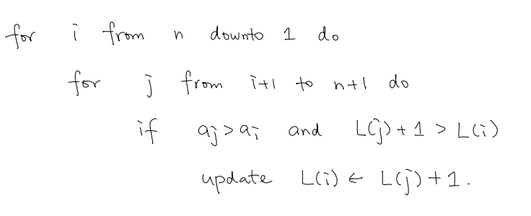
The Algorithm
Time complexity: O(n²)

Slide 16
Can We Do Better?
L[i] = 1 + max{L[j]| i<j<=n, a_{j}>a_{i}}
Can we check less than L[i+1], …, L[n]?
2, 3, 4, 3, 6, 5, 8,7
L-values
3, 3, 2, 2,1,1
compute L[2]: use “best” solution of each length
best[j] = the best position of starting LIS with length j
best[1] =7, best[2]=5, best[3]=3

Slide 17
Sortedness
a[best[L]] < a[best[L-1]] < … < a[best[1]]
2, 3, 4, 3, 6, 5, 8,7
3, 3, 2, 2,1,1
L=3, a[best[3]]=4, a[best[2]]=6, a[best[1]] = 8
Why?
if a[best[j]] >= a[best[j-1]], then
a_{p1} < a_{p2} <… < a_{pj} is an IS with length j, p1 =best[j]
a_{p2} <… < a_{pL} is an IS with length j-1, a_{p2} > a_{best[j]} >= a_{best[j-1]}
Contradicting maximality of best[j-1]

Slide 18
Updating Best[j]
After a[n],…,a[i+1], we obtain best[1],…,best[L]
a[best[L]] < a[best[L-1]] < … < a[best[1]]
When consider a[i], we now update best[1],...,best[L]
If a[i] < a[best[L]], best[L+1] = i, L=L+1
If a[best[j]] < a[i] < a[best[j-1]], best [j]=i
If a[best[1]] < a[1], best[1]=i

Slide 19
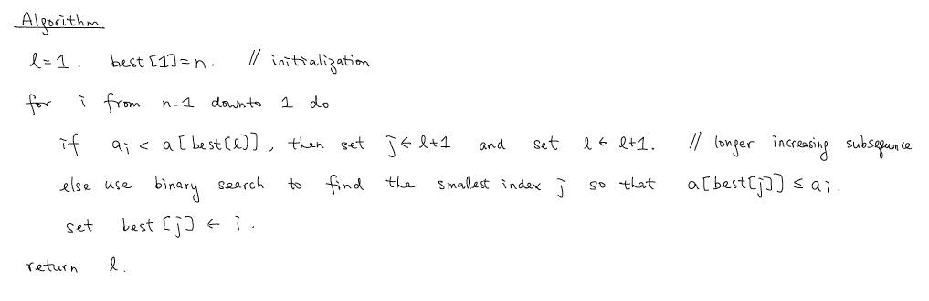
Algorithm
time complexity: O(n log n)

Slide 20
Example
best[j] = the best position of starting LIS with length i
2, 3, 4, 3, 6, 5, 8,7
L=1, best[1]=8
i=7, L=1, best[1]=7
i=6, L=2, best[2]=6, best[1]=7
i=5, L=2, best[2]=5, best[1]=7
i=4, L=3, best[3]=4, best[2]=5, best[1]=7
i=3, L=3, best[3]=3, best[2]=5, best[1]=7
i=2, L=4, best[4]=2, best[3]=3, best[2]=5, best[1]=7
i=1, L=5, best[5]=1, best[4]=2, best[3]=3, best[2]=5, best[1]=7

Slide 21
Summary
Edit Distance
O(nlogn) Algorithm for LIS

