Slide 1
CSCI-SHU 220: Algorithms
Dynamic Programming on Trees
Fall 2020 @ NYU Shanghai

Slide 2
Independent Set

Slide 3
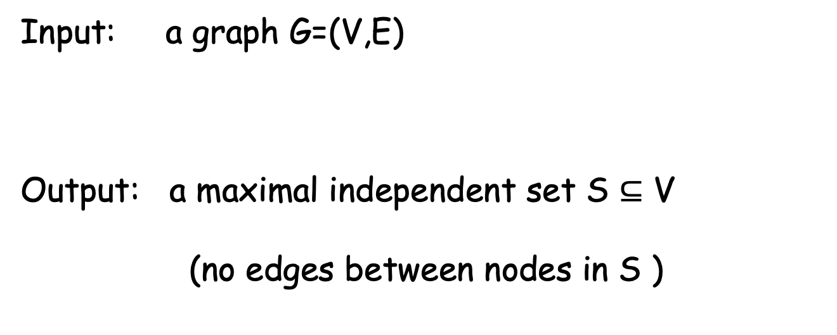
Independent Set
Input: a graph G=(V,E)
Output: a maximal independent set S $⊆$ V
(no edges between nodes in S )
Special cases: interval scheduling

Slide 4
The Trivial Algorithm
Enumerate all possible S, and check
Time complexity: O(n 2^{n})
Polynomial time algorithm??
One of the biggest open problem (USD 1000000)

Slide 5
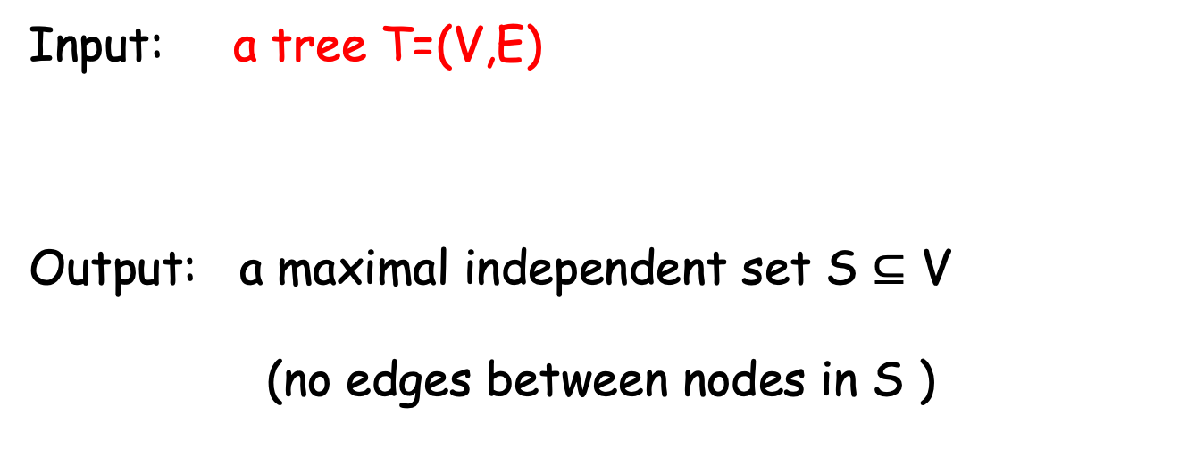
Our Problem: IS on Trees
Input: a tree T=(V,E)
Output: a maximal independent set S $⊆$ V
(no edges between nodes in S )

Slide 6
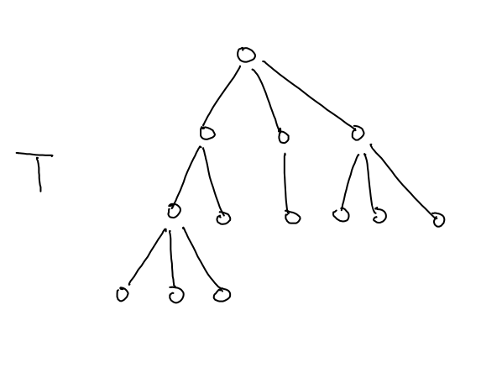
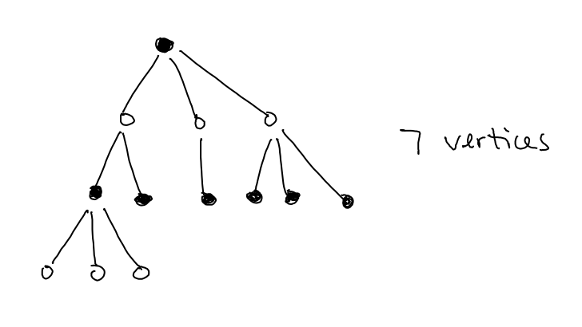
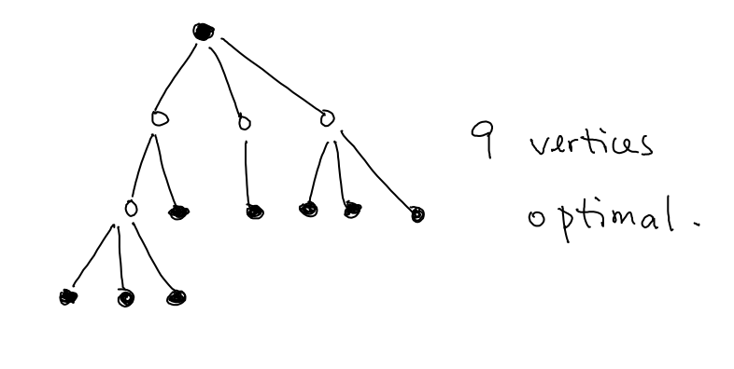
An Example

Slide 7
The Collection of Subproblems
for each vertex v in the tree, consider I(v):
maximal independent set in the subtree rooted at v
Our goal: I(root)
Base case: I(leaf) = 1

Slide 8
Recurrence: Choose or Not Choose the Root
Pick an independent set in tree rooted at v
Case I: choose v
cannot pick v’s children
pick IS from subtrees rooted at v’s grandchildren
Case I: not choose v
pick IS from subtrees rooted at v’s children
I(v) = max{ 1+ sum _{w: v’s grandchild} I(w), sum _{u: v’s child} I(u)}

Slide 9
An Example
9
4
1
3
3
1
1
1
1
1
1
1
1
Base case: I(leaf) = 1
Recurrence: I(v) = max{ 1+ sum _{w: v’s grandchild} I(w), sum _{u: v’s child} I(u)}
Goal: I(root) =9 (1+ sum_{w: v’s grandchild} I(w))

Slide 10
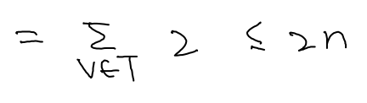
Time Complexity
n subproblems
each subproblem on v requires O(# children + # grandchildren)
total time complexity : O(n)
(bottom up/top-down memorization)

Slide 11
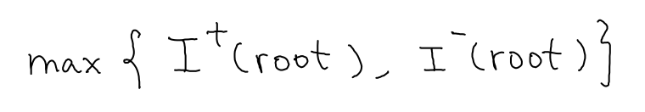
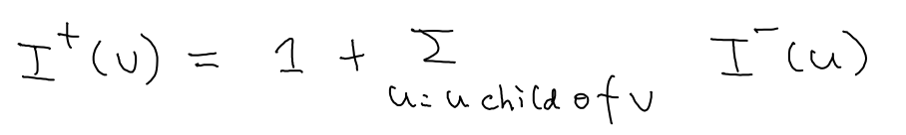
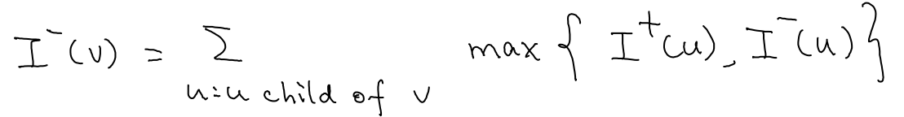
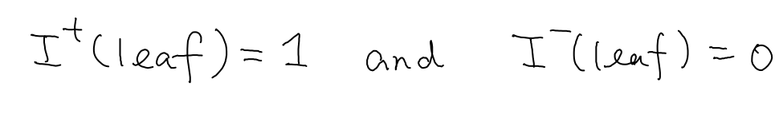
Alternative Recurrence
I⁺(v): size of maximal IS in subtree rooted at v
with v in the solution
I⁻(v): size of maximal IS in subtree rooted at v
without v in the solution
final answer:
recurrence:
base case:

Slide 12
Optimal Binary Search Tree

Slide 13
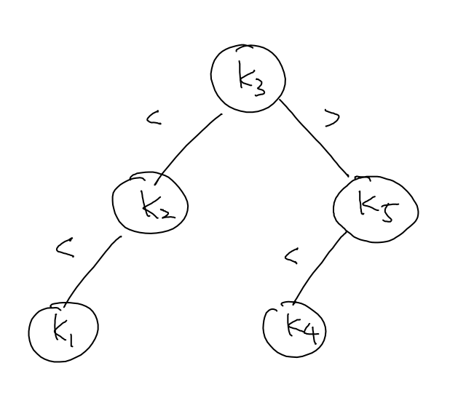
A Dictionary Using Binary Search Tree
minimal number of comparisons to locate a key?
what if some strings are searched more frequently?

Slide 14
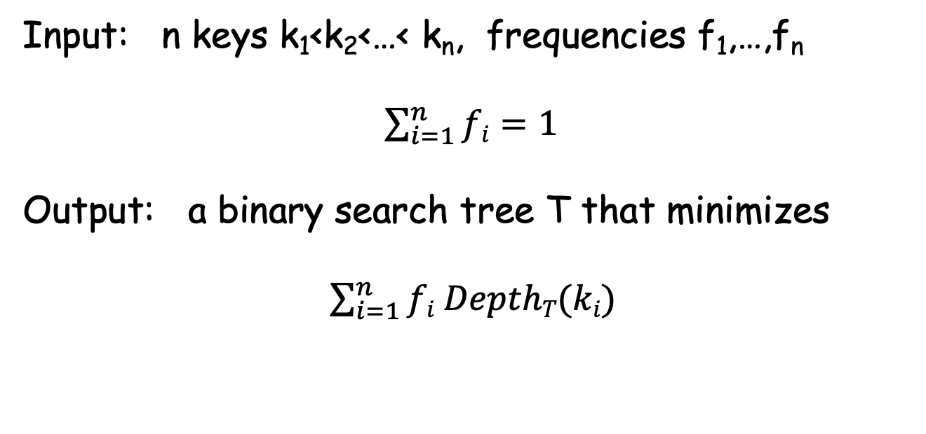
Our Problem: Optimal Binary Search Tee
Input: n keys k₁<k₂<…< k_{n}, frequencies f₁,…,f_{n}
$\sum_{i=1}^{n}{fi=1}$
Output: a binary search tree T that minimizes
$\sum_{i=1}^{n}{fi DepthT(ki)}$

Slide 15
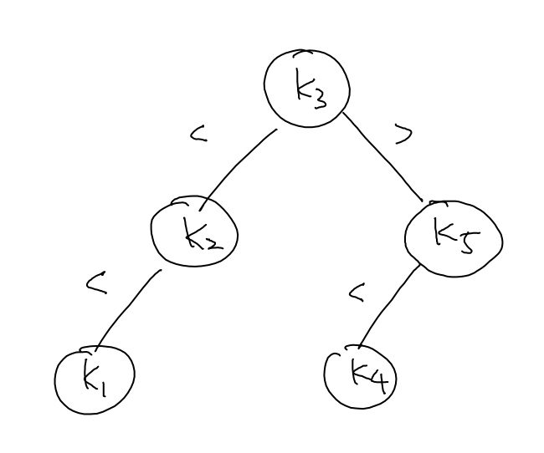
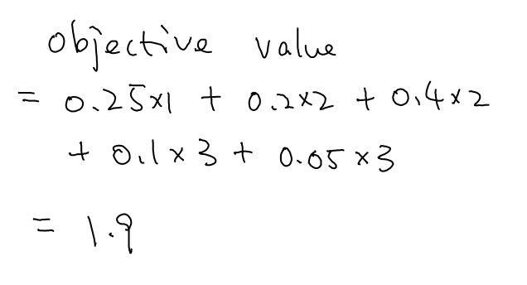
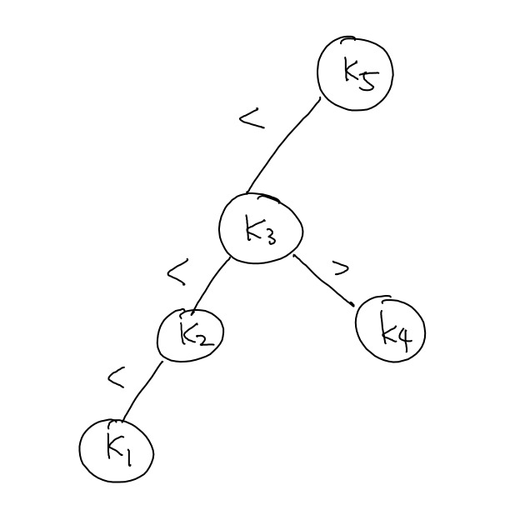
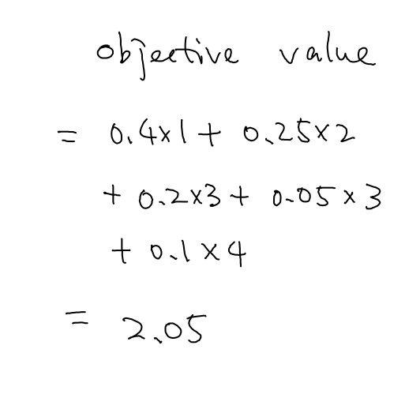
An Example

Slide 16
The Trivial Algorithm
Enumerate all possible binary search trees
Pick a root k_{i}
Generate leftsubtree k₁,…,k_{i-1}
Generate rightsubtree k_{i+1},…,k_{n}
# BST with n nodes = (2n choose n)/n+1

Slide 17
The Collection of Subproblems
C[i,j]: the objective value of an optimal binary search tree
using k_{i} < … < k_{j}
Goal: C[1,n]
Base case: C[i,i] = f_{i} C[i-1,i] = 0 (boundary cases)

Slide 18
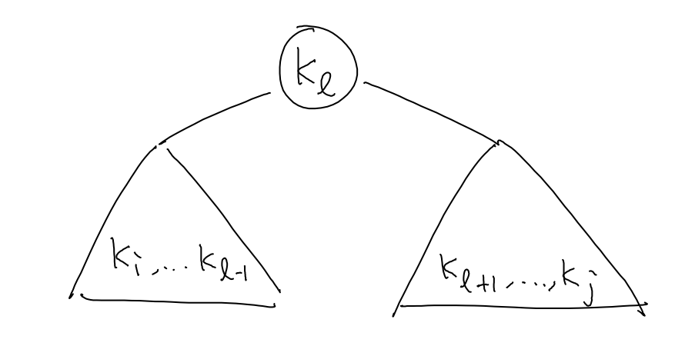
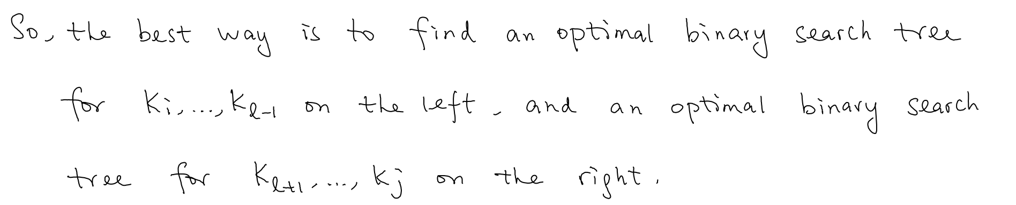
The Recurrence

Slide 19
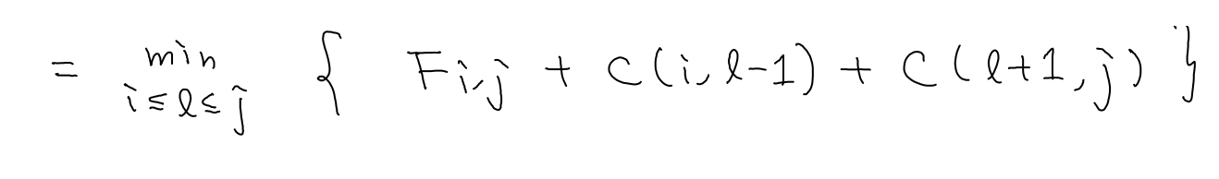
The Recurrence

Slide 20
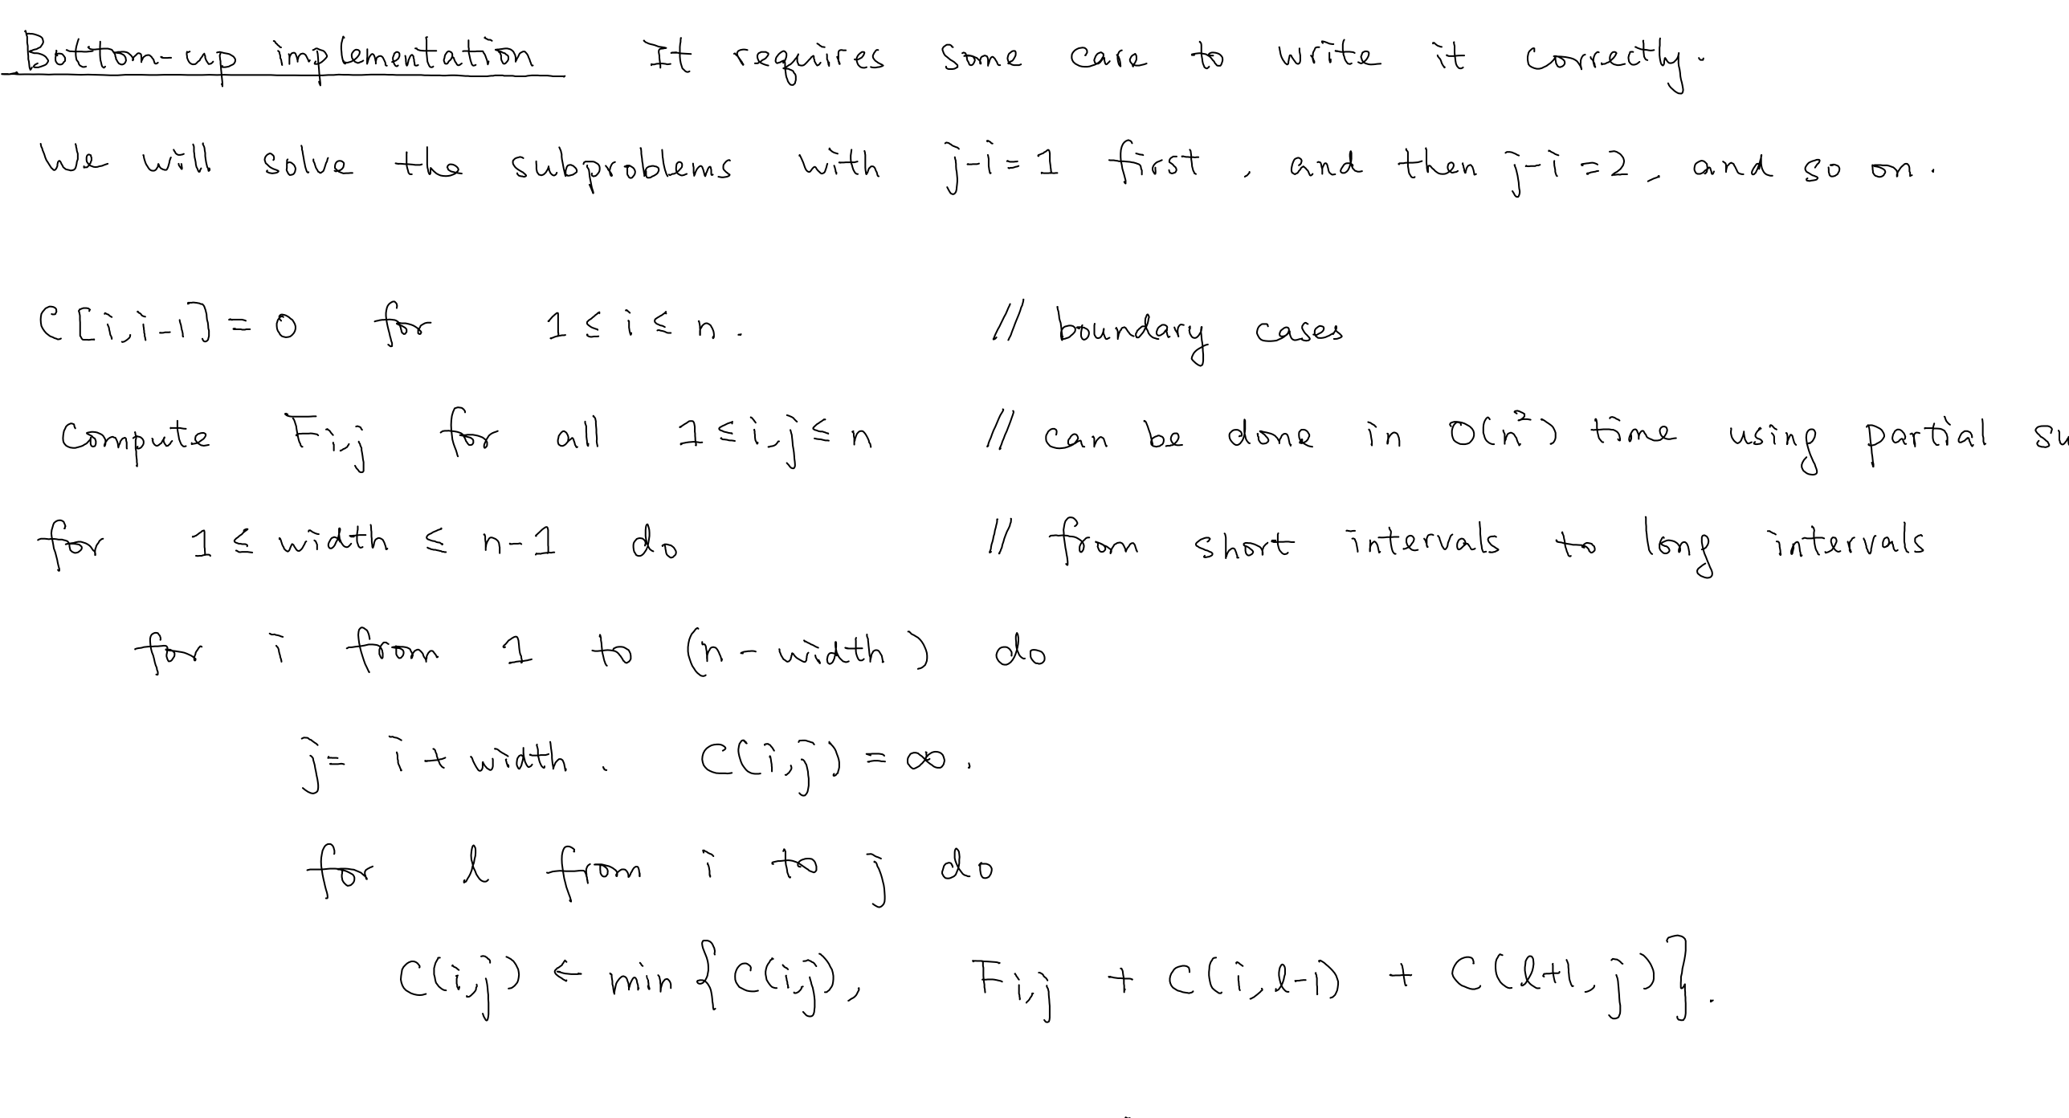
The Algorithm (Bottom-up implementation)

Slide 21
Summary
Independent Set on Trees
Optimal Binary Search Tree

