Slide 1
CSCI-SHU 220: Algorithms
Breadth First Search
Fall 2020 @ NYU Shanghai

Slide 2
Part I: Connectivity

Slide 3
How to Search A Person in a Social Network
ask your friends for help
ask friends of your friends for help
ask friends of friends of your friends for help
……
Breadth First Search (宽度优先搜索)

Slide 4
Modeling The Problem
nodes: persons
edges: friendships
searching a person: graph connectivity

Slide 5
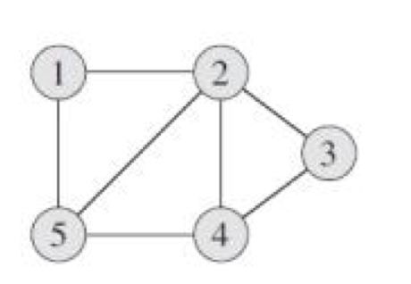
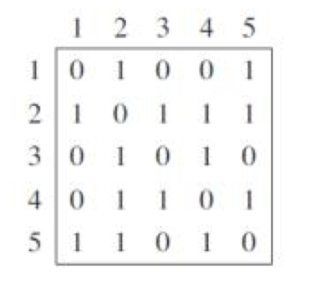
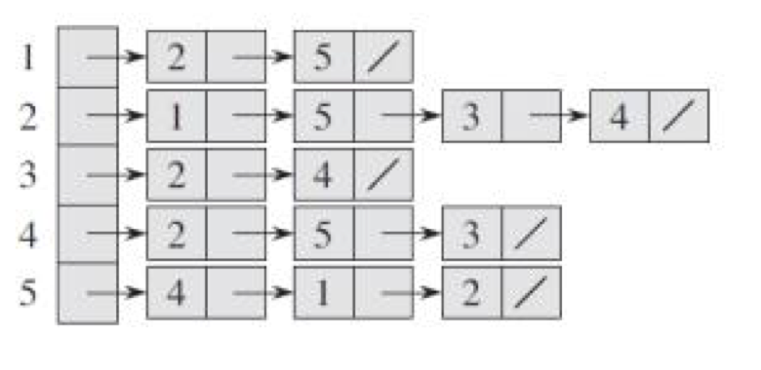
Graph Representations
n: number of nodes
m: number of edges
Adjacency Matrix
Adjacency List
O(n²) space
O(m) space
time for going over all edges?

Slide 6
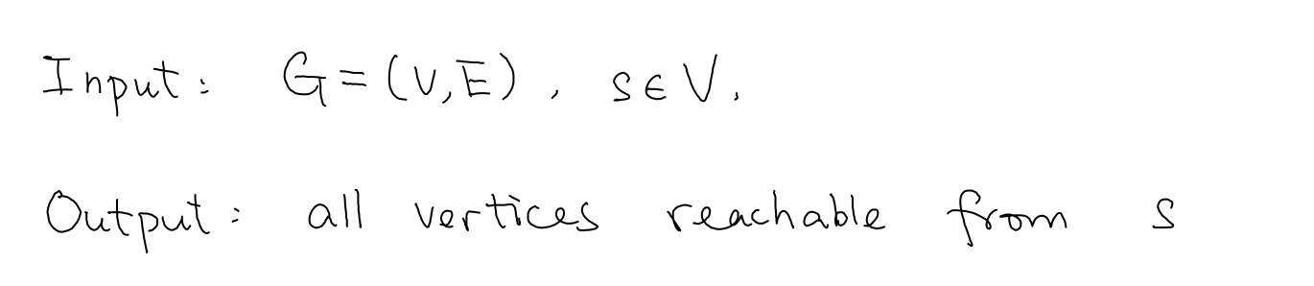
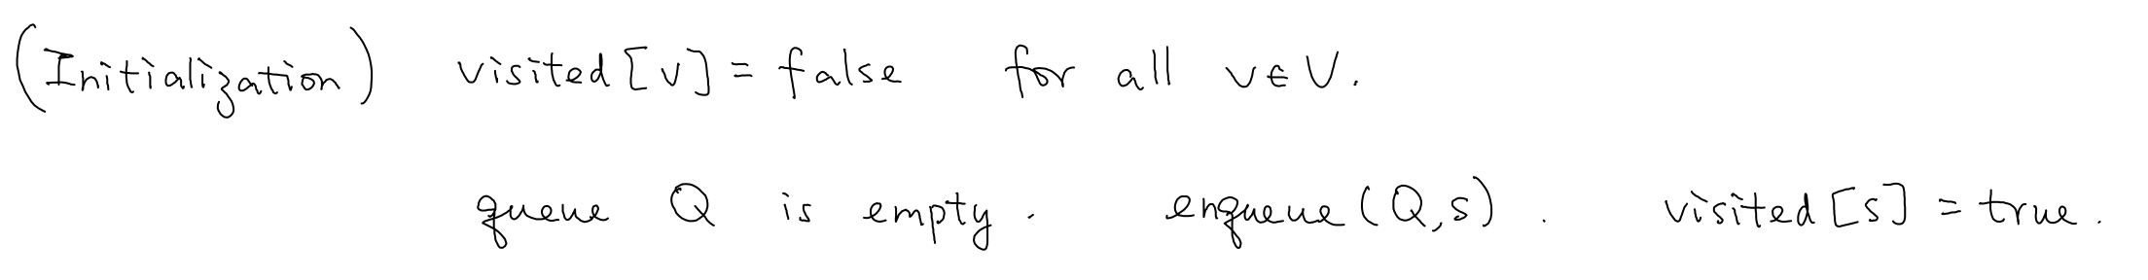
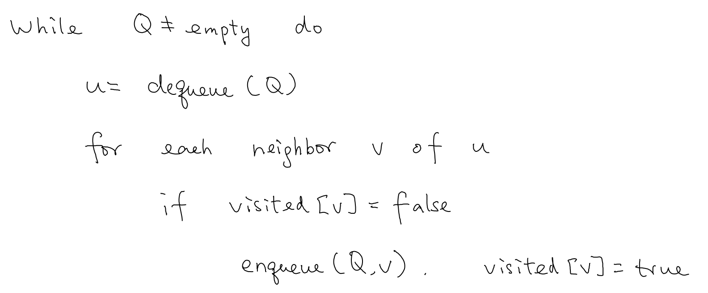
BFS For Connectivity

Slide 7
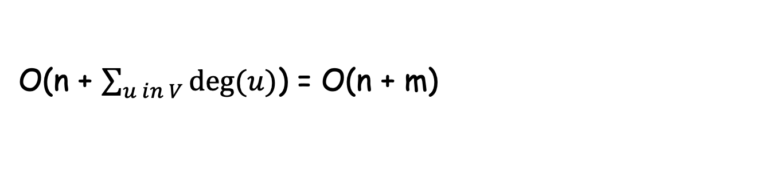
Time Complexity
Each vertex is enqueued at most once
When a vertex u is dequeued, the for loop is executed deg(u) times
O(n + $\sum_{u in V}{deg⁡(u)}$) = O(n + m)

Slide 8
Correctness
Claim: ∃ a path from s to v <=> visited[v] = true at the end
“<=” induction on number of steps of algorithms
base case:
visited[s]= true
inductive step:
if visited[v] is set to be true, inside the for loop of u
then visited[u]=true
so ∃ a path from s to u by induction hypothesis
so ∃ a path from s to v by extending it with edge uv

Slide 9
Correctness
Claim: ∃ a path from s to v <=> visited[v] = true at the end
“=>” U = {v in V: visited[v]=true }
v
S
U
No edges between U and V\U
(otherwise enqueued)
if visited[v]=false and ∃ a path from s to v,
then crossing edge from U to V\U
Contradiction.

Slide 10
Variants
A graph is connected or not
check visited[v] = true for all v in V
Find the connected component containing s
the set of vertices with visited[v]=true
Whether there is a path from s to t
check whether visited[t]=true
Find all connected components
keep finding connected components from the remaining graph

Slide 11
Part II: Shortest Path

Slide 12
Trace Back A Path from v to s?
Add an array parent[v]:
v is first visited within the for loop of u,
then parent[v]=u
Trace back a path from v to s:
starts from v, keep going to its parent
until s

Slide 13
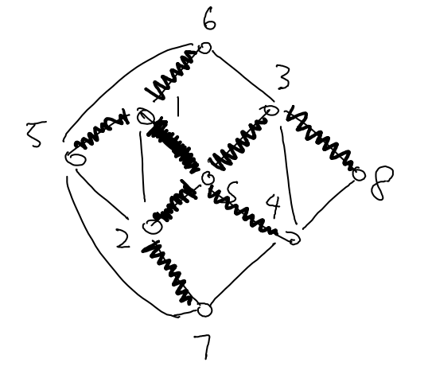
BFS Tree
Nodes: vertices reachable from s
Edges: {(v, parent[v])}
acyclic, (n-1) edges, and n nodes
It is a tree

Slide 14
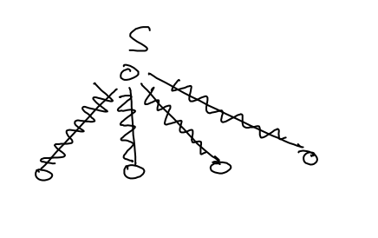
The Shortest Path from v to s?
The same path from v to using the BFS tree
Initially just s
Then all vertices with distance 1 are enqueued
(before other vertices)
all vertices with distance one will be dequeued
all vertices with distance two will be enqueued
(before vertices with distance at least 3)
………

Slide 15
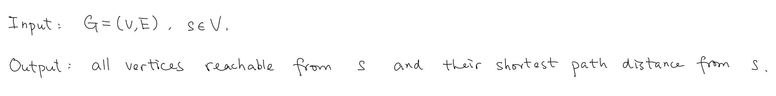
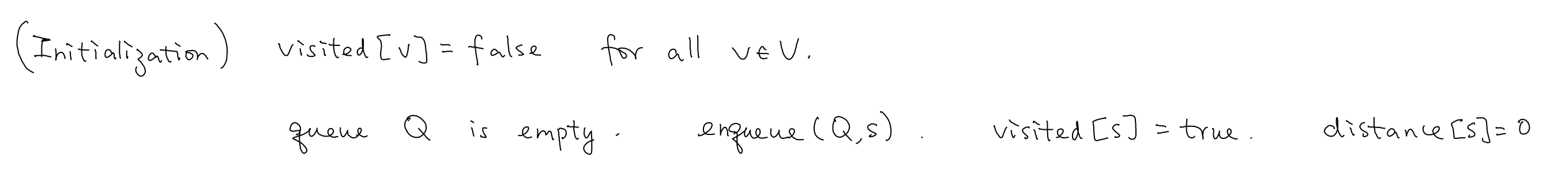
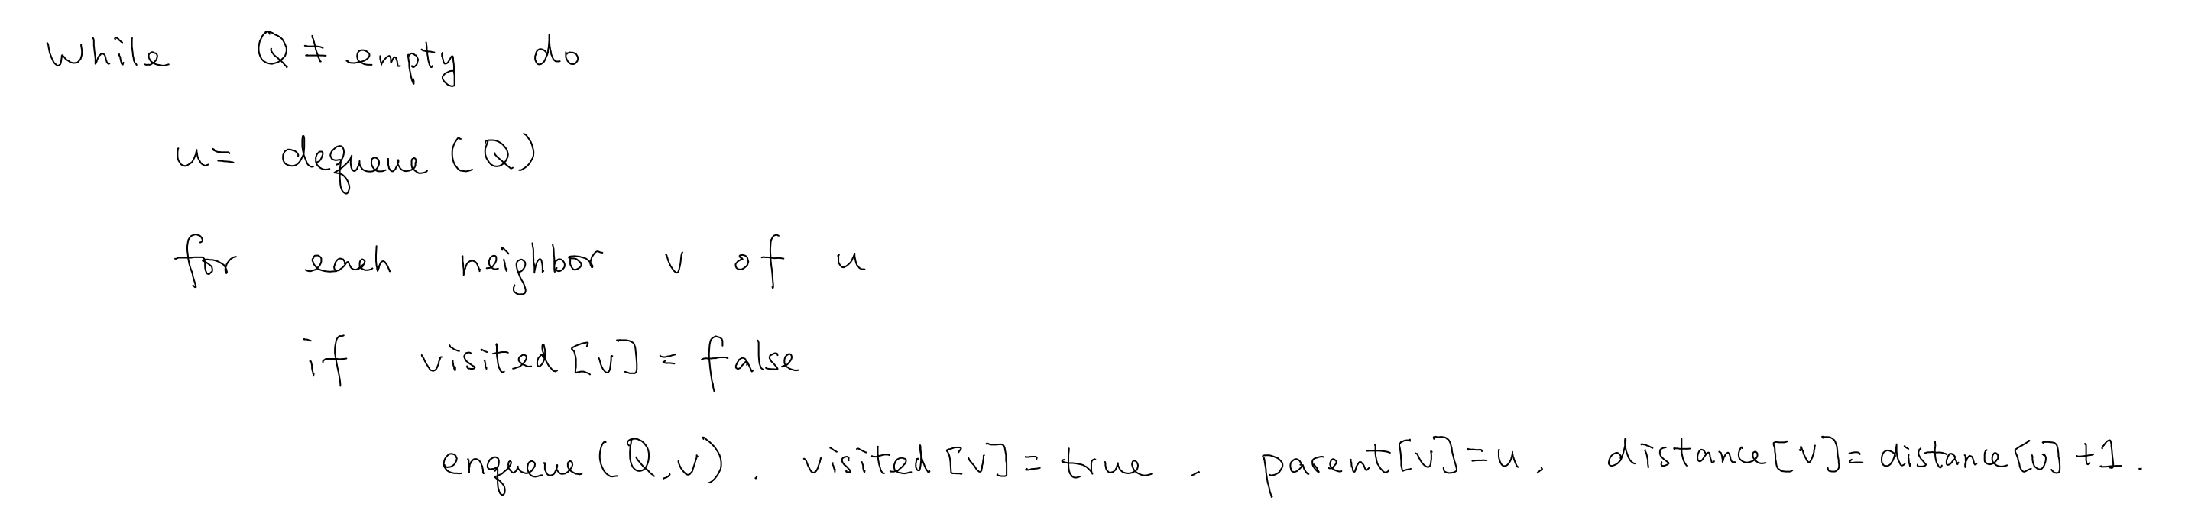
BFS for Shortest Distances

Slide 16
Part III: Bipartiteness

Slide 17
Bipartite Graphs
V can be partitioned into L and R
L and R are non-empty independent sets

Slide 18
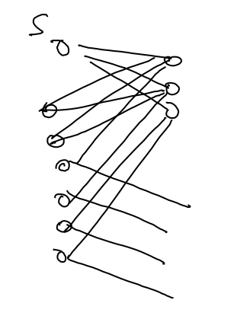
Checking Bipartiteness
neighbors must be on the other side
neighbors of neighbors must be on the same side
neighbors of neighbors of neighbors must be on the other side

Slide 19
Algorithm
L:={v in V | dist(s,v) is even}
R:={v in V | dist(s,v) is odd}
If there are edges within L, and R, return non-bipartite
Otherwise return (L,R) as bipartite
Time complexity: O(n+m) (BFS once + checking)

Slide 20
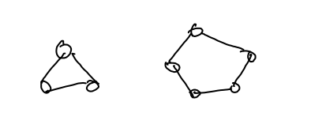
Correctness
Algorithms return “bipartite”, then it is bipartite (easy)
Algorithms return “non-bipartite”, then it is not:
Suffices to show, there exists an odd cycle

Slide 21
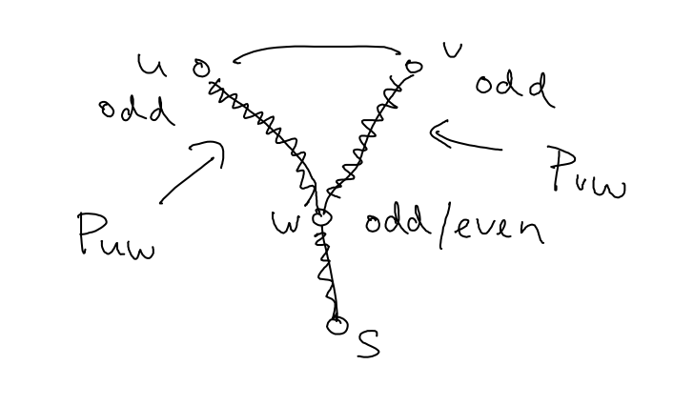
An Odd Cycle
Suppose there exists an edge between u,v in L
Look at the BFS tree, w being their lowest common ancestor
Puw, Pvu and uv forms an odd cycle
Length of the cycle = dist[s,u] + dist[s,v] – 2 dist[s,w] + 1

Slide 22
Summary
Connectivity
Binary Search Tree and Shortest Path
Bipartiteness

