Slide 1
CSCI-SHU 220: Algorithms
The Basics
Fall 2020 @ NYU Shanghai

Slide 2
Time is Precious
一寸光阴一寸金, 寸金难买寸光阴
time is more precious than gold

Slide 3
Time is Precious
Solve problems
efficiently!
How to measure and compare
efficiency (of algorithms)?

Slide 4
Part I: Time Complexity

Slide 5
How to Measure Efficiency?
number of basic operations required by the algorithm
e.g., exact number of comparisons to sort n numbers
Algorithm 1: n²
Algorithm 2: 10nlogn
Algorithm 3: 100n

Slide 6
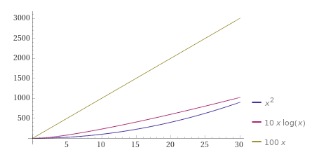
How to Compare? [0,30]
n² is leading !

Slide 7
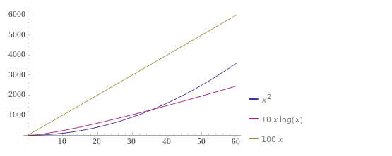
How to Compare? [0,60]
10nlogn surpasses n² !

Slide 8
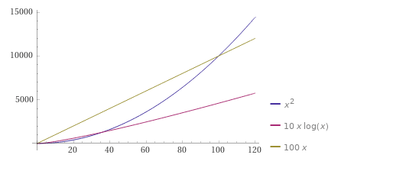
How to Compare? [0,120]
100n surpasses n² ,
but 10nlogn is still leading

Slide 9
The Standard Practice
THINK BIG
Imagine what happens when
n tends to infinity
Determine who grows faster

Slide 10
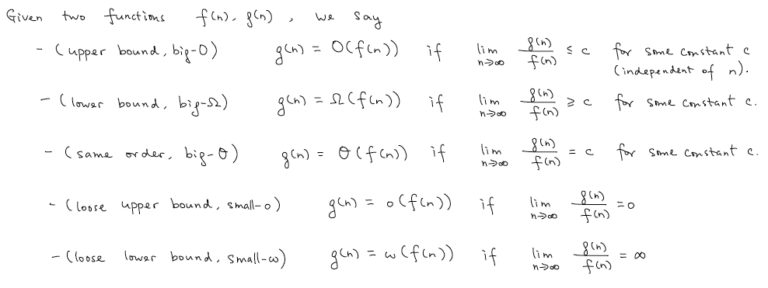







Comparing Asymptotic Growth Ratios
$$“≪”$$
“ $≫”$
$$“=“$$
$$“<“$$
$$“>”$$
10nlogn = $ω($100n)
10nlogn $“>”$ 100n

Slide 11




Alternative Definitions
$$“≪”$$
“ $≫”$
$$“=“$$

Slide 12
Asymptotic Analysis
Ignore leading constants and lower order terms
Focus on the big picture
Enable us to rank functions without great pain

Slide 13
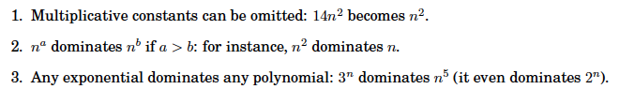








Some Commonsense Rules

Slide 14





Asymptotic Comparisons

Slide 15




Tricky Ones

Slide 16

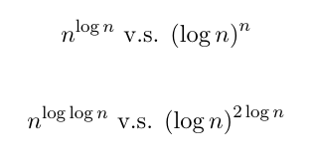
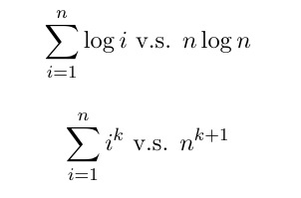
Challenging Ones

Slide 17
Asymptotic Time Complexity
How to measure:
asymptotic number of basic operations required by the algorithm
How to compare:
asymptotic growth ratios

Slide 18
The Word-RAM Model
Basic operations: O(1) time
Access an arbitrary location of an array
Word operations (addition, read/write)
Example: a graph with n vertices
Identify a vertex: log n bits
(usually assume that these bits can be fit into a word )
Comparing local of two vertices: O(1) time
Example: binary search
O(log n) word operations in word-RAM model
Turing machine (with one dimensional tape): cannot do binary search

Slide 19
Part II: 3SUM

Slide 20
Today’s Problem: 3SUM
Input: a₁ , a₂ , … , a_{n} and c
Output: determine if there are i,j,k, s.t.,
a_{i} + a_{j} + a_{k} = c

Slide 21
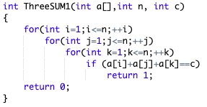
Attempt 1
Enumerate all triples and check whether its sum is c
Correctness?
Efficiency?
O(n³)

Slide 22
Can We Do Better?
Checking whether c-a[i]-a[j] equals to some a[k]

Slide 23
More Efficient Checking?
Input: a₁ , a₂ , … , a_{n} and b
Output: determine if there is a k, s.t., a_{k} = b
General Case: O(n) is necessary and sufficient
Special Case: if a₁ , a₂ , … , a_{n} are sorted, then
Binary Search! O(log n) time!
OK, let us sort then do binary search.

Slide 24
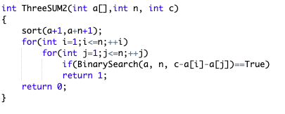
Attempt 2
Enumerate i,j, and check whether c-a_{i}-a_{j} equals some a_{k}
O(n log n)
O(log n) per checking
Efficiency?
O(n log n + n² log n) = O(n² log n)

Slide 25
Can We Do Better?
Checking if there are k,j s.t. a[j]+a[k] = c-a[i]

Slide 26
More Efficient Checking?
Input: a₁ , a₂ , … , a_{n} and b
Output: determine if there are j,k, s.t., a_{j} + a_{k} = b
2SUM Problem
When a is sorted, can be solved in O(n) time

Slide 27
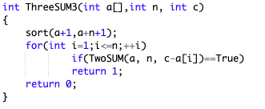
Attempt 3
Enumerate i and check whether c-a_{i} equals some a_{j} +a_{k}
O(n log n)
O(n) per call
Efficiency?
O(n log n + n²) = O(n²)

Slide 28
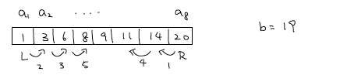
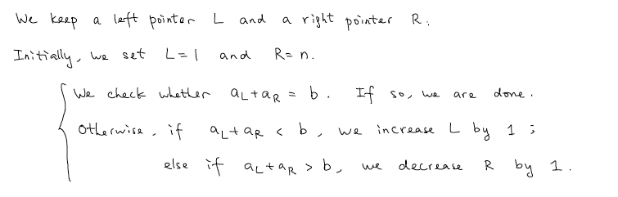

2SUM Algorithm

Slide 29
Time Complexity O(n)
R-L decreases by 1 in each iteration
Algorithm will stop within n-1 iterations

Slide 30
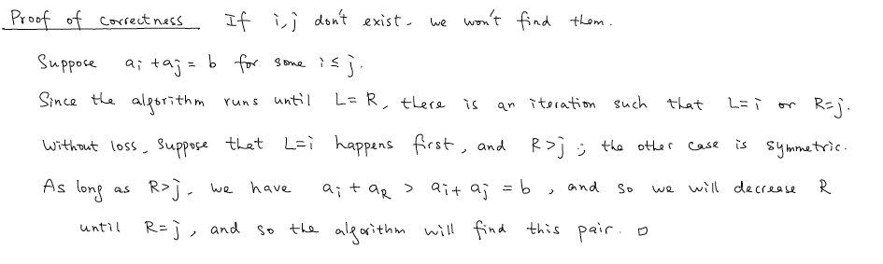
Correctness

Slide 31
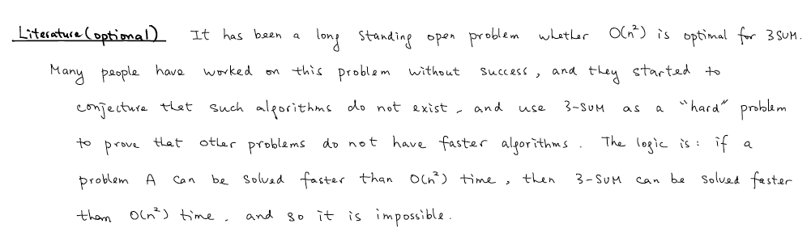
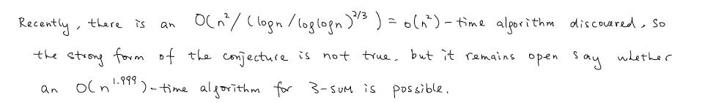
Can We Do Better?

Slide 32
Summary
Asymptotic Time Complexity
(simplify or compare using the big Oh notation)
3-SUM
(reduce to searching or 2 sum on sorted array)

