Slide 1
CSCI-SHU 220: Algorithms
Depth First Search
Fall 2020 @ NYU Shanghai

Slide 2
Part I: Connectivity

Slide 3
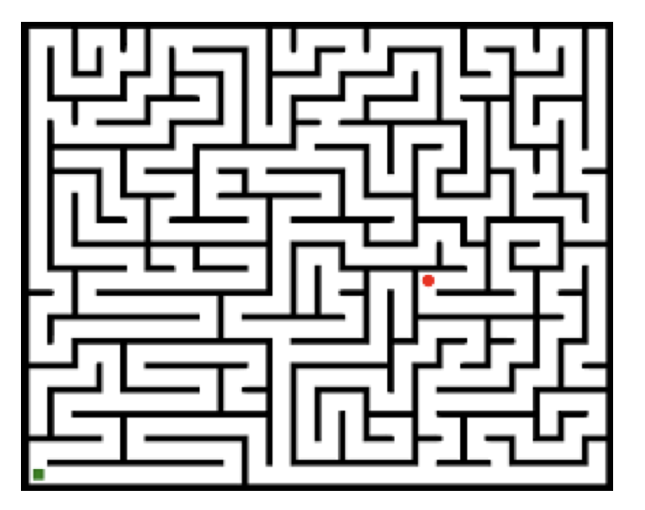
Maze: Searching For the Exit
Natural algorithm with a chalk (no friends but a chalk)
Keep going until hitting a dead end
Make some marks on the way
Only explore unexplored places
Model the problem:
Graph: node (square), edge (reachable in one step)
Finding the exit: s-t connectivity

Slide 4
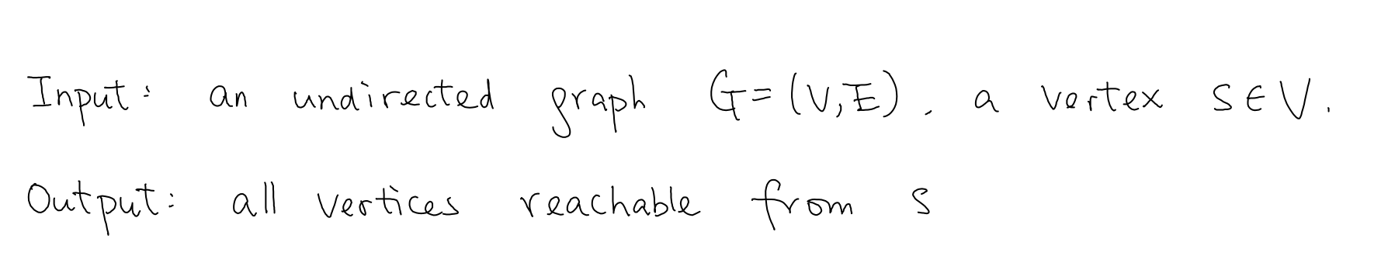
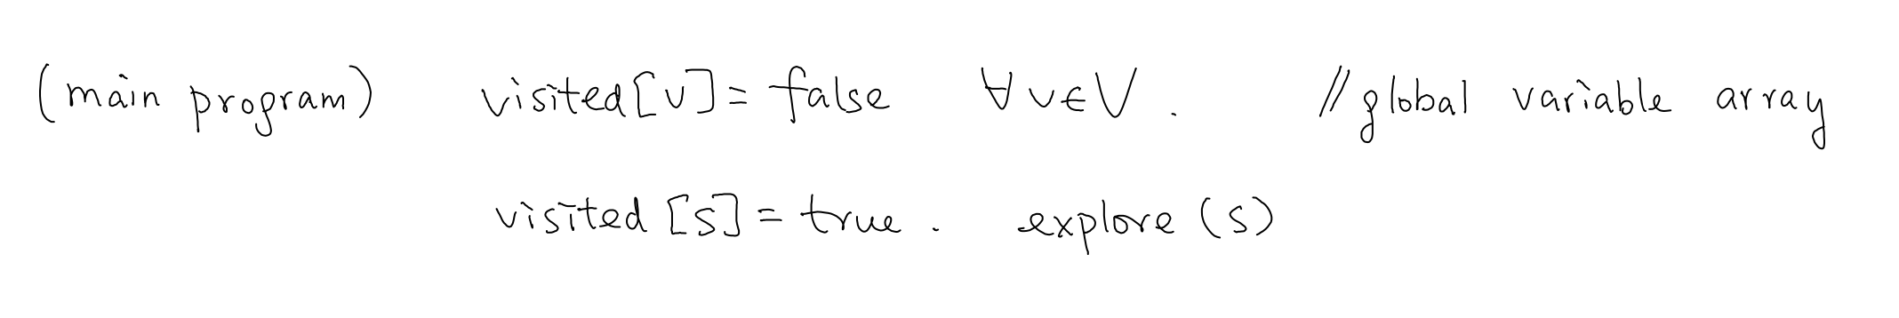
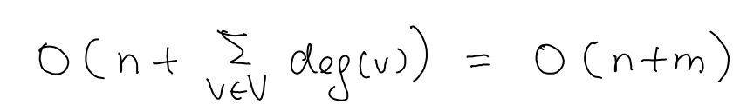
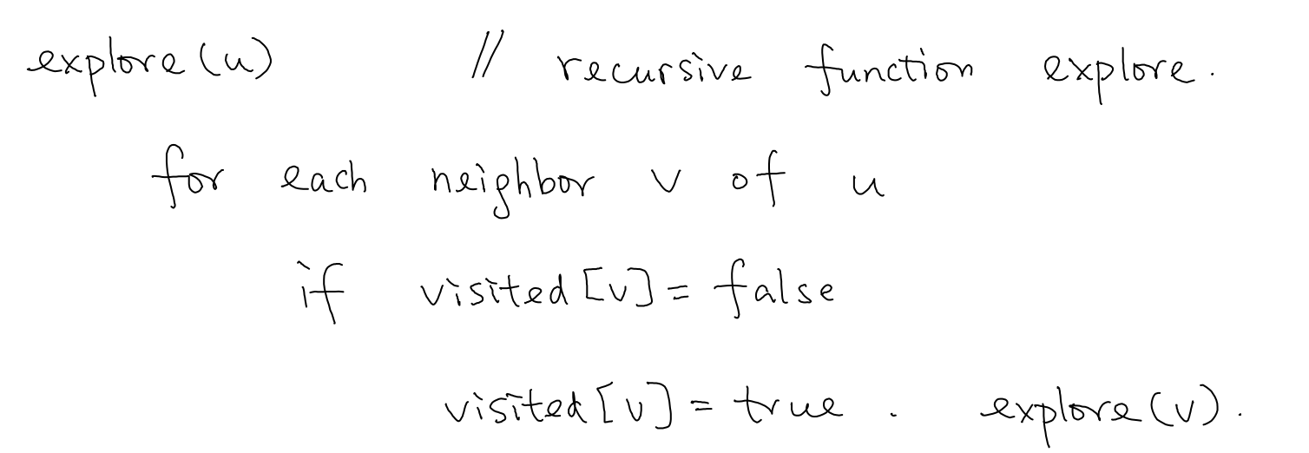

Depth First Search Algorithm
time complexity:
non-recursive implementations:

Slide 5
Correctness and Variants
?? S-T connectivity
?? Connected component containing S
O(n+m)
?? Graph connectivity
?? Shortest path
X (BFS)

Slide 6
Part II: DFS Tree

Slide 7
Tracing Out A Path
parent [v] = u: v is first visited in the call of explore(u)
tracing out a path [v]: keep going to parent of v
DFS tree: (v, parent[v]) form a tree

Slide 8
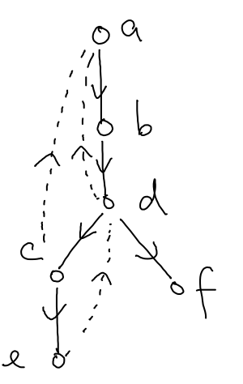
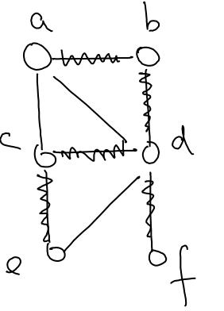
DFS Trees
root: starting vertex
parent[v] = u: if uv is in the tree and u is closer to the root v
u is an ancestor of v: if u is closer,
and u is on the path from v to the root
Back edge: descendent to ancestor

Slide 9

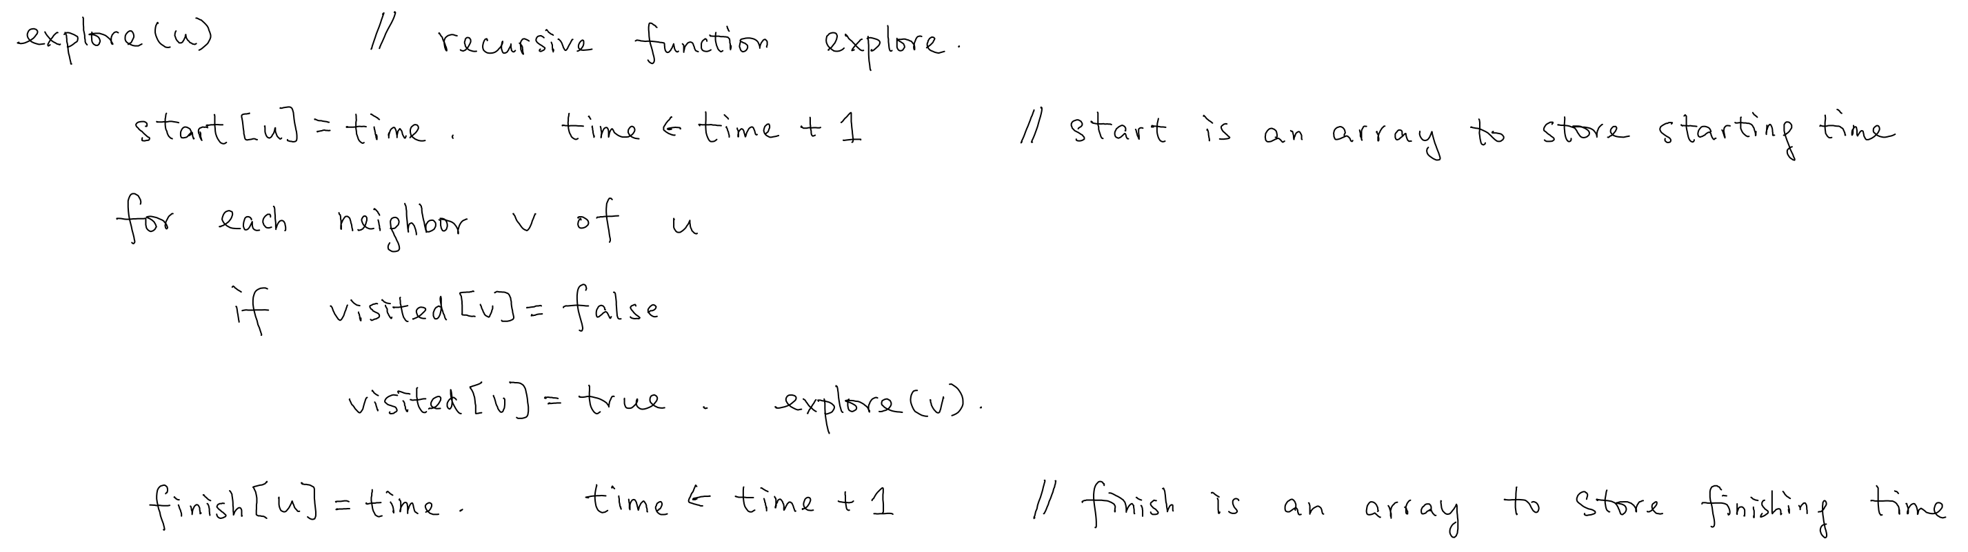
Useful Information
Starting time, finishing time
(first visited, finished exploring)

Slide 10
An Example
[1,12]
[2,11]
[3,10]
[4,7]
[8,9]
[5,6]

Slide 11
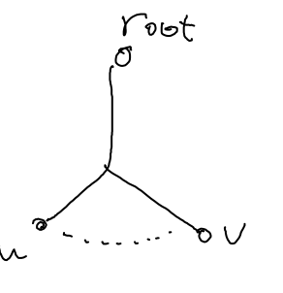
Properties
1. (parenthesis)
[start(v), finish(v)]
[start(u), finish(u)]
either disjoint or contained
2. (back edges)
all back edges are non-tree edges
(Otherwise, u starts early and finishes later than v, should be v’s parent)

Slide 12
Part III: Cut

Slide 13
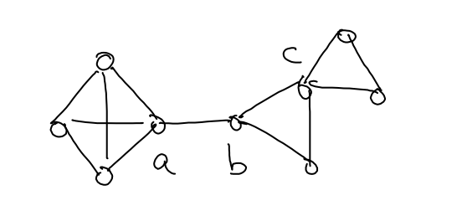
Cut Vertices and Edges
Critical edges and vertices in graph connectedness
Cut vertex: G\{v} is not connected
(e.g., a,b,c)
Cut edge: G\{e} is not connected
(e.g., ab)
(G is connected)

Slide 14
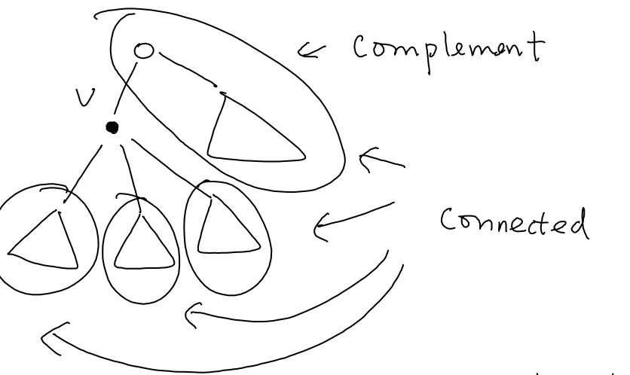
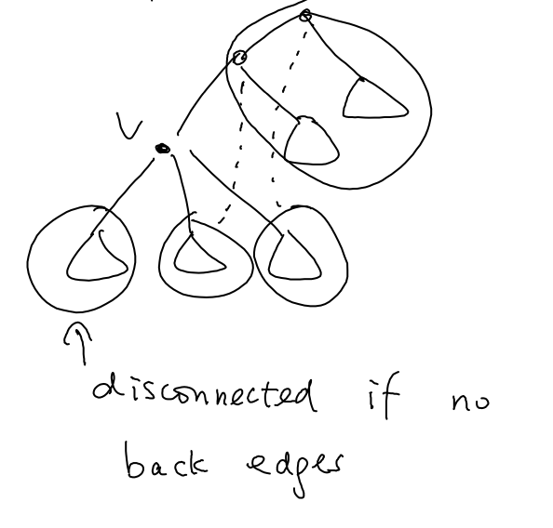
Look Through the DFS Tree
Subtrees and complement are connected
All subtrees have back edges then v is not cut
A subtree of v has no back edge then v is cut

Slide 15
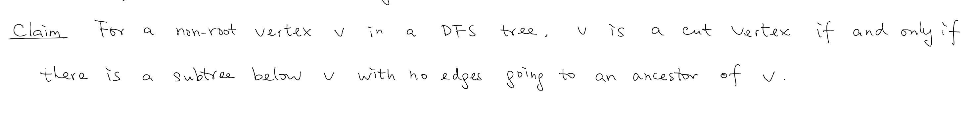
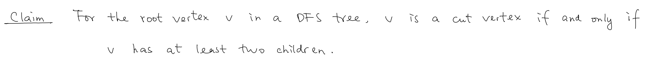
Observations
Compute which furthest ancestors can subtrees rely on, then we are done
How? Using starting and finishing time

Slide 16
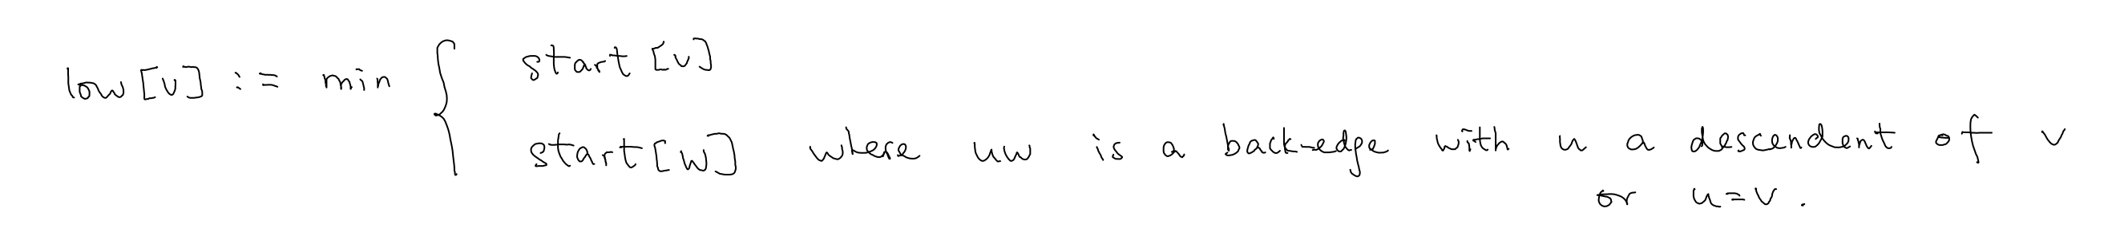
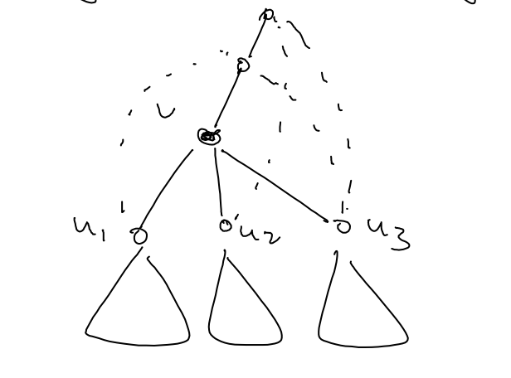
Which furthest ancestor can a subtree rely on?
for every v, we compute
check if v is a cut
low[u₁] < start[v]
low[u₂] < start[v]
v is not a cut
low[u₃] < start[v]

Slide 17
The Algorithm
for every v, we store how far up one can go
check if v is a cut
low[u₁] < start[v]
low[u₂] < start[v]
v is not a cut
low[u₃] < start[v]
(we handle the root separately)

Slide 18
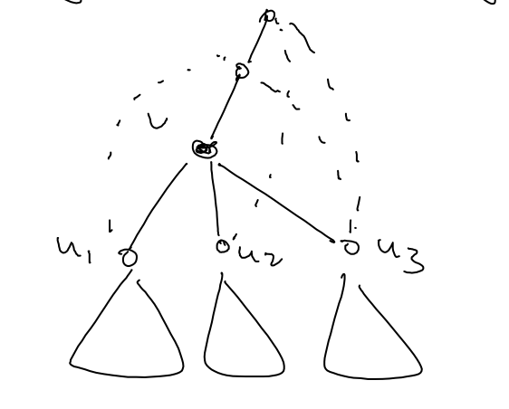
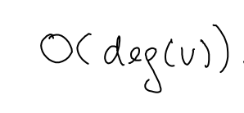
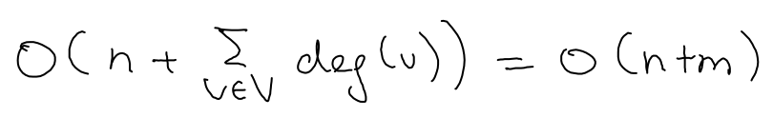
Compute low[v] Inductively
From leaves to root
low[v] = min_{vw is a back edge}(low[u₁], low[u₂], low[u₃], start[w])
Overall time complexity:

Slide 19
Summary
The maze problem
DFS tree and useful properties
Cut vertices and edges

Slide 20
Summary
DFS 0: visited => s-t connectivity
DFS 1: parent => DFS tree & trace out paths
DFS 2: start & finish time => cut vertex/edges
linear time O(n+m)

