Slide 1
CSCI-SHU 220: Algorithms
Directed Graphs
Fall 2020 @ NYU Shanghai

Slide 2
Graph with Directed Edges
outgoing edges
tail
head
incoming edges
asymmetric relation: one-way street, web links

Slide 3

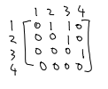

Graph Representations
n: number of nodes
m: number of edges
Adjacency List
Adjacency Matrix
O(n²) space
O(n+m) space

Slide 4
Part I: Connectivity

Slide 5
Reachability
Input: a direct graph G, and s in V
Output: all vertices reachable from s
(Reachable: there exists a direct path)

Slide 6
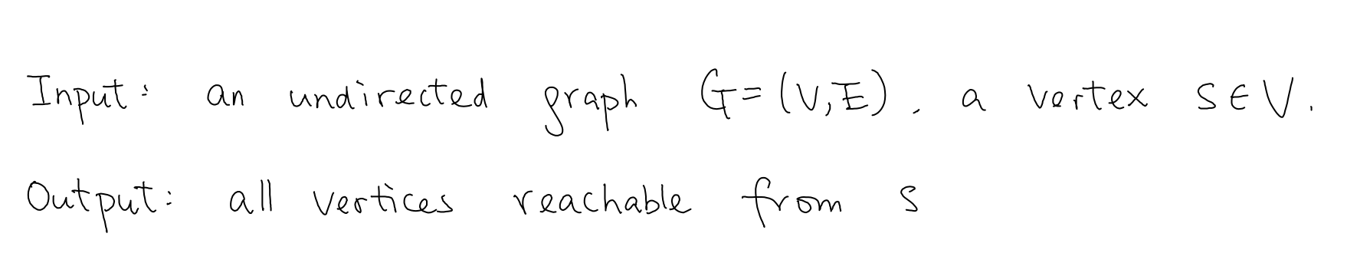
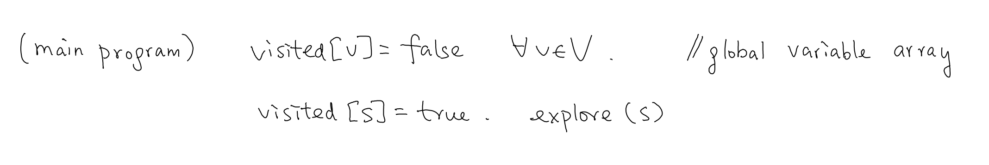
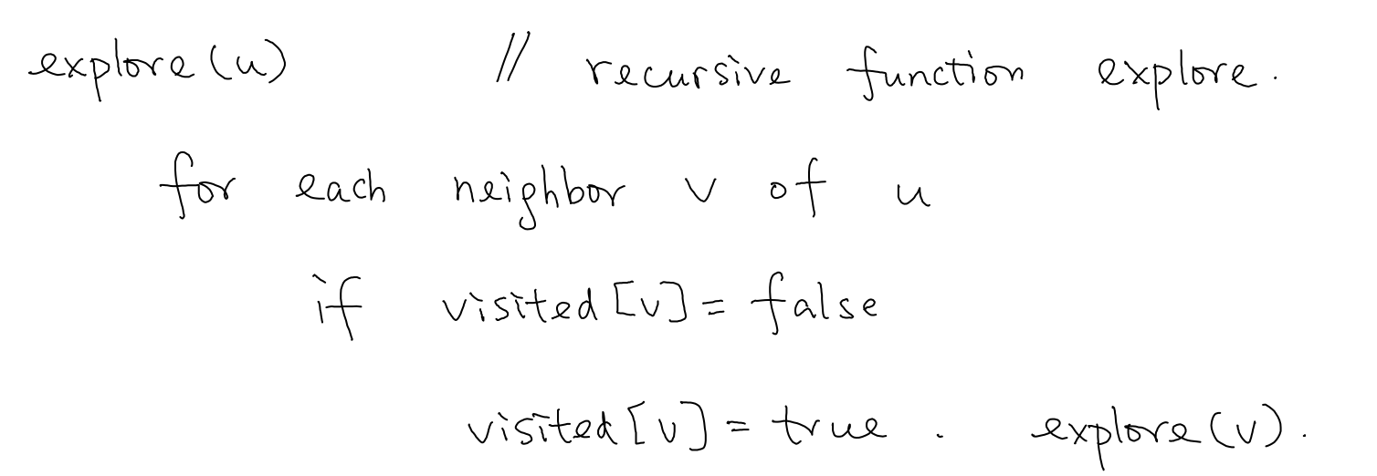
What Did We Do for Undirected Graph?
what about direct graph?

Slide 7
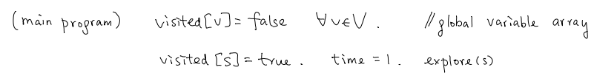
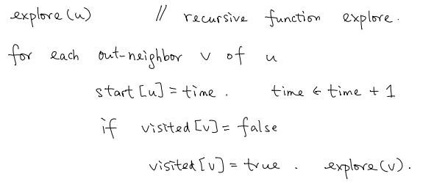
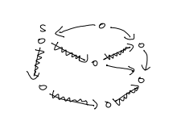
DFS for Direct Graph: Only Explore Out-going Edges

Slide 8
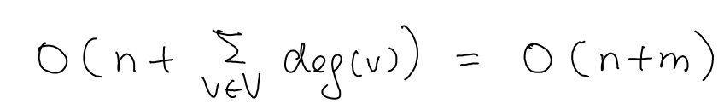
Analysis
Out-degree
Time complexity:
Correctness:
t is reachable from s iff visited[t] =true

Slide 9
Part II: BFS/DFS Tree

Slide 10
BFS/DFS Tree for Undirected Graphs
Parent[v]: the vertex u when v is first visited
(v, Parent[v]) form a BFS/DFS tree
We can still define BFS/DFS tree in a similar way

Slide 11
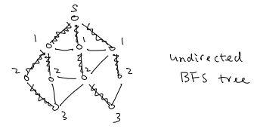
BFS Tree: Undirected Graphs
A non-tree edge uv:
| dis[u] – dis[v]| <=1

Slide 12
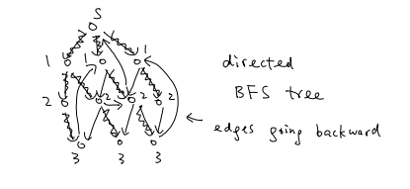
BFS Tree: Directed Graphs
A non-tree edge uv:
| dis[u] – dis[v]| <=1 or
| dis[u] – dis[v]| > 2 (then backward edge)

Slide 13
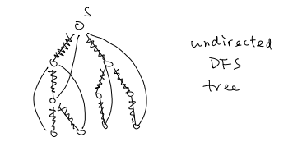
DFS Tree: Undirected Graphs
non-tree edges are all back edges

Slide 14
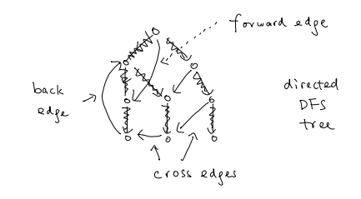
DFS Tree: Directed Graphs
“forward” edges and “cross” edges

Slide 15
Part III: Strongly Connected Graphs

Slide 16
Strongly Connectivity
Input: a direct graph G
Output: whether G is strongly connected
(i.e., every pair of nodes are reachable
from each other)

Slide 17
Natural Algorithms
Enumerate every pair of nodes, and run DFS
O(n² (n+m))
Enumerate every node and run DFS
O(n (n+m))
Can we do better?

Slide 18
An Observation: G is strongly connected iff
every vertex v is reachable from s
and
s is reachable from every vertex v

Slide 19
Check s is reachable from every vertex v?
Reverse the direction of edges in G (denoted as G^{R})
Check if every vertex is reachable from s

Slide 20
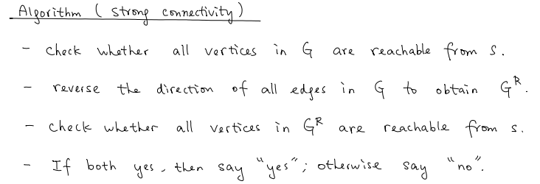
The Algorithm
Time complexity: O(n+m)

Slide 21
Part IV: Directed Acyclic Graphs

Slide 22

Directed Acyclic Graphs
directed graphs without directed cycles
modeling dependency relations
(e.g. course prerequisite)

Slide 23
Topological Ordering
An ordering of vertices s.t. all edges go forward
(e.g. an ordering of taking courses)
1,2,3,4,5

Slide 24
Topological Ordering & DAG
Proposition: A directed graph is a DAG if and only if
it has a topological ordering
“=>”:
A topological ordering => all edges go forward
=> no cycle

Slide 25
Topological Ordering of DAG
Proposition: A directed graph is a DAG if and only if
it has a topological ordering
“<=”:
DAG has a vertex of indegree zero v
we put v as the first vertex, remove v and repeat

Slide 26
The Algorithm
Keep finding vertices of degree zero and put them in front of the remaining vertices
Time complexity: O(n+m)
(leave as an exercise)

Slide 27
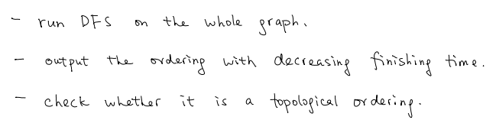
An Alternative Algorithm
Notes:
run dfs, and for every unvisitted nodes, run dfs.

Slide 28
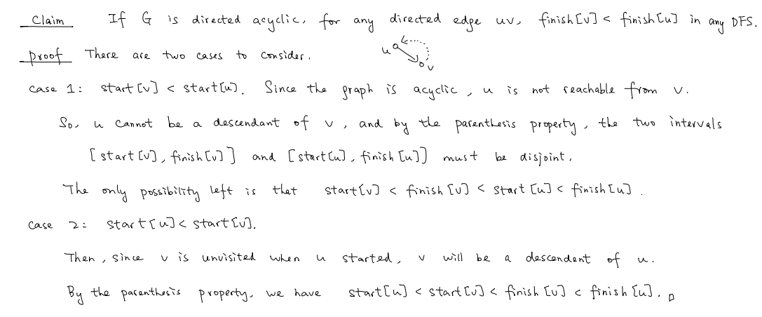
Correctness

Slide 29
Time Complexity
Naïve implementation (with sorting):
O(n + m + n log n)
Put a vertex in the queue when it is finished:
O(n + m )

Slide 30
Summary
Directed Graphs
Properties of BFS/DFS Trees
Reachability, Strongly Connectivity, Topological Ordering

