Slide 1
CSCI-SHU 220: Algorithms
Recurrence
Fall 2020 @ NYU Shanghai

Slide 2
Recurrence
Reduce to Smaller Instances
of the Same Problem
大事化小，小事化无

Slide 3
Part I: Recurrent Problems

Slide 4
Problem 1: Search
Input: a₁ , a₂ , … , a_{n} (sorted) and b
Output: determine if there is an i, s.t.,
a_{i} = c
The naïve solution: enumerate i, T(n)=O(n)

Slide 5
Reduce to smaller instances?
a₁ , a₂ , … , a_{n}
b <= a_{n/2}
b> a_{n/2}
a₁ , a₂ , … , a_{n/2}
a_{n/2+1}, a₂ , … , a_{n}
Time complexity: T (n) = T(n/2) + 1

Slide 6
Solve T(n) <=T(n/2)+1 ?
For simplicity, n = 2^{k} and T(1)=1.
T(2^{k}) =T(2^{k-1})+1
=T(2^{k-2})+1+1
=T(2^{k-3})+1+1+1
= ….
=T(1) + 1+ …+ 1
k ones
T(n) = 1 + k = O(log n)

Slide 7
Problem 2: Exponentiation
Input: a positive integer n
Output: 2^{n}
The naïve solution: n integer multiplications

Slide 8
Reduce to smaller instances?
n is even:
2^{n} = (2^{n/2})²
T(n) = T(n/2) + 1
n is odd:
2^{n} = 2 2^{n-1}
T(n) = T(n-1) + 1
= T(⌊n/2⌋) +2
T(n) = T(⌊n/2⌋) + 2
Solve it?
T(n) = O(log n)

Slide 9
Problem 3: Sorting
Input: a₁ , a₂ , … , a_{n}
Output: a permutation of a₁ , a₂ , … , a_{n} s.t.
a’₁ <= a’₂ … <= a’_{n}

Slide 10
Reduce to smaller instances?
How to use solutions of smaller instances?
sorted: a₁ , a₂ , … , a_{n/2}
sorted: a_{n/2+1}, a₂ , … , a_{n}
now sort: a₁ , a₂ , … , a_{n} ?
merge two sorted lists

Slide 11
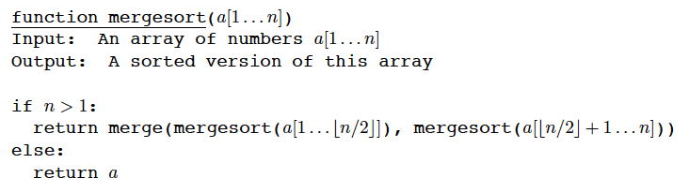
Merge Sort
T(n) = 2T(n/2) + MT (n)

Slide 12
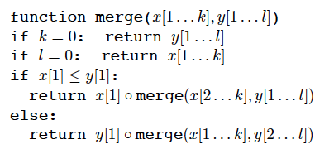
How to Merge?
total length k+l
total length k+l-1
MT(k+l) = MT(k+l-1) + O(1)
Linear in k+l

Slide 13
The Overall Time Complexity
T(n) = 2T(n/2) + O(n)
How to solve it?

Slide 14
Part II: Draw A Tree

Slide 15
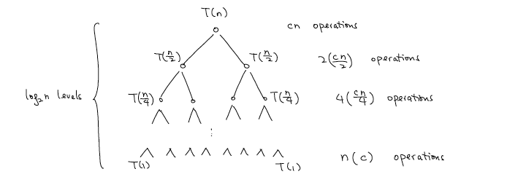
Draw the Recursion Tree
T(n) = 2T(n/2) + c n
cn operations per level
Overall: T(n) = cn log₂ n

Slide 16
Solve Following Recurrences?
Assuming n is a power of 2 and T(1)=1
T(n) = 2 T(n/2) + 1
T(n) = 2 T(n/2) + n²
T(n) = 2 T(n/2) + n³
T(n) = 4 T(n/2) + n
T(n) = T(n/2) + n
T(n) = T(n/2) + 1

Slide 17
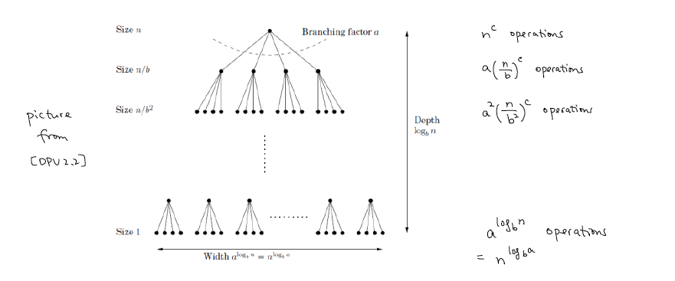
A More General Setting
T(n) = a T(n/b) + n^{c} (constants a>0, c>=0, b>1)
A geometric sequence with ratio a/b^{c}
T(n): sum of the sequence

Slide 18
Sum of the Sequence: ratio = 1
T(n) = a T(n/b) + n^{c} (constants a>0, c>=0, b>1)
n^{c} + … + n^{c} = n^{c} log_{b} n

Slide 19
Sum of the Sequence: ratio > 1
T(n) = a T(n/b) + n^{c} (constants a>0, c>=0, b>1)
Dominated by the last term: O(n ^{log_b a})

Slide 20
Sum of the Sequence: ratio < 1
T(n) = a T(n/b) + n^{c} (constants a>0, c >=0, b>1)
Dominated by the first term: O(n^{c})

Slide 21
Master Theorem
T(n) = a T(n/b) + n^{c} (constants a>0, c>=0, b>1)
O(n^{c})
If c > log_{b} a
T(n) =
O(n^{c} log n)
If c = log_{b} a
O(n ^{log_b a})
If c < log_{b} a
Try Again?
T(n) = 4 T(n/2) + n
T(n) = 3 T(n/2) + n
T(n) = 2 T(n/2) + n²
T(n) = 2 T(n/2) + 1
more important to remember the method

Slide 22
More Recurrences: Single Subproblem
T(n) = T(n/2) + 1
Binary search
T(n) = T(n/2) + n
Geometric sequence
T(n) = T(n^{1/2}) + 1
Counting levels
T(n) = T(n-1) + 1
Insertion sort

Slide 23
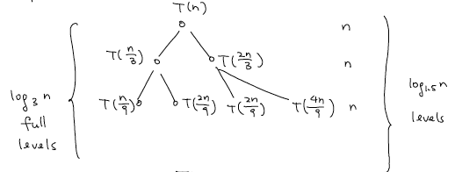
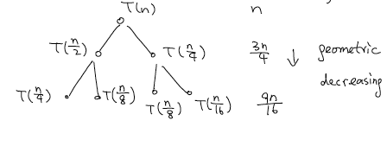
More Recurrences: Non-even Size Subproblems
T(n) = T(2n/3) + T(n/3) + n
O(n log n)
T(n) = T(n/2) + T(n/4) + n
O(n)

Slide 24
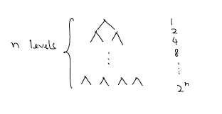
More Recurrences: Exponential Time
T(n) = 2T(n-1) + 1
O(2^{n})

Slide 25
Exercises
T(n) = T(n-1) + 1
T(n) = 2T(n-1) + 1
T(n) = T(n^{1/2}) + 1

Slide 26
Tricky Ones
T(n) = T(n-1) + T(n/2) +1
T(n) = T(n-a) + T(a) + n (constant a>=1)
T(n) = T(bn) + T(n-bn) + n (constant 0<b<1)

Slide 27
Challenging Ones
T(n) = n^{3/4}T(n^{1/4}) + n
T(n) = n^{1/2}T(n^{1/2}) + n

Slide 28
Summary
Design:
Recurrence
reduce to smaller instances of the same problem
(binary search, fast exponentiation, merge sort)
Analysis:
Recursive tree method
draw the recursion tree
(master theorem)

