Slide 1
CSCI-SHU 220: Algorithms
Solving Recurrence
Fall 2020 @ NYU Shanghai

Slide 2
Solving Recurrence
Recursion Tree Method
Substitution Method
Generating Functions

Slide 3
Part I: Recursion Tree Method

Slide 4
Example 1: T(n) = T(n-1) + 1
T(n)
1
T(n-1)
1
T(n-2)
1
n-1
….
….
T(2)
1
T(n)=T(1)+n-1=O(n)
T(1)

Slide 5
Example 2: T(n) = T(n-1) + n
T(n)
n
T(n-1)
n-1
T(n-2)
n-2
n+n-1+…+2
….
….
T(2)
2
T(n)=T(1)+(n+2)(n-1)/2=O(n²)
T(1)

Slide 6
Example 3: T(n) = T(n^{1/2}) + 1
n^{1/2^0}
T(n)
1
n^{1/2^1}
T(n^{1/2})
1
n^{1/2^2}
T(n^{1/4})
1
k ones
….
….
T(4)
1
n^{1/2^k}
T(2)
n^{1/2^k}=2 => k = loglog n
T(n)=T(2)+k =O(log log n)

Slide 7
Example 4: T(n) = 2T(n-1) + 1
T(n)
1
1
+1
T(n-1)
T(n-1)
T(n-2)
T(n-2)
T(n-2)
T(n-2)
1+1+1+1
….
….
….
….
T(1)
T(1)
T(1)
T(1)
T(1)
T(1)
T(1)
T(1)
T(n)= 2^{n} T(1) + 1 + 2 + 4 + … + 2^{n-1} = O(2^{n})

Slide 8
Part I: Substitution Method

Slide 9
Substitution Method (猜答案大法)
Guess
Check
the form of solution
by induction

Slide 10
Example 1: T(n) = 2T(n/2) + n
Guess (induction hypothesis):
T(n) <= cn log₂ n
a constant to be chosen
Check (induction step):
T(m) = 2 T(m/2) + m
<= 2 c(m/2) log₂ (m/2) + m
= cm log₂ m – cm + m
<= cm log₂ m (holds for any c>=1)
Substitution!

Slide 11
Example 2: T(n) = T(n-1) + n
Guess (induction hypothesis):
T(n) <= c n²
a constant to be chosen
Check (induction step):
T(m) = T(m-1) + m
<= c(m-1)² + m
= cm² + m + c – 2cm
<= cm² (holds for any c>=1, m>=1 )
Substitution!

Slide 12
Example 3: T(n) = T(n^{1/2}) + 1
Guess (induction hypothesis):
T(n) <= c log log n
a constant to be chosen
Check (induction step):
T(m) = T(m^{1/2}) + 1
<= c log log m^{1/2} + 1
= c log (½log m) + 1
= c log log m – c +1
<= c log log m (holds for any c>=1)
Substitution!

Slide 13
Example 4: T(n) = T(n/2) + T(n/4) + n
Guess (induction hypothesis):
T(n) <= c n
a constant to be chosen
Check (induction step):
T(m) = T(m/2) + T(m/4) + m
<= c m/2 + cm/4 + m
= (c/2+c/4+1) m
<= c m (holds for any c=4)
Substitution!

Slide 14
Example 5: T(n) = T(n-a) + T(a) + n (constant a>=1)
Guess (induction hypothesis):
T(n) <= c n²
a constant to be chosen
Check (induction step):
T(m) = T(m-a) + T(a) + m
<= c (m-a)² + ca² + m
= cm² – 2mac +2ca² + m
<= cm² (holds for any c>=1, m>=2a)
Substitution!

Slide 15
What’s Wrong with this Proof?
T(n) = 2T(n/2) + n
Induction hypothesis:
T(n) = O(n)
Induction step:
T(m) = 2 T(m/2) + O(m)
= 2 O(m/2) + O(m)
= O(m)

Slide 16
What’s Wrong with this Proof?
T(n) = 2T(n/2), T(1)=1
Induction hypothesis:
T(n) = O(1)
Induction step:
T(m) = 2 T(m/2) = 2 O(1) = O(1)
prove the exact form of the induction hypothesis,
not the asymptotic form

Slide 17
The Base Case?
Guess (induction hypothesis):
T(n) <= cn log₂ n
a constant to be chosen
Check (base case):
boundary condition T(1) = 1
T(1) <= c 1 log₂ 1 ??
fails to hold for any c !

Slide 18
Take Advantage of Asymptotic Notation
Guess (induction hypothesis):
T(n) <= cn log₂ n
a constant to be chosen
for any n>=n₀,
we get to chose!
Check (base case):
n₀ = 2, T(2)=2T(1)+2 =4
T(2) <= c 2 log₂ 2??
Yes, holds for any c>=2!

Slide 19
Tips for Check
prove by induction
prove the exact form of the induction hypothesis
(not the asymptotic form)
adjust the base case if necessary
(usually go through easily)

Slide 20
How to make a good guess?
By Experience
Tips:
Use bounds from similar cases
T(n) = 2T(n/2 + 17) + n
Begin with loose upper/lower bounds
T(n) = 2T(n/2) + n
(begin with O(n²), Ω(n))
Change variables
T(n) = 2 T(n^{1/2}) + log n
Recursion tree methods

Slide 21
Change Variables
T(n) = 2 T(n^{1/2}) + log n
T(2^{m}) = 2 T(2^{m/2}) + m
m:= log n
S(m):= T(2^{m})
S(m) = 2 S(m/2) + m
S(m) = O(m log m)
T(n) = O((log n) (loglog n))
Try T(n) = 3 T(n^{1/2}) + log n?

Slide 22
Subtleties in Guess
T(n) = 2T(n/2) + 1
Guess: T(n) = O(n)
Subtracting a lower order term
Induction hypothesis:
T(n) <= c n
- 1
Need a stronger hypothesis
Check (induction step):
T(m) <= 2 T(m/2) + 1
= 2c (m/2) + 1
= cm + 1
- 2
- 2
Doesn’t work

Slide 23
Part II: Generating Function (optional)

Slide 24
Today’s Problem: Counting Binary Trees
What’s the number of binary trees
with n nodes?
C(0) = 1, C(1)=1, C(2)=2, C(3)=5, …

Slide 25
Recurrence
Root
Binary tree with i nodes
Binary tree with n-1-i nodes
C(i) different choices
C(n-1-i) different choices
i = 0,1,2,…,n-1
C(n) = C(1)C(n-2) + C(2)C(n-3) + …+ C(n-2)C(1)
Solve it?

Slide 26
The Generating Function
F(z)= C(0) + C(1) z + … + C(i) z^{i} + …
Properties:
F(0)= C(0), F(1)=C(0) + … + C(i) + …
C(i) is the i-th coefficient

Slide 27
Manipulate F
F(z)²= (C(0) + C(1) z + … + C(i) z^{i} + …)²
= (C(0) + … + C(i) z^{i} + …) (C(0) + … + C(j) z^{i} + …)
= C(0)C(0) + … C(i)C(j) z^{i} z^{j} + ….
= C(0)² + (C(0)C(1) + C(1)C(0)) z
+ (C(0)C(2) + C(1)C(1)+C(2)(0)) z²
+ …
+ (C(i)C(0)+C(1)C(i-1)+ …+ C(0)C(i)) z^{i}
+ ….
= C(1) + C(2) z + C(3) z² +…+ C(i+1) z^{i} + …
F(z) = C(0) + C(1) z + C(2) z² + C(3) z² + C(i) z^{i} + …
z F(z)² - F(z) = - C(0)

Slide 28
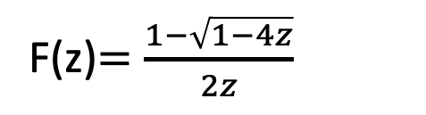
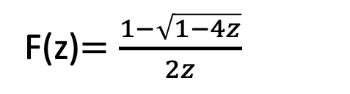
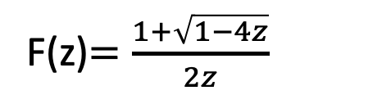
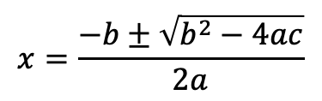

Solve F
z F(z)² + F(z) + 1 = 0
$$x=\frac{−b±\sqrt{b^{2}−4ac}}{2a}$$
^{Recall:}
$$ax2+bx+c=0$$
^{Plug in:}
^{F(z) = x, a = z, b=-1, c=1}
F(z)$=\frac{1+\sqrt{1−4z}}{2z}$
F(z)$=\frac{1−\sqrt{1−4z}}{2z}$
^{So:}
^{or}
F(z)$=\frac{1−\sqrt{1−4z}}{2z}$
^{Recall F(0)=C(0)=1:}

Slide 29


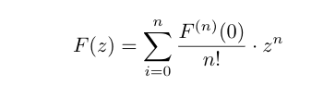
Almost Done!
Taylor Series!

Slide 30

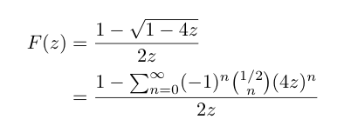

Use Known Series
Binomial series
Eventually

Slide 31
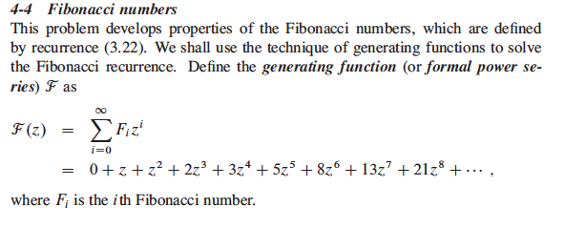
Try This One?
(see [CLRS] problem 4-4 for intermediate questions)

Slide 32
Summary
Recursion Tree Method
(draw the recursion tree)
Substitution Method
(guess and check)
Generating Functions
(optional)

Slide 33
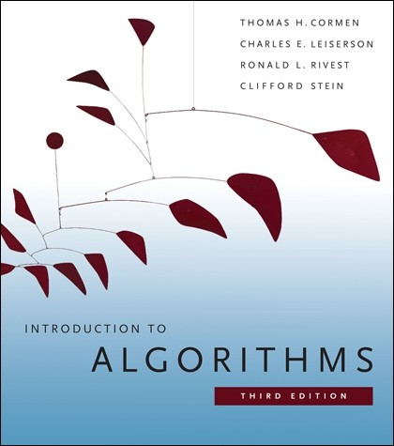
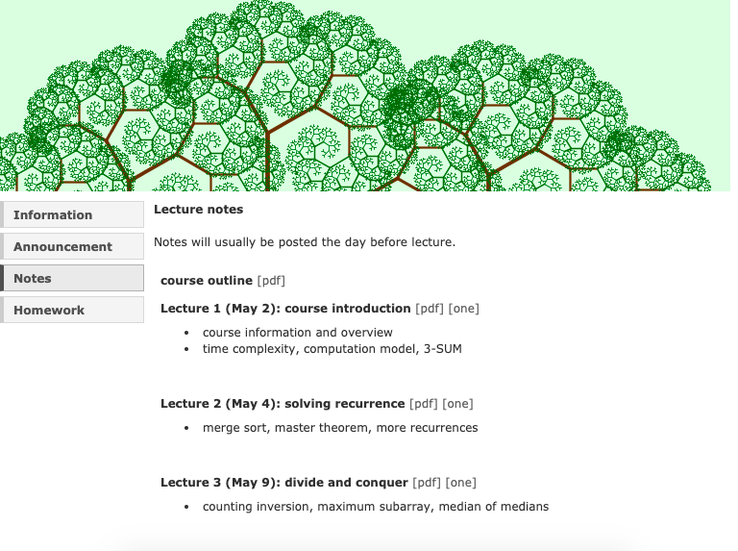
More Details
[CLRS] 4.3-4.4
Lecture 2 cs.uwaterloo.ca/~lapchi/cs341/notes/L02.pdf

Slide 34
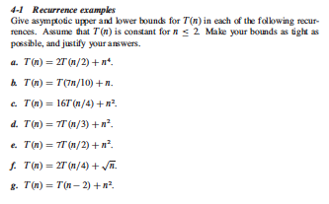
Exercises

Slide 35
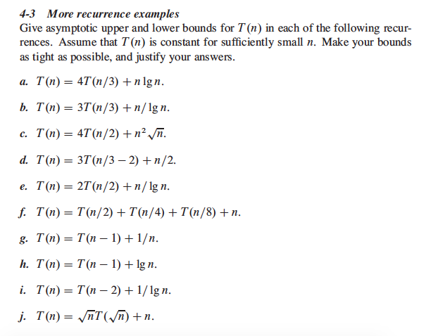
Exercises

Slide 36
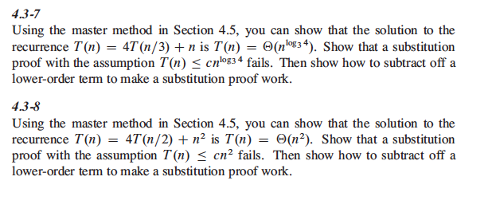
Exercises

