Slide 1
CSCI-SHU 220: Algorithms
Divide and Conquer I
Fall 2020 @ NYU Shanghai

Slide 2
Divide and Conquer
Divide (分):
breaking into subproblems
Conquer (治):
recursively solving subproblems
Combine (合):
combining their answers

Slide 3
Part I: Counting Inversions

Slide 4
Counting Inversions
Input: n distinct numbers a₁,…,a_{n}
Output: number of pairs with i<j but a_{i}>a_{j}
Example: (3,7,2,5,4), 5 inversion pairs
(3,2), (7,2), (7,5), (7,4), (5,4)

Slide 5
The Naïve Solution
Enumerate all pairs with i <j,
check if a_{i} > a_{j}
Time Complexity: O(n²)

Slide 6
Divide and Conquer
3 9 2 4 6 1 7 8
Divide:
3 9 2 4
6 1 7 8
3 pairs
1 pair
Conquer:
Combine:
3 + 1
+ “Cross” Inversion Pairs

Slide 7
Count ”Cross” Inversion Pairs?
3 9 2 4
6 1 7 8
Pairs involving 6: (9,6)
Pairs involving 1: (3,1), (9,1), (2,1), (4,1)
Pairs involving 7: (9,7)
Pairs involving 8: (9,8)
involving a_{j}: # of numbers > a_{j} in the first half

Slide 8
Count ”Cross” Inversion Pairs?
3 9 2 4
6 1 7 8
involving a_{j}: # of numbers > a_{j} in the first half
method 1: sort the first half, do binary search
(n/2) log (n/2) + (n/2) (log n) = O (n log n)
Sorting
Searching

Slide 9
Method 1: Sorting + Binary Search
involving a_{j}: # of numbers > a_{j} in the first half
3 9 2 4
6 1 7 8
2 3 4 9
search 6 1 7 8
(n/2) log (n/2) + (n/2) (log n)
Time Complexity: O (n log n)

Slide 10
Method 2: Sorting + Merge
involving a_{j}: # of numbers > a_{j} in the first half
3 9 2 4
6 1 7 8
2 3 4 9
1 6 7 8
(1 number > 6)
(4 numbers> 1)
2 3 4
6
=> 1
2(n/2) log (n/2) +n = O(n log n)

Slide 11
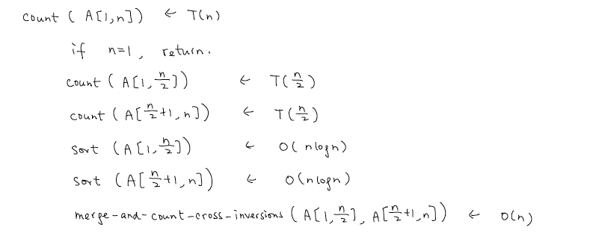
The Improved Solution
the bottleneck
not necessary
T(n)=2T(n/2) + O(n log n)
= O(n log² n)

Slide 12
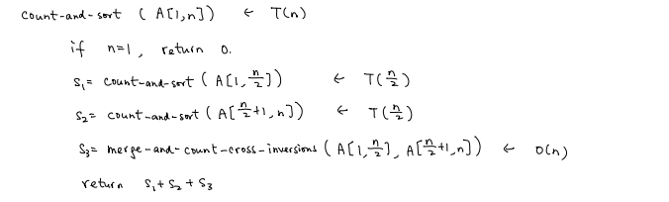
The Final Algorithm
T(n)=2T(n/2) + O(n)
= O(n log n)

Slide 13
Part II: Maximal Subarray

Slide 14
Maximal Subarray
Input: n numbers a₁,…,a_{n}
Output: i, j that maximize a_{i} + a_{i+1} … + a_{j}
Example: 1, -3, 4, 5, 6, -20, 5, 7, 7,-3,9,10, 11, -10, 3,3

Slide 15
The Naïve Solution
Enumerate all pairs with i <j,
Speed this up?
compute the sum a_{i} + a_{i+1} + … + a_{j}
Time Complexity: O(n³)

Slide 16
The Improved Solution
Enumerate i, for all j = i+1, …., n
Sum[i,j] = Sum[i,j-1] + a_{j}
_{O(n)}
compute the sum a_{i} + a_{i+1} + … + a_{j}
Time Complexity: O(n²)

Slide 17
Divide and Conquer
1, -3, 4, 5, 6, -20, 5, 7, 7,-3,9,10, 11, -10, 3,3
Divide:
1, -3, 4, 5, 6, -20, 5, 7
7,-3,9,10, 11, -10, 3,3
3,6
Conquer:
9,13
Combine:
Left half or right half or cross the middle point

Slide 18
Maximal Subarray Crossing the Middle Point
1, -3, 4, 5, 6, -20, 5, 7, 7,-3,9,10, 11, -10, 3,3
Maximal subarray with i,j s.t. i<=n/2<=j
[i, n/2]
The maximal subarray ending at n/2
[n/2+1,j]
The maximal subarray starting at n/2+1

Slide 19
Maximal Subarray Ending/Starting at n/2
1, -3, 4, 5, 6, -20, 5, 7, 7,-3,9,10, 11, -10, 3,3
PSum [i] = a_{i} + … + a_{n/2}
Compute PSum[1], …, PSum[n/2]
Output i that maximize PSum[i]
O(n) time

Slide 20
Time Complexity of Maximal Subarray
T(n) = 2 T(n/2) + O(n)
T(n) = O(n log n)
Challenge: O(n) time algorithm?
Question: extend to the circular setting?

Slide 21
Part III: Finding Median

Slide 22
Finding Median
Input: n distinct numbers a₁,…,a_{n}
Output: return the median

Slide 23
A General Problem
Input: n distinct numbers a₁,…,a_{n} and k
Output: return the k-th smallest number
k=1: the smallest number
O(n)
k=n: the largest number
O(n)
k=n/2: the median
O(n)???

Slide 24
The General Problem Enables Recursion
a₁,…,a_{n} and k
a_{i}: pivot
a_{i}: rank r
Partition:
a_{i}
S₁ = {a_{j}: a_{j} < a_{i} }
S₂ = {a_{j}: a_{j} > a_{i} }
If r=k, we are done
Problem size: r-1
If r>k, k-th smallest number in S₁
Problem size: n-r
If r<k, (k-r)-th smallest number in S₂

Slide 25
Given A Pivot in the Middle
a₁,…,a_{n} and k
Get back to finding median
a_{i}: pivot
a_{i}: rank r=n/2
Partition:
a_{i}
S₁ = {a_{j}: a_{j} < a_{i} }
S₂ = {a_{j}: a_{j} > a_{i} }
T(n) = T(n/2) + O(n)
T(n) = O(n)

Slide 26
Good Enough to Use A Pivot Almost in the Middle
a₁,…,a_{n} and k
a_{i}: pivot
a_{i}: rank r in [3n/10, 7n/10]
Partition:
a_{i}
S₁ = {a_{j}: a_{j} < a_{i} }
S₂ = {a_{j}: a_{j} > a_{i} }
T(n) = T(7n/10) + O(n)
T(n) = O(n)

Slide 27
Find A Pivot Almost in the Middle
Input: a₁,…,a_{n}
Output: a_{i} with rank r in [3n/10, 7n/10]

Slide 28
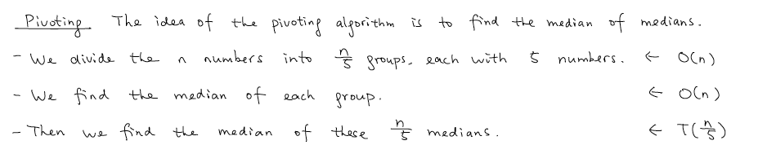
Find the Median of Medians

Slide 29
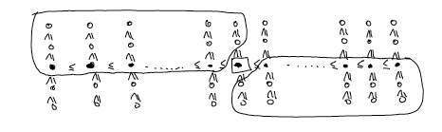
Correctness
3*n/10 numbers <=
<= 3*n/10 numbers

Slide 30
Time Complexity
T(n): time to find the median among n numbers
P(n): time to find the median of medians among n numbers
P(n) = T(n/5) + c₂n
T(n) = T(7n/10) + P(n) + c₁n
= T(7n/10) + T(n/5) + (c₁ + c₂) n
T(n) = O(n)
What if the group size is 3 or 7or n^{1/2} ?

Slide 31
Summary
Divide and Conquer
(divide, conquer, combine)
Three Problems
(counting inversion, maximal subarray, finding median)

