Slide 1
CSCI-SHU 220: Algorithms
Divide and Conquer II
Fall 2020 @ NYU Shanghai

Slide 2
Divide and Conquer
Divide (分):
breaking into subproblems
Conquer (治):
recursively solving subproblems
Combine (合):
combining their answers

Slide 3
Part I: Arithmetic Problems

Slide 4
Problem 1: Integer Multiplication
Input: two n-bit numbers
a = a₁,…,a_{n}
b = b₁,…,b_{n}
Output: ab

Slide 5
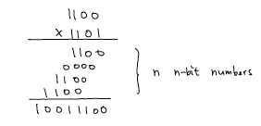

The Naïve O(n²) Solution

Slide 6
Divide and Conquer
a = (a₁, …, a_{2n})
= (a₁,…,a_{n}) 2^{n} + (a_{n+1},…,a_{2n})
b = (b₁, …, b_{2n})
= (b₁,…,b_{n}) 2^{n} + (b_{n+1},…,b_{2n})
Divide: a b = (a₁,…,a_{n}) (b₁,…,b_{n}) 2^{2n} +
(a_{n+1},…,a_{2n})(b₁,…,b_{n}) 2^{n} +
(a₁,…,a_{n})(b_{n+1},…,b_{2n}) 2^{n} +
(a_{n+1},…,a_{2n} )(b_{n+1},…,b_{2n})
T(2n) = 4 T(n) + O(n)

Slide 7
Karatsubas’s Algorithm
a = (a₁, …, a_{2n})
= X₁ 2^{n} + X₀
b = (b₁, …, b_{2n})
= Y₁ 2^{n} + Y₀
= (X₁+X₀)(Y₁+Y₀) - X₁Y₁ ₋ X₀Y₀
a b = X₁Y₁ 2^{2n} + (X₀Y₁+X₁Y₀) 2^{n} + X₀Y₀
Previously (4): X₁Y₁ , X₀Y₁ , X₁Y₀, X₀Y₀
Now (3): X₁Y₁ , (X₁+X₀)(Y₁+Y₀), X₀Y₀
T(2n) = 3 T(n) + O(n) = O(n ^{log_2 3})

Slide 8
Problem 2: Matrix Multiplication
Input: two n by n matrix A, B
Output: AB
The Naïve Solution: O(n³)

Slide 9
Divide and Conquer
A₁₁ A₁₂
A₂₁ A₂₂
B₁₁ B₁₂
B₂₁ B₂₂
A₁₁ B₁₁ + A₁₂ B₂₁
A₁₁ B₁₂ + A₁₂ B₂₂
A₂₁ B₁₁ + A₂₂ B₂₁
A₂₁ B₁₂ + A₂₂ B₂₂
T(n) = 8 T(n/2) + O(n²) = O(n³)

Slide 10
Strassen’s Algorithm
A₁₁ A₁₂
A₂₁ A₂₂
B₁₁ B₁₂
B₂₁ B₂₂
P₁ = A₁₁ (B₁₂ – B₂₂)
P₂ = (A₁₁ + A₁₂) B₂₂
P₃ = (A₂₁ + A₂₂) B₁₁
P₄ = A₂₂ (B₂₁ – B₁₁)
P₅ = (A₁₁+A₂₂) (B₁₁+B₂₂)
P₆ = (A₁₂-A₂₂) (B₂₁+B₂₂)
P₇ = (A₁₁-A₂₂)(B₁₁+B₁₂)
P₅+ P₄ – P₂+P₆
P₁+ P₂
P₃+ P₄
P₁ + P₅-P₂ – P₇
T(n) = 7 T(n/2) + O(n²) = O(n^{log_2 7})

Slide 11
Part II: Closest Pair

Slide 12
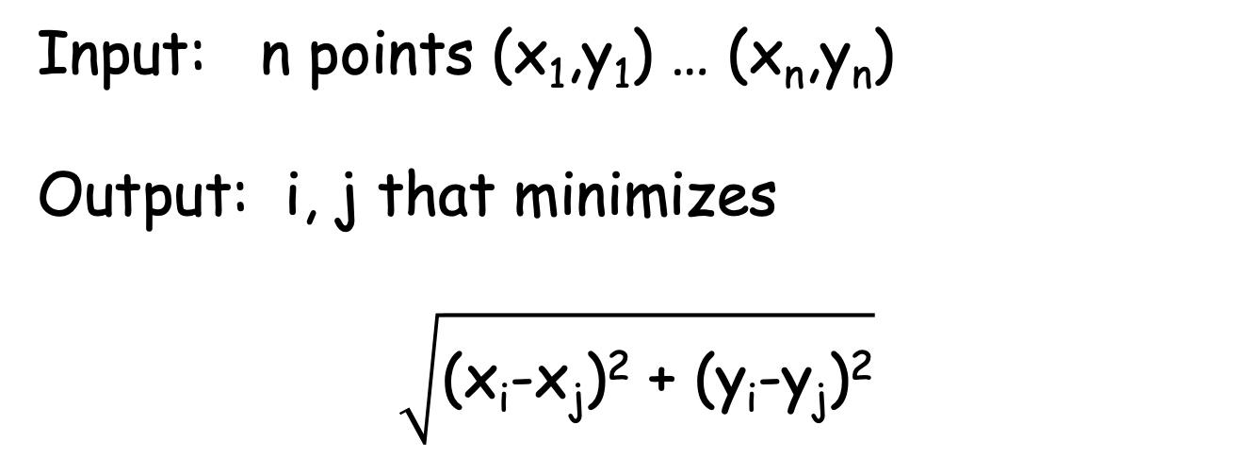
Closest Pair
Input: n points (x₁,y₁) … (x_{n},y_{n})
Output: i, j that minimizes
$$\sqrt{\text{(}\text{xi}\text{-}\text{xj}\text{)}\text{2} \text{+} \text{(}\text{yi}\text{-}\text{yj}\text{)}\text{2}}$$
The Naïve Solution: O(n²)

Slide 13
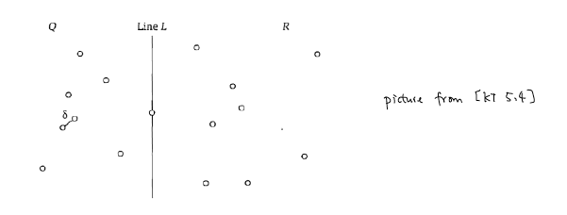
Divide
_{|Q| = |R|=n/2}
Find Line L: median based on x-values
(for simplicity, we assume every point has a distinct x-value)

Slide 14

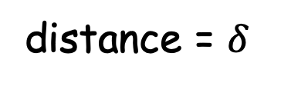
Conquer and Combine
Conquer: (recursively) find closest pairs within Q and R
Combine: closest pairs within Q and R,
closest pair crossing Q and R
distance = $δ$
The remaining problem:
any crossing pair with distance <$δ$?

Slide 15


Crossing Pairs with Distance < $δ ?$
.
.
.
.
.
.
.
.
.
.
.
.
.
points with x-value within$δ$to L

Slide 16
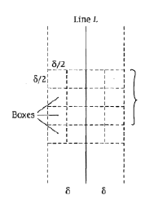
Divide this Region into Square Boxes
Each box has side length$δ$/2

Slide 17


Observation 1: Each Box has at most 1 point
If two points
then distance is <$δ$
Contracting that closest distance = $δ$ within Q and R

Slide 18

Observation 2: for each point, only need to compute points within two horizontal layers

Slide 19
Putting Together Two Observations
Observation 2: for each point, only need to compute points within two horizontal layers
Check at most 11 boxes (per point)!
Observation 1: each box has at most 1 point
Check at most 11 points (per point)!
Check at most O(n) pairs

Slide 20
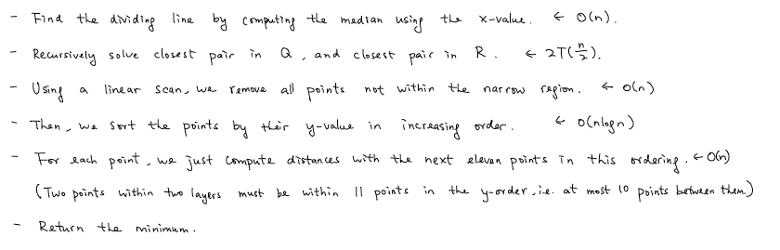
Algorithm
Bottleneck.
T(n) = 2T(n/2) + O(nlogn) = O(n log²n)

Slide 21
Do Sorting Outside the Recursion
T(n) = 2T(n/2) + O(n) = O(n log n)

Slide 22
Summary
Arithmetic Problems
(Integer multiplication, Matrix multiplication)
Closest Pair

Slide 23
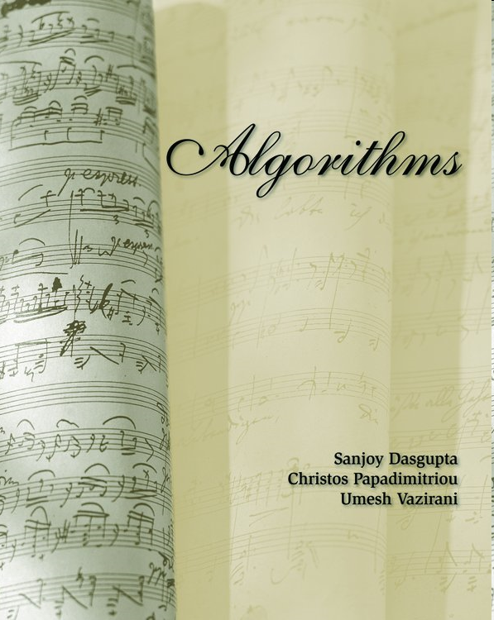

Remarks
Integer multiplication: O(n log n)
[DPV] 2.5
Closest pair: O(n) (expected)
[KT] 13.7

