Slide 1
CSCI-SHU 220: Algorithms
Sorting
Fall 2020 @ NYU Shanghai

Slide 2
The Sorting Problem
Input: a sequence of n numbers
a₁, a₂, a₃, …, a_{n}
Output: (a reordering) a’₁, a’₂, a’₃, …, a’_{n} s.t.
a’₁ <= a’₂ <= a’₃ <= … <= a’_{n}

Slide 3
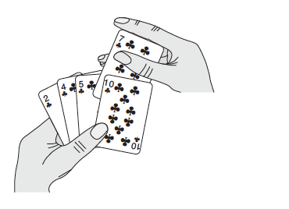

Slide 4
Recurrence
Insertion Sort (A[1,…,n])
If n=1, return;
Insertion Sort (A[1,…,n-1])
Insert A[n] to sorted A[1,…,n-1]
T(n) = T(n-1) + n
= O(n²)

Slide 5
Open the Recursion
Insertion Sort (A[1,…,n])
for (i=2;i<=n;++i)
insert A[i] to sorted A[1,…,i-1]
Is O(n²) tight?
n, n-1, n-2,…, 1

Slide 6
Remarks
Fast for small input size
In place
(only O(1) elements is stored outside the array)

Slide 8
Recurrence
MergeSort(A[1,…,n])
If n=0 or 1, return
MergeSort(A[1,…,n/2])
MergeSort(A[n/2+1,…,n])
Merge(A[1,…,n/2], A[n/2+1,…,n])
T(n) = 2T(n/2) + n
= O(n log n)

Slide 9
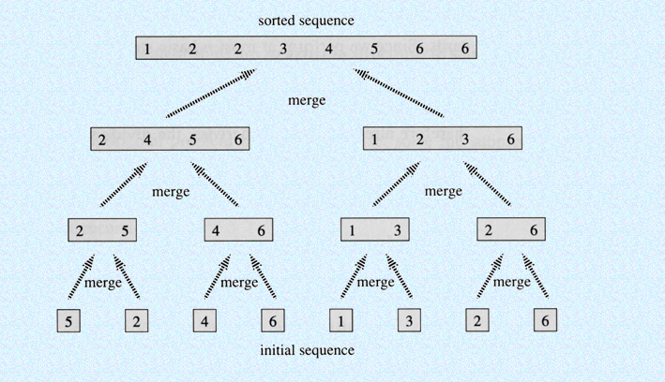
Open the Recursion
Is O(n log n) tight? Is it in place?

Slide 10
< v
v
>= v

Slide 11
Recurrence
QuickSort(S)
If |S|=0 or 1, return
Pick v in S, partition S\{v}
A_{>=}={a_{i} : i>= v }
A< ={a_{i}: i < v }
QuickSort(A<)
QuickSort(A_{>=})
T(n) = T(| A< |) + T(| A_{>=} |) + n

Slide 12
How to pick v
Always the first element
T(n) = T(| A< |) + T(| A_{>=} |) + n
Best case:
O(n log n)
O(n²) (sequence n,n-1,…,1)
Worst case:
Always the last element?
Always the second element?
Pick v randomly?
Expected O(n log n)

Slide 13
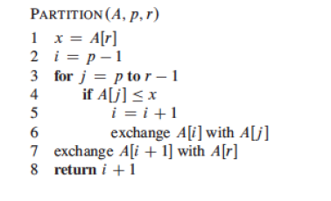
In Place Partition?

Slide 14
<= v
v
<= v

Slide 15
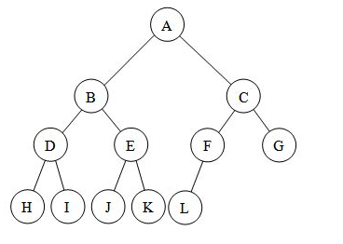
A Complete Binary Tree
completely filled except the last layer
(all nodes are as far left as possible)
Height (h):
length of the longest path
from root to a leaf
Size (n):
number of nodes
2^{h} <=n < 2^{h+1}
h = log n + $Θ$(1)

Slide 16
Heap
a complete binary with an order property
Max heap:
value_parent >= value_child
Min heap:
value_parent <= value_child
Maximal value in a max heap?
Minimal value in a min heap?
Maximal value in a min heap?

Slide 17
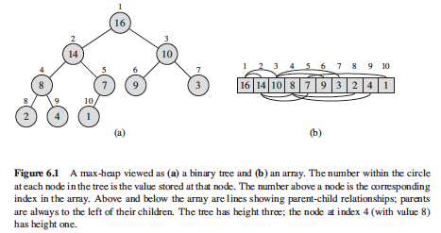
Maintain A Tree Using An Array
Node i:
Left Child: 2i
Right Child: 2i+1

Slide 18
Basic Operations: Insert and Delete
Insert: create a leaf,
then pop up
(keep swapping until…)
Delete: swap root with the last leaf
then push down the new root
reduce size by 1
O(h) swapping and comparison
O(log n) time

Slide 19
Basic Operations: Build
Build: perform push down for all parents
(last second layer -> root, right -> left)
Recurrence:
build (right-subtree)
build (left-subtree)
pushdown root
T(n) = 2 T(n/2) + h = 2 T(n/2) + log n
T(n) = O(n)

Slide 20
Heapsort
Build max heap
O(n)
Delete the maximal value n times
O(n log n)
Time complexity: O(n log n)
In place?

Slide 21
Using New Tool for Old Problems
Merge k sorted list (each with n numbers)?
Find the kth smallest number?

Slide 22
Summary
Time
Space (In Place?)
Remarks
O(n²)
Insertion Sort
Yes
fast for small input sizes
Merge Sort
can be in-place with a
sophisticated merging
O(n log n)
No
O(n log n) or O(n²)
outperforms heapsort
in practice
Quicksort
Yes
O(n log n)
date structure based
design technique
Heapsort
Yes

Slide 23

More Details
[CLRS] 6

Slide 24
Next Lecture
Can we do better?

