Slide 1
CSCI-SHU 220: Algorithms
Sorting
Fall 2020 @ NYU Shanghai

Slide 2
The Sorting Problem
Input: a sequence of n numbers
a₁, a₂, a₃, …, a_{n}
Output: (a reordering) a’₁, a’₂, a’₃, …, a’_{n} s.t.
a’₁ <= a’₂ <= a’₃ <= … <= a’_{n}

Slide 3
Part I: Comparison Sorts

Slide 4
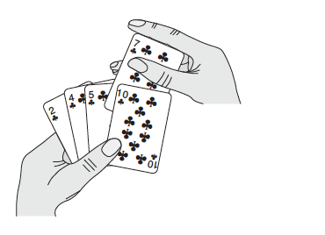

Slide 6
< v
v
>= v

Slide 7
The Partition Problem
Input: v and a sequence of n numbers,
a₁, …, a_{n}
Output: (a reordering) a’₁, …, a’_{n} and i s.t.
a’_{j} <= v for j<=i
a’_{j} > v for j> i

Slide 8
With Two Extra Arrays
V=6
5 3 4 7 1 2 8
Array _{<=}
Array >
Scan the sequence, add elements into corresponding arrays

Slide 9
With One Extra Array
V=6
5 3 4 7 1 2 8
Array
_{Scan the input sequence}
Smaller elements are added from 1-> 7
Larger elements are added from 7 -> 1

Slide 10
With Zero Extra Array
V=6
5 3 4 7 1 2 8
_{(Image an) Extra array B}
Scan the input sequence from 1->7
5, 3, 4 should be added to B[1,2,3]
already in A[1,2,3], great stay there!
Scan the input sequence from 7->1
_{8 should be added to B[7]}
already in A[7], great stay there!

Slide 11
Forget About the Good Numbers, Start Again
V=6
5 3 4 7 1 2 8
_{(Image an) Extra array B}
Scan the input sequence from 4->6
_{7 should be added to B[7]}
_{cannot use A[7], 2 is there}
Scan the input sequence from 6->4
_{2 should be added to B[4]}
_{cannot use A[4], 7 is there}
_{Swap them!!}

Slide 12
Forget About the Good Numbers, Start Again
V=6
5 3 4 2 1 7 8
_{(Image an) Extra array B}
Scan the input sequence from 5->5
_{1 should be added to B[5]}
already in A[5], great stay there!
Done with all numbers, return array A and 5

Slide 13
<= v
v
<= v

Slide 14
The Building Heap Problem
Input: n numbers (organized as a tree)
a₁, …, a_{n}
Output: (a reordering) a’₁, …, a’_{n} s.t.
a’₁, …, a’_{n} forms a max heap

Slide 15
Forget about the Array, Think about the Tree
5 3 4 7 1 2 8
5
3
4
7
1
2
8
Is this a max heap?

Slide 16
Let us fix them
5 3 4 7 1 2 8
5
3
4
7
1
2
8
Swap them!

Slide 17
Let us fix it again
5 3 4 7 1 2 8
5
7
8
3
1
2
4
Is it a max heap?

Slide 18
Are We Good Now?
5 3 4 7 1 2 8
8
Yes
7
5
3
1
2
4
Algorithm: keep fixing (bottom->top, right -> left)

Slide 19
Think Using Divide and Conquer
5 3 4 7 1 2 8
5
3
4
7
1
2
8
Build left subtree
Build right heap

Slide 20
Think Using Divide and Conquer
5 3 4 7 1 2 8
5
7
8
3
1
2
4
Now, combine

Slide 21
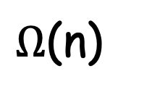
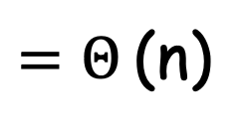
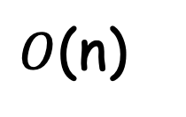
Recurrence
T(n) = 2T(n/2) + log n
$=Θ$(n)
$Ω$(n)
T(n) > 2T(n/2) + 1
$O$(n)
Guess and check:
T(n) <= n – 2 log n

Slide 22
Recall
Time
Space (In Place?)
Remarks
O(n²)
Insertion Sort
Yes
fast for small input sizes
Merge Sort
can be in-place with a
sophisticated merging
O(n log n)
No
O(n log n) or O(n²)
outperforms heapsort
in practice
Quicksort
Yes
O(n log n)
date structure based
design technique
Heapsort
Yes

Slide 23
The Question
Can we do better that O(n log n)?
No, for comparison sorts!
Yes, with more information from the input.

Slide 24
Part II: Sorting in Linear Time

Slide 25
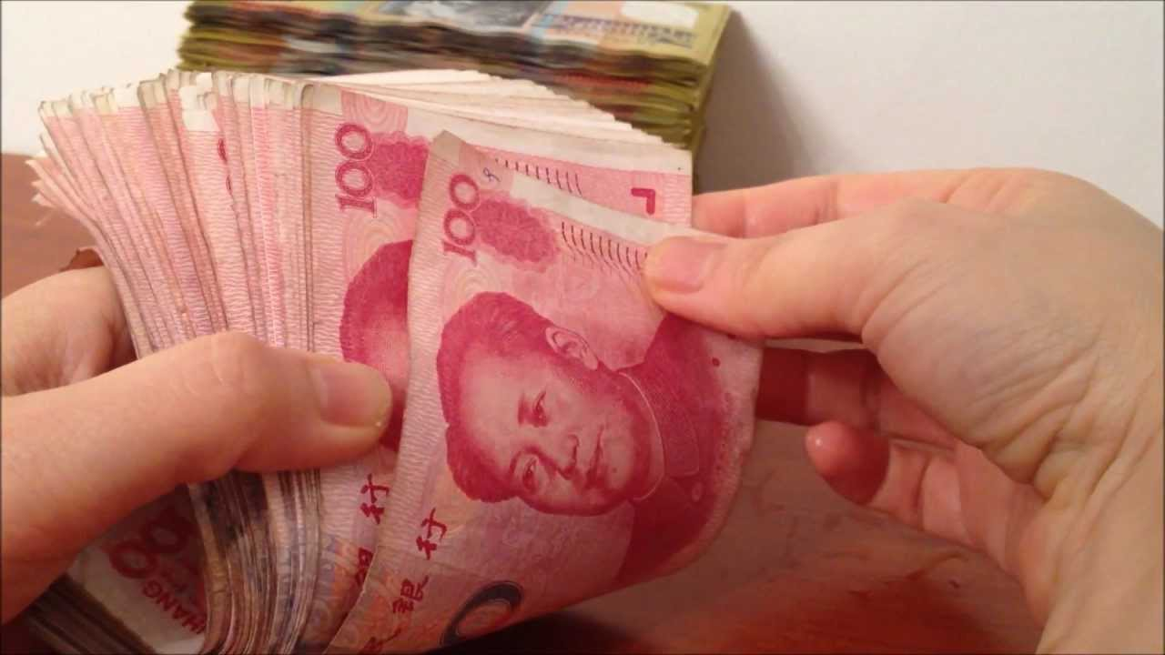

Slide 26
The Sorting Problem
Given 1000 Chinese notes,
how will you sort them?

Slide 27
The Sorting Problem
Input: a sequence of n numbers in [0,k]
a₁, a₂, a₃, …, a_{n}
Output: (a reordering) a’₁, a’₂, a’₃, …, a’_{n} s.t.
a’₁ <= a’₂ <= a’₃ <= … <= a’_{n}

Slide 28
Counting Sort
Create an array C [0,…,k]
C[i]: count how many times value i appears
Scan C from i=0 to k
Output i for C[i] times
O(k+n)
O(n) if k = O(n)

Slide 29


Slide 30
The Sorting Problem
Input: a sequence of n random numbers
uniformly drawn from [0,1)
Output: (a reordering) a’₁, a’₂, a’₃, …, a’_{n} s.t.
a’₁ <= a’₂ <= a’₃ <= … <= a’_{n}

Slide 31
Bucket Sort
Create an array B[0,…,n-1]
O(n)
O(n)
B[i]: put elements in [i/n, (i+1)/n) to B[i]
???
Sort each B[i] with insertion sort
O(n)
From i=0 to n-1, output elements in B[i]

Slide 32
Sort Each Bucket
Sort each B[i] with insertion sort
|B[0]|+ …. + |B[n-1]| = n
Cost: |B[0]|² + |B[1]|² +…+ |B[n-1]|²
Worst case time complexity: O(n²)

Slide 33
Expected Cost
Sort each B[i] with insertion sort
|B[0]|+ …. + |B[n-1]| = n
Cost: |B[0]|² + |B[1]|² +…+ |B[n-1]|²
n numbers are independently and uniformly drawn from [0,1)
E[|B[i]|] = 1
E[|B[i]|²] = 2 – 1/n
Expected cost O(n)

Slide 34
Summary
Comparison sorts
(insertion sort, merge sort, quicksort, heapsort)
Sorting in linear time
(counting sort, bucket sort)

Slide 35
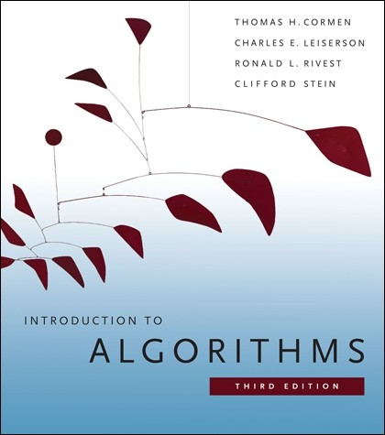
More Details
[CLRS] 6

