Slide 1
CSCI-SHU 220: Algorithms
Scheduling Problems
Fall 2020 @ NYU Shanghai

Slide 2
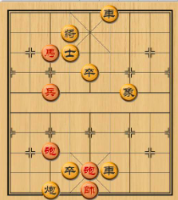
Strategy for Playing Chess
thinking ahead

Slide 3

Greedy (贪心) Strategy
NO thinking ahead,
use LOCAL optimal

Slide 4
Problem I: Interval Scheduling

Slide 5
Room Booking
Activity 1: 11:30-12:45
Activity 2: 8:30-11:00
Room 604
Activity 3: 9:00-10:00
Activity 4: 7:00-9:30
Activity 5: 7:45-8:00
Activity 6: 8:15-9:15
Maximize the # of activities with no time conflicts?

Slide 6
Problem 1: Interval Schedule
Input: n intervals
[s₁,f₁], …, [s_{n},f_{n}]
Output:
a maximal set of disjoint intervals

Slide 7
Example

Slide 8
Being Greedy?
Earliest starting time
Earliest finishing time
Shortest interval
Minimum conflicts

Slide 9
Earliest Starting Time
choose the interval with minimal s_{i}
a counterexample for this greedy strategy

Slide 10
Shortest Intervals
choose the interval with minimal f_{i} - s_{i}
a counterexample for this greedy strategy

Slide 11
Minimum Conflicts
choose the interval with least overlaps with others
a counterexample for this greedy strategy

Slide 12
Earliest Finishing Time
choose the interval with minimal f_{i}
leave maximum space for future intervals
how could we argue that it works?

Slide 13
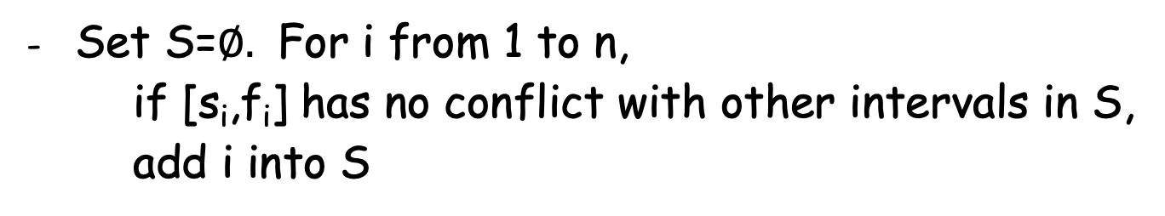
Algorithm: Earlies Finishing Time
- Sort the interval so that f₁<= f₂ <= … <= f_{n}
Set S=$∅.$ For i from 1 to n,
if [s_{i},f_{i}] has no conflict with other intervals in S,
add i into S
- Return S

Slide 14
Example: Room Booking
Activity 1: 7:45-8:00
Activity 2: 8:15-9:15
Activity 3: 7:00-9:30
Room 604
Activity 4: 9:00-10:00
Activity 5: 8:30-11:00
Activity 6: 11:30-12:45
Return S={1,2,6}

Slide 15
Why S={1,2,6} optimal??
Activity 1: 7:45-8:00
Suppose {1,4,6} is optimal
Activity 2: 8:15-9:15
Activity 1: 7:45-8:00
Activity 3: 7:00-9:30
Activity 4: 9:00-10:00
Activity 6: 11:30-12:45
Activity 4: 9:00-10:00
Activity 5: 8:30-11:00
Better to choose 2 than 4
Activity 6: 11:30-12:45
Then {1,2,6} is also optimal

Slide 16
Intuition
Algorithm returns (ordered)
i_{1,} i₂, … , i_{k}
The optimal solution is (ordered) with r>=k
j_{1,} j₂, … , j_{r}
j₁
j₂
Idea: replace j₁ by i₁
i₁
j₂
i_{1,} j₂, … , j_{r}
i₁ finishes earlier
This is also an optimal solution!

Slide 17
Repeat More Times
Claim: the following is an (ordered) optimal solution
i_{1,} i₂, … , i_{k} , j_{k+1}, … , j_{r}
Optimality of our algorithm: suppose it is not, i.e.,
r > k
j_{k+1} should have been added to S by our algorithm
a contradiction that our algorithm only finds k intervals

Slide 18
Proof of the Claim
Claim: the following is an (ordered) optimal solution
i_{1,} i₂, … , i_{k} , j_{k+1}, … , j_{r}
Proof idea: prove by induction.
Based case: the following is optimal
i_{1,} j₂, … , j_{r}
As we discussed, it is. Let us prove the inductive step.

Slide 19
Proof of the Claim
Claim: the following is an (ordered) optimal solution
i_{1,} i₂, … , i_{k} , j_{k+1}, … , j_{r}
Proof idea: suppose for c>=1, the following is optimal
i_{1,} i₂, … , i_{c} , j_{c+1}, … , j_{r}
then we can replace j_{c+1} by i_{c+1}
i_{1,} i₂, … , i_{c} , j_{c+1}, … , j_{r}
and show it is also an optimal solution.

Slide 20
Time Complexity
- Sort the interval so that f₁<= f₂ <= … <= f_{n}
O(n log n)
Set S=$∅.$ For i from 1 to n,
if [s_{i},f_{i}] has no conflict with other intervals in S,
add i into S
O(n)
- Return S
O(n log n )

Slide 21
Problem II: Total Completion Time

Slide 22
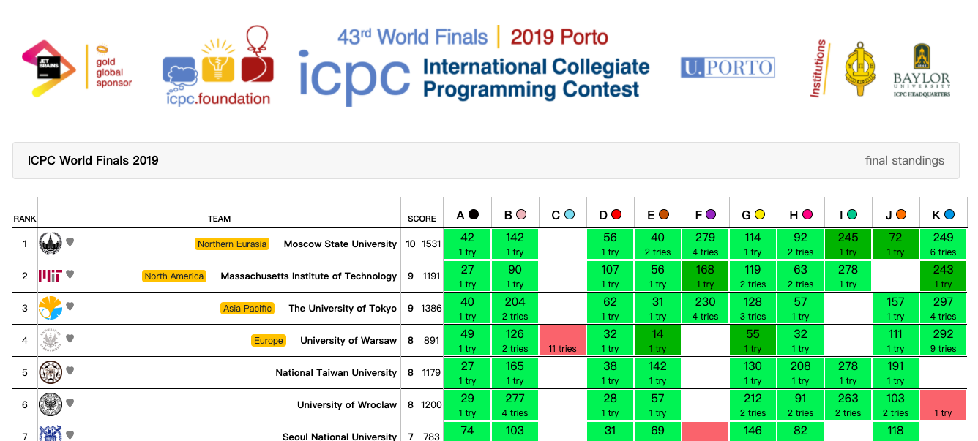
Ranking: # of problems solved,
total completion time

Slide 23
Problem 2: Total Completion Time
Input: n jobs, each requiring time p_{i} (p_{i} >0)
Output: an ordering that minimize the
total completion time

Slide 24
Example
4 jobs : 3, 6, 4, 7
Ordering: 3, 4, 6, 7
Completion time: 3, 7, 13, 20
Total completion time: 3 + 7 + 13 + 20

Slide 25
Greedy Strategy
Finish the easiest thing first!
Prove this is optimal?

Slide 26
Exchange Argument
Consider a solution which is not sorted
p₁ , p_{2, …,} p_{n-1} , p_{n}
=> there exists an inversion pair
p_{i} > p_{j} (i<j)
=> there exists a local inversion pair
p_{k} > p_{k+1}
=> swapping them gives a better solution

Slide 27
An Example
Consider a solution which is not sorted
3, 6, 4, 7
=> there exists a local inversion pair
6 > 4
total completion:
3 + 9 + 13 + 20 = 45
total completion (after swapping):
3 + 7 + 13 + 20 = 43

Slide 28
Formally
Consider a solution which is not sorted
p₁ , p_{2, …,} p_{n-1} , p_{n}
(with p_{k} > p_{k+1})
Total completion time:
p₁ + (p₁ + p₂) +… + (p₁ + p₂ + … + p_{n})
= n p₁ + (n-1) p₂ + … + p_{n}
Swapping is better:
(k+1) p_{k} + k p_{k+1} > k p_{k} + (k+1) p_{k+1}
not sorted solution cannot be optimal

Slide 29
An Exercise: Rearrange Inequality
Given a₁ >= a₂>= … >= a_{n} , b₁ >= b₂>= … >= b_{n}
For any permutation f:[n] -> [n], it holds that
a₁ b₁ + a₂ b₂ + … + a_{n} b_{n}
>= a₁ b_{f(1)} + a₂ b_{f(2)} + … + a_{n} b_{f(n)}
>= a₁ b_{n} + a₂ b_{n-1} + … + a_{n} b₁
Prove it by the exchange argument?

Slide 30
Summary
Greedy Strategy
(no thinking ahead, use local optimal)
Two Scheduling Problems
(interval scheduling, minimize total completion time)
Proof of Correctness
(exchange argument)

