Slide 1

Notes:
Solving Recurrence
https://www.polleverywhere.com/competitions/ctn2igCmFyxoE7d5loZ7U?display_state=welcome&controls=none&onscreen=persist

Slide 2
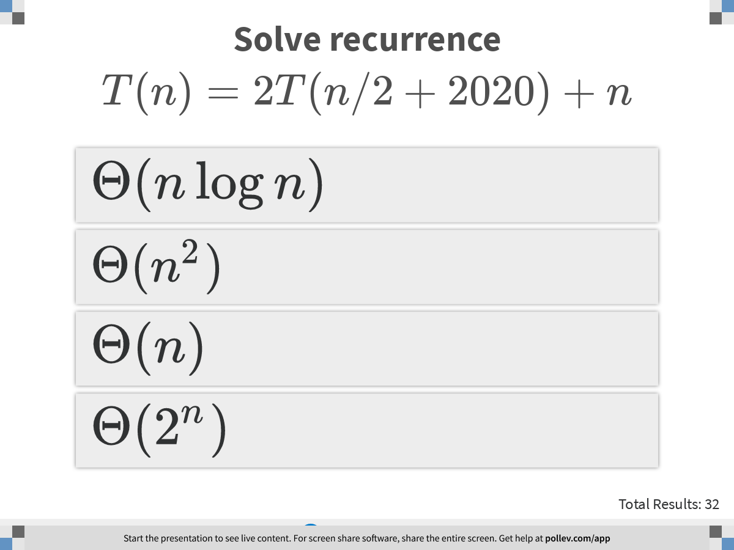
Notes:
Solve recurrence $$T(n)=2T(n/2+2020)+n$$
https://www.polleverywhere.com/multiple_choice_polls/dVqLP2Ve1OFGgjG3kCamp?display_state=instructions&controls=none&onscreen=persist

Slide 3
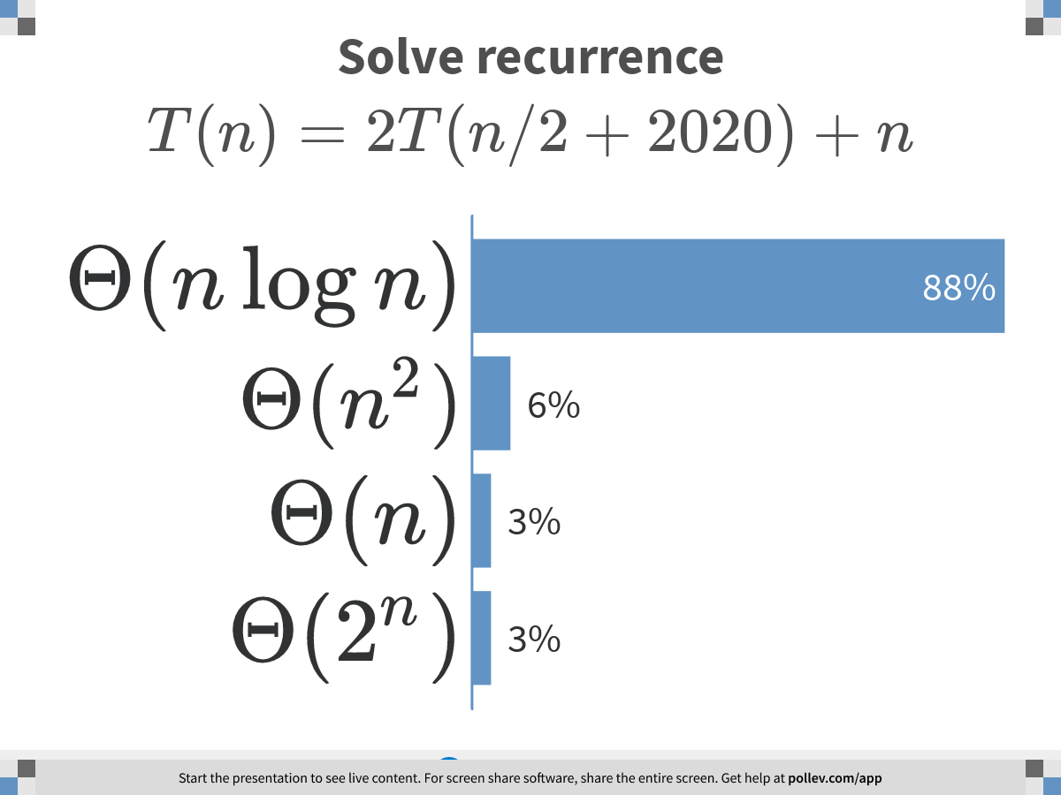
Notes:
Solve recurrence $$T(n)=2T(n/2+2020)+n$$
https://www.polleverywhere.com/multiple_choice_polls/dVqLP2Ve1OFGgjG3kCamp?display_state=chart&display=correctness&controls=none&onscreen=persist

Slide 4
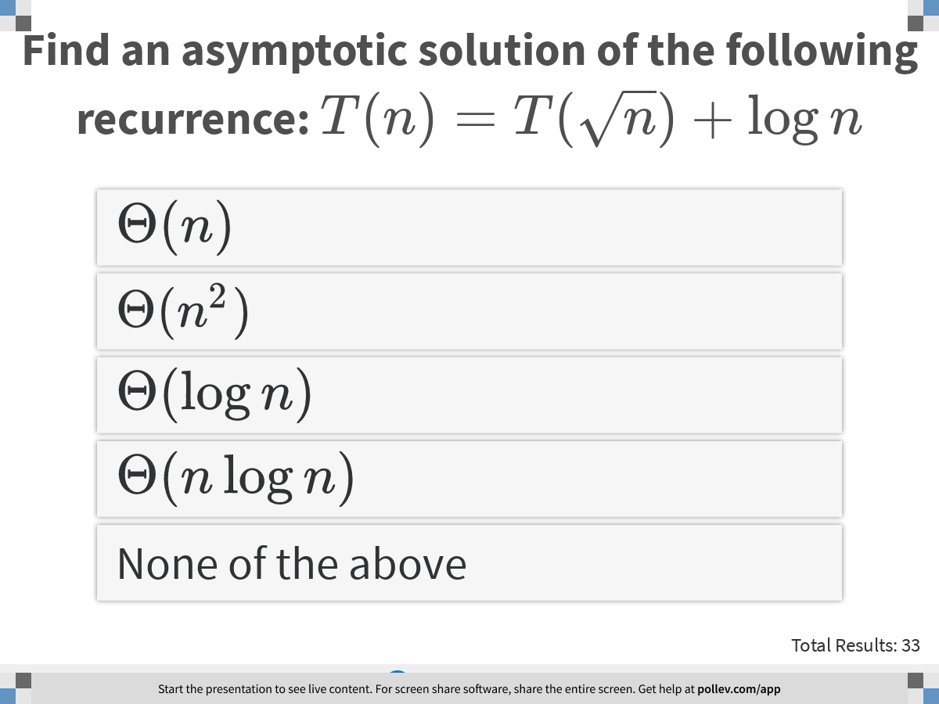
Notes:
Find an asymptotic solution of the following recurrence: $$T(n) = T(\sqrt{n}) + \log n$$
https://www.polleverywhere.com/multiple_choice_polls/m7AgdqdeiliYw4l1YOaOk?display_state=instructions&controls=none&onscreen=persist

Slide 5
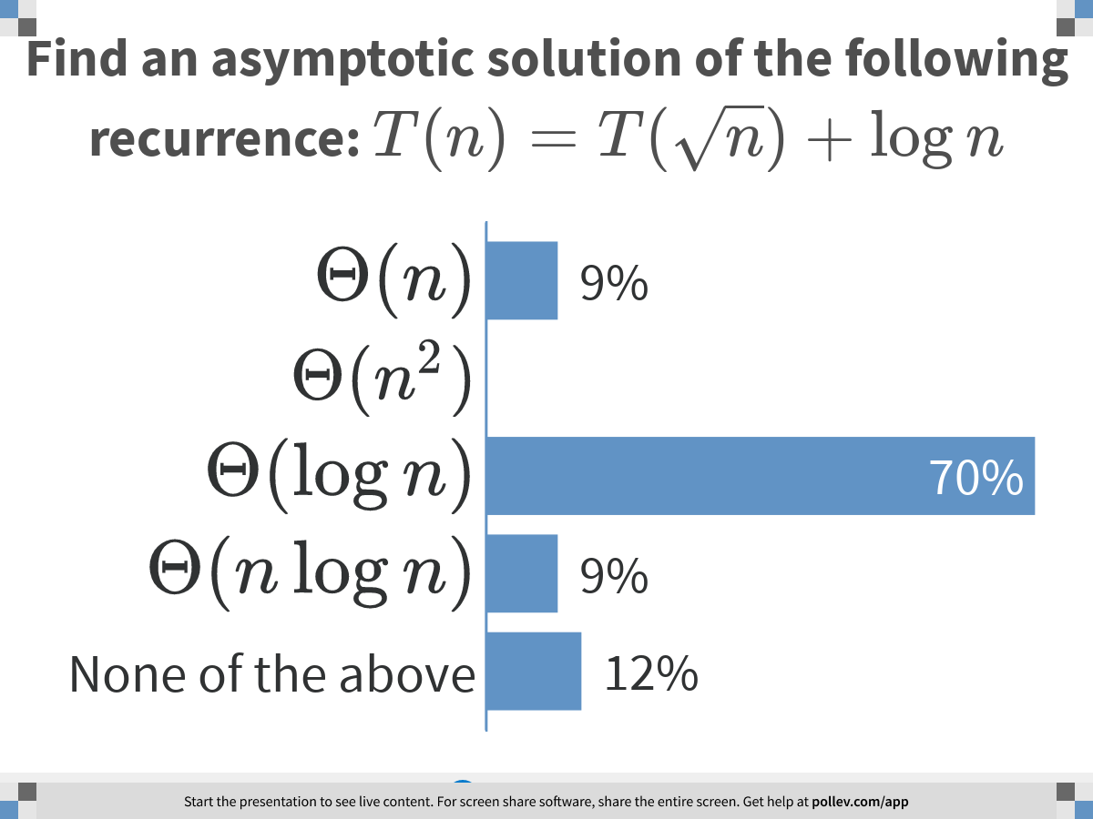
Notes:
Find an asymptotic solution of the following recurrence: $$T(n) = T(\sqrt{n}) + \log n$$
https://www.polleverywhere.com/multiple_choice_polls/m7AgdqdeiliYw4l1YOaOk?display_state=chart&display=correctness&controls=none&onscreen=persist

Slide 6
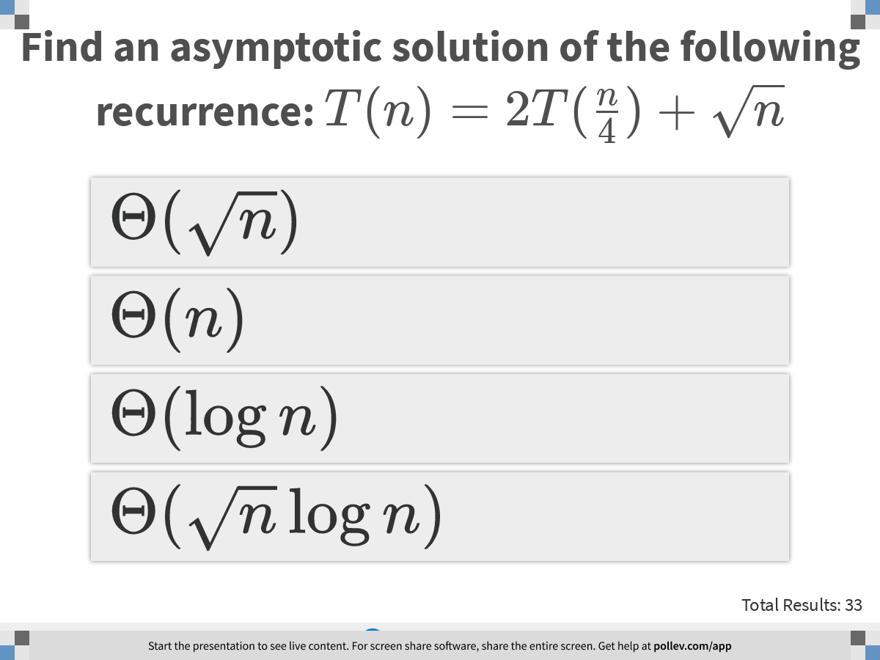
Notes:
Find an asymptotic solution of the following recurrence: $$T(n) = 2T(\frac{n}{4}) + \sqrt{n}$$
https://www.polleverywhere.com/multiple_choice_polls/qnnTnxYz1VOAZU8LHbLwe?display_state=instructions&controls=none&onscreen=persist

Slide 7
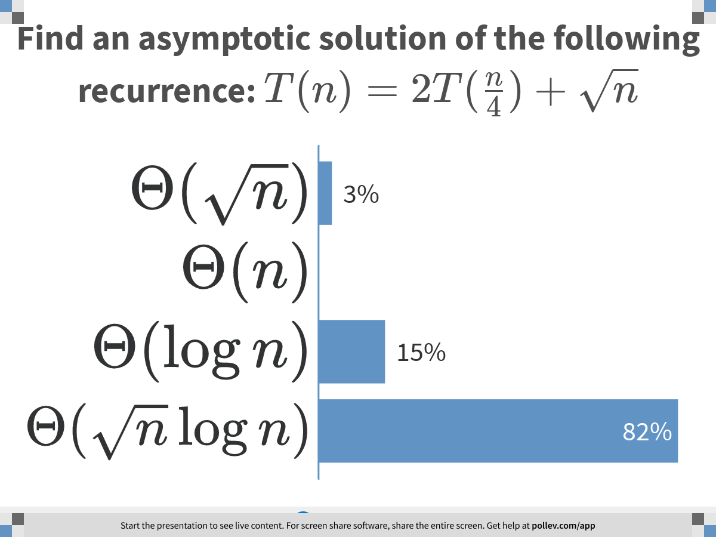
Notes:
Find an asymptotic solution of the following recurrence: $$T(n) = 2T(\frac{n}{4}) + \sqrt{n}$$
https://www.polleverywhere.com/multiple_choice_polls/qnnTnxYz1VOAZU8LHbLwe?display_state=chart&display=correctness&controls=none&onscreen=persist

Slide 8
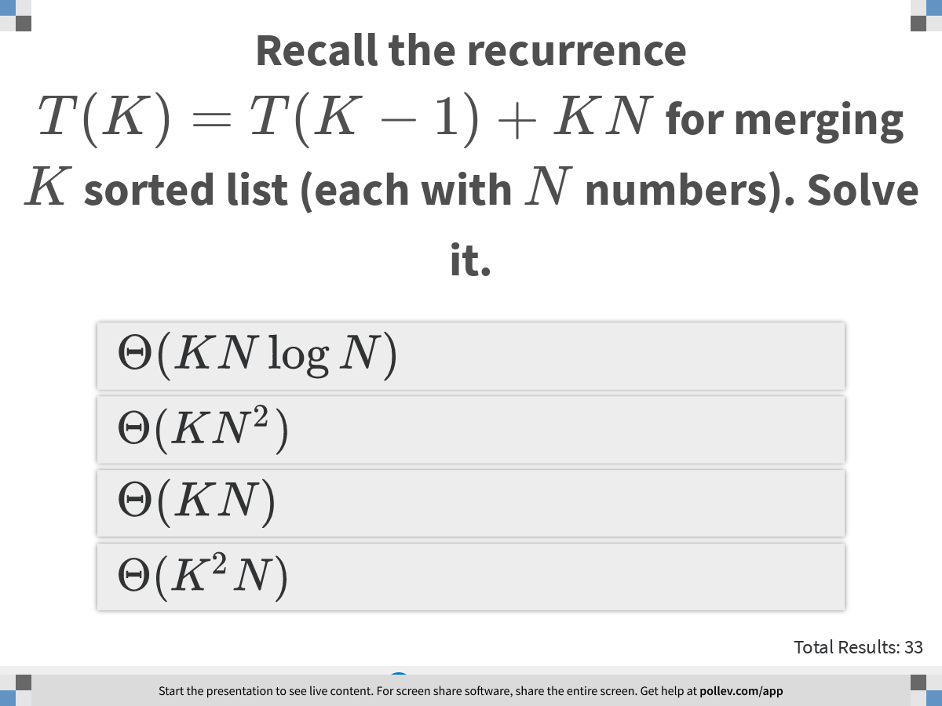
Notes:
Recall the recurrence $$T(K) = T(K-1) +KN$$ for merging $$K$$ sorted list (each with $$N$$ numbers). Solve it.
https://www.polleverywhere.com/multiple_choice_polls/fyWDz2VJgkCg5AubI1Tr6?display_state=instructions&controls=none&onscreen=persist

Slide 9
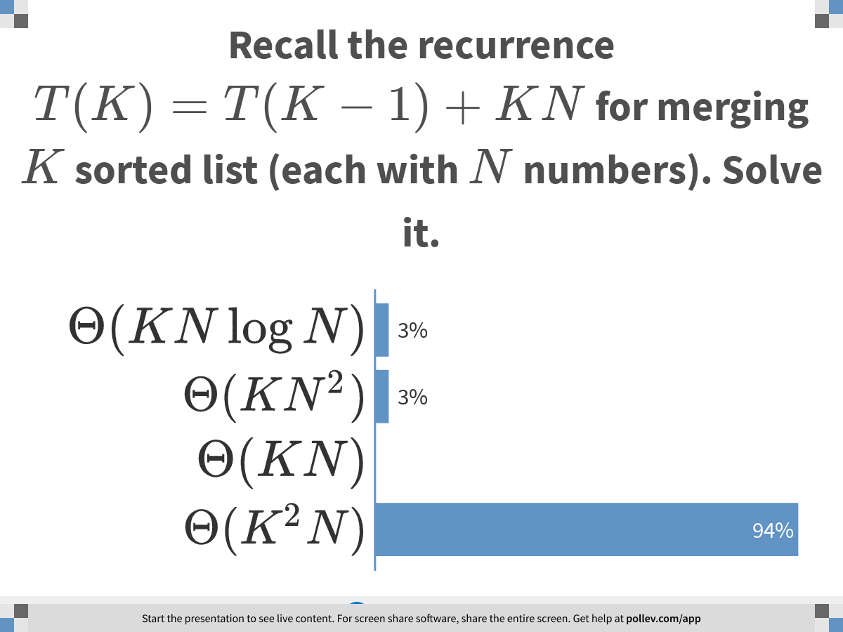
Notes:
Recall the recurrence $$T(K) = T(K-1) +KN$$ for merging $$K$$ sorted list (each with $$N$$ numbers). Solve it.
https://www.polleverywhere.com/multiple_choice_polls/fyWDz2VJgkCg5AubI1Tr6?display_state=chart&display=correctness&controls=none&onscreen=persist

Slide 10
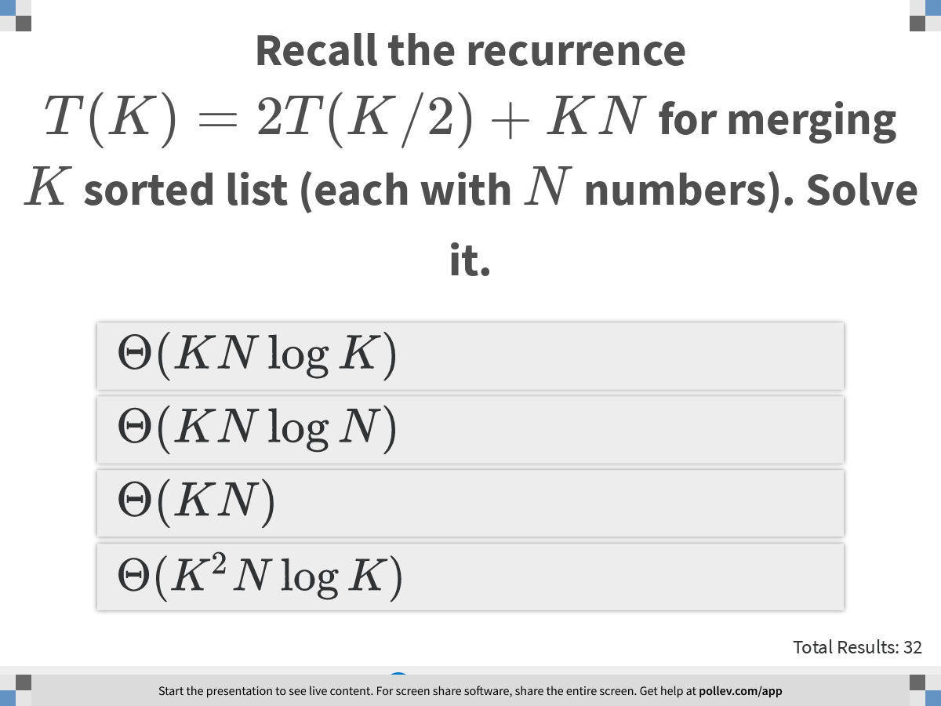
Notes:
Recall the recurrence $$T(K) = 2T(K/2) +KN$$ for merging $$K$$ sorted list (each with $$N$$ numbers). Solve it.
https://www.polleverywhere.com/multiple_choice_polls/qmphZobmmXVz7tqnqneKE?display_state=instructions&controls=none&onscreen=persist

Slide 11
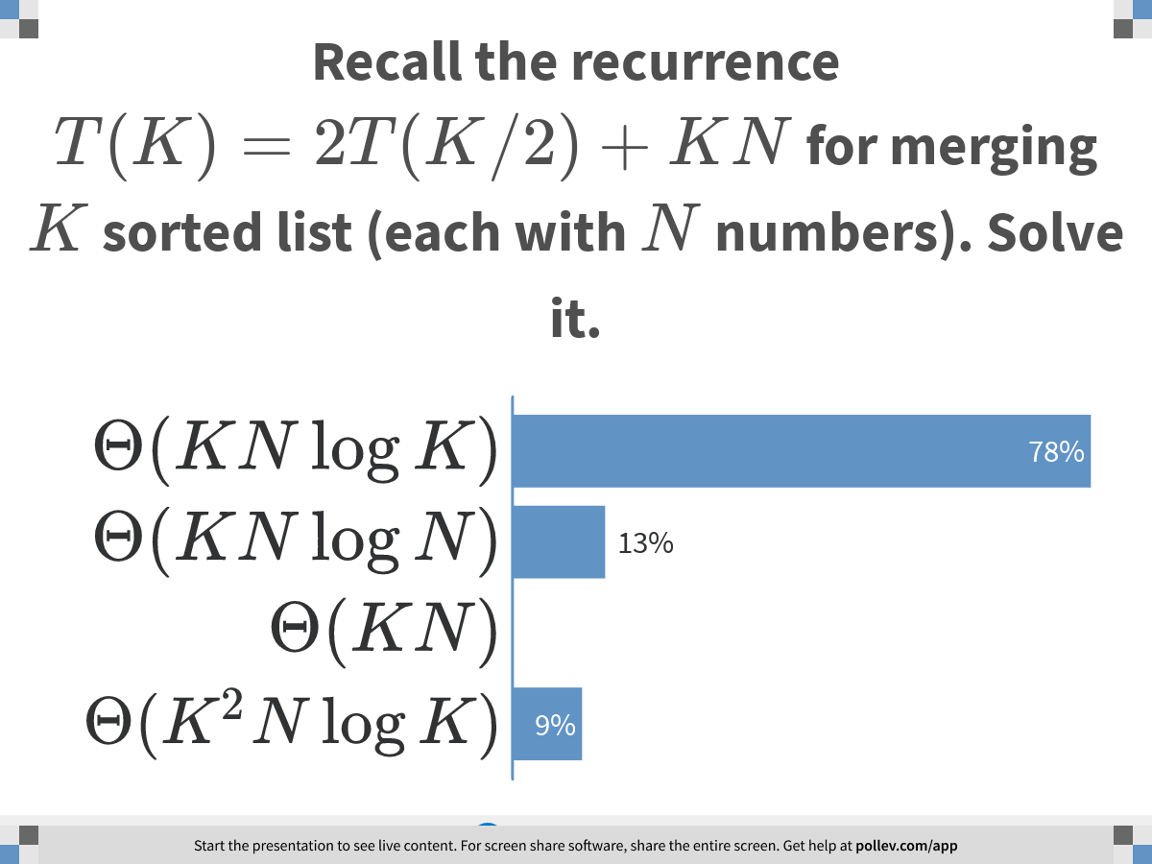
Notes:
Recall the recurrence $$T(K) = 2T(K/2) +KN$$ for merging $$K$$ sorted list (each with $$N$$ numbers). Solve it.
https://www.polleverywhere.com/multiple_choice_polls/qmphZobmmXVz7tqnqneKE?display_state=chart&display=correctness&controls=none&onscreen=persist

Slide 12
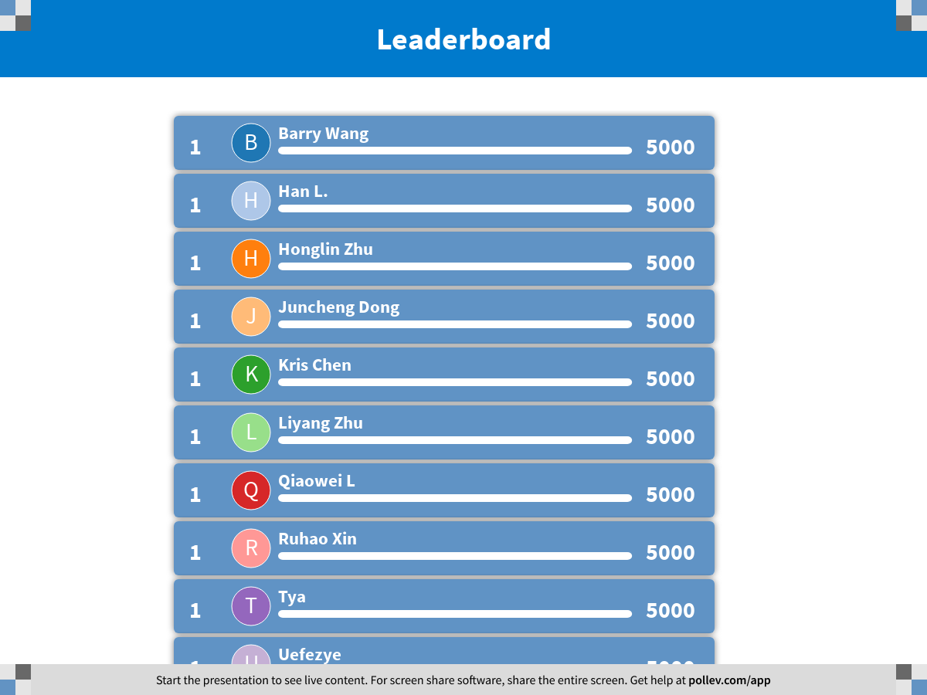
Notes:
Solving Recurrence
https://www.polleverywhere.com/competitions/ctn2igCmFyxoE7d5loZ7U?display_state=finale&onscreen=persist

Slide 13

Notes:
Divide and Conquer
https://www.polleverywhere.com/competitions/B8sajevtMpb9FdW1pKb83?display_state=welcome&controls=none&onscreen=persist

Slide 14
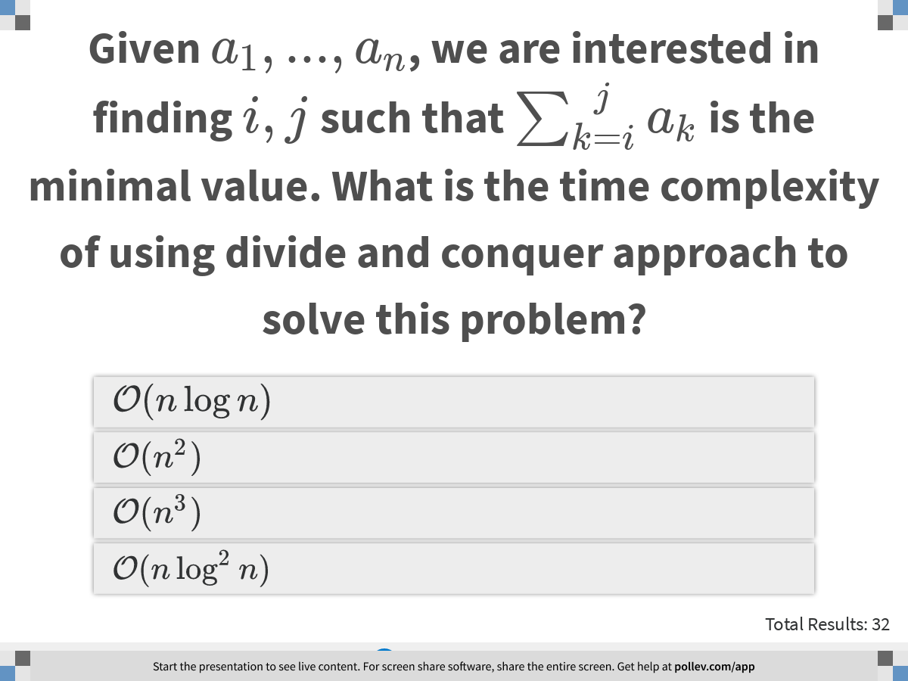
Notes:
Given $$a_1,..., a_n$$, we are interested in finding $$i,j$$ such that $$\sum_{k=i}^j a_{k}$$ is the minimal value. What is the time complexity of using divide and conquer approach to solve this problem?
https://www.polleverywhere.com/multiple_choice_polls/3jfoA56dOmwGHlRRefw7O?display_state=instructions&controls=none&onscreen=persist

Slide 15
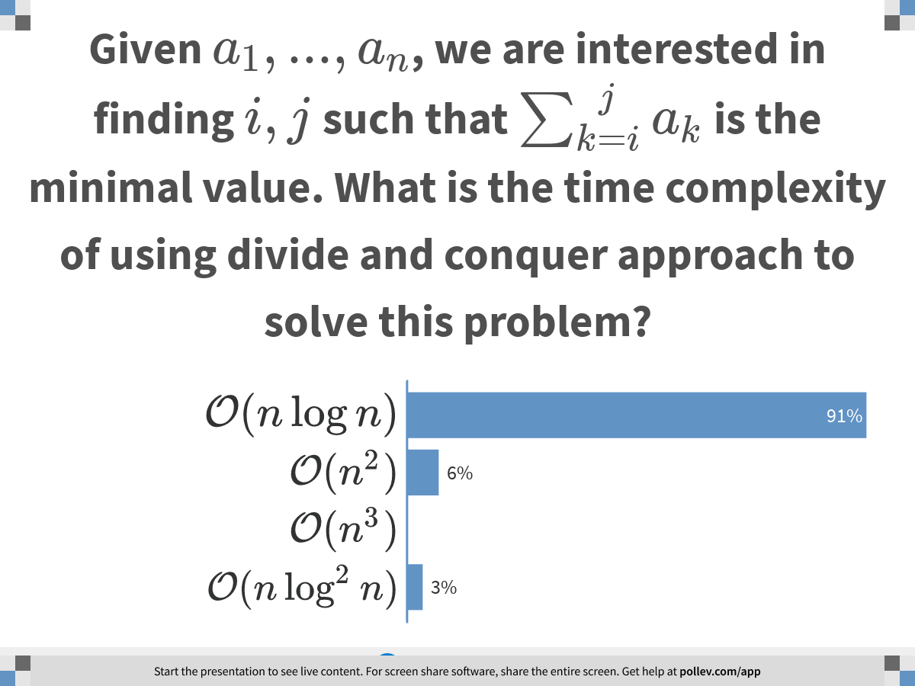
Notes:
Given $$a_1,..., a_n$$, we are interested in finding $$i,j$$ such that $$\sum_{k=i}^j a_{k}$$ is the minimal value. What is the time complexity of using divide and conquer approach to solve this problem?
https://www.polleverywhere.com/multiple_choice_polls/3jfoA56dOmwGHlRRefw7O?display_state=chart&display=correctness&controls=none&onscreen=persist

Slide 16
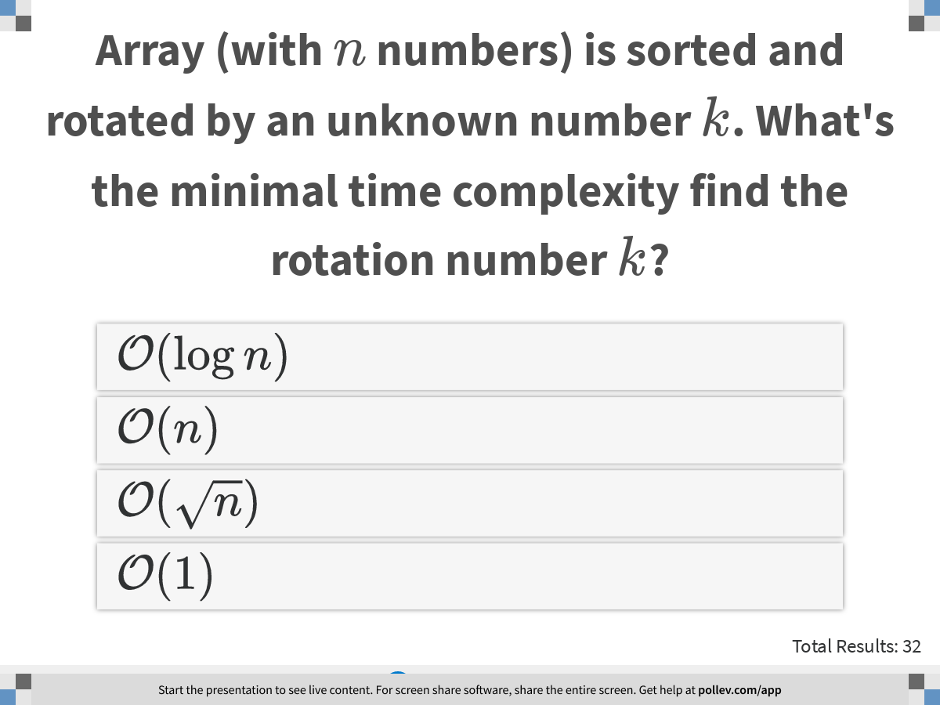
Notes:
Array (with $$n$$ numbers) is sorted and rotated by an unknown number $$k$$. What's the minimal time complexity find the rotation number $$k$$?
https://www.polleverywhere.com/multiple_choice_polls/MxeFU58VnNXTenlXwnnLy?display_state=instructions&controls=none&onscreen=persist

Slide 17
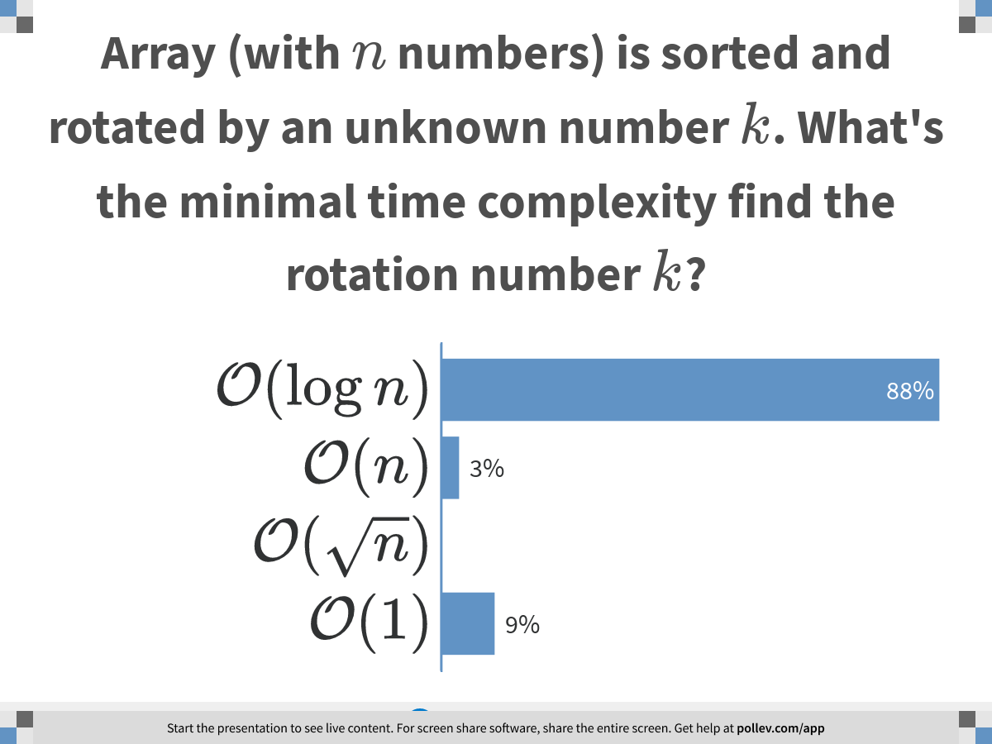
Notes:
Array (with $$n$$ numbers) is sorted and rotated by an unknown number $$k$$. What's the minimal time complexity find the rotation number $$k$$?
https://www.polleverywhere.com/multiple_choice_polls/MxeFU58VnNXTenlXwnnLy?display_state=chart&display=correctness&controls=none&onscreen=persist

Slide 18
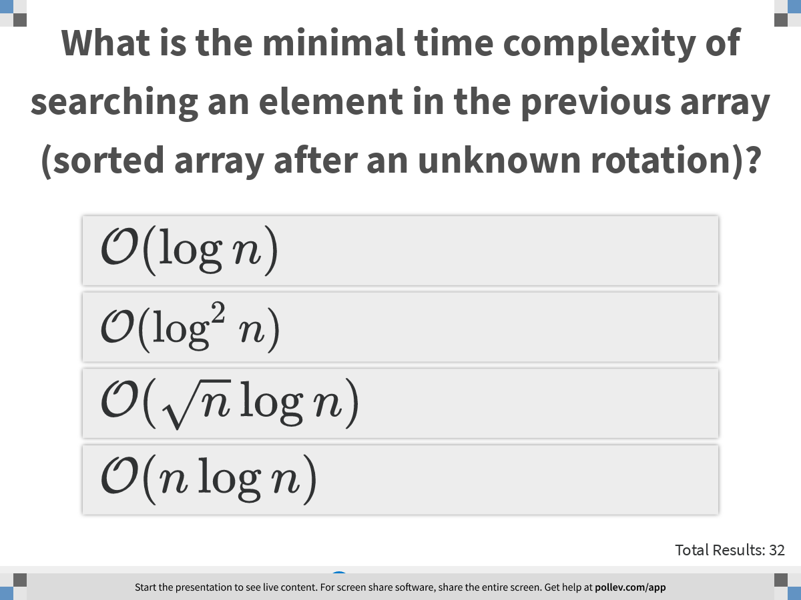
Notes:
What is the minimal time complexity of searching an element in the previous array (sorted array after an unknown rotation)?
https://www.polleverywhere.com/multiple_choice_polls/lGZCjvTy4OvtRON1XJYsQ?display_state=instructions&controls=none&onscreen=persist

Slide 19
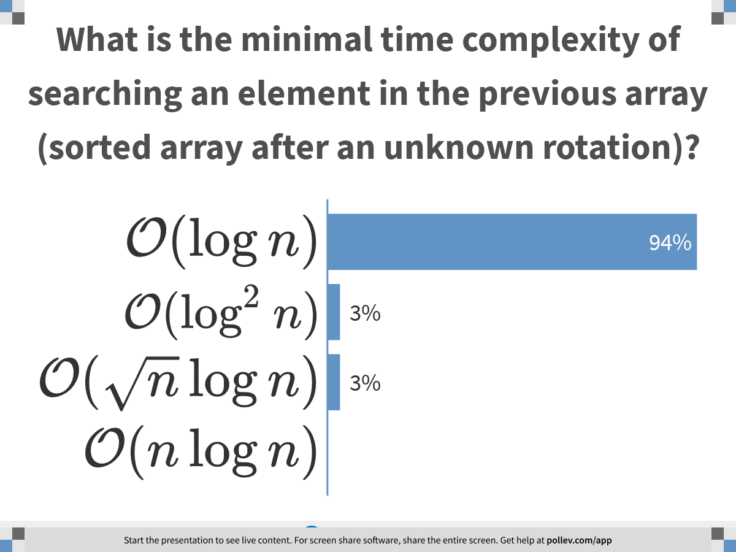
Notes:
What is the minimal time complexity of searching an element in the previous array (sorted array after an unknown rotation)?
https://www.polleverywhere.com/multiple_choice_polls/lGZCjvTy4OvtRON1XJYsQ?display_state=chart&display=correctness&controls=none&onscreen=persist

Slide 20
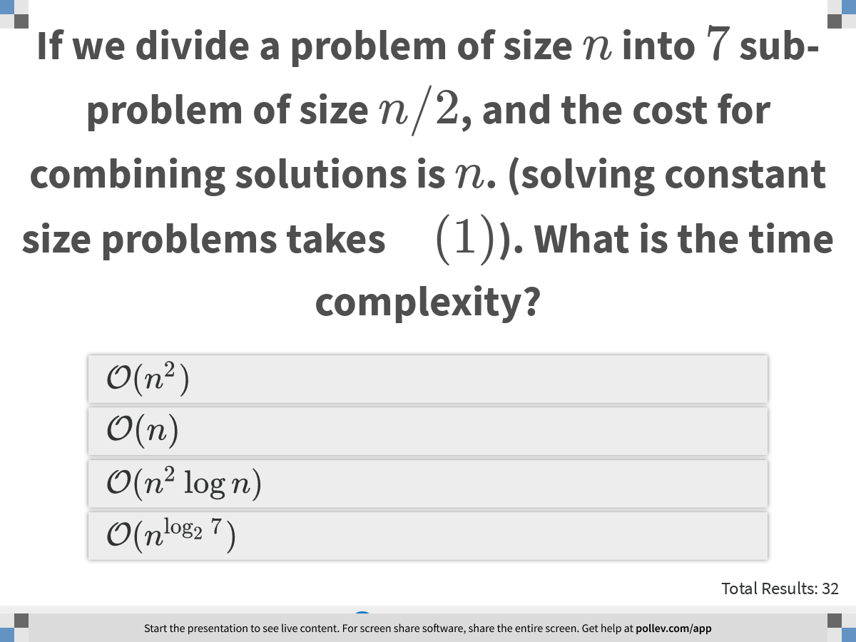
Notes:
If we divide a problem of size $$n$$ into $$7$$ sub-problem of size $$n/2$$, and the cost for combining solutions is $$n$$. (solving constant size problems takes $$\mathcal{O}(1)$$). What is the time complexity?
https://www.polleverywhere.com/multiple_choice_polls/Bg2fwe26fpKE7TQ1775Ni?display_state=instructions&controls=none&onscreen=persist

Slide 21
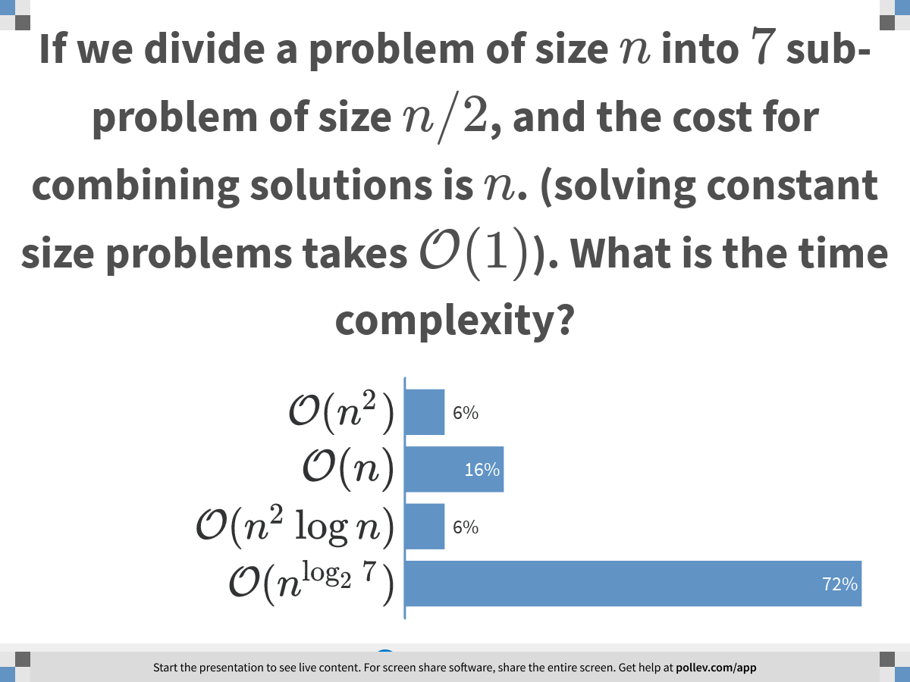
Notes:
If we divide a problem of size $$n$$ into $$7$$ sub-problem of size $$n/2$$, and the cost for combining solutions is $$n$$. (solving constant size problems takes $$\mathcal{O}(1)$$). What is the time complexity?
https://www.polleverywhere.com/multiple_choice_polls/Bg2fwe26fpKE7TQ1775Ni?display_state=chart&display=correctness&controls=none&onscreen=persist

Slide 22
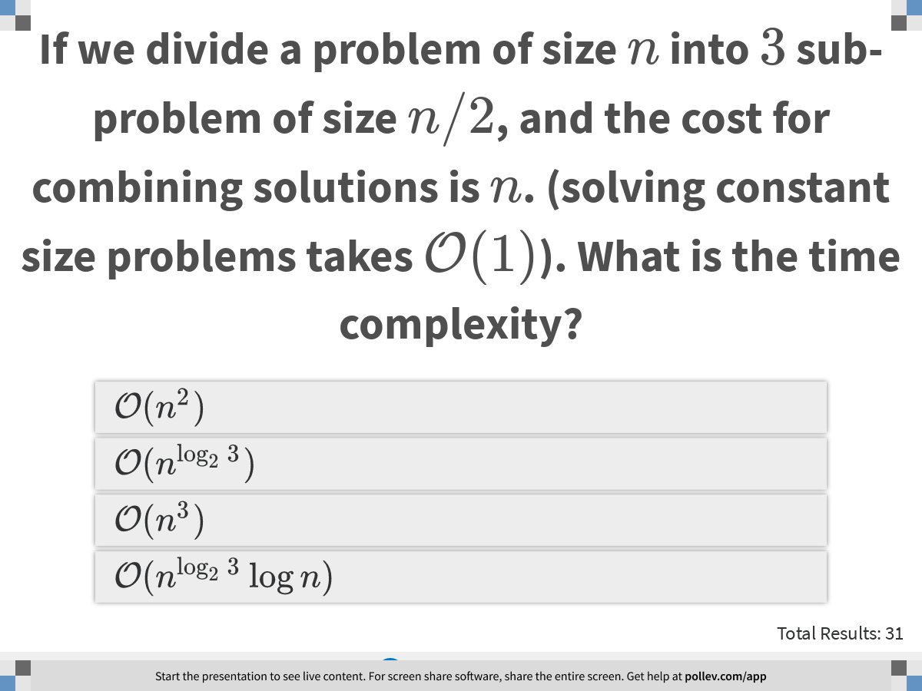
Notes:
If we divide a problem of size $$n$$ into $$3$$ sub-problem of size $$n/2$$, and the cost for combining solutions is $$n$$. (solving constant size problems takes $$\mathcal{O}(1)$$). What is the time complexity?
https://www.polleverywhere.com/multiple_choice_polls/1N34sqpwCBwLi3lIhEs1J?display_state=instructions&controls=none&onscreen=persist

Slide 23
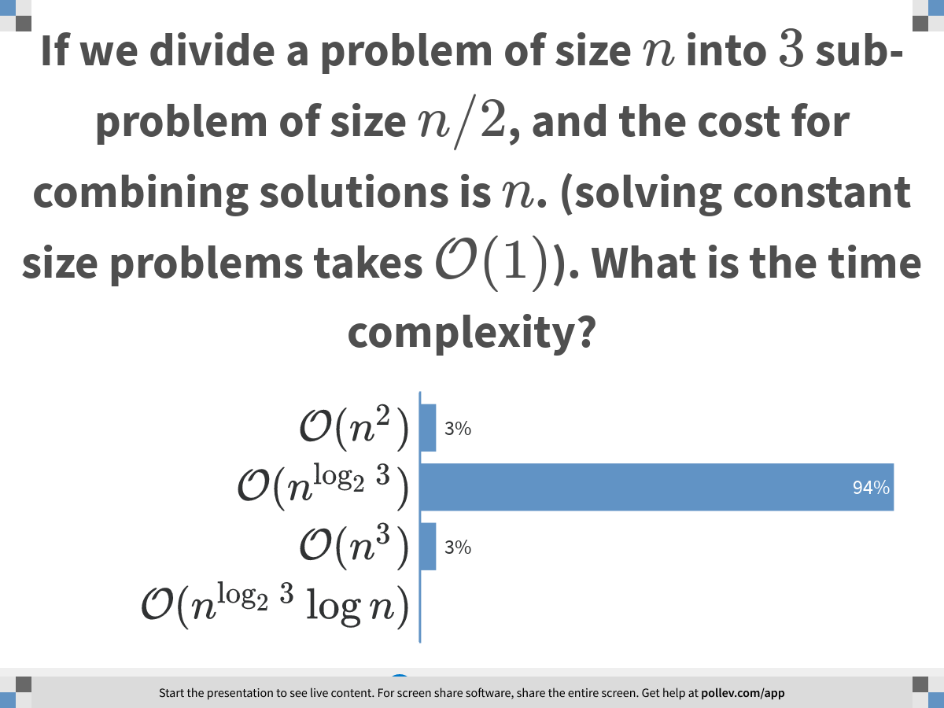
Notes:
If we divide a problem of size $$n$$ into $$3$$ sub-problem of size $$n/2$$, and the cost for combining solutions is $$n$$. (solving constant size problems takes $$\mathcal{O}(1)$$). What is the time complexity?
https://www.polleverywhere.com/multiple_choice_polls/1N34sqpwCBwLi3lIhEs1J?display_state=chart&display=correctness&controls=none&onscreen=persist

Slide 24
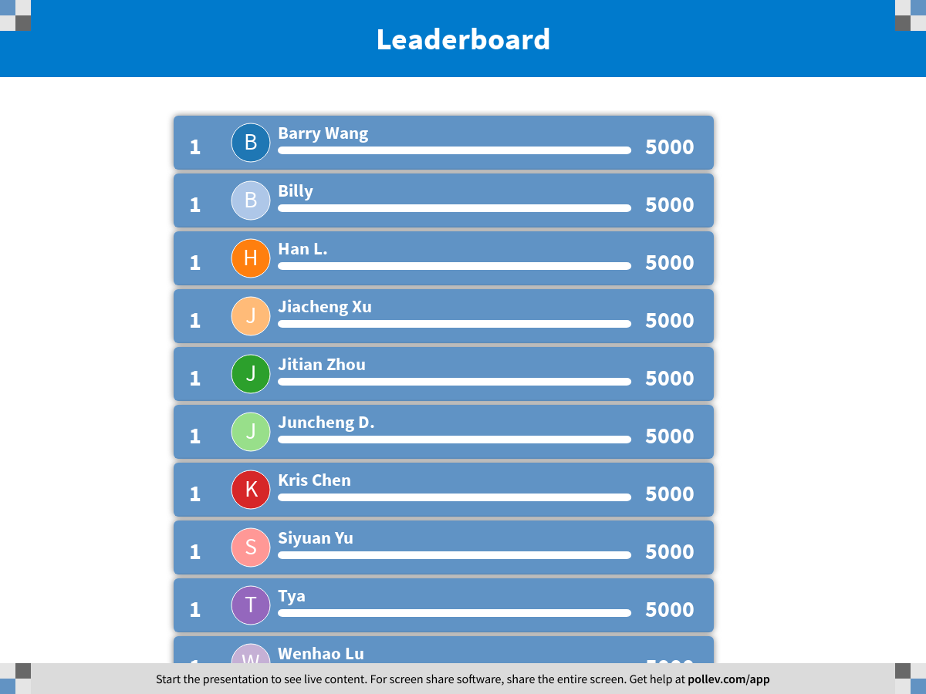
Notes:
Divide and Conquer
https://www.polleverywhere.com/competitions/B8sajevtMpb9FdW1pKb83?display_state=finale&onscreen=persist

