Slide 1
Chapter 2: Intro to Relational Model

Slide 2

Example of a Relation
attributes
(or columns)
tuples
(or rows)

Slide 3
Attribute
The set of allowed values for each attribute is called the domain of the attribute
Attribute values are (normally) required to be atomic; that is, indivisible
The special value null is a member of every domain. Indicated that the value is “unknown”
The null value causes complications in the definition of many operations

Slide 4

Relations are Unordered
Order of tuples is irrelevant (tuples may be stored in an arbitrary order)
Example: instructor relation with unordered tuples

Slide 5
Database Schema
Database schema -- is the logical structure of the database.
Database instance -- is a snapshot of the data in the database at a given instant in time.
Example:
  schema: instructor (ID, name, dept_name, salary)
  Instance:

Slide 6
Keys
Let K ⊆ R
K is a superkey of R if values for K are sufficient to identify a unique tuple of each possible relation r(R)
  Example: {ID} and {ID,name} are both superkeys of instructor.
Superkey K is a candidate key if K is minimal
Example: {ID} is a candidate key for Instructor
One of the candidate keys is selected to be the primary key.
  which one?
Foreign key constraint: Value in one relation must appear in another
  Referencing relation – who included primary key of other relation in its attribute list.
  Referenced relation – whose primary key is included
  Example – dept_name in instructor is a foreign key from instructor referencing department
    Instructor is referencing relation and department is referenced rel.

Slide 7

Schema Diagram for University Database

Slide 8
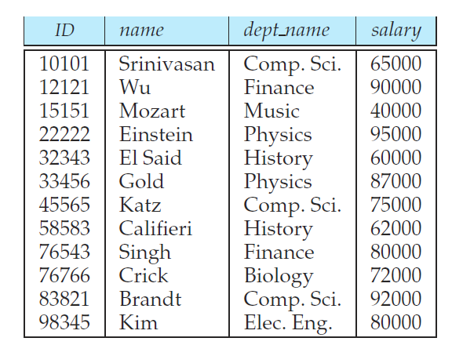
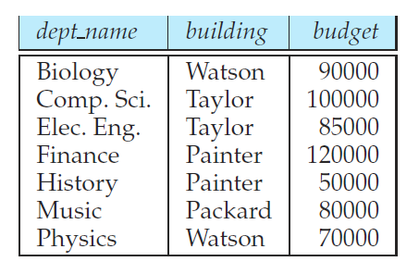
Foreign Key Constraints
Consider the foreign key constraint from the dept name attribute of instructor to the department relation. Give examples of inserts and deletes to these relations, which can cause a violation of the foreign key constraint.

Slide 9
Relational Query Languages
Procedural vs .non-procedural, or declarative
“Pure” languages:
  Relational algebra
  Tuple relational calculus
  Domain relational calculus
The above 3 pure languages are equivalent in computing power
We will concentrate in this chapter on relational algebra
  Not turing-machine equivalent
  consists of 6 basic operations

Slide 10
Select Operation
Notation: σ_{ρ} (r)
ρ is called the selection predicate
Defined as: σ_{ρ} (r) = {t | t ∈ r and ρ(t)}
  Where
  ρ is a formula in propositional calculus consisting of terms and
  connected by : ∧ (and), ∨ (or), ¬ (not)
  Each term is one of: op or where op is one of: =, ≠, >, ≥.

Slide 11

Select Operation – selection of rows (tuples)
Relation r
σ_{predicate}(r)
σ_{A=B ^ D > 5} (r)

Slide 12
Project Operation
Notation:
  where A1 , A2 are attribute names and r is a relation name.
The result is defined as the relation of k columns obtained by erasing the columns that are not listed
Duplicate rows removed from result, since relations are sets
∏_{A1,A2,….,An} (r)

Slide 13

Project Operation – selection of columns (Attributes)
Relation r:
∏_{A,C} (r)
Notes:
Duplicate rows removed from result, since relations are sets

Slide 14
Union Operation
Notation: r ∪ s
Defined as: r ∪ s = {t | t ∈ r or t ∈ s}
For r ∪ s to be valid.
1. r, s must have the same arity (same number of attributes)
2. The attribute domains must be compatible (example: 2nd column of r deals with the same type of values as does the 2 nd column of s)

Slide 15

Union of two relations
Relations r, s:
r ∪ s:

Slide 16
Set Difference Operation
Notation r – s
Defined as: r – s = {t | t ∈ r and t ∉ s}
Set differences must be taken between compatible relations.
  r and s must have the same arity
  attribute domains of r and s must be compatible

Slide 17

Set difference of two relations
Relations r, s:
r – s:

Slide 18
Intersection Operation
Notation: r ∩ s
Defined as: r ∩ s = {t | t ∈ r and t ∈ s}
For r ∩ s to be valid.
1. r, s must have the same arity (same number of attributes)
2. The attribute domains must be compatible (example: 2nd column of r deals with the same type of values as does the 2 nd column of s)

Slide 19

Set intersection of two relations
Relation r, s:
r ∩ s
Note: r ∩ s = r – (r – s)

Slide 20
Cartesian-Product Operation
Notation r x s
Defined as: r x s = {t q | t ∈ r and q ∈ s}
Assume that attributes of r(R) and s(S) are disjoint. (That is, R ∩ S = ∅).
If attributes of r(R) and s(S) are not disjoint, then renaming must be used.

Slide 21

joining two relations -- Cartesian-product
Relations r, s:
r x s:

Slide 22
joining two relations -- Cartesian-product
Relations r, s:
r x s:

Slide 23
Cartesian-product – naming issue
B
Relations r, s:
r.B
s.B
r x s:

Slide 24
Renaming a Table
Allows us to refer to a relation, (say E) by more than one name.
ρ _{x} (E)
returns the expression E under the name X
Relations r
r.A r.B s.A s.B
r x ρ _{s} (r)
α
α
β
β
1
1
2
2
α
β
α
β
1
2
1
2

Slide 25

Composition of Operations
Can build expressions using multiple operations
Example: σ_{A=C} (r x s)
r x s
σ_{A=C} (r x s)

Slide 26
Joining two relations – Natural Join
Let r and s be relations on schemas R and S respectively.
Then, the “natural join” of relations R and S is a relation on schema R ∪ S obtained as follows:
  Consider each pair of tuples t_{r} from r and t_{s} from s.
  If t_{r} and t_{s} have the same value on each of the attributes in R ∩ S, add a tuple t to the result, where
    t has the same value as t_{r} on r
    t has the same value as t_{s} on s

Slide 27

Natural Join Example
Relations r, s:
Natural Join
  r s

Slide 28
Natural Join Example
Relations r, s:
Natural Join
  r s
∏ _{A, r.B, C, r.D, E} (σ _{r.B = s.B ˄ r.D = s.D} (r x s)))

Slide 29
Notes about Relational Languages
Each Query input is a table (or set of tables)
Each query output is a table.
All data in the output table appears in one of the input tables

Slide 30
Summary of Relational Algebra Operators
Symbol (Name) Example of Use
σ
(Selection) ^{σ} salary > = 85000 ^{(instructor)}
Return rows of the input relation that satisfy the predicate.
Π
(Projection) ^{Π} ID, salary ^{(instructor)}
Output specified attributes from all rows of the input relation. Remove duplicate tuples from the output.
x
(Cartesian Product) instructor x department
Output pairs of rows from the two input relations that have the same value on all attributes that have the same name.
∪
(Union) ^{Π} name ^{(instructor) ∪ Π} name ^{(student)}
Output the union of tuples from the two input relations.
-
(Set Difference) ^{Π} name ^{(instructor)} ^{-- Π} name ^{(student)}
Output the set difference of tuples from the two input relations.
⋈
(Natural Join) instructor ⋈ department
Output pairs of rows from the two input relations that have the same value on all attributes that have the same name.

Slide 31
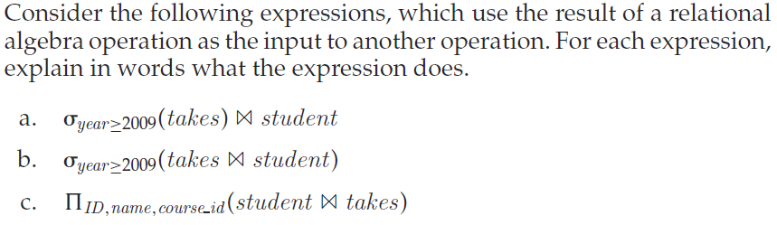
Practice Relational Algebra
Student (ID, name, dept name, tot cred)
Takes (ID, course id, sec id, semester, year, grade)

Slide 32
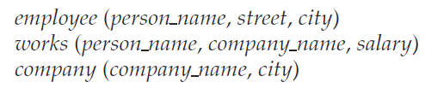
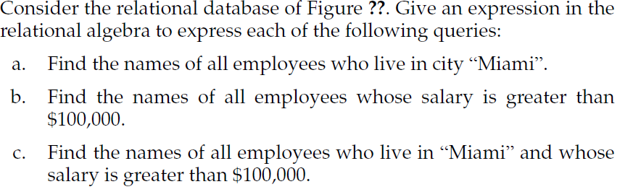
Practice Continue

Slide 33
End of Chapter 2
Questions???

