Slide 1

Notes:
All about Cutting Watermelons
https://www.polleverywhere.com/competitions/ykFTT03M9fL9O9u033QSD?display_state=welcome&controls=none&onscreen=persist

Slide 2
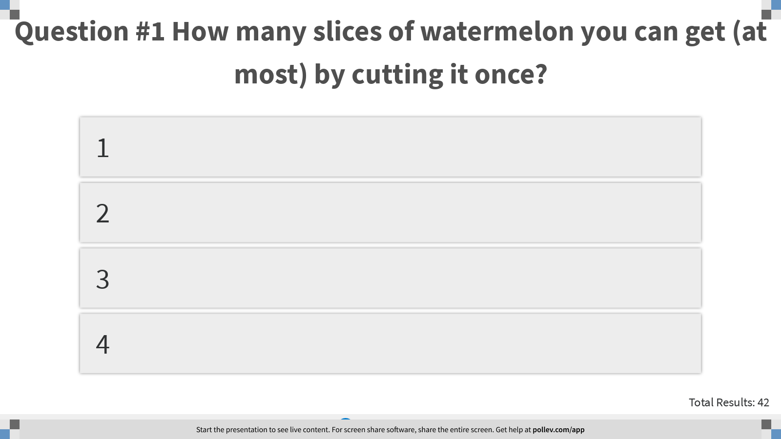
Notes:
Question #1 How many slices of watermelon you can get (at most) by cutting it once?
https://www.polleverywhere.com/multiple_choice_polls/XqWDO1B8q1pxbH4ZmeX2N?display_state=instructions&controls=none&onscreen=persist

Slide 3
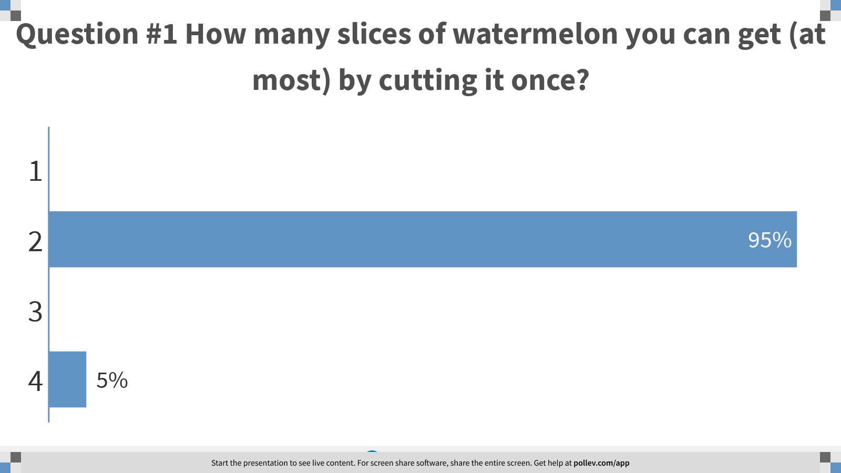
Notes:
Question #1 How many slices of watermelon you can get (at most) by cutting it once?
https://www.polleverywhere.com/multiple_choice_polls/XqWDO1B8q1pxbH4ZmeX2N?display_state=chart&display=correctness&controls=none&onscreen=persist

Slide 4
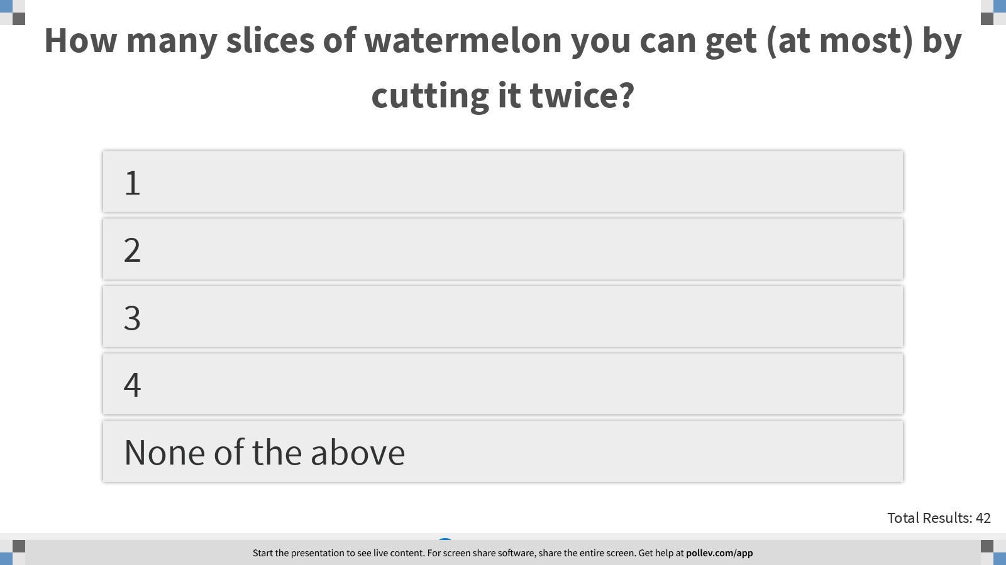
Notes:
How many slices of watermelon you can get (at most) by cutting it twice?
https://www.polleverywhere.com/multiple_choice_polls/986WsbnD4uFYzrQfbJkzu?display_state=instructions&controls=none&onscreen=persist

Slide 5
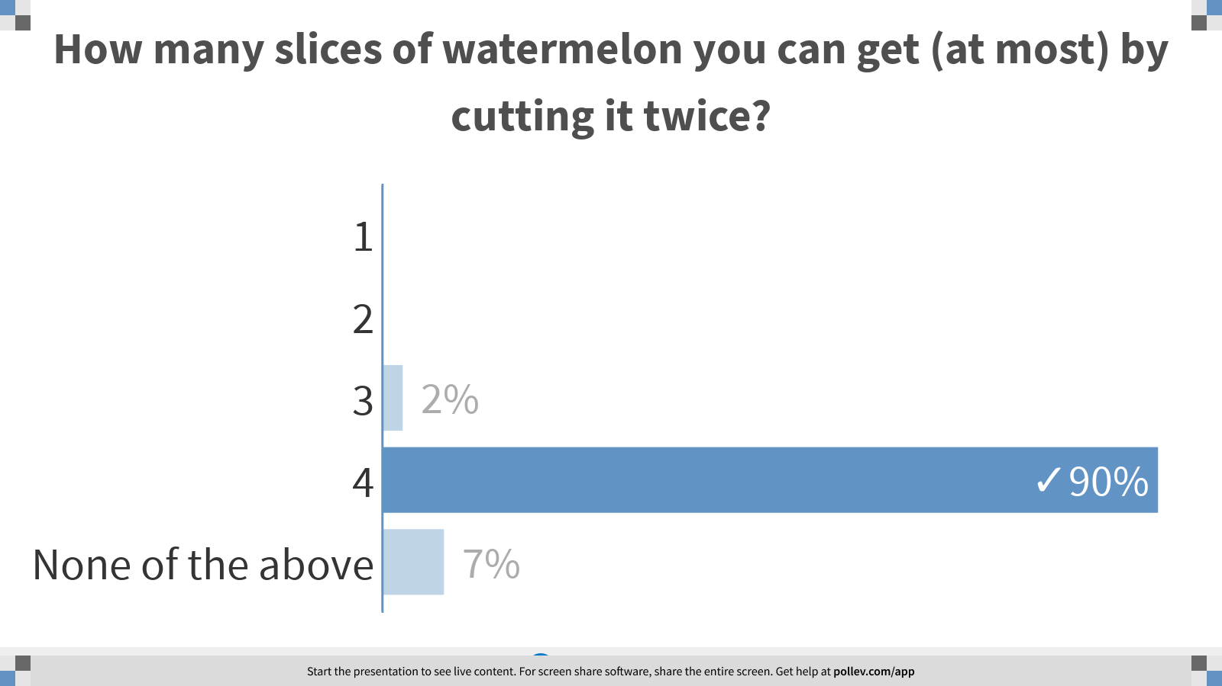
Notes:
How many slices of watermelon you can get (at most) by cutting it twice?
https://www.polleverywhere.com/multiple_choice_polls/986WsbnD4uFYzrQfbJkzu?display_state=chart&display=correctness&controls=none&onscreen=persist

Slide 6

Notes:
How many slices of watermelon you can get (at most) by cutting it 3 times?
https://www.polleverywhere.com/multiple_choice_polls/J5ebw3CRjQoWAZ69oKati?display_state=instructions&controls=none&onscreen=persist

Slide 7
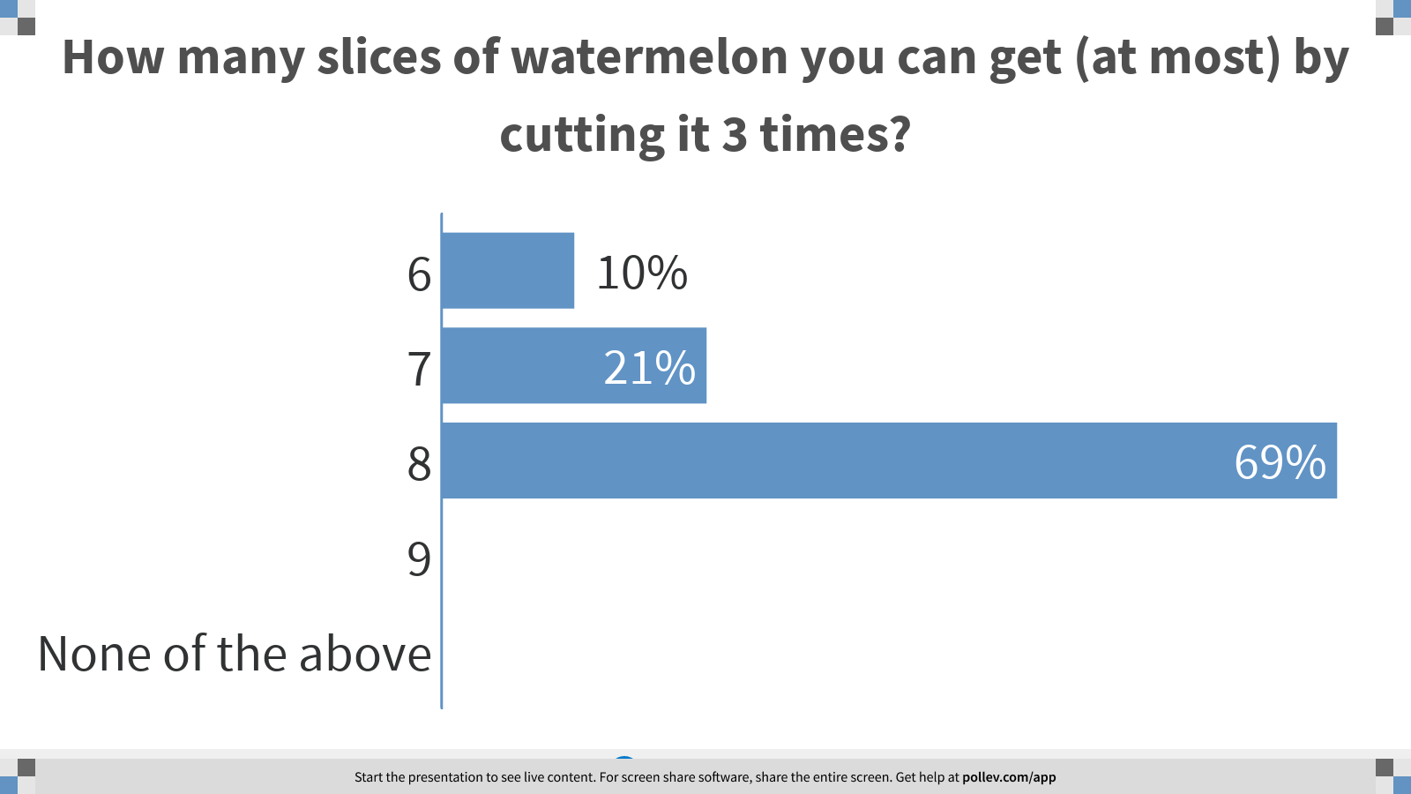
Notes:
How many slices of watermelon you can get (at most) by cutting it 3 times?
https://www.polleverywhere.com/multiple_choice_polls/J5ebw3CRjQoWAZ69oKati?display_state=chart&display=correctness&controls=none&onscreen=persist

Slide 8

Notes:
How many slices of watermelon you can get (at most) by cutting it 4 times?
https://www.polleverywhere.com/multiple_choice_polls/bVBn72CRzE9SMfb5a2ODD?display_state=instructions&controls=none&onscreen=persist

Slide 9
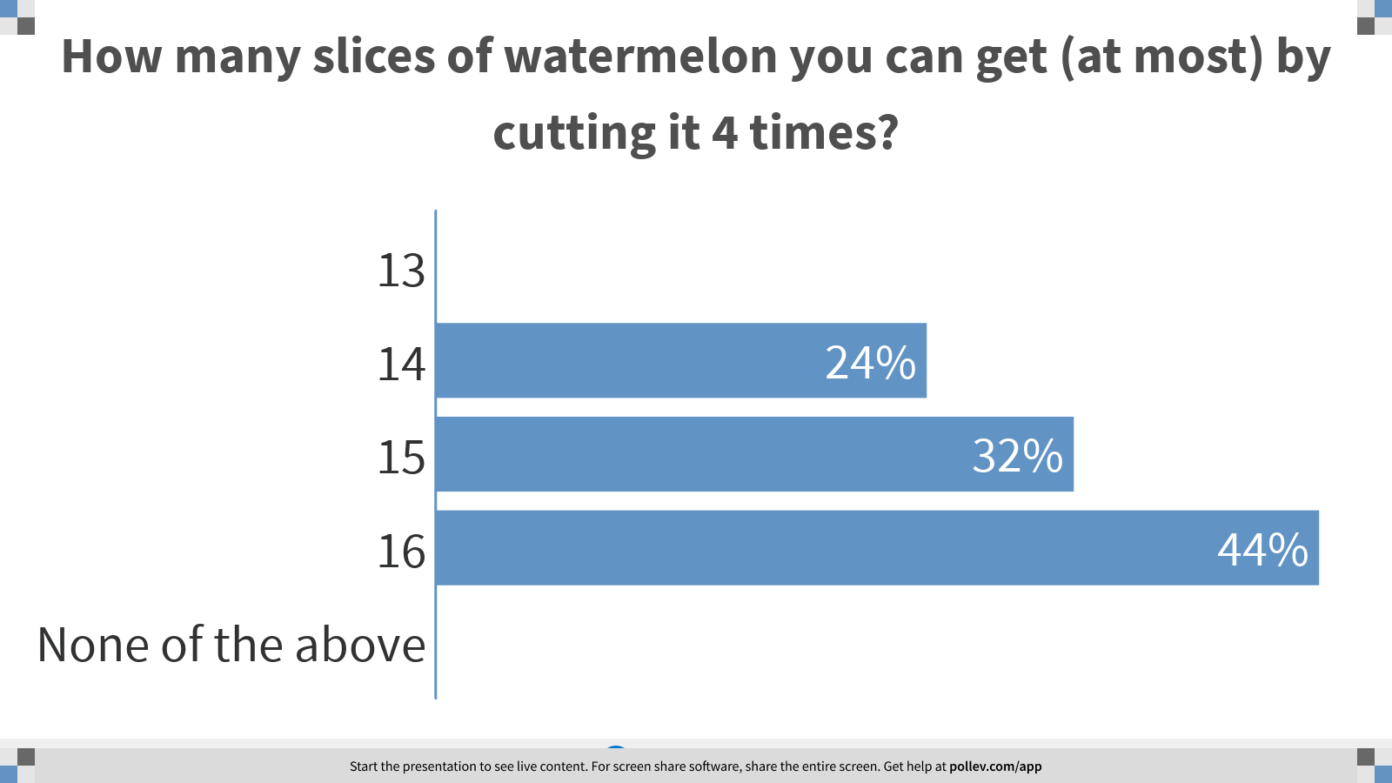
Notes:
How many slices of watermelon you can get (at most) by cutting it 4 times?
https://www.polleverywhere.com/multiple_choice_polls/bVBn72CRzE9SMfb5a2ODD?display_state=chart&display=correctness&controls=none&onscreen=persist

Slide 10
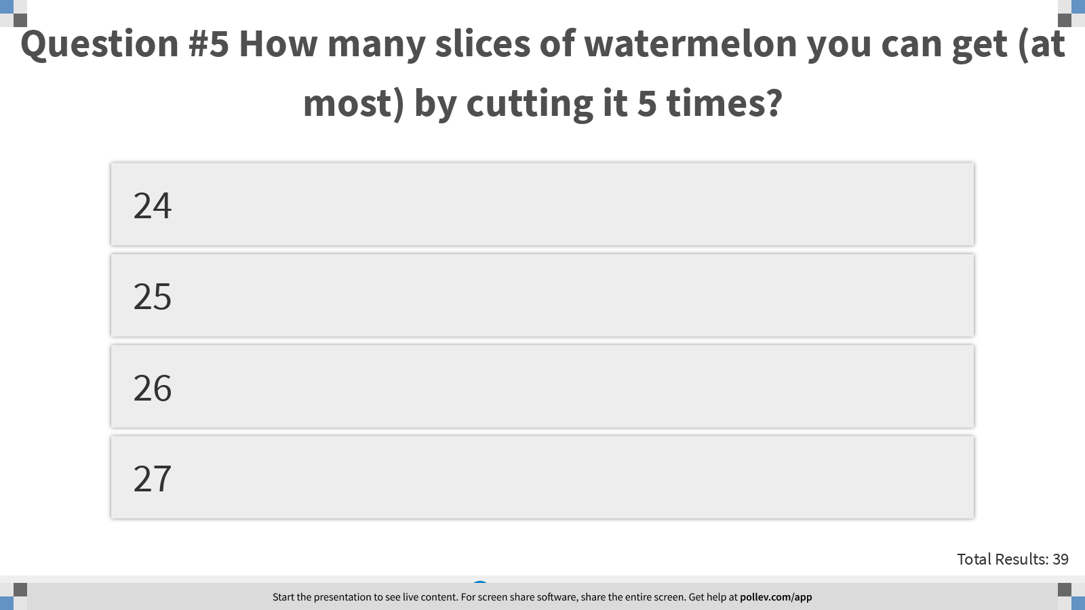
Notes:
Question #5 How many slices of watermelon you can get (at most) by cutting it 5 times?
https://www.polleverywhere.com/multiple_choice_polls/S0hffj8QAYeaZRgG0mpqT?display_state=instructions&controls=none&onscreen=persist

Slide 11
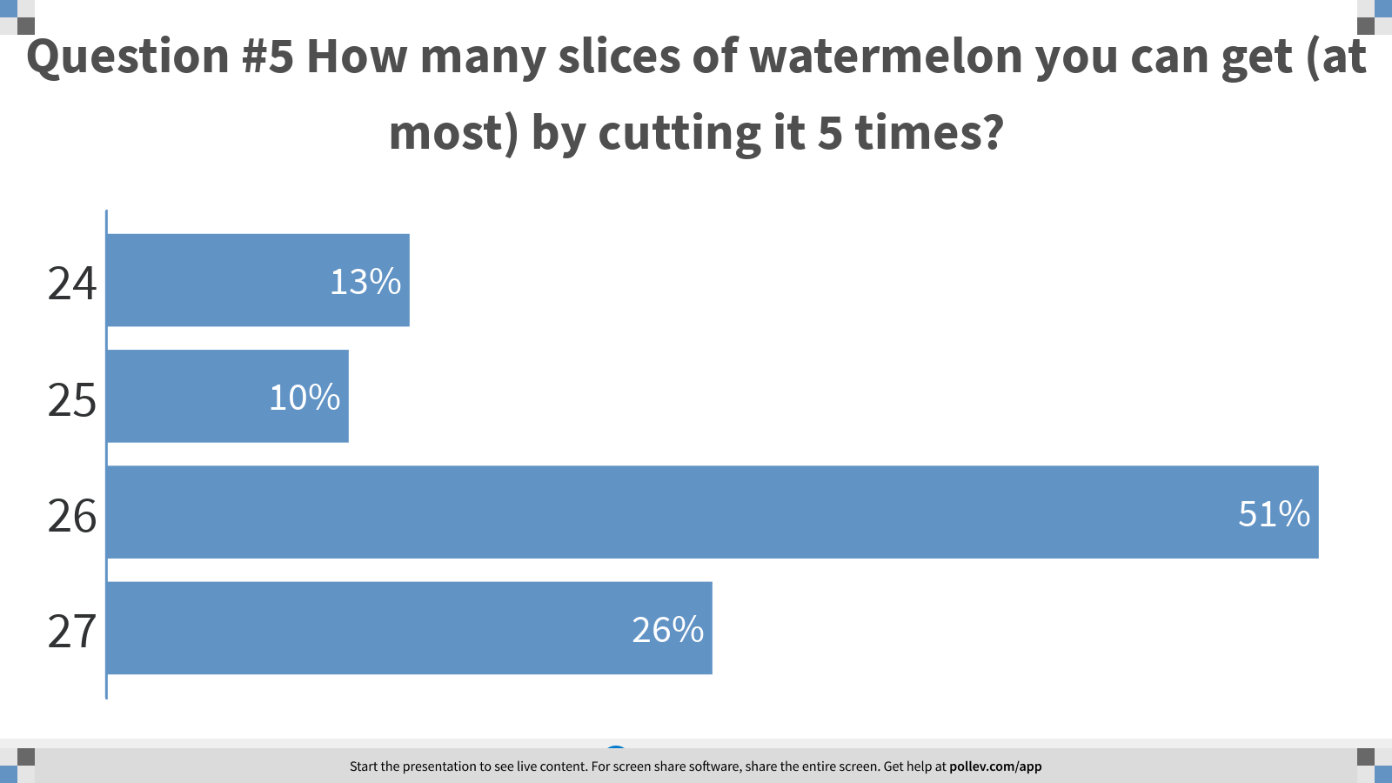
Notes:
Question #5 How many slices of watermelon you can get (at most) by cutting it 5 times?
https://www.polleverywhere.com/multiple_choice_polls/S0hffj8QAYeaZRgG0mpqT?display_state=chart&display=correctness&controls=none&onscreen=persist

Slide 12
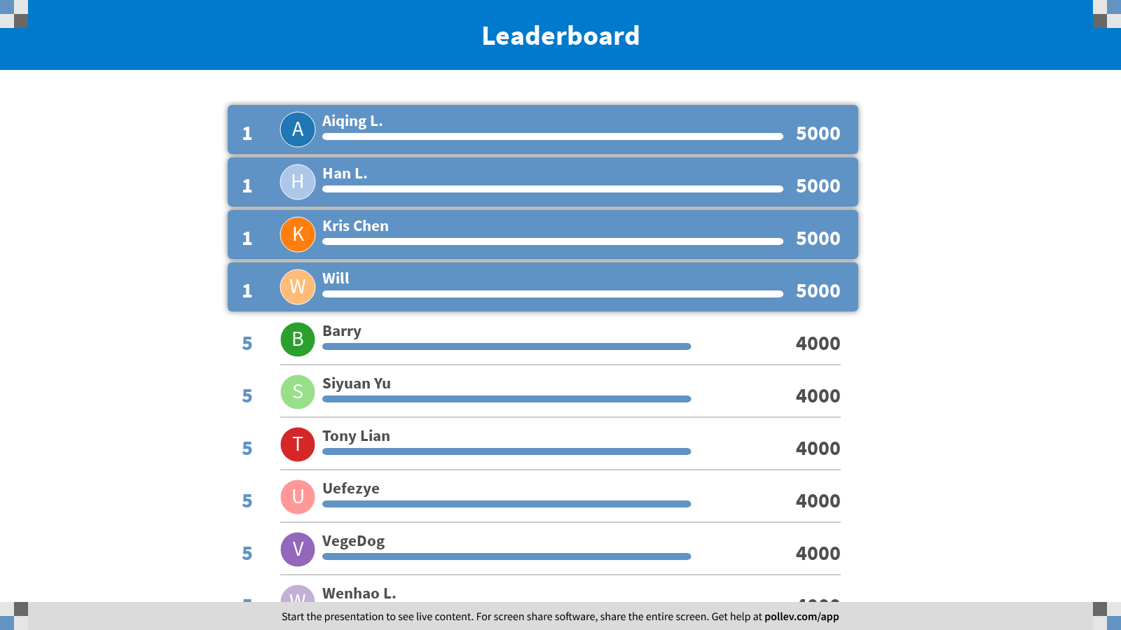
Notes:
All about Cutting Watermelons
https://www.polleverywhere.com/competitions/ykFTT03M9fL9O9u033QSD?display_state=finale&onscreen=persist

Slide 13

Notes:
Fibonacci
https://www.polleverywhere.com/competitions/AaKrnOY1km3rze2RH7Bqo?display_state=welcome&controls=none&onscreen=persist

Slide 14
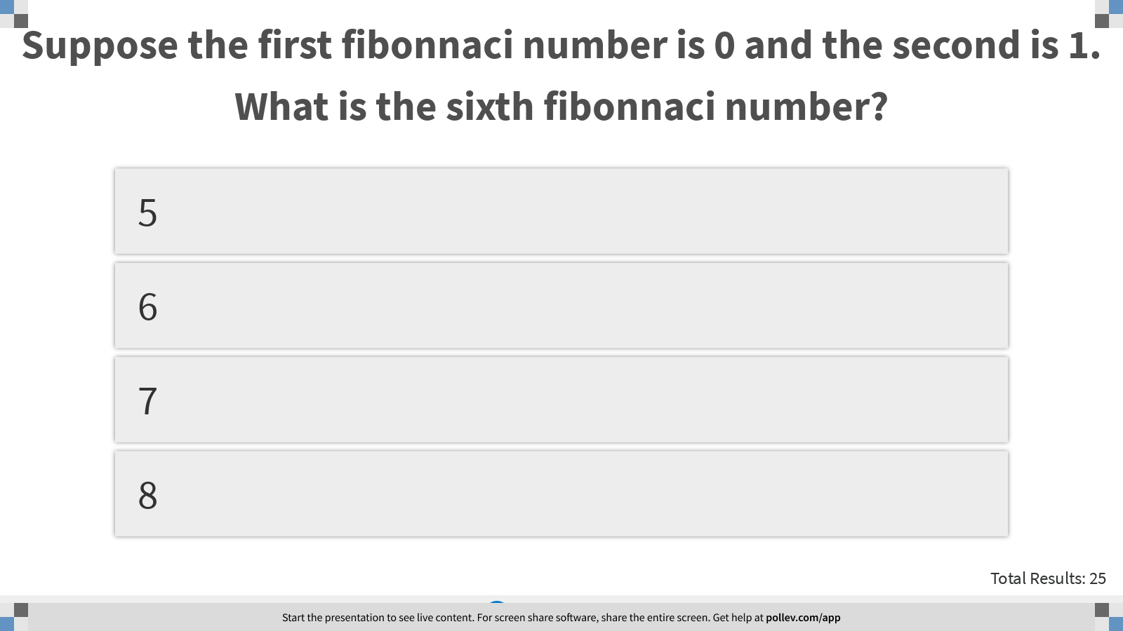
Notes:
Suppose the first fibonnaci number is 0 and the second is 1. What is the sixth fibonnaci number?
https://www.polleverywhere.com/multiple_choice_polls/4awTQCKDqaXrV8OfwyKJq?display_state=instructions&controls=none&onscreen=persist

Slide 15
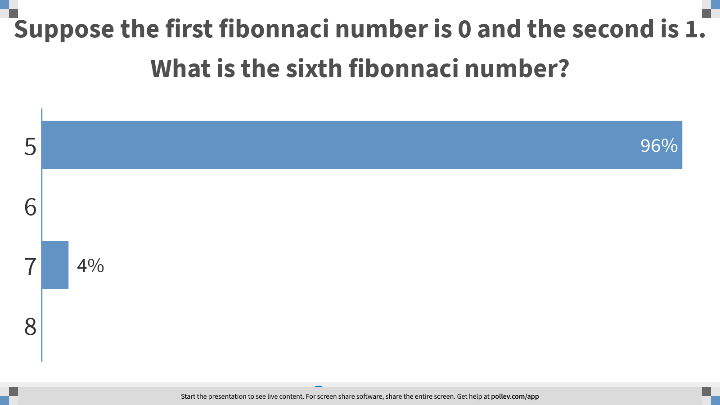
Notes:
Suppose the first fibonnaci number is 0 and the second is 1. What is the sixth fibonnaci number?
https://www.polleverywhere.com/multiple_choice_polls/4awTQCKDqaXrV8OfwyKJq?display_state=chart&display=correctness&controls=none&onscreen=persist

Slide 16
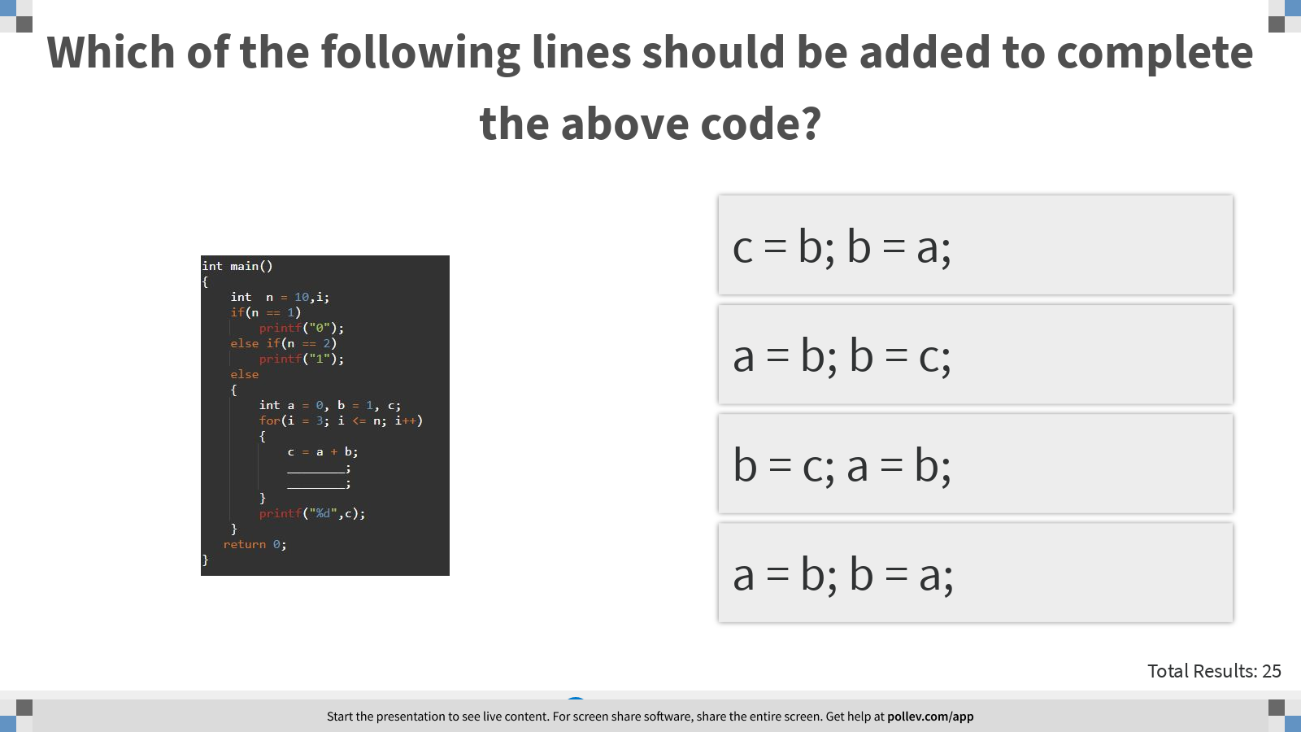
Notes:
Which of the following lines should be added to complete the above code?
https://www.polleverywhere.com/multiple_choice_polls/Qt6JAp3etvE5mqq5VNqiy?display_state=instructions&controls=none&onscreen=persist

Slide 17
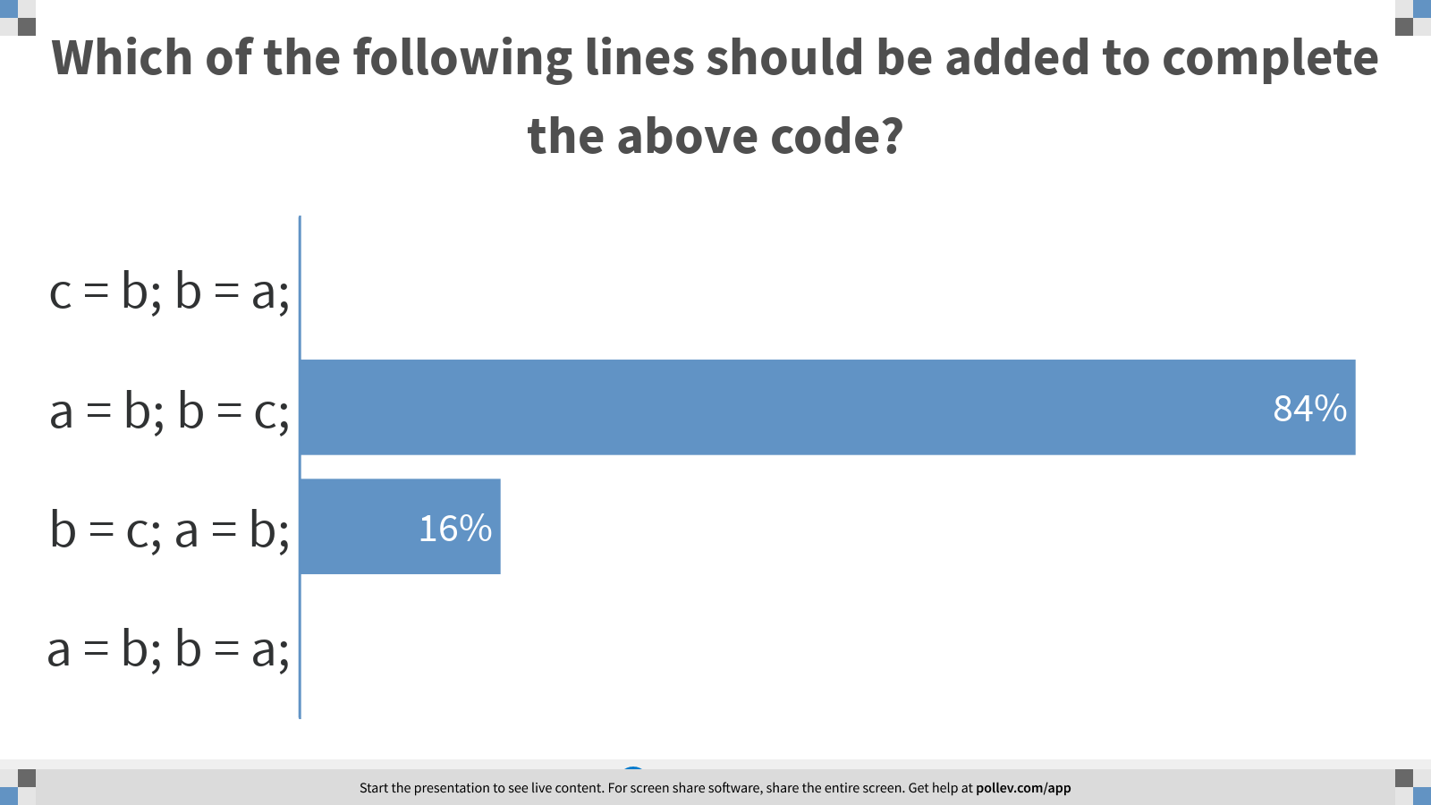
Notes:
Which of the following lines should be added to complete the above code?
https://www.polleverywhere.com/multiple_choice_polls/Qt6JAp3etvE5mqq5VNqiy?display_state=chart&display=correctness&controls=none&onscreen=persist

Slide 18
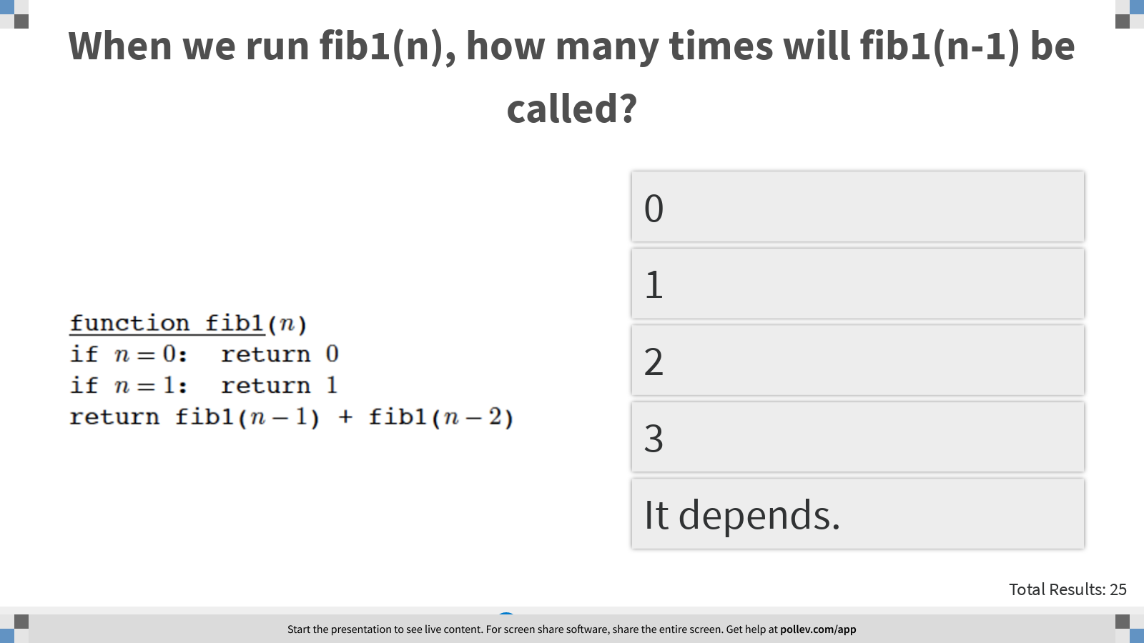
Notes:
When we run fib1(n), how many times will fib1(n-1) be called?
https://www.polleverywhere.com/multiple_choice_polls/orFI3lwOe7VJFXY2gIpsc?display_state=instructions&controls=none&onscreen=persist

Slide 19
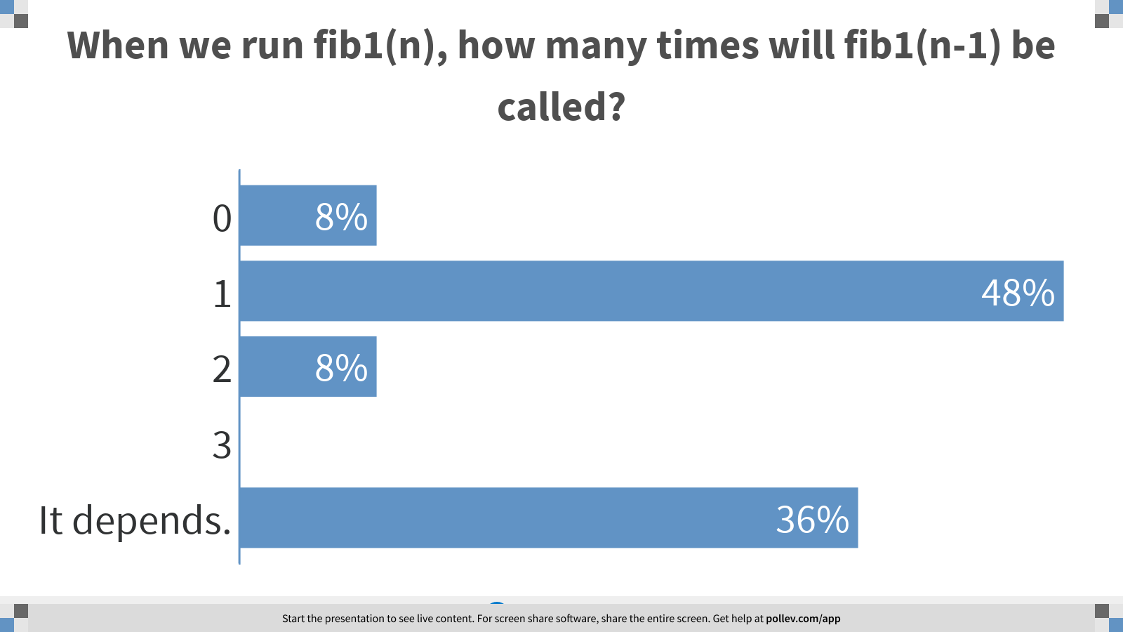
Notes:
When we run fib1(n), how many times will fib1(n-1) be called?
https://www.polleverywhere.com/multiple_choice_polls/orFI3lwOe7VJFXY2gIpsc?display_state=chart&display=correctness&controls=none&onscreen=persist

Slide 20
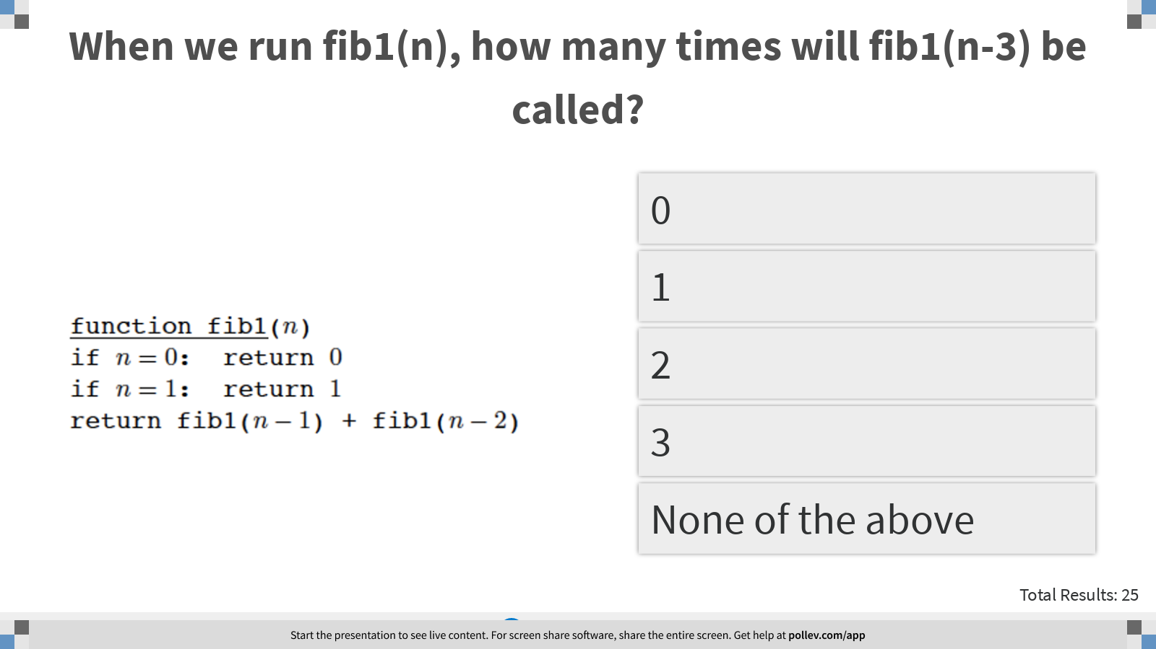
Notes:
When we run fib1(n), how many times will fib1(n-3) be called?
https://www.polleverywhere.com/multiple_choice_polls/4TZsH0EcdYa7VUjNiNDm6?display_state=instructions&controls=none&onscreen=persist

Slide 21
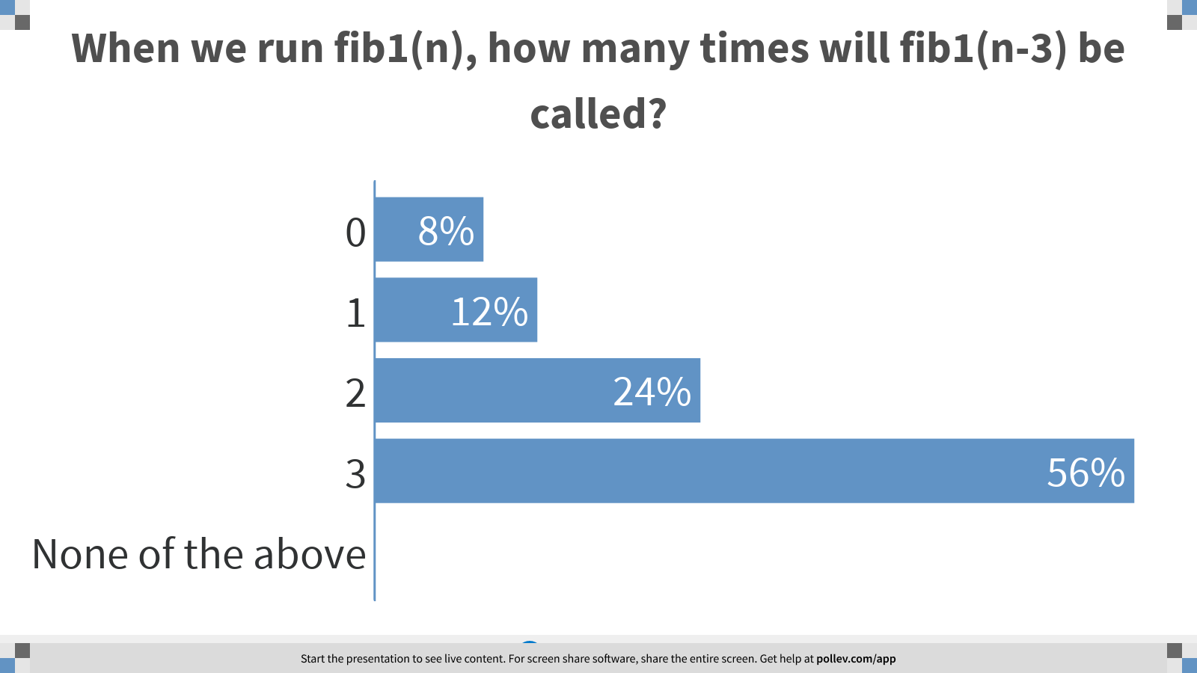
Notes:
When we run fib1(n), how many times will fib1(n-3) be called?
https://www.polleverywhere.com/multiple_choice_polls/4TZsH0EcdYa7VUjNiNDm6?display_state=chart&display=correctness&controls=none&onscreen=persist

Slide 22
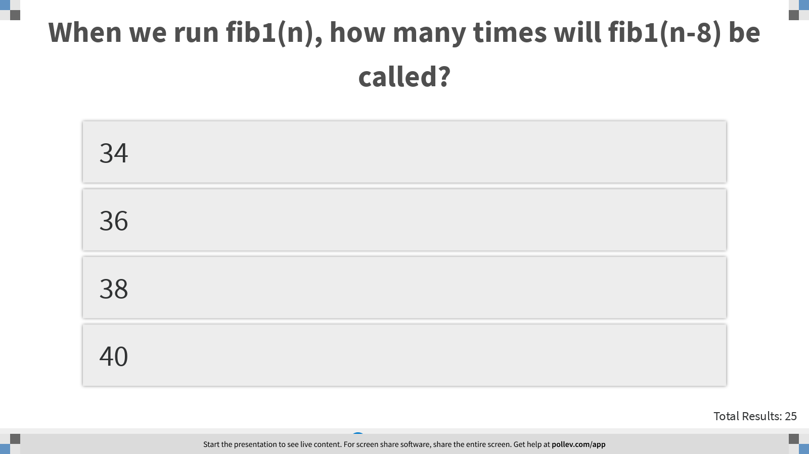
Notes:
When we run fib1(n), how many times will fib1(n-8) be called?
https://www.polleverywhere.com/multiple_choice_polls/wzPxneURlW70L8S7f2Gf5?display_state=instructions&controls=none&onscreen=persist

Slide 23
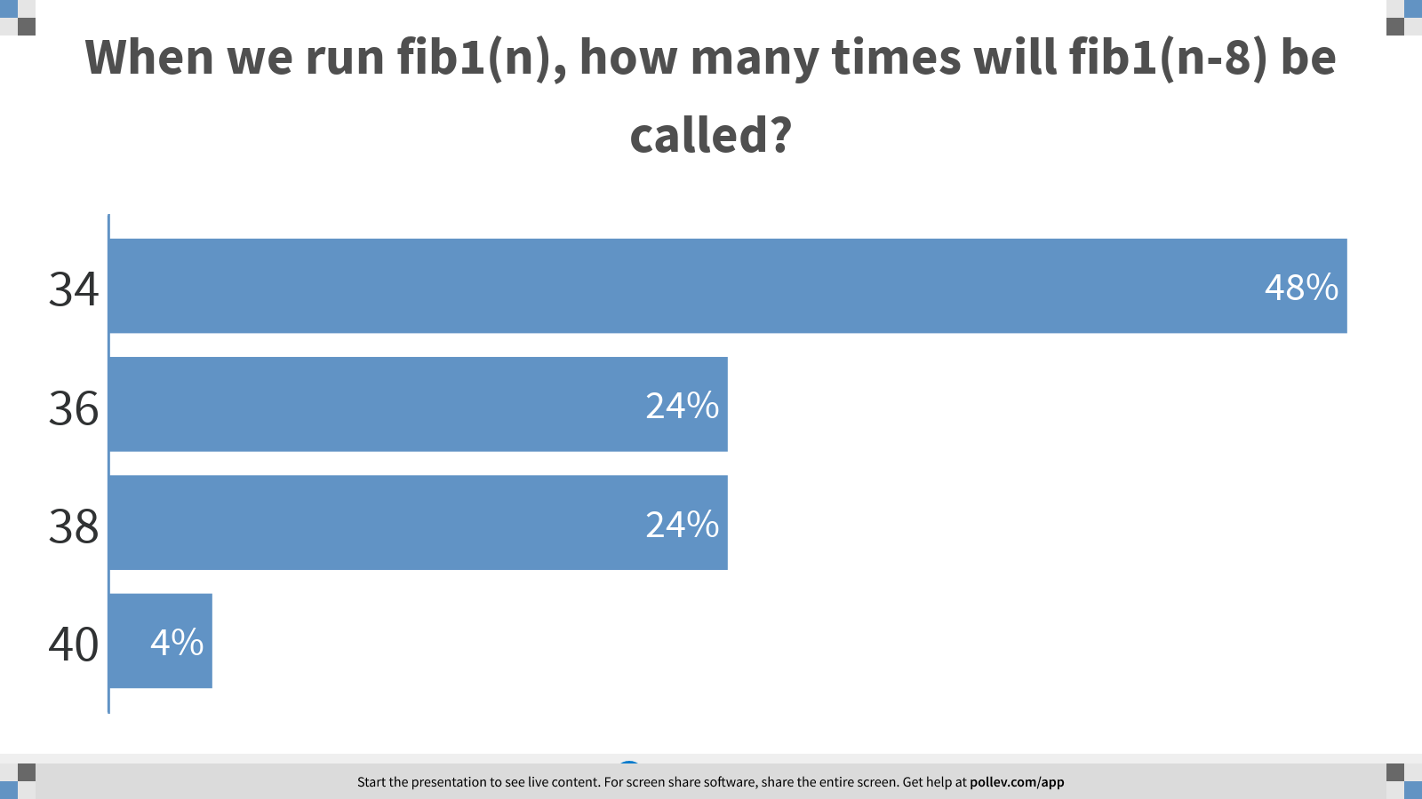
Notes:
When we run fib1(n), how many times will fib1(n-8) be called?
https://www.polleverywhere.com/multiple_choice_polls/wzPxneURlW70L8S7f2Gf5?display_state=chart&display=correctness&controls=none&onscreen=persist

Slide 24
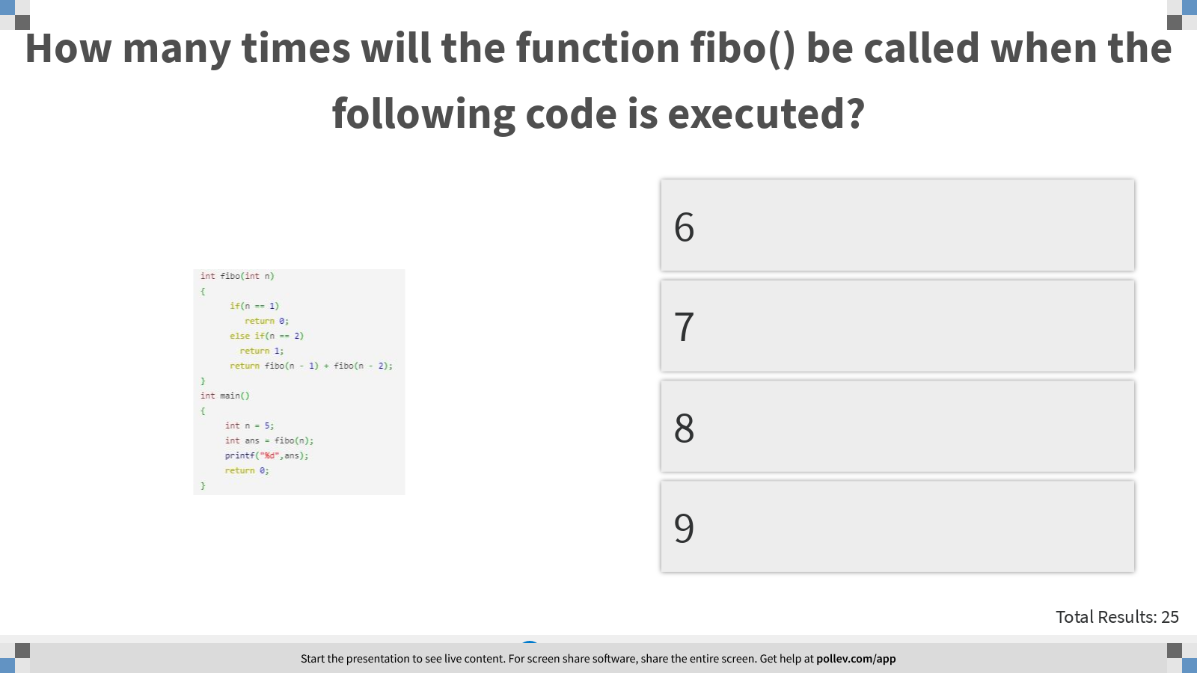
Notes:
How many times will the function fibo() be called when the following code is executed?
https://www.polleverywhere.com/multiple_choice_polls/9keBCqLdNhTbjUx8Zz7hO?display_state=instructions&controls=none&onscreen=persist

Slide 25
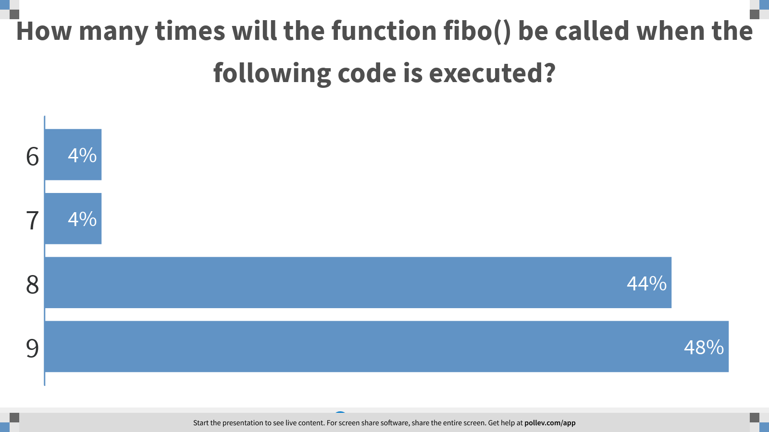
Notes:
How many times will the function fibo() be called when the following code is executed?
https://www.polleverywhere.com/multiple_choice_polls/9keBCqLdNhTbjUx8Zz7hO?display_state=chart&display=correctness&controls=none&onscreen=persist

Slide 26
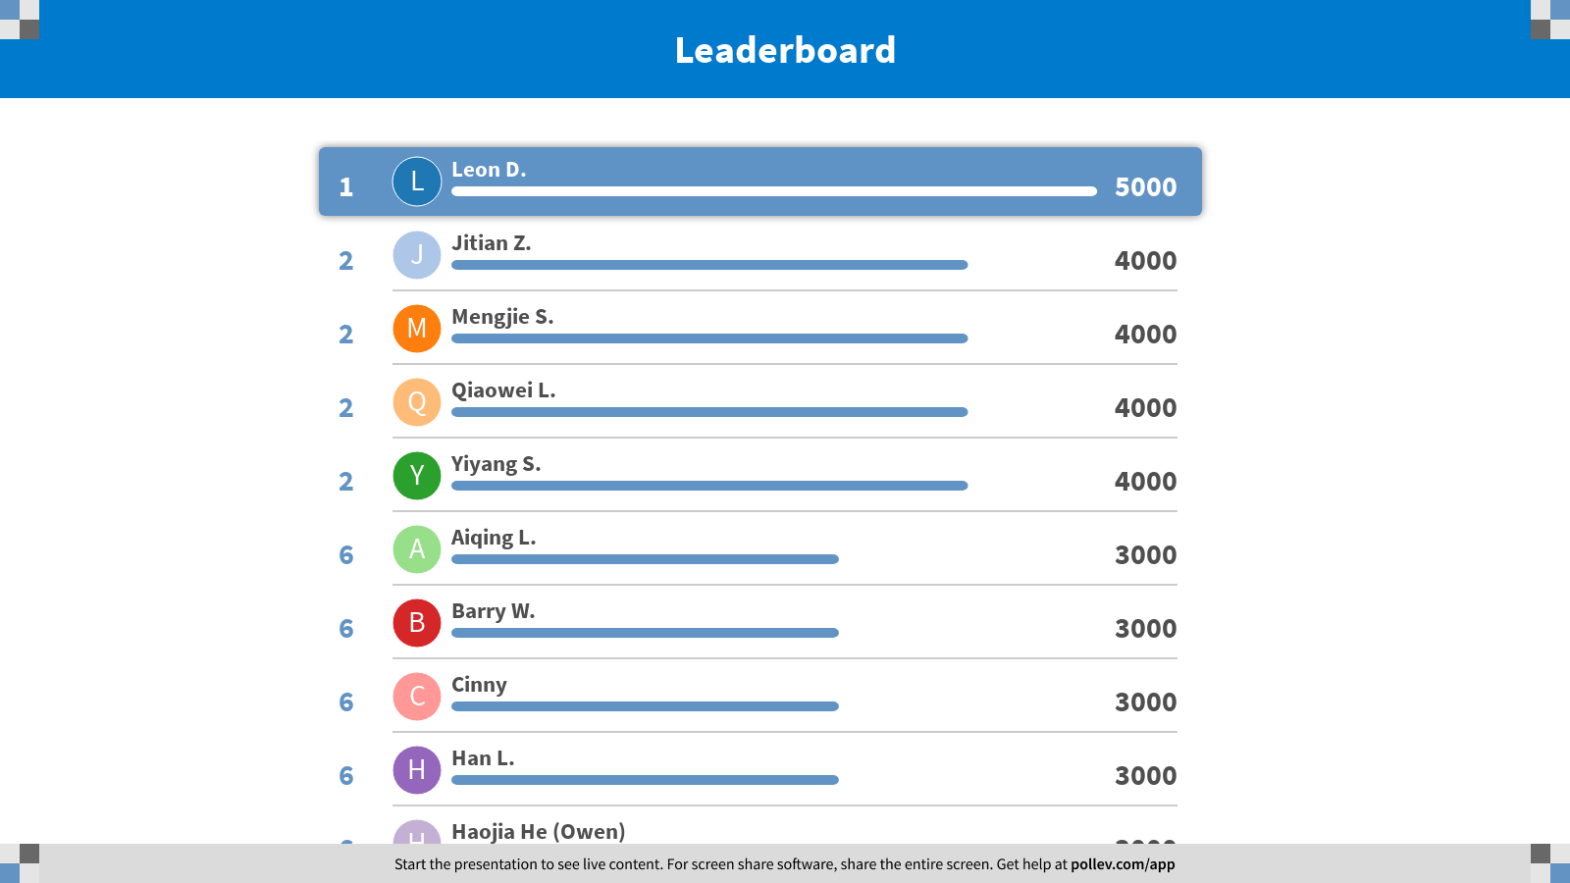
Notes:
Fibonacci
https://www.polleverywhere.com/competitions/AaKrnOY1km3rze2RH7Bqo?display_state=finale&onscreen=persist

