Slide 1

Notes:
DP on Trees
https://www.polleverywhere.com/competitions/FvVv43aCMn5AtHfn2REZk?display_state=welcome&controls=none&onscreen=persist

Slide 2
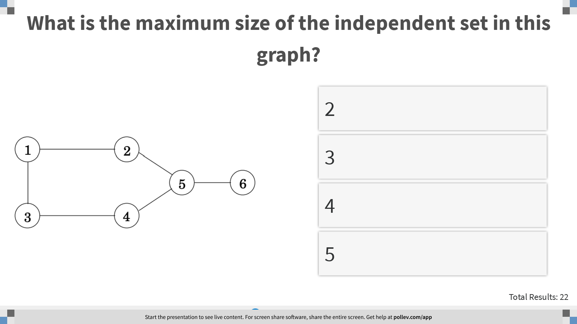
Notes:
What is the maximum size of the independent set in this graph?
https://www.polleverywhere.com/multiple_choice_polls/1x6xWAX4Q75StUcADfMaE?display_state=instructions&controls=none&onscreen=persist

Slide 3
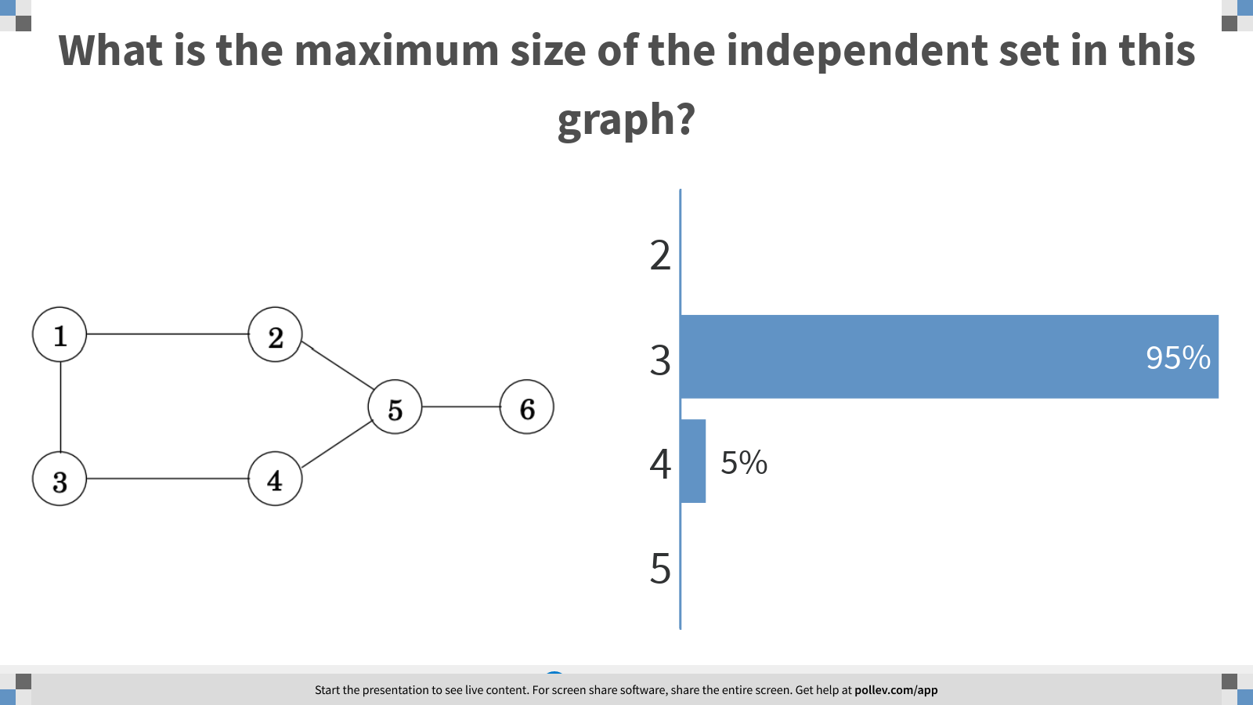
Notes:
What is the maximum size of the independent set in this graph?
https://www.polleverywhere.com/multiple_choice_polls/1x6xWAX4Q75StUcADfMaE?display_state=chart&display=correctness&controls=none&onscreen=persist

Slide 4
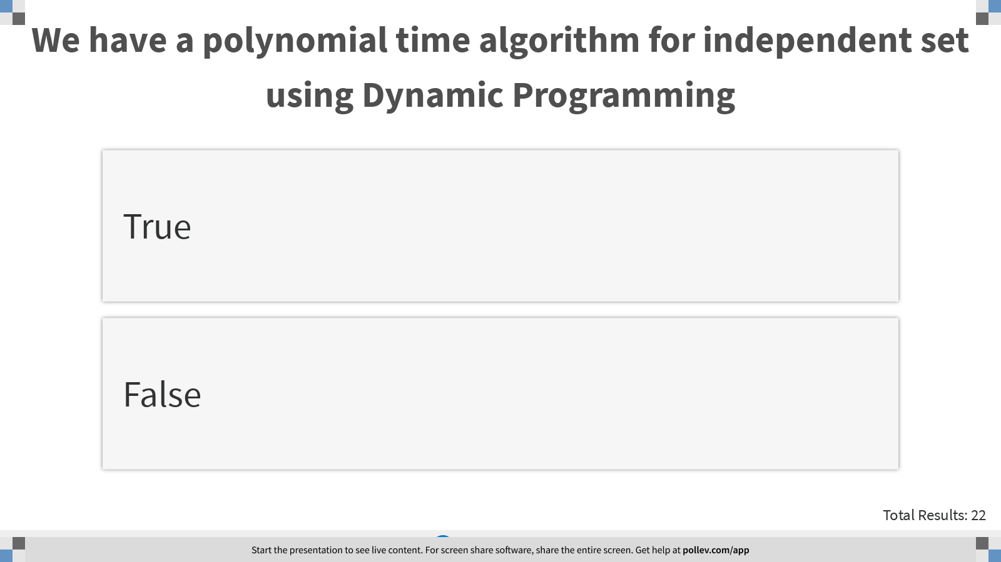
Notes:
We have a polynomial time algorithm for independent set using Dynamic Programming
https://www.polleverywhere.com/multiple_choice_polls/1NcMgwadRqsvyyqcPaCoa?display_state=instructions&controls=none&onscreen=persist

Slide 5
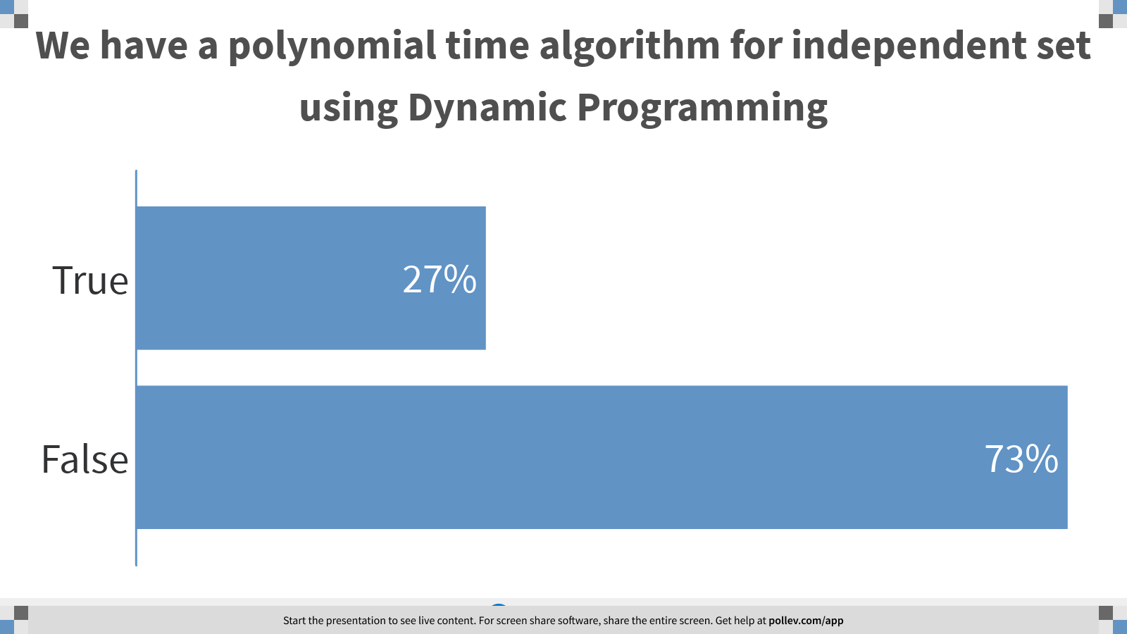
Notes:
We have a polynomial time algorithm for independent set using Dynamic Programming
https://www.polleverywhere.com/multiple_choice_polls/1NcMgwadRqsvyyqcPaCoa?display_state=chart&display=correctness&controls=none&onscreen=persist

Slide 6
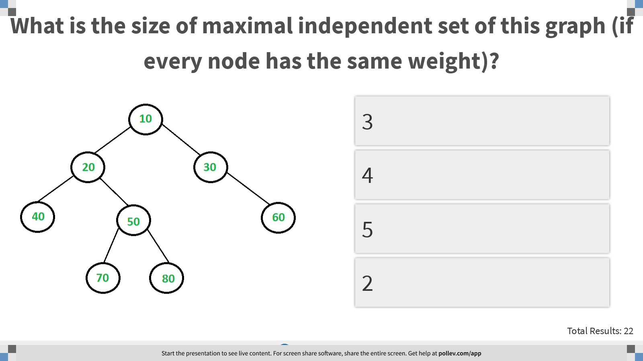
Notes:
What is the size of maximal independent set of this graph (if every node has the same weight)?
https://www.polleverywhere.com/multiple_choice_polls/o1RSbWXKSCQrlxrNzmF5g?display_state=instructions&controls=none&onscreen=persist

Slide 7
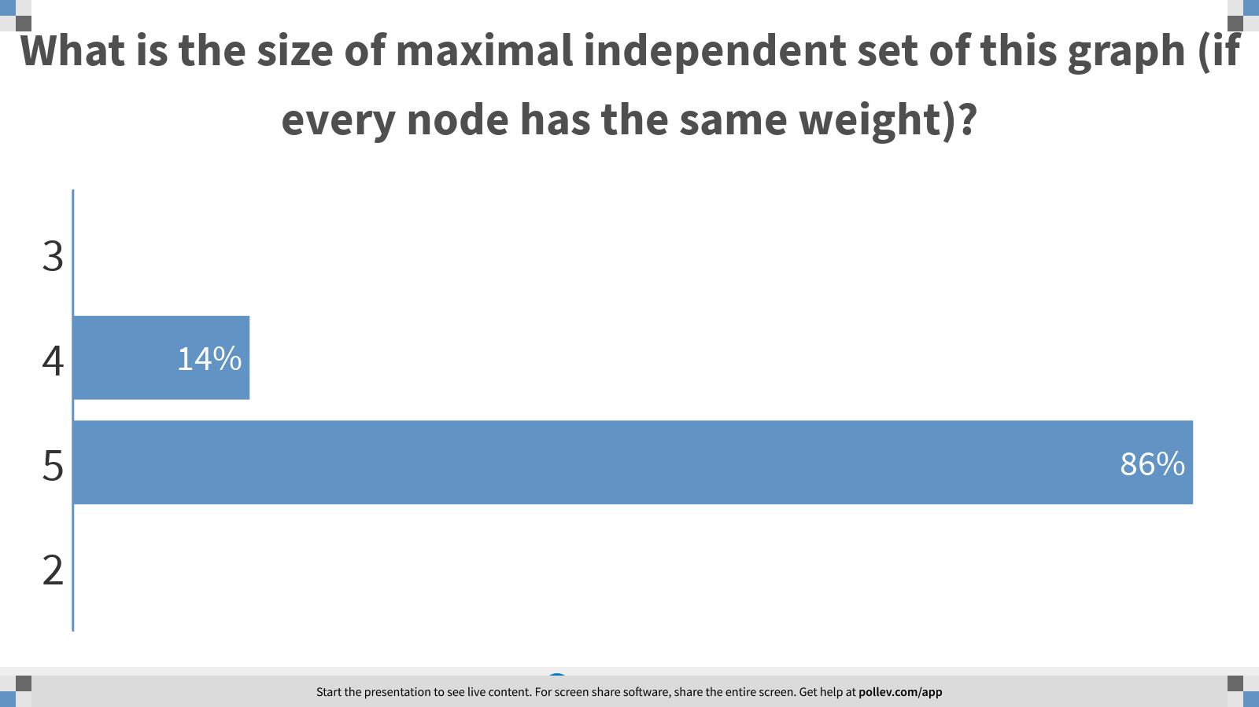
Notes:
What is the size of maximal independent set of this graph (if every node has the same weight)?
https://www.polleverywhere.com/multiple_choice_polls/o1RSbWXKSCQrlxrNzmF5g?display_state=chart&display=correctness&controls=none&onscreen=persist

Slide 8
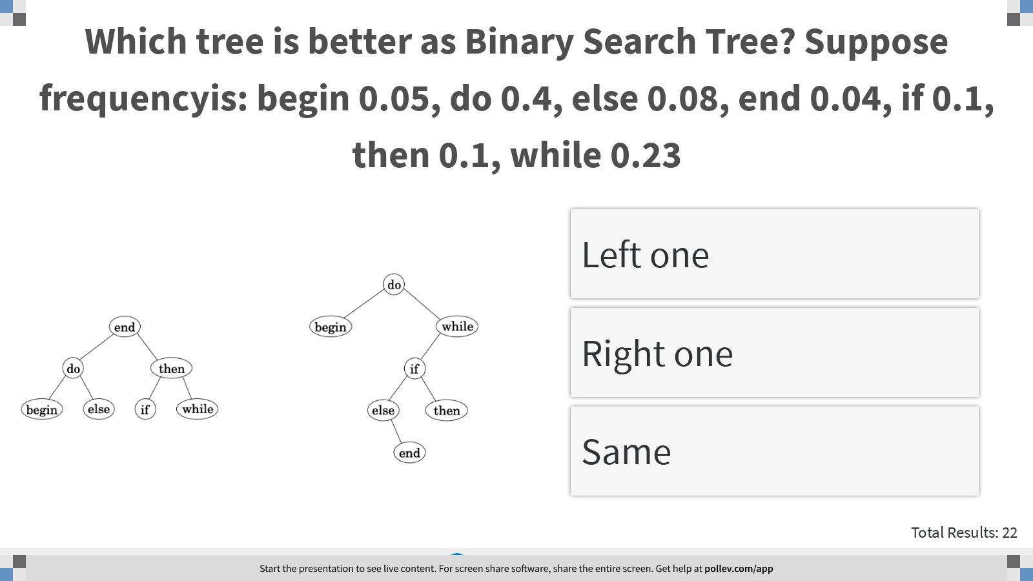
Notes:
Which tree is better as Binary Search Tree? Suppose frequencyis: begin 0.05, do 0.4, else 0.08, end 0.04, if 0.1, then 0.1, while 0.23
https://www.polleverywhere.com/multiple_choice_polls/vt5nXm9ZUlvS6G3fJGt8Y?display_state=instructions&controls=none&onscreen=persist

Slide 9
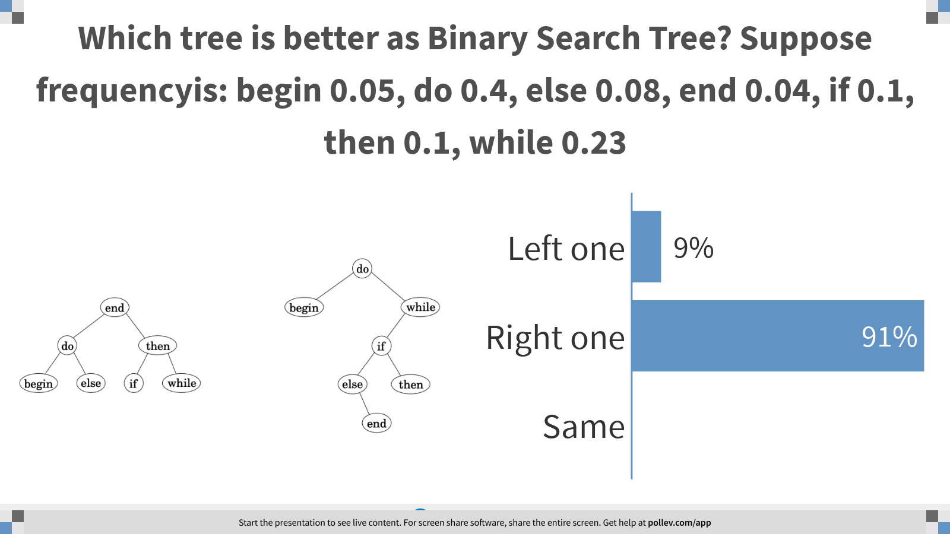
Notes:
Which tree is better as Binary Search Tree? Suppose frequencyis: begin 0.05, do 0.4, else 0.08, end 0.04, if 0.1, then 0.1, while 0.23
https://www.polleverywhere.com/multiple_choice_polls/vt5nXm9ZUlvS6G3fJGt8Y?display_state=chart&display=correctness&controls=none&onscreen=persist

Slide 10
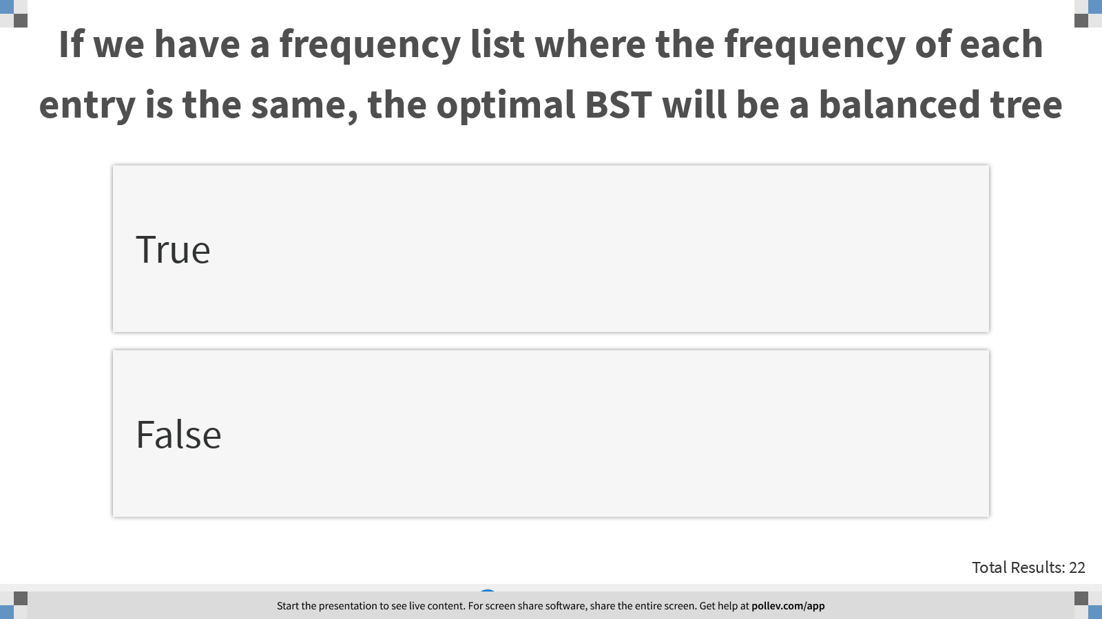
Notes:
If we have a frequency list where the frequency of each entry is the same, the optimal BST will be a balanced tree
https://www.polleverywhere.com/multiple_choice_polls/4ZkskGRk0avppJpRmEy22?display_state=instructions&controls=none&onscreen=persist

Slide 11
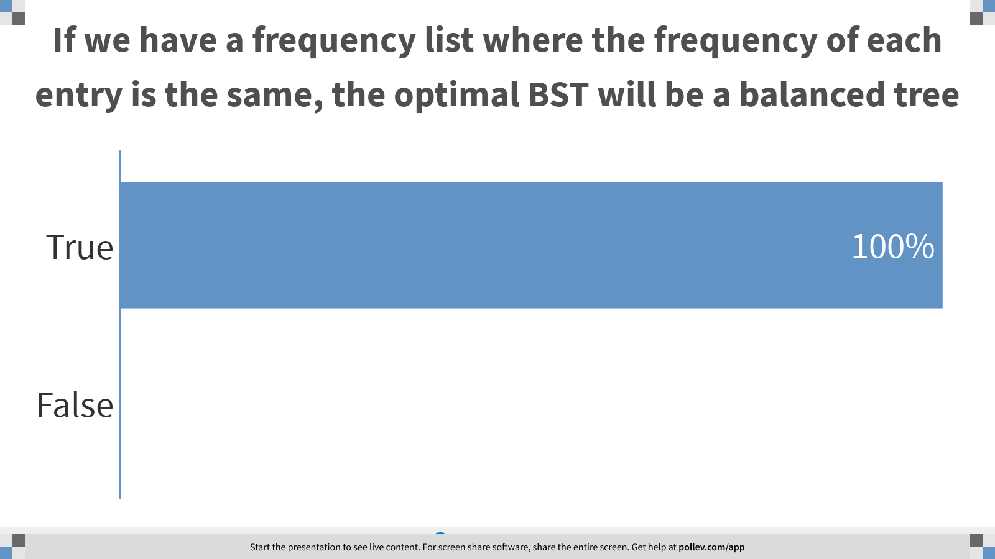
Notes:
If we have a frequency list where the frequency of each entry is the same, the optimal BST will be a balanced tree
https://www.polleverywhere.com/multiple_choice_polls/4ZkskGRk0avppJpRmEy22?display_state=chart&display=correctness&controls=none&onscreen=persist

Slide 12
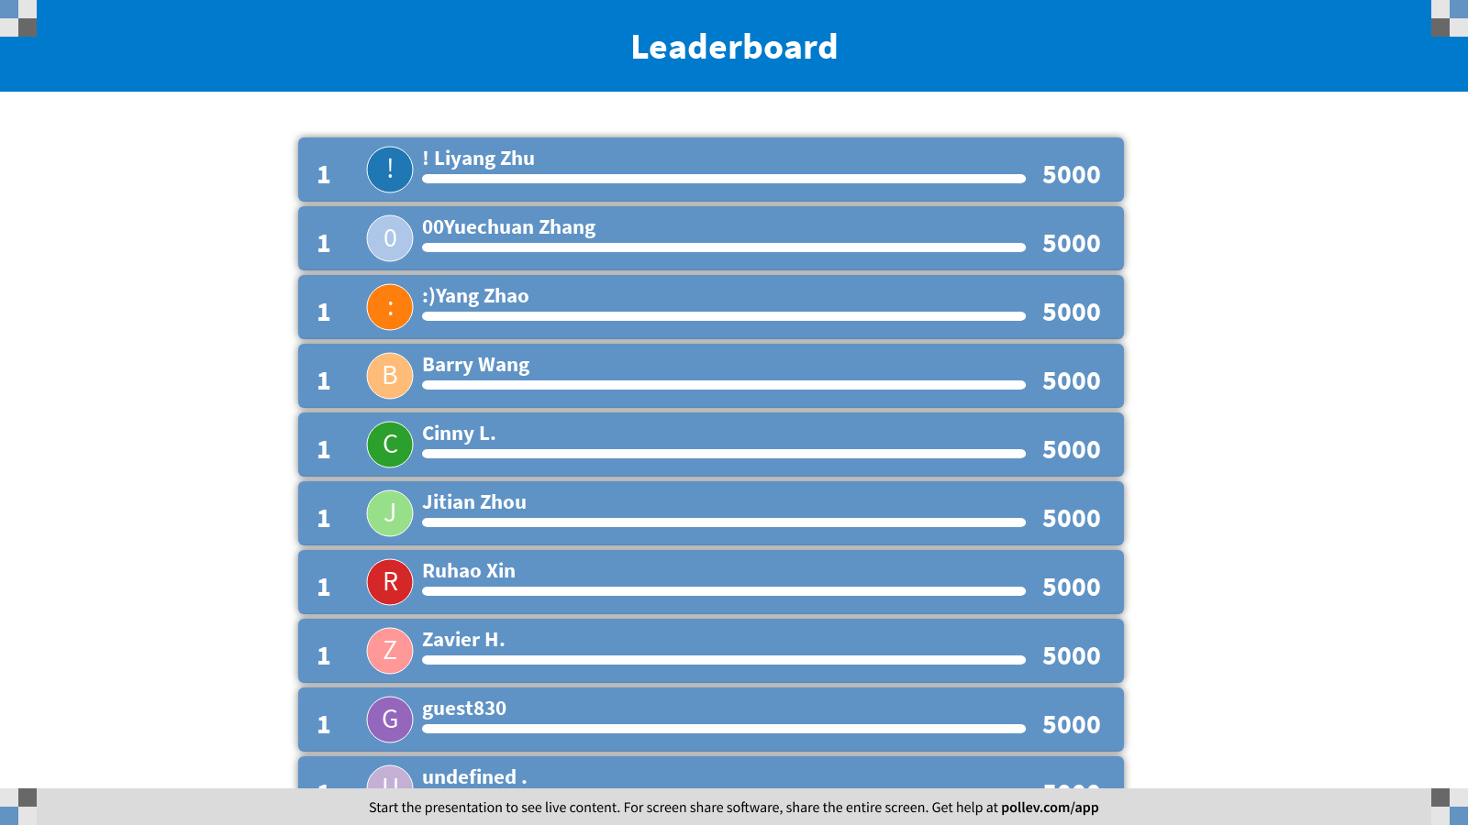
Notes:
DP on Trees
https://www.polleverywhere.com/competitions/FvVv43aCMn5AtHfn2REZk?display_state=finale&onscreen=persist

Slide 13
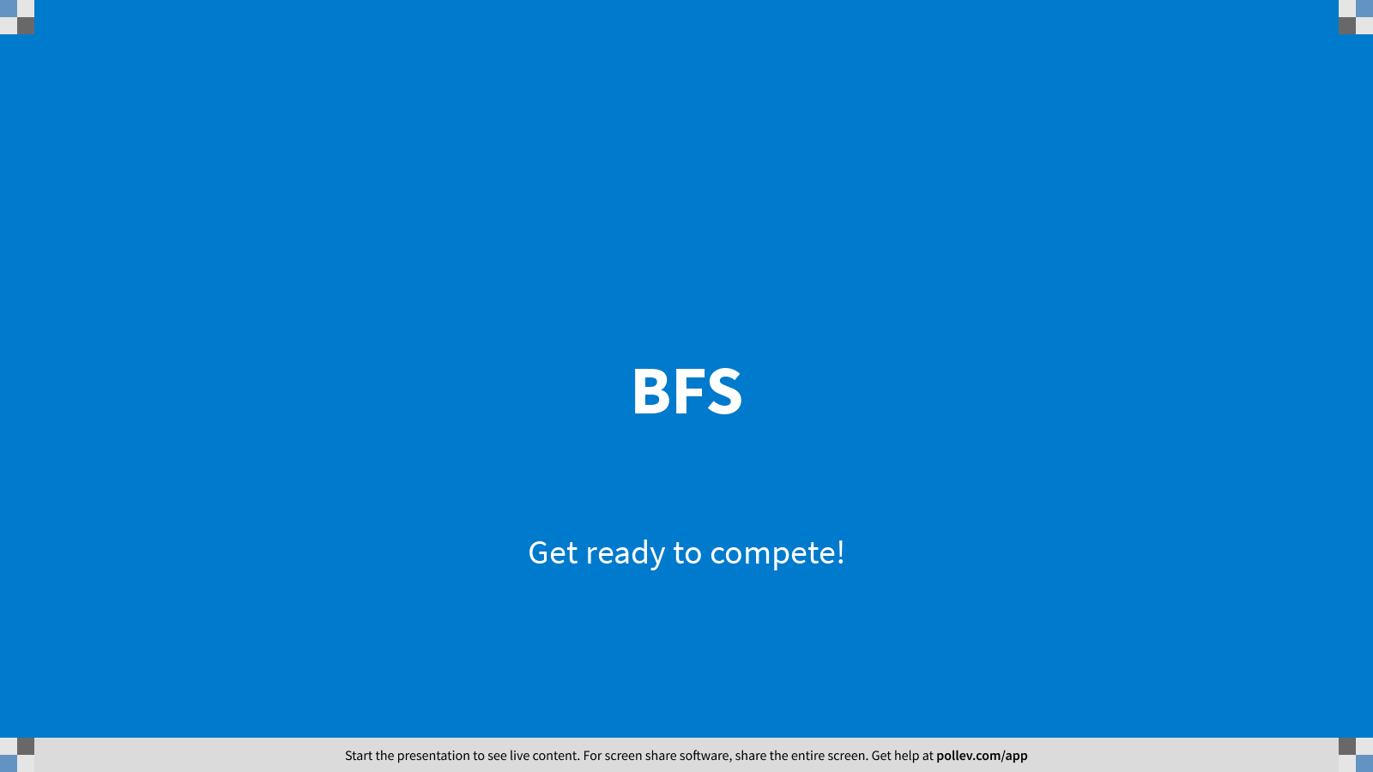
Notes:
BFS
https://www.polleverywhere.com/competitions/u8SCouozGFDMxyxszux5z?display_state=welcome&controls=none&onscreen=persist

Slide 14
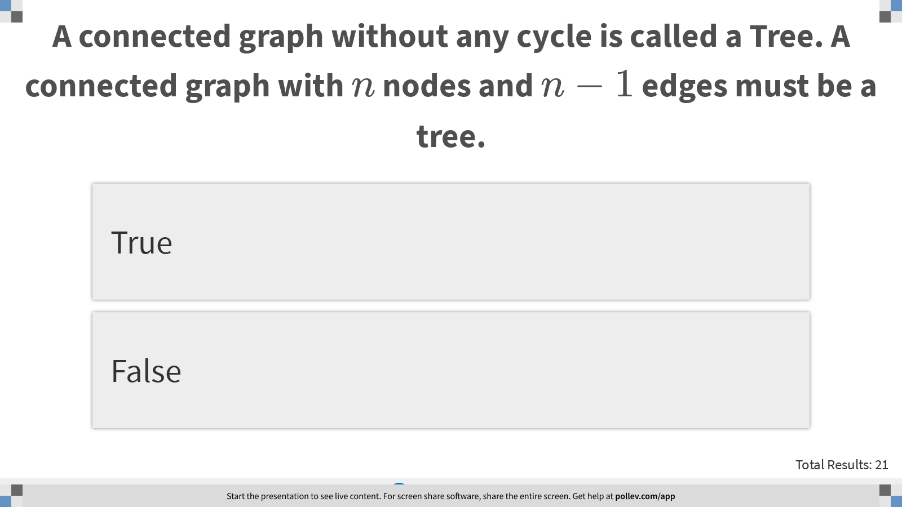
Notes:
A connected graph without any cycle is called a Tree. A connected graph with $$n$$ nodes and $$n-1$$ edges must be a tree.
https://www.polleverywhere.com/multiple_choice_polls/filVWwnOpTkcVqBDBSjm2?display_state=instructions&controls=none&onscreen=persist

Slide 15
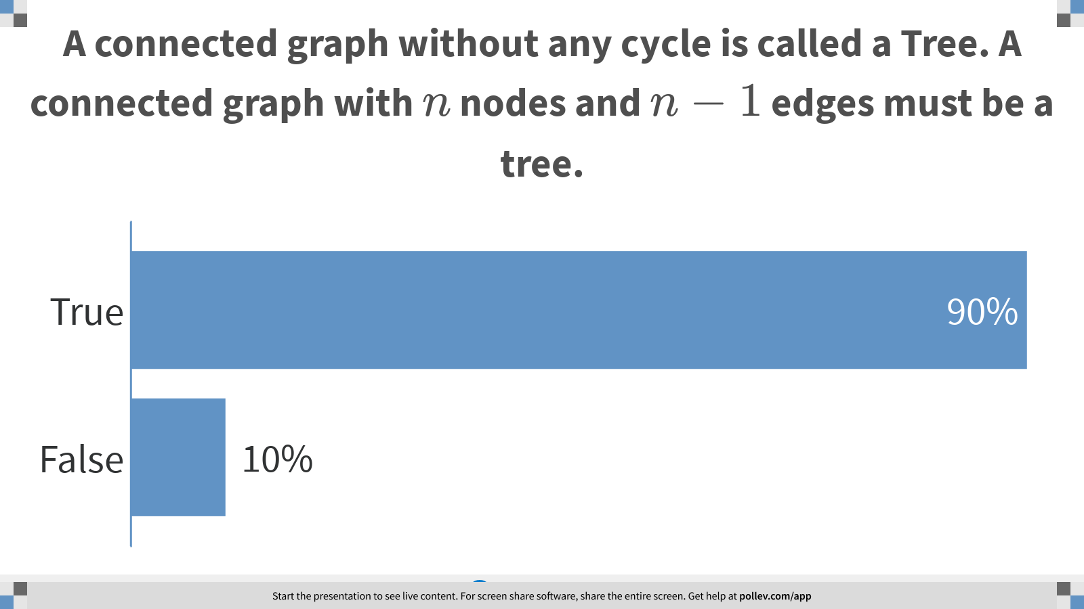
Notes:
A connected graph without any cycle is called a Tree. A connected graph with $$n$$ nodes and $$n-1$$ edges must be a tree.
https://www.polleverywhere.com/multiple_choice_polls/filVWwnOpTkcVqBDBSjm2?display_state=chart&display=correctness&controls=none&onscreen=persist

Slide 16
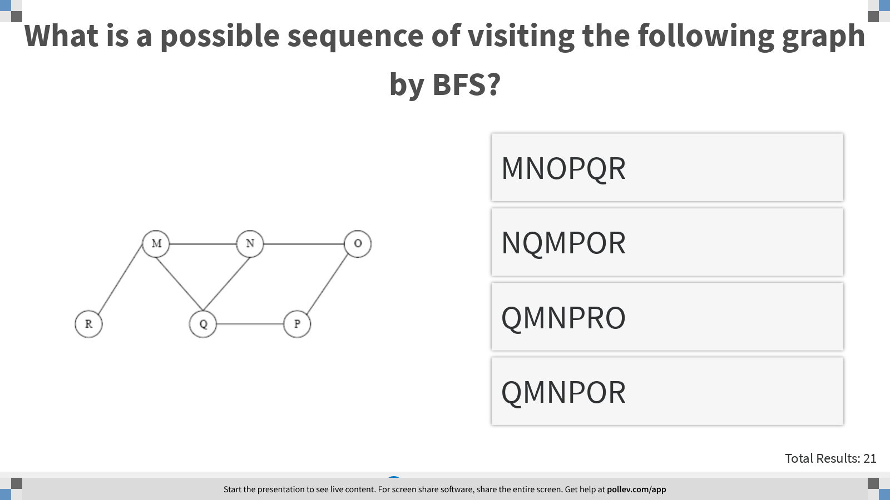
Notes:
What is a possible sequence of visiting the following graph by BFS?
https://www.polleverywhere.com/multiple_choice_polls/rcKY8yLLsq5qw4f4asQcz?display_state=instructions&controls=none&onscreen=persist

Slide 17
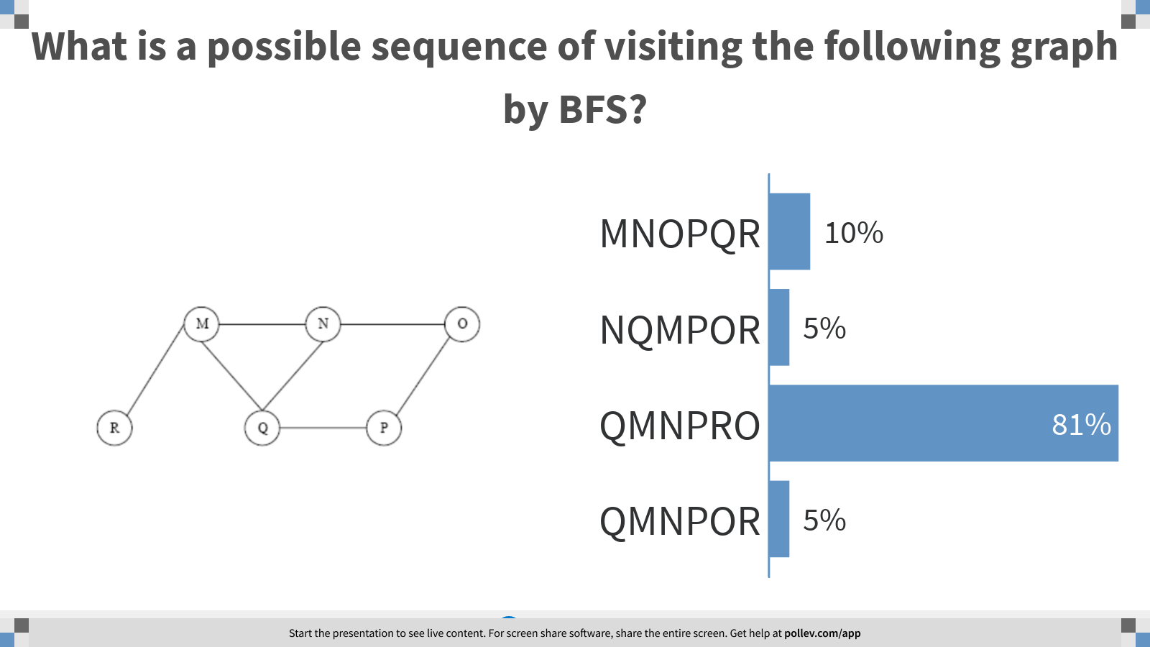
Notes:
What is a possible sequence of visiting the following graph by BFS?
https://www.polleverywhere.com/multiple_choice_polls/rcKY8yLLsq5qw4f4asQcz?display_state=chart&display=correctness&controls=none&onscreen=persist

Slide 18
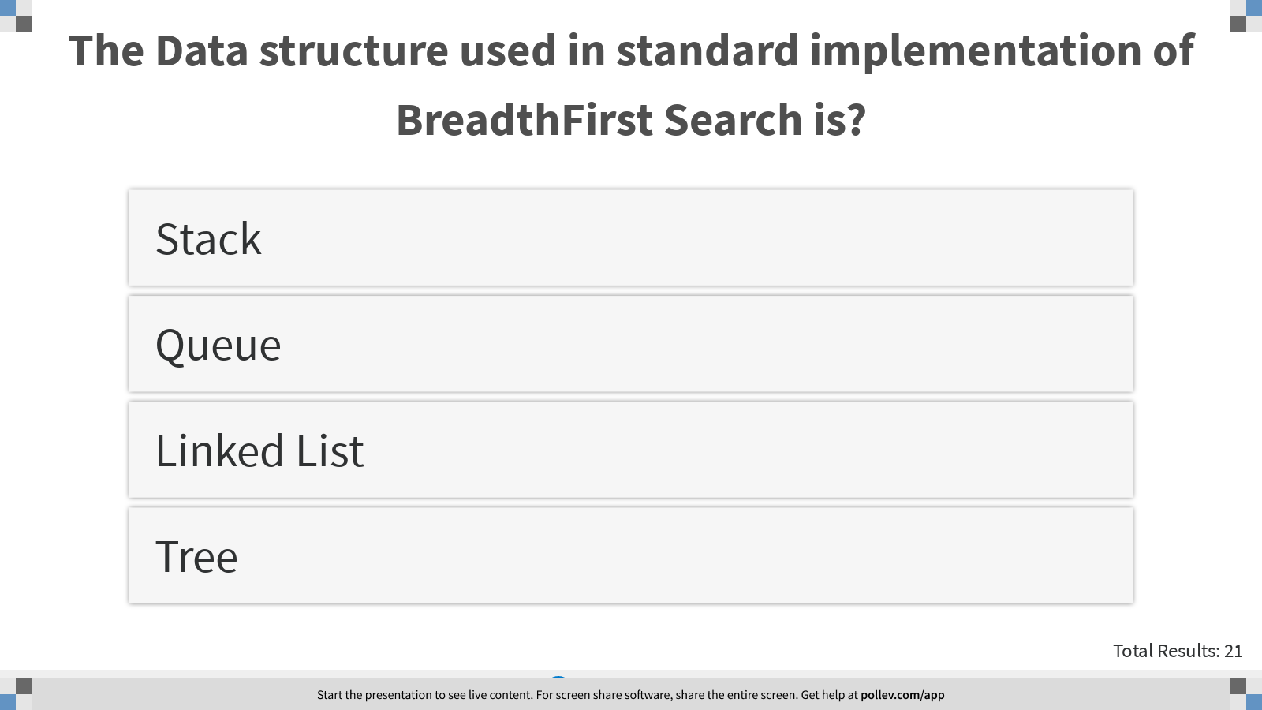
Notes:
The Data structure used in standard implementation of BreadthFirst Search is?
https://www.polleverywhere.com/multiple_choice_polls/3qaFxmPo4BX5rPaqvEDgZ?display_state=instructions&controls=none&onscreen=persist

Slide 19
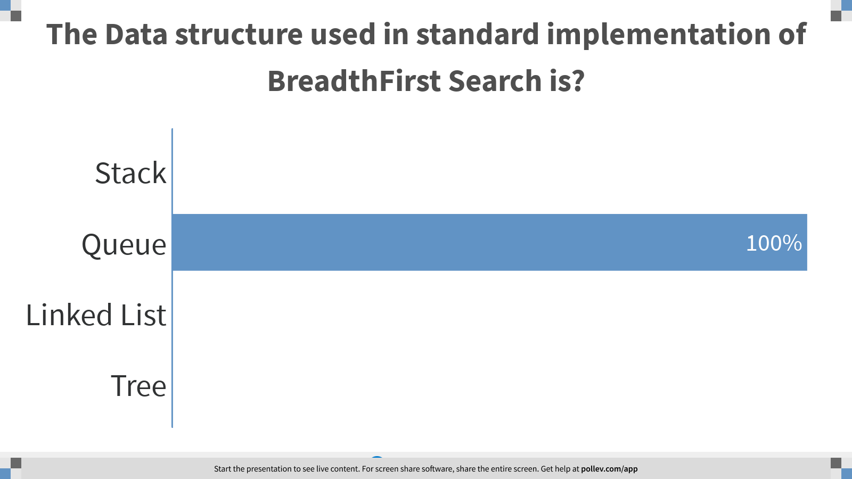
Notes:
The Data structure used in standard implementation of BreadthFirst Search is?
https://www.polleverywhere.com/multiple_choice_polls/3qaFxmPo4BX5rPaqvEDgZ?display_state=chart&display=correctness&controls=none&onscreen=persist

Slide 20
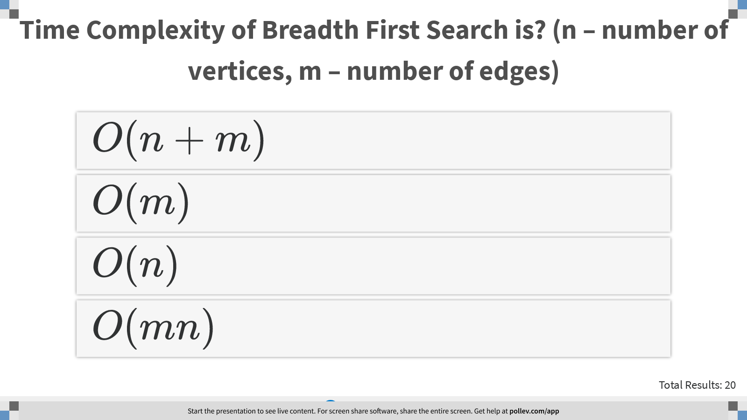
Notes:
Time Complexity of Breadth First Search is? (n – number of vertices, m – number of edges)
https://www.polleverywhere.com/multiple_choice_polls/4PNSPJjDId8clltQCMWYI?display_state=instructions&controls=none&onscreen=persist

Slide 21
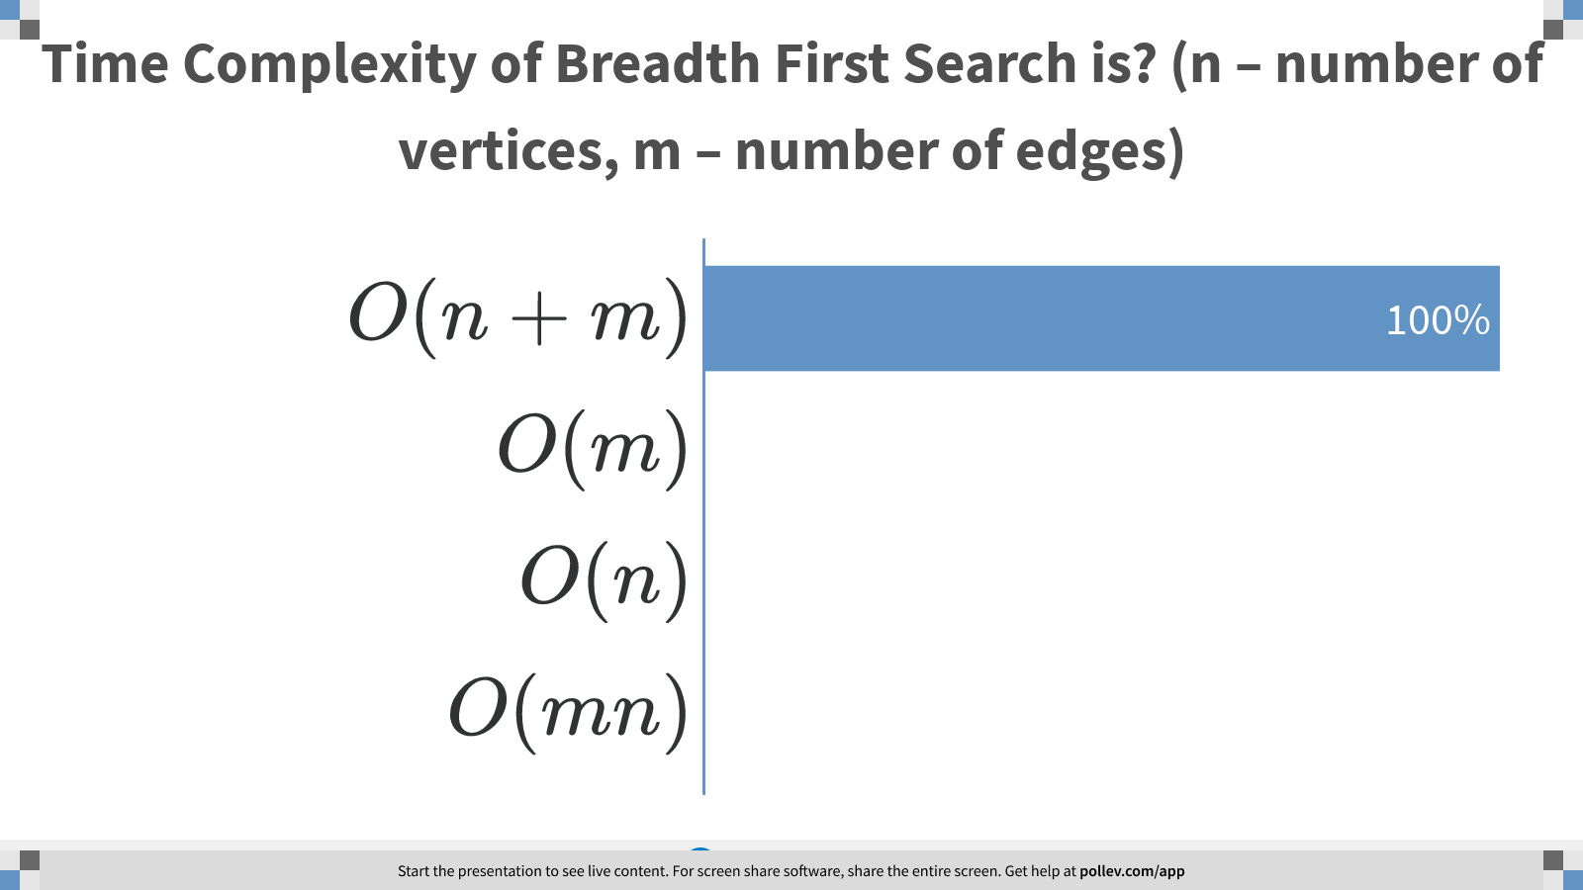
Notes:
Time Complexity of Breadth First Search is? (n – number of vertices, m – number of edges)
https://www.polleverywhere.com/multiple_choice_polls/4PNSPJjDId8clltQCMWYI?display_state=chart&display=correctness&controls=none&onscreen=persist

Slide 22
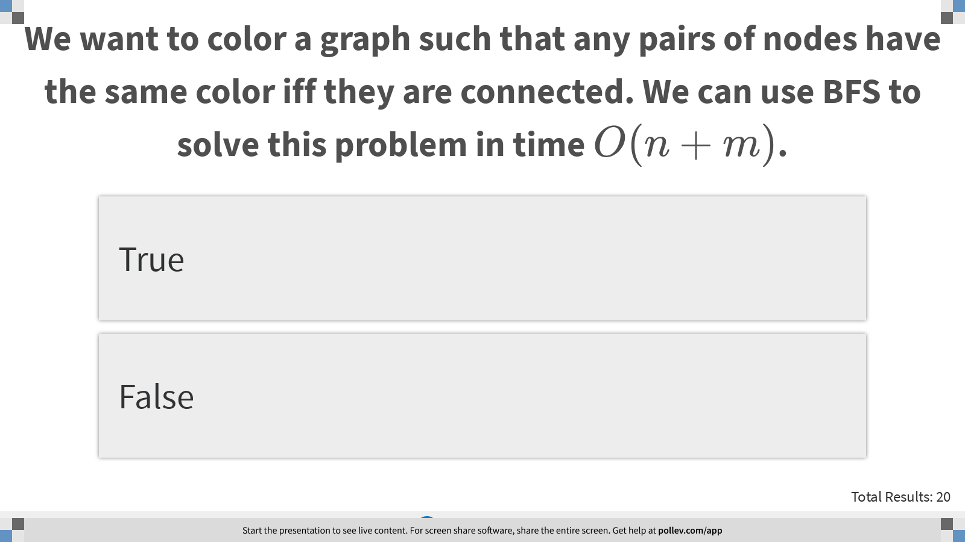
Notes:
We want to color a graph such that any pairs of nodes have the same color iff they are connected. We can use BFS to solve this problem in time $$O(n+m)$$.
https://www.polleverywhere.com/multiple_choice_polls/gL45wsjcO1yYUfRAFU2Gf?display_state=instructions&controls=none&onscreen=persist

Slide 23
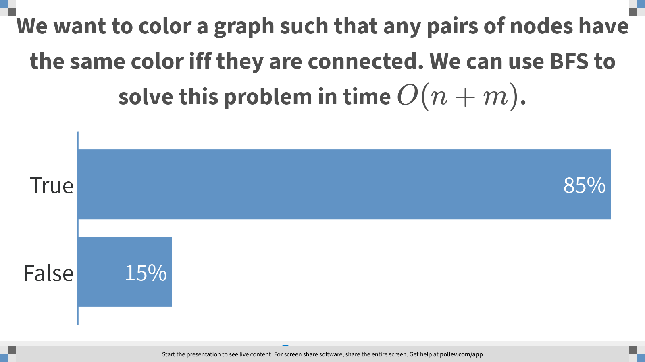
Notes:
We want to color a graph such that any pairs of nodes have the same color iff they are connected. We can use BFS to solve this problem in time $$O(n+m)$$.
https://www.polleverywhere.com/multiple_choice_polls/gL45wsjcO1yYUfRAFU2Gf?display_state=chart&display=correctness&controls=none&onscreen=persist

Slide 24
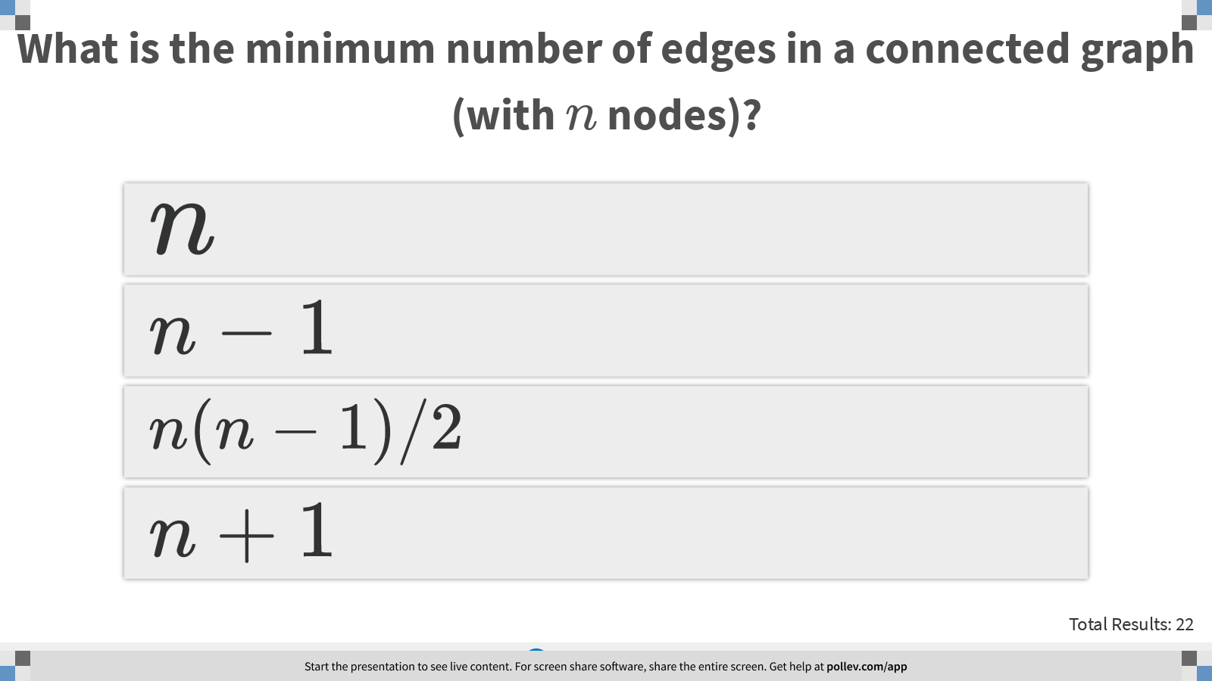
Notes:
What is the minimum number of edges in a connected graph (with $$n$$ nodes)?
https://www.polleverywhere.com/multiple_choice_polls/w3jLNnFRlHFnnn4kmi5oO?display_state=instructions&controls=none&onscreen=persist

Slide 25
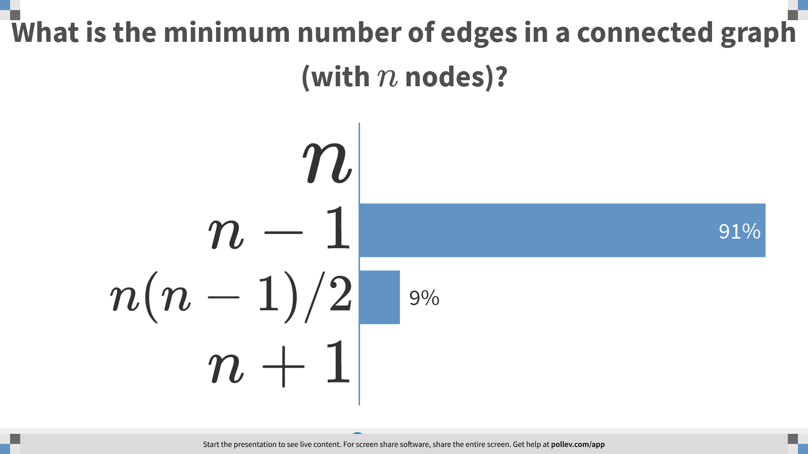
Notes:
What is the minimum number of edges in a connected graph (with $$n$$ nodes)?
https://www.polleverywhere.com/multiple_choice_polls/w3jLNnFRlHFnnn4kmi5oO?display_state=chart&display=correctness&controls=none&onscreen=persist

Slide 26
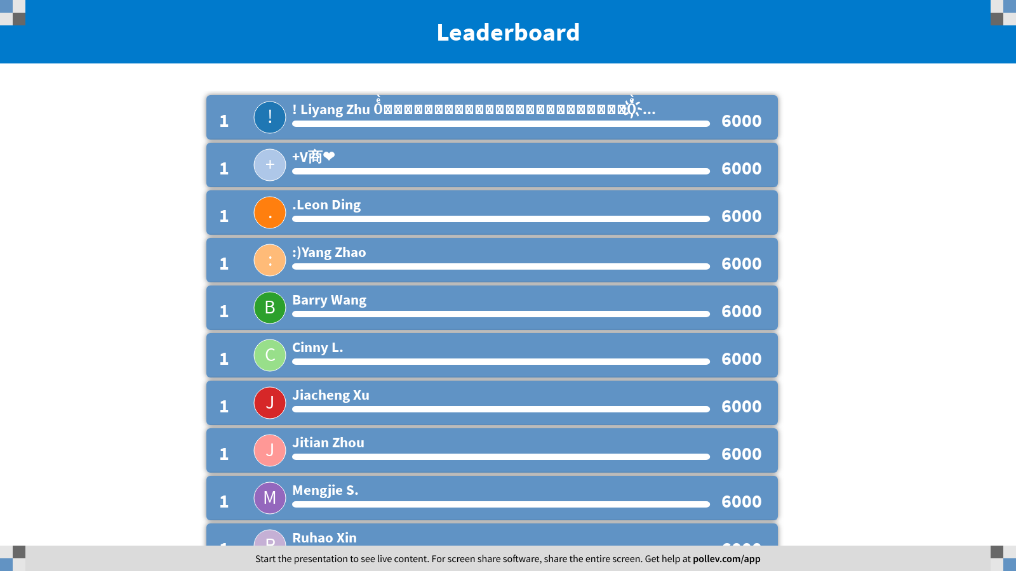
Notes:
BFS
https://www.polleverywhere.com/competitions/u8SCouozGFDMxyxszux5z?display_state=leaderboard&onscreen=persist

