Slide 1

Notes:
BFS II
https://www.polleverywhere.com/competitions/3H3JYWeBF9gNLqB2Ti1GC?display_state=welcome&controls=none&onscreen=persist

Slide 2
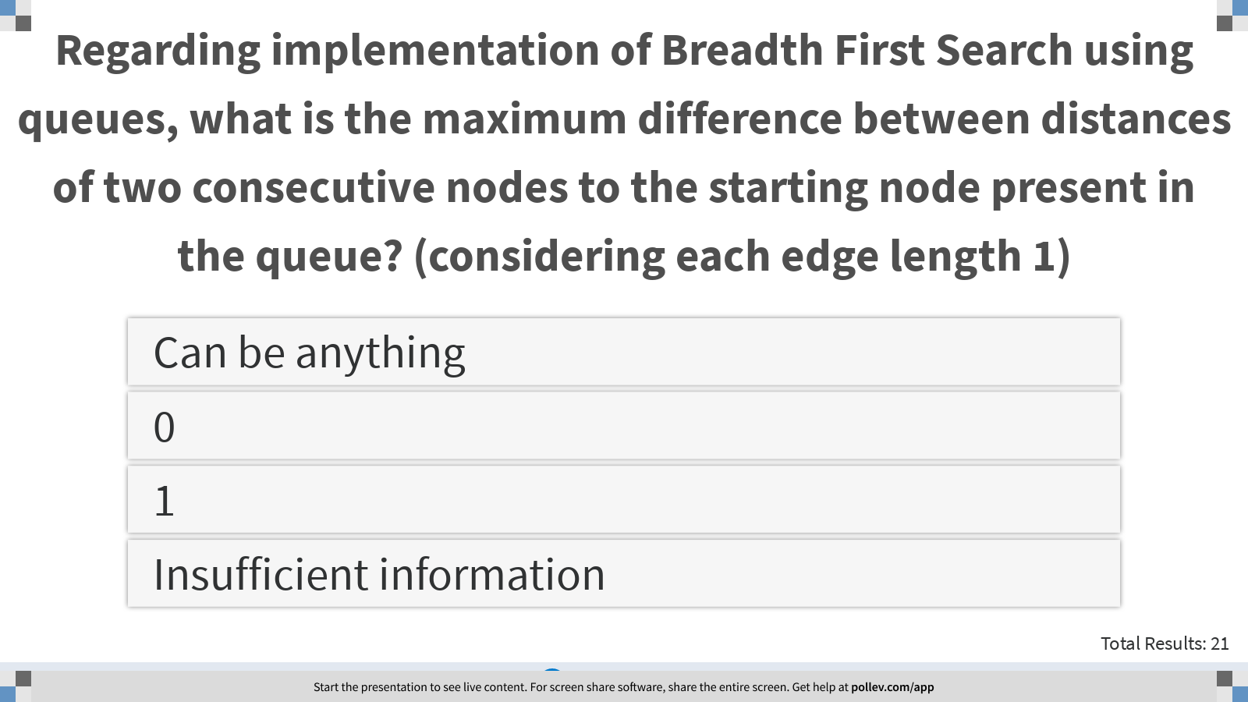
Notes:
Regarding implementation of Breadth First Search using queues, what is the maximum difference between distances of two consecutive nodes to the starting node present in the queue? (considering each edge length 1)
https://www.polleverywhere.com/multiple_choice_polls/mtMY2CP61Hv2YnYyW4NSG?display_state=instructions&controls=none&onscreen=persist

Slide 3
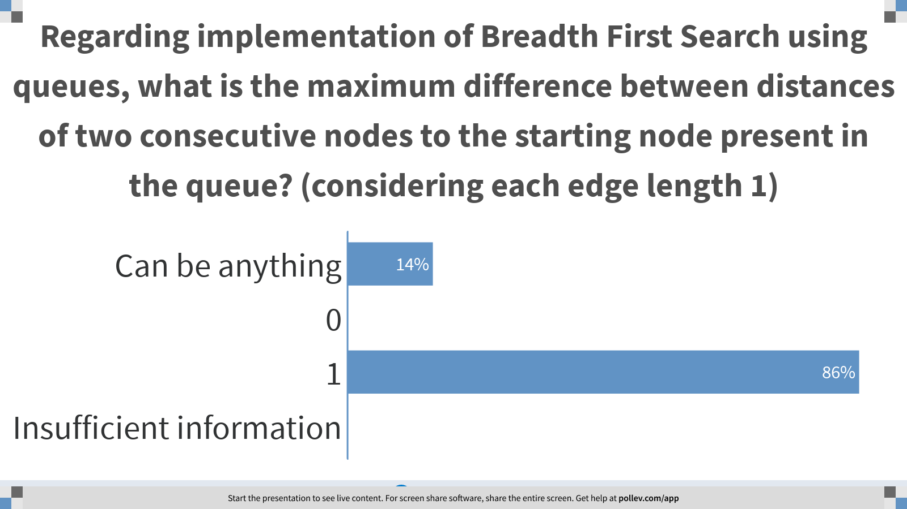
Notes:
Regarding implementation of Breadth First Search using queues, what is the maximum difference between distances of two consecutive nodes to the starting node present in the queue? (considering each edge length 1)
https://www.polleverywhere.com/multiple_choice_polls/mtMY2CP61Hv2YnYyW4NSG?display_state=chart&display=correctness&controls=none&onscreen=persist

Slide 4
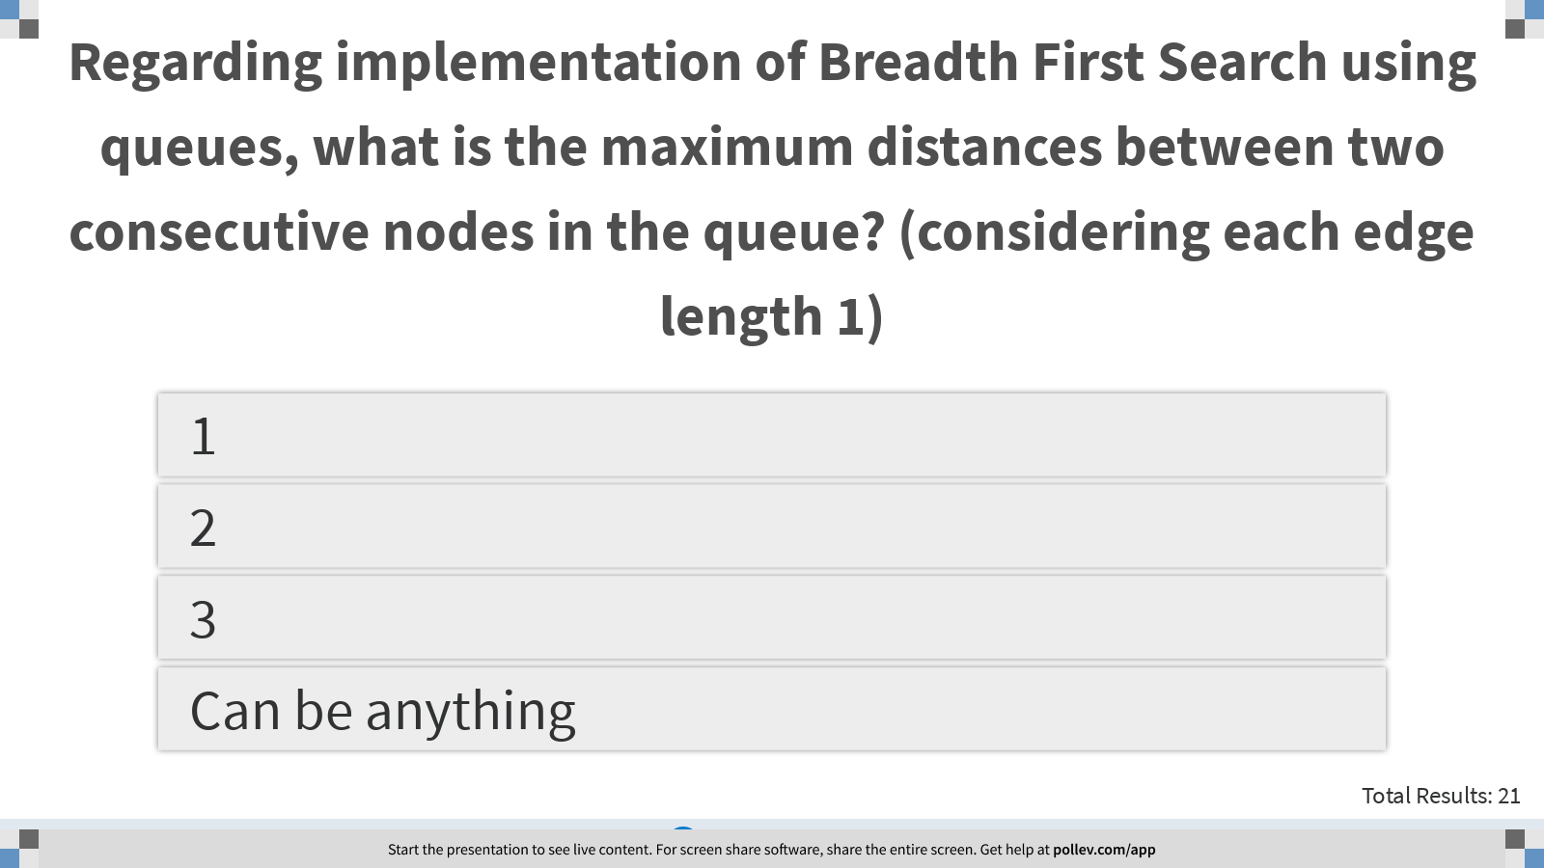
Notes:
Regarding implementation of Breadth First Search using queues, what is the maximum distances between two consecutive nodes in the queue? (considering each edge length 1)
https://www.polleverywhere.com/multiple_choice_polls/Kq1geeXTiz0PWKMaDgRsY?display_state=instructions&controls=none&onscreen=persist

Slide 5
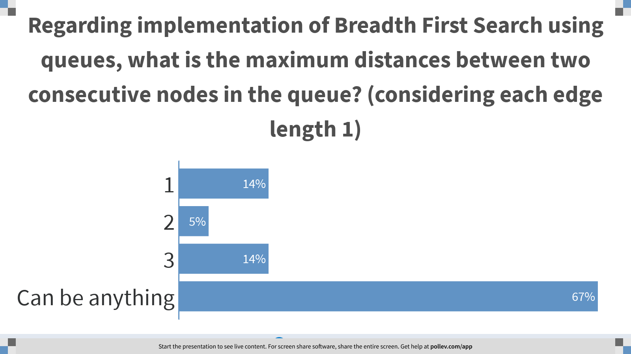
Notes:
Regarding implementation of Breadth First Search using queues, what is the maximum distances between two consecutive nodes in the queue? (considering each edge length 1)
https://www.polleverywhere.com/multiple_choice_polls/Kq1geeXTiz0PWKMaDgRsY?display_state=chart&display=correctness&controls=none&onscreen=persist

Slide 6
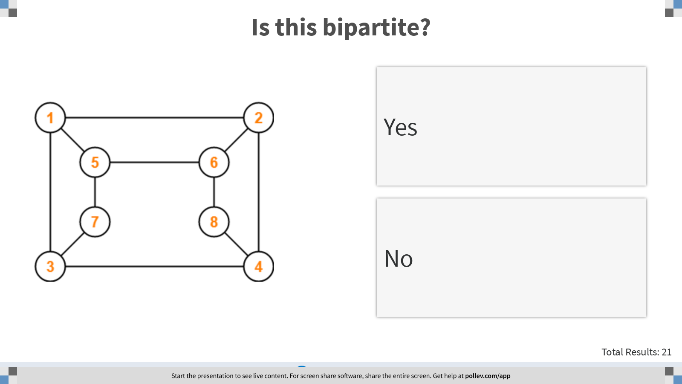
Notes:
Is this bipartite?
https://www.polleverywhere.com/multiple_choice_polls/NPtZUOl2RtxXVT6bIY6gC?display_state=instructions&controls=none&onscreen=persist

Slide 7
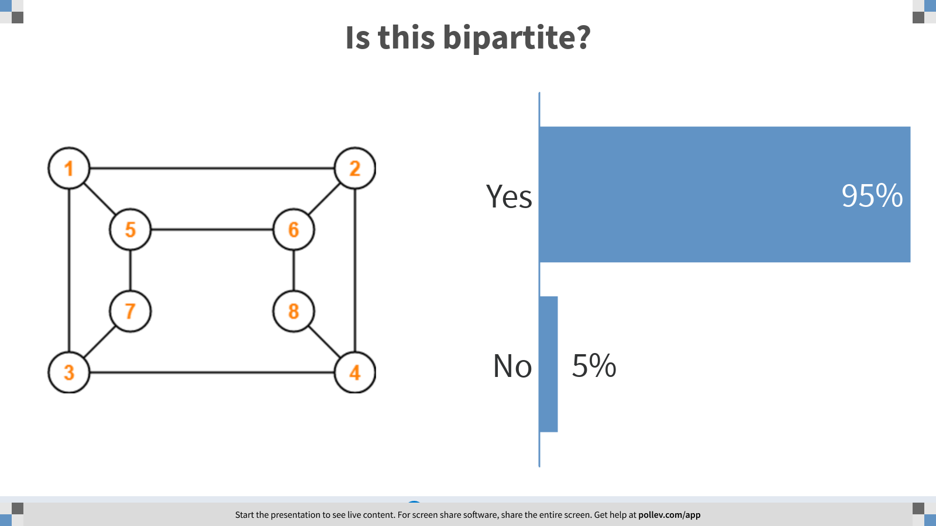
Notes:
Is this bipartite?
https://www.polleverywhere.com/multiple_choice_polls/NPtZUOl2RtxXVT6bIY6gC?display_state=chart&display=correctness&controls=none&onscreen=persist

Slide 8
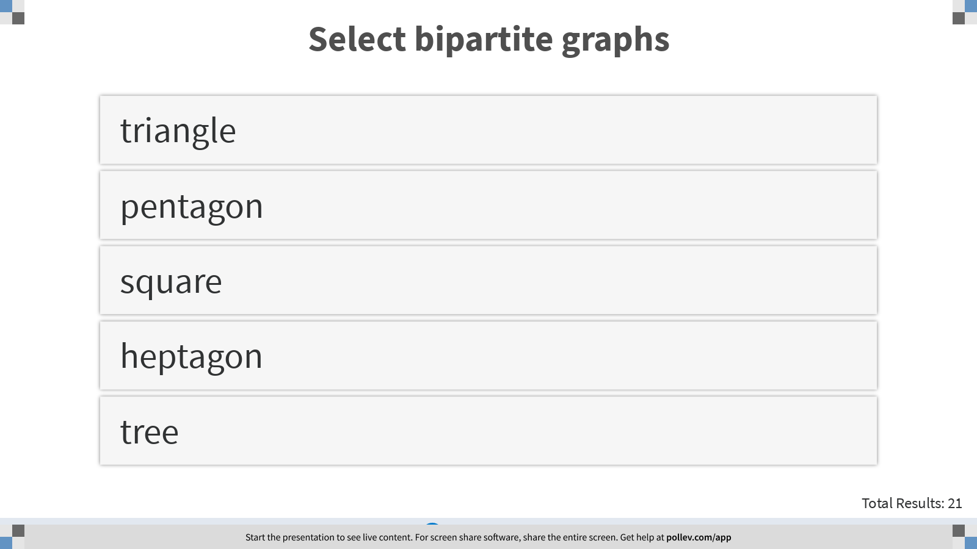
Notes:
Select bipartite graphs
https://www.polleverywhere.com/multiple_choice_polls/imiiqDDfDuPAWogS5Fusn?display_state=instructions&controls=none&onscreen=persist

Slide 9
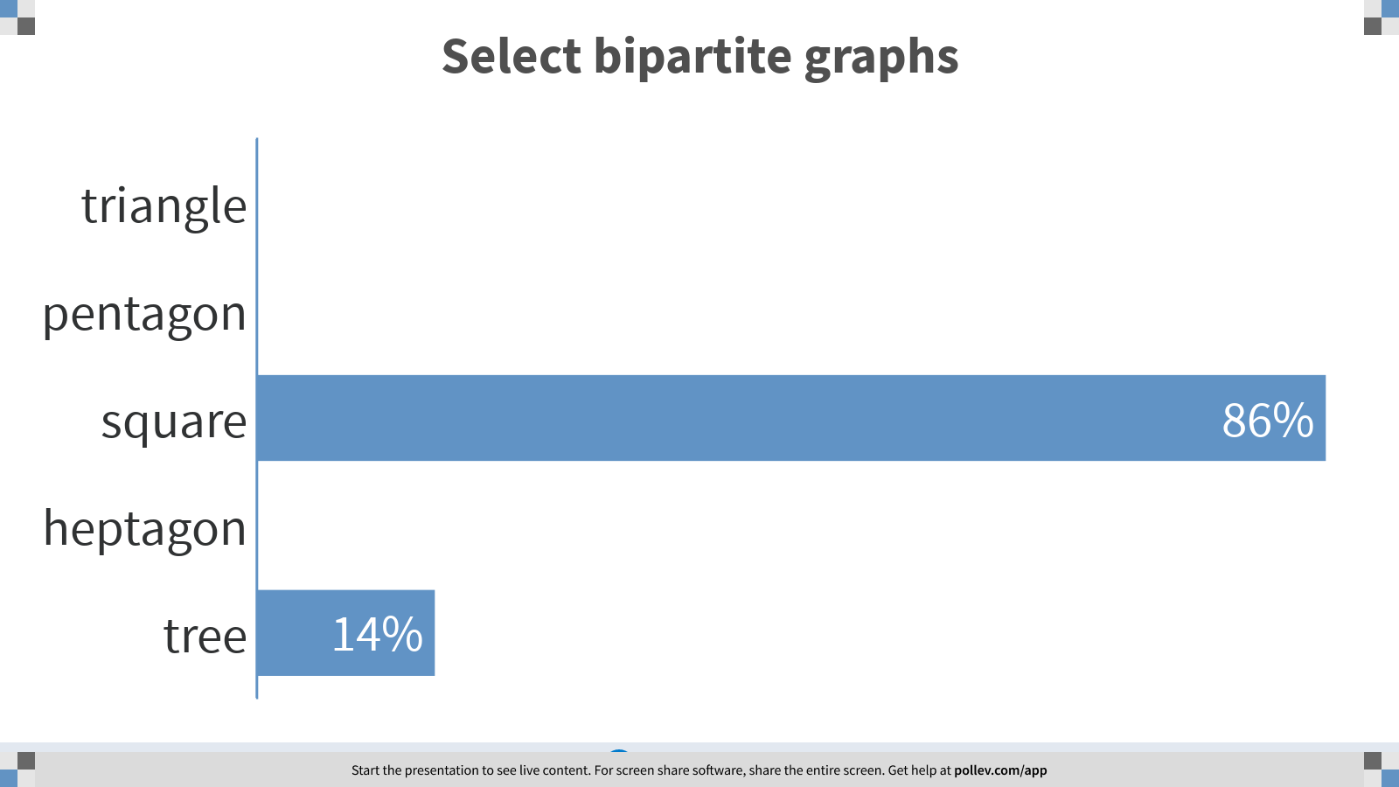
Notes:
Select bipartite graphs
https://www.polleverywhere.com/multiple_choice_polls/imiiqDDfDuPAWogS5Fusn?display_state=chart&display=correctness&controls=none&onscreen=persist

Slide 10
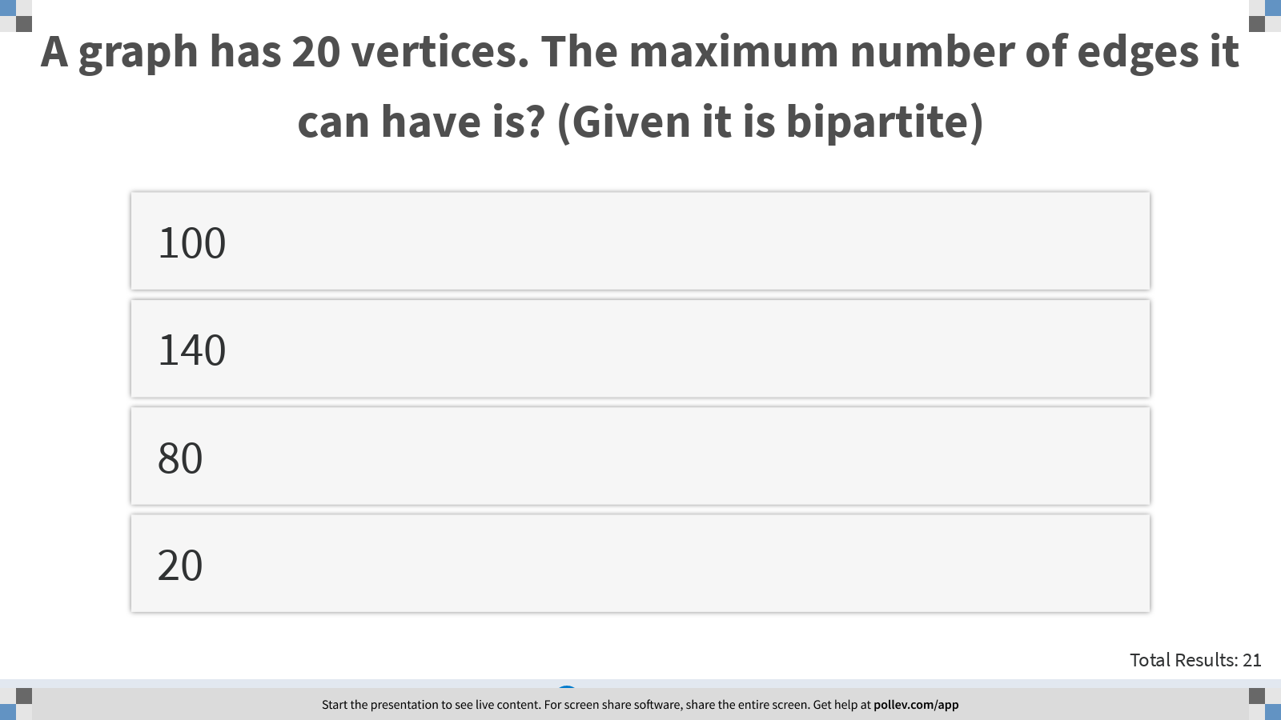
Notes:
A graph has 20 vertices. The maximum number of edges it can have is? (Given it is bipartite)
https://www.polleverywhere.com/multiple_choice_polls/hZzxXkYQiZomRshL6VjGs?display_state=instructions&controls=none&onscreen=persist

Slide 11
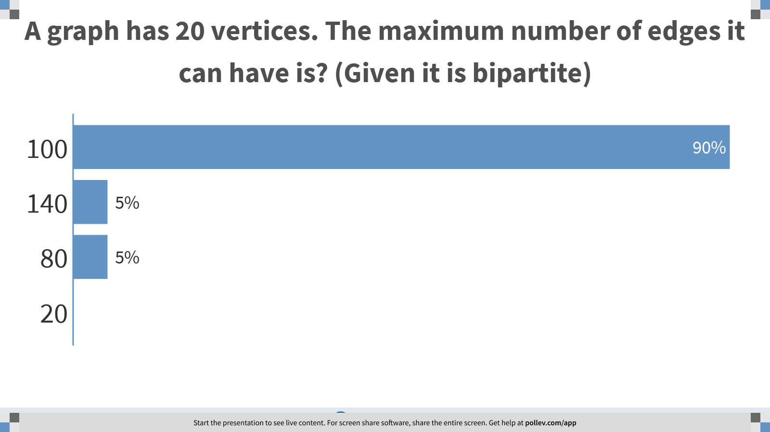
Notes:
A graph has 20 vertices. The maximum number of edges it can have is? (Given it is bipartite)
https://www.polleverywhere.com/multiple_choice_polls/hZzxXkYQiZomRshL6VjGs?display_state=chart&display=correctness&controls=none&onscreen=persist

Slide 12

Notes:
BFS II
https://www.polleverywhere.com/competitions/3H3JYWeBF9gNLqB2Ti1GC?display_state=finale&onscreen=persist

Slide 13

Notes:
DFS
https://www.polleverywhere.com/competitions/kecG4nzwG87NqWTKoEcyE?display_state=welcome&controls=none&onscreen=persist

Slide 14
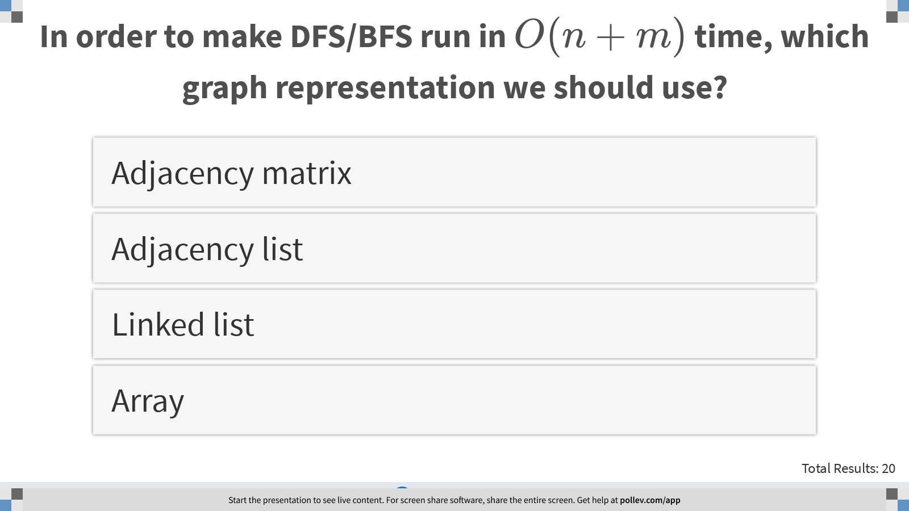
Notes:
In order to make DFS/BFS run in $$O(n+m)$$ time, which graph representation we should use?
https://www.polleverywhere.com/multiple_choice_polls/j03S0OeFl0gJxXhVeMvva?display_state=instructions&controls=none&onscreen=persist

Slide 15
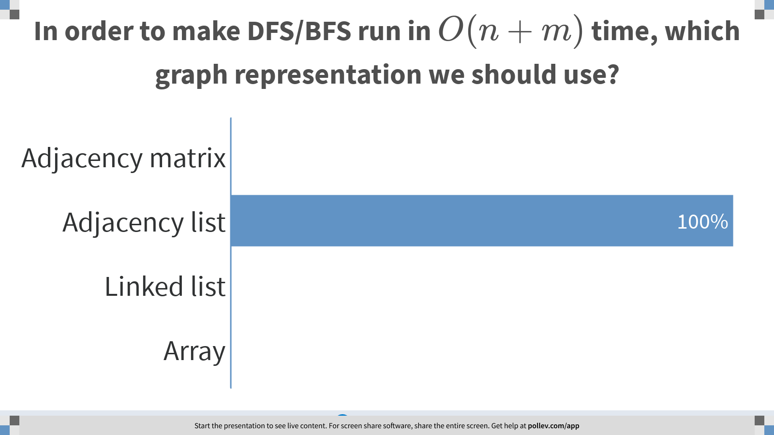
Notes:
In order to make DFS/BFS run in $$O(n+m)$$ time, which graph representation we should use?
https://www.polleverywhere.com/multiple_choice_polls/j03S0OeFl0gJxXhVeMvva?display_state=chart&display=correctness&controls=none&onscreen=persist

Slide 16

Notes:
Which data structure we should use to implement DFS in non-recursive way?
https://www.polleverywhere.com/multiple_choice_polls/Wj3e17lXCaKJVH66NWwU1?display_state=instructions&controls=none&onscreen=persist

Slide 17
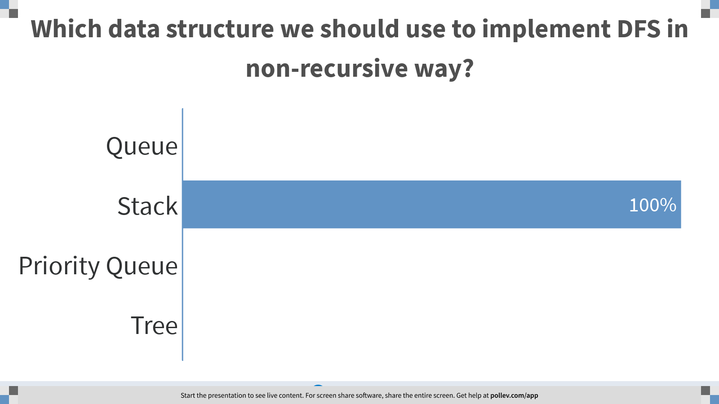
Notes:
Which data structure we should use to implement DFS in non-recursive way?
https://www.polleverywhere.com/multiple_choice_polls/Wj3e17lXCaKJVH66NWwU1?display_state=chart&display=correctness&controls=none&onscreen=persist

Slide 18
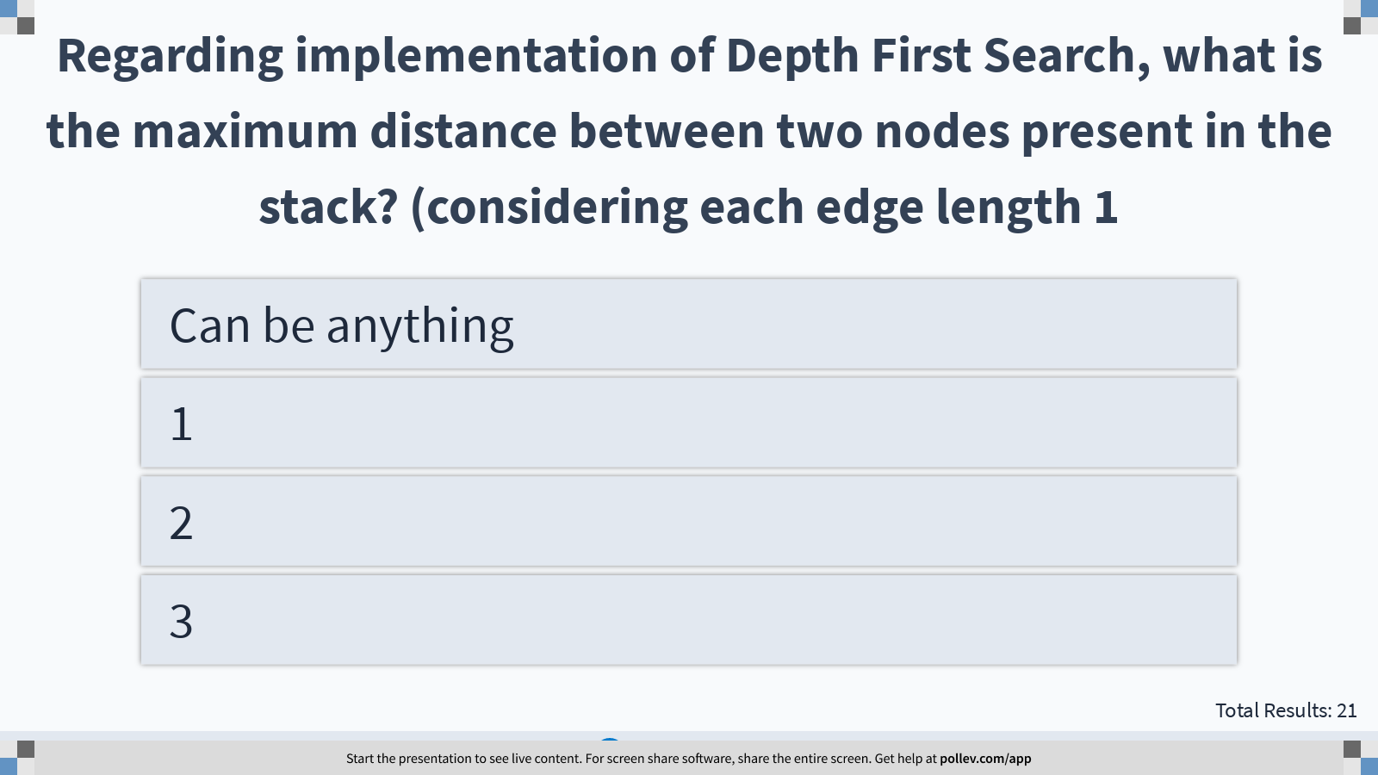
Notes:
Regarding implementation of Depth First Search, what is the maximum distance between two nodes present in the stack? (considering each edge length 1
https://www.polleverywhere.com/multiple_choice_polls/yfkQlzP6v4mAwUeuccGrf?display_state=instructions&controls=none&onscreen=persist

Slide 19
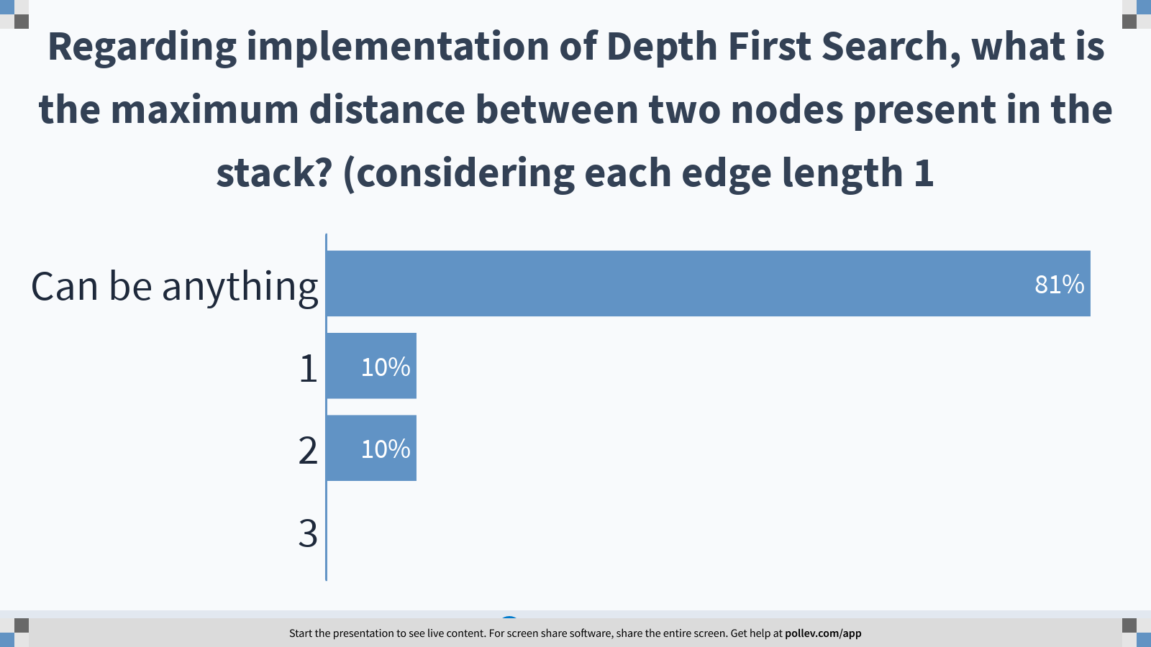
If it is for two consecutive nodes, the answer is 1
Notes:
Regarding implementation of Depth First Search, what is the maximum distance between two nodes present in the stack? (considering each edge length 1
https://www.polleverywhere.com/multiple_choice_polls/yfkQlzP6v4mAwUeuccGrf?display_state=chart&display=correctness&controls=none&onscreen=persist

Slide 20
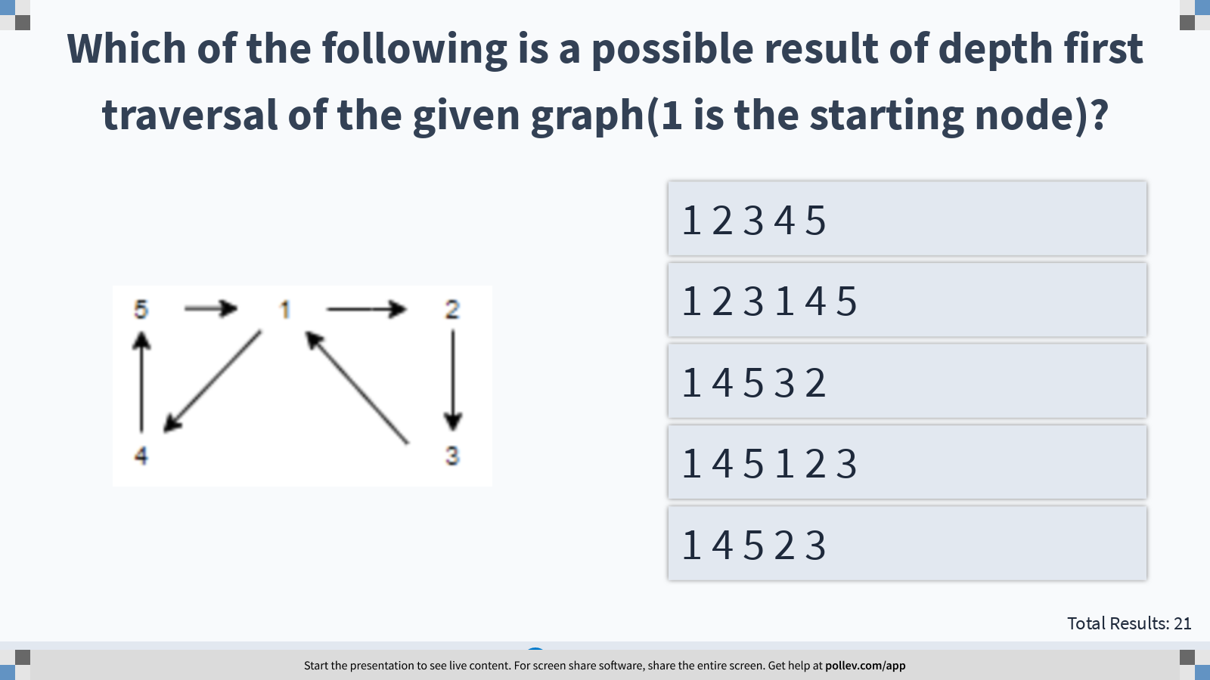
Notes:
Which of the following is a possible result of depth first traversal of the given graph(1 is the starting node)?
https://www.polleverywhere.com/multiple_choice_polls/5myONmK5j5p0XnBHBNlE6?display_state=instructions&controls=none&onscreen=persist

Slide 21
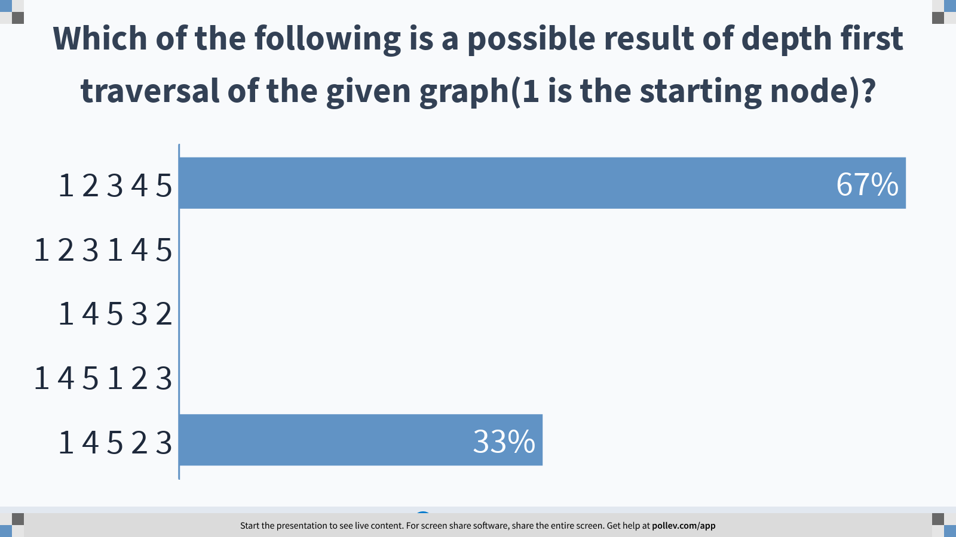
Notes:
Which of the following is a possible result of depth first traversal of the given graph(1 is the starting node)?
https://www.polleverywhere.com/multiple_choice_polls/5myONmK5j5p0XnBHBNlE6?display_state=chart&display=correctness&controls=none&onscreen=persist

Slide 22
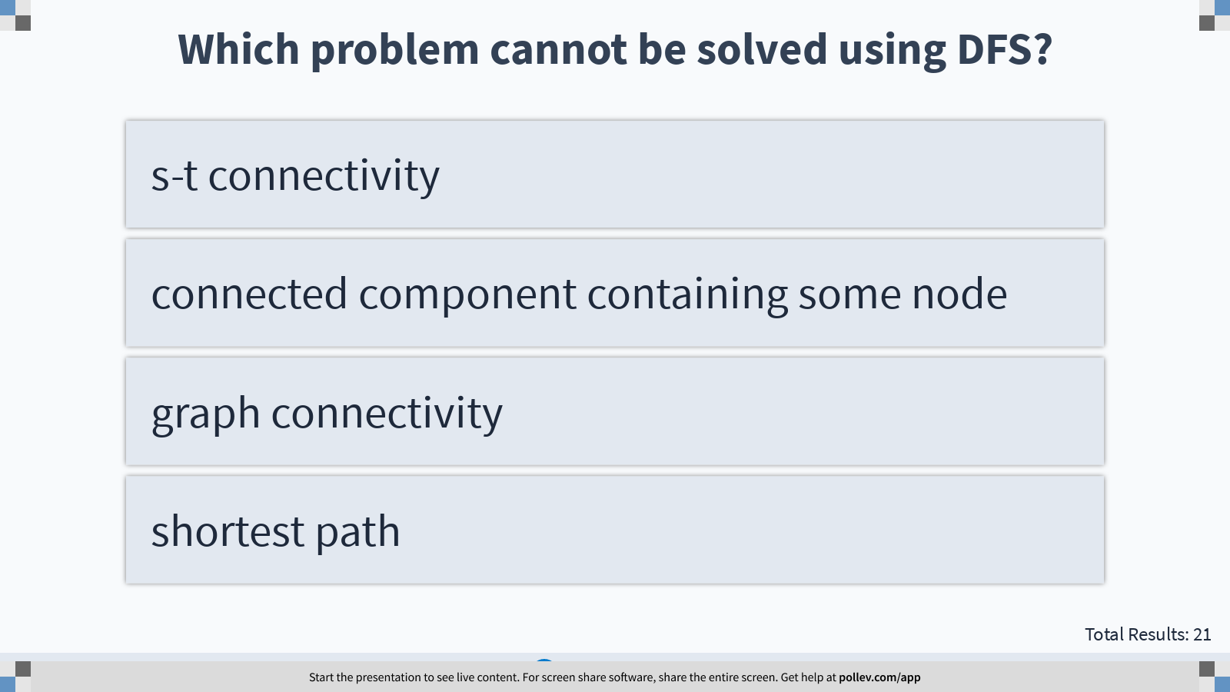
Notes:
Which problem cannot be solved using DFS?
https://www.polleverywhere.com/multiple_choice_polls/b9pCh540FPZge8sUe0BFu?display_state=instructions&controls=none&onscreen=persist

Slide 23
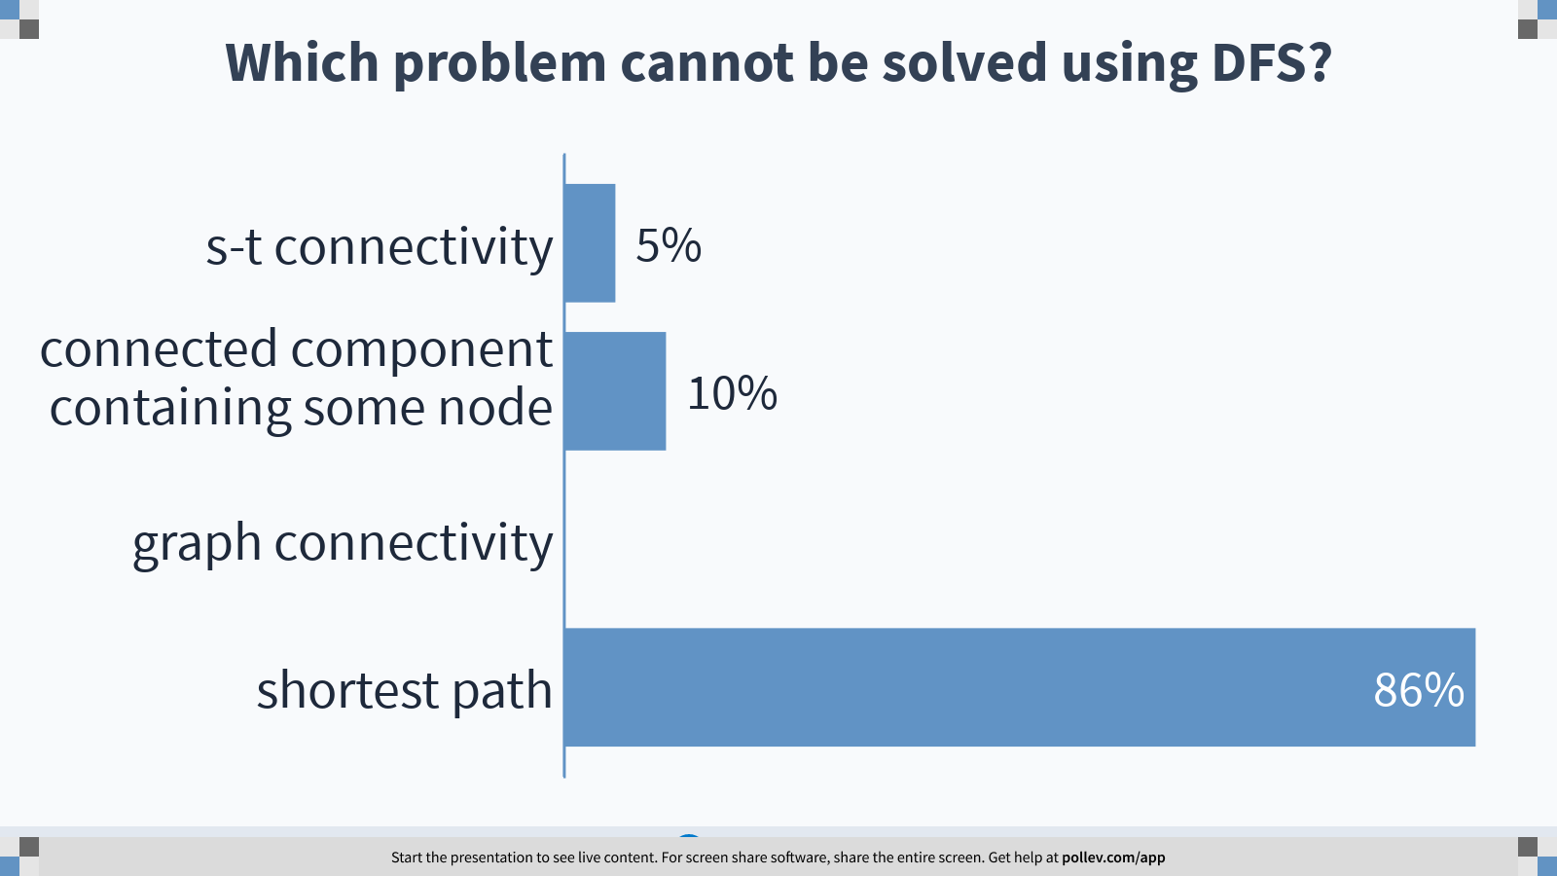
Notes:
Which problem cannot be solved using DFS?
https://www.polleverywhere.com/multiple_choice_polls/b9pCh540FPZge8sUe0BFu?display_state=chart&display=correctness&controls=none&onscreen=persist

Slide 24
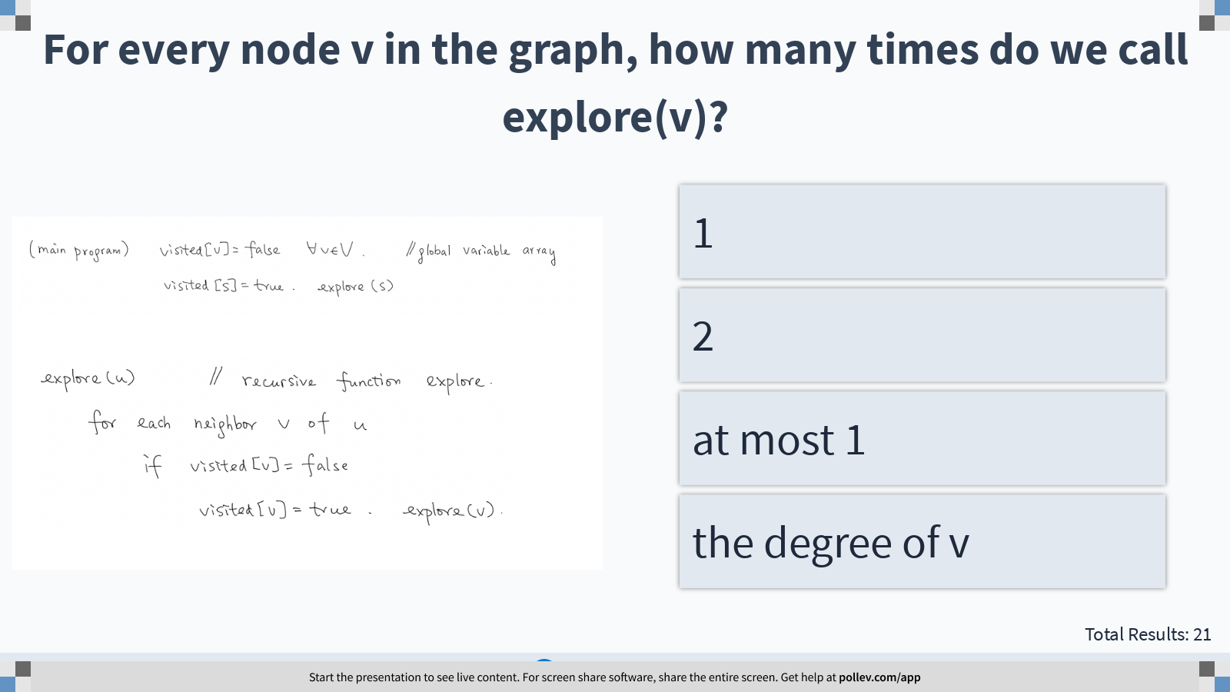
Notes:
For every node v in the graph, how many times do we call explore(v)?
https://www.polleverywhere.com/multiple_choice_polls/U87WuDcA02TOhwLUS2Djt?display_state=instructions&controls=none&onscreen=persist

Slide 25
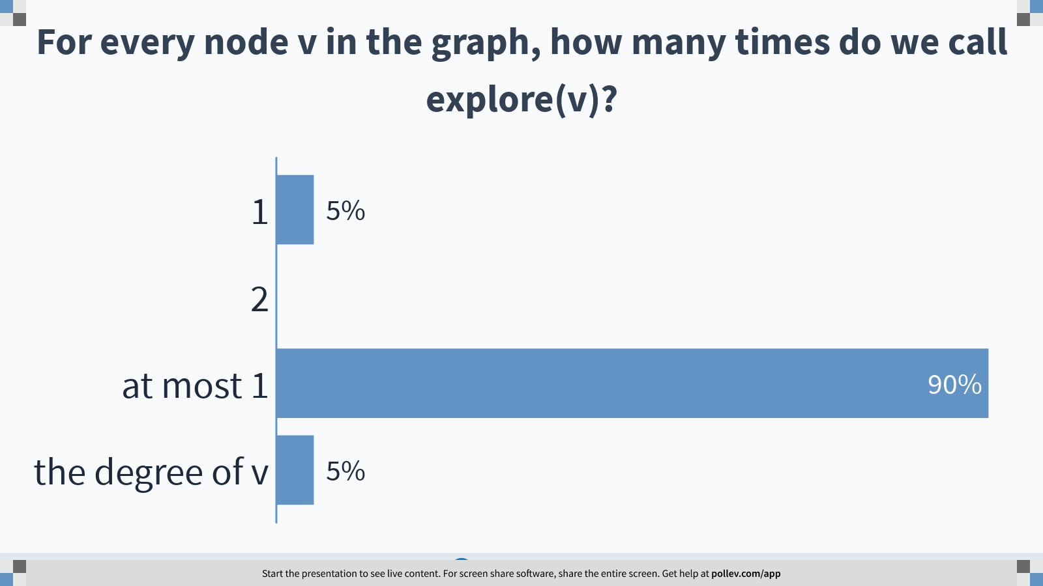
Notes:
For every node v in the graph, how many times do we call explore(v)?
https://www.polleverywhere.com/multiple_choice_polls/U87WuDcA02TOhwLUS2Djt?display_state=chart&display=correctness&controls=none&onscreen=persist

Slide 26
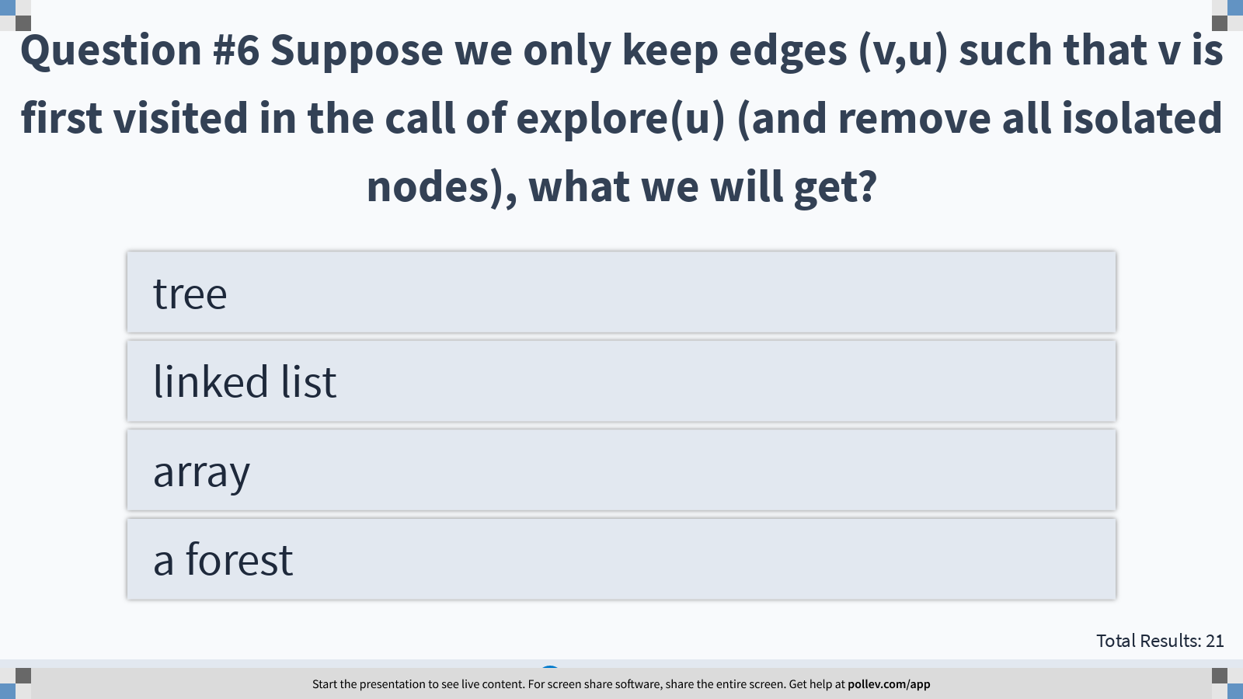
Notes:
Question #6 Suppose we only keep edges (v,u) such that v is first visited in the call of explore(u) (and remove all isolated nodes), what we will get?
https://www.polleverywhere.com/multiple_choice_polls/7ZMbYpPIpfFL3sK3tbVsH?display_state=instructions&controls=none&onscreen=persist

Slide 27
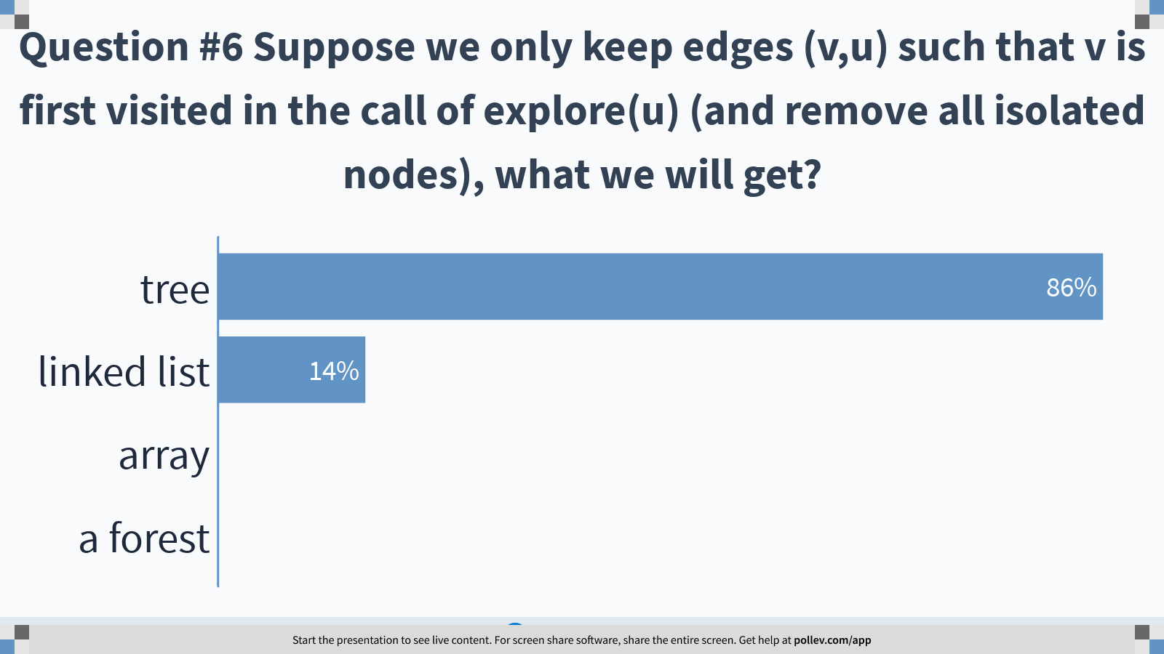
Notes:
Question #6 Suppose we only keep edges (v,u) such that v is first visited in the call of explore(u) (and remove all isolated nodes), what we will get?
https://www.polleverywhere.com/multiple_choice_polls/7ZMbYpPIpfFL3sK3tbVsH?display_state=chart&display=correctness&controls=none&onscreen=persist

Slide 28
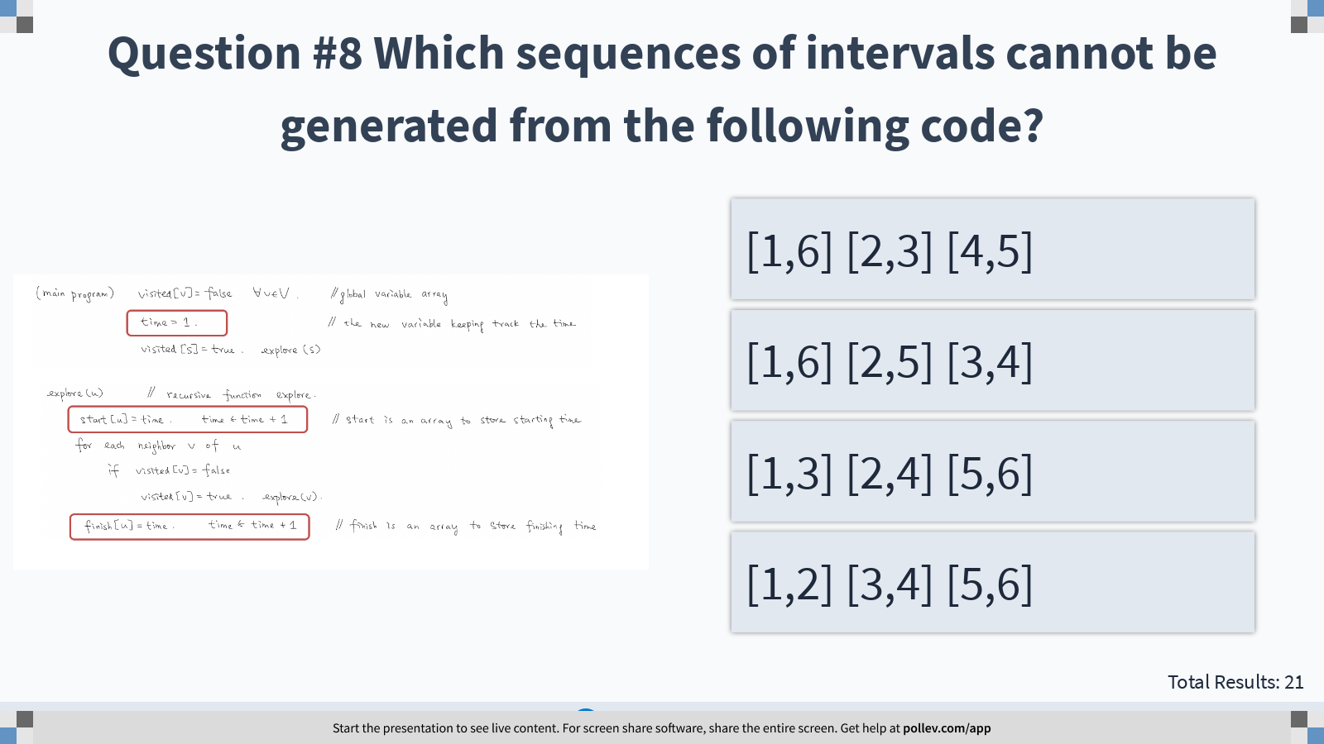
Notes:
Question #8 Which sequences of intervals cannot be generated from the following code?
https://www.polleverywhere.com/multiple_choice_polls/osWa7osGdY7KfvGverNUn?display_state=instructions&controls=none&onscreen=persist

Slide 29
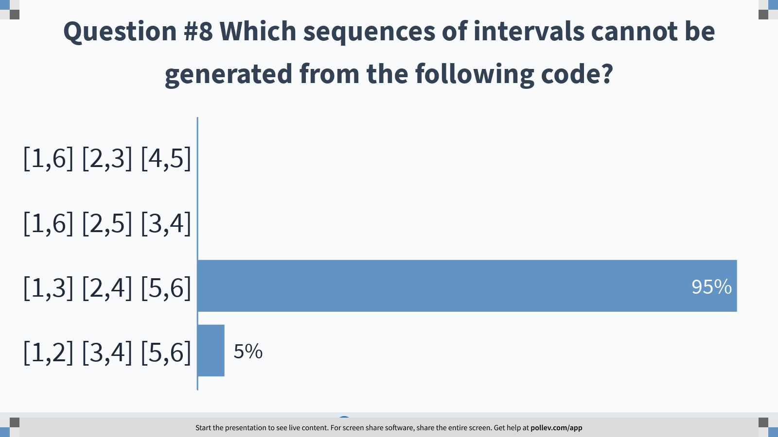
Notes:
Question #8 Which sequences of intervals cannot be generated from the following code?
https://www.polleverywhere.com/multiple_choice_polls/osWa7osGdY7KfvGverNUn?display_state=chart&display=correctness&controls=none&onscreen=persist

Slide 30
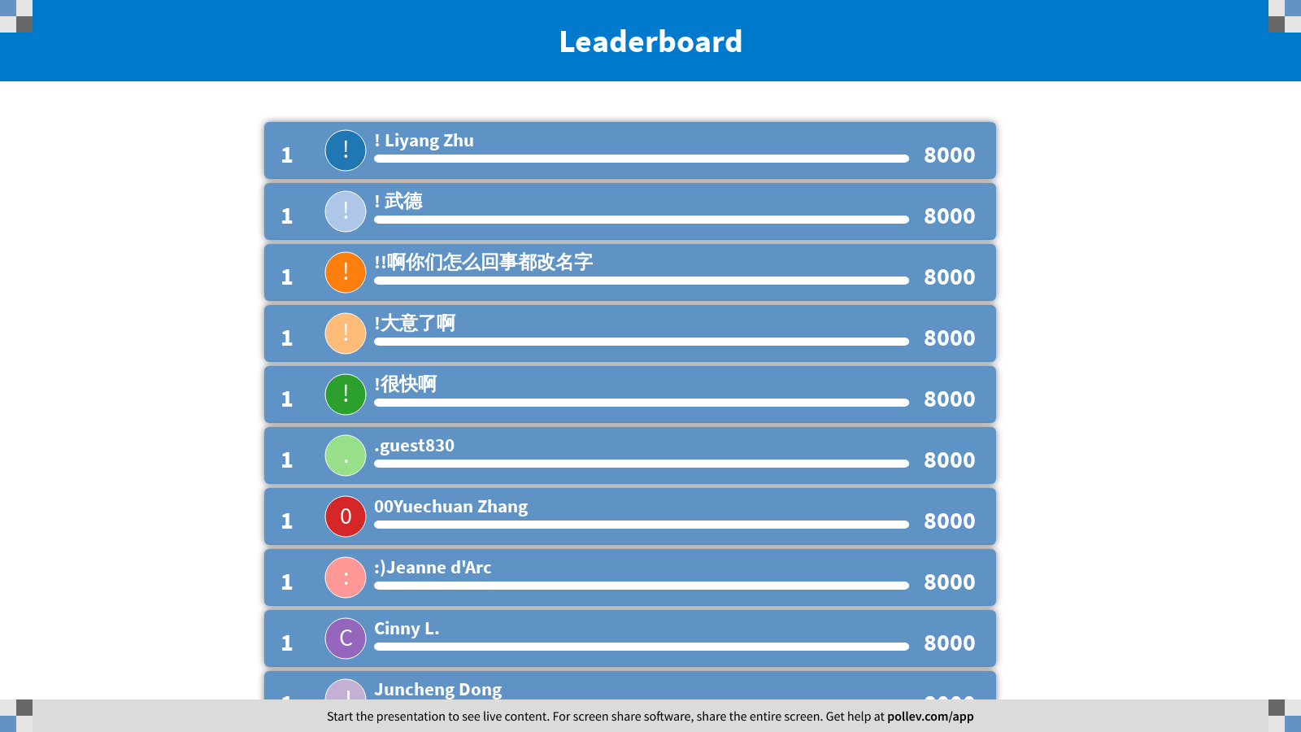
Notes:
DFS
https://www.polleverywhere.com/competitions/kecG4nzwG87NqWTKoEcyE?display_state=finale&onscreen=persist

