Slide 1

Notes:
DFS II
https://www.polleverywhere.com/competitions/GfdTyDTHpJRtY5bZ17n3N?display_state=welcome&controls=none&onscreen=persist

Slide 2
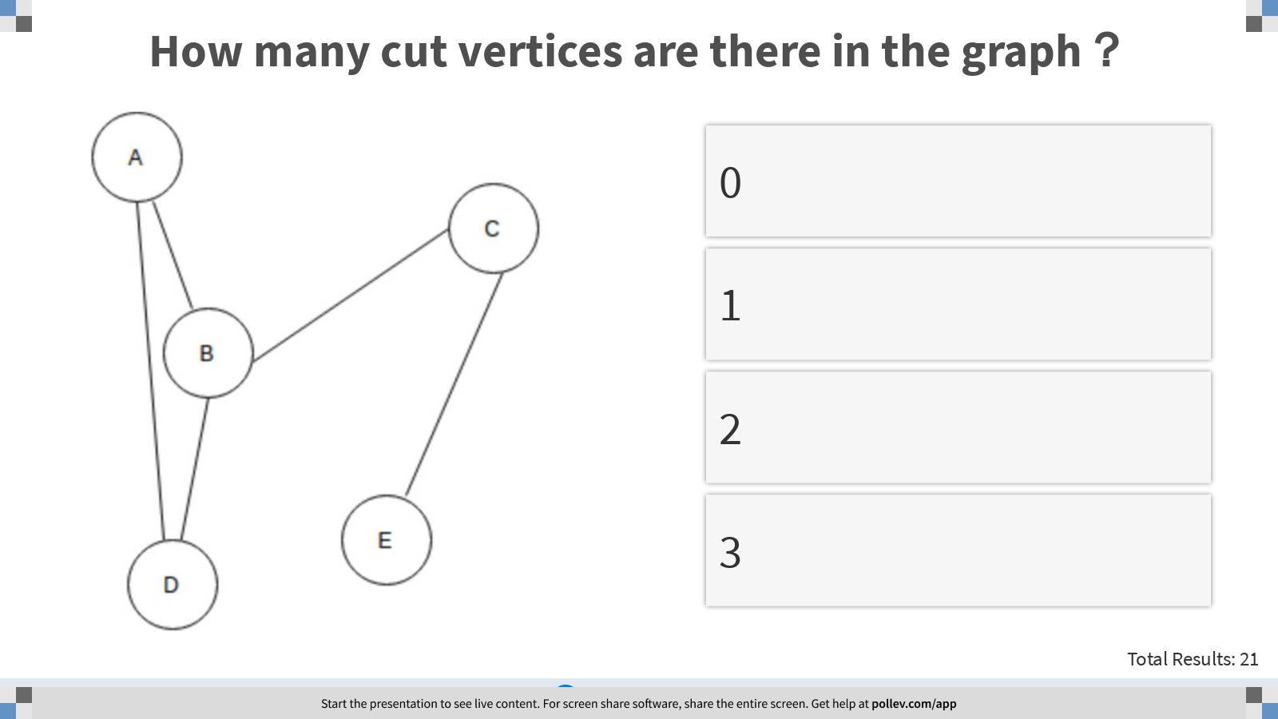
Notes:
How many cut vertices are there in the graph？
https://www.polleverywhere.com/multiple_choice_polls/H5koblBuAxDU6EcWbOwKv?display_state=instructions&controls=none&onscreen=persist

Slide 3
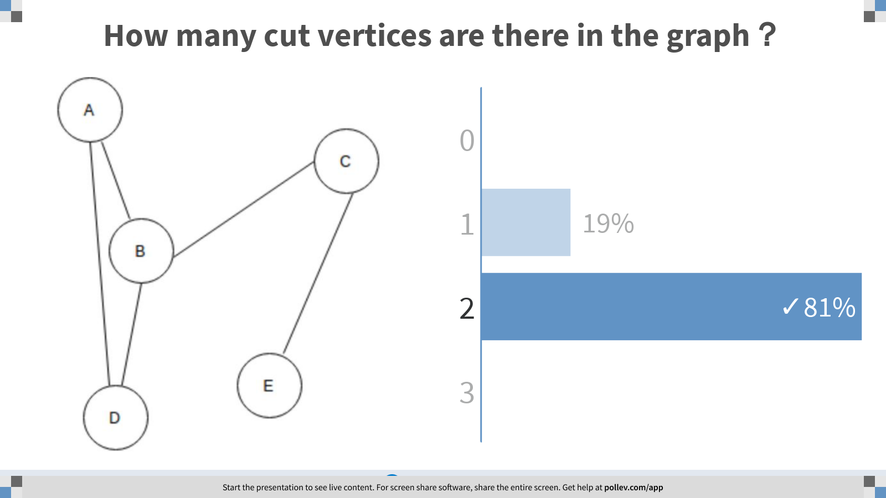
Notes:
How many cut vertices are there in the graph？
https://www.polleverywhere.com/multiple_choice_polls/H5koblBuAxDU6EcWbOwKv?display_state=chart&display=correctness&controls=none&onscreen=persist

Slide 4
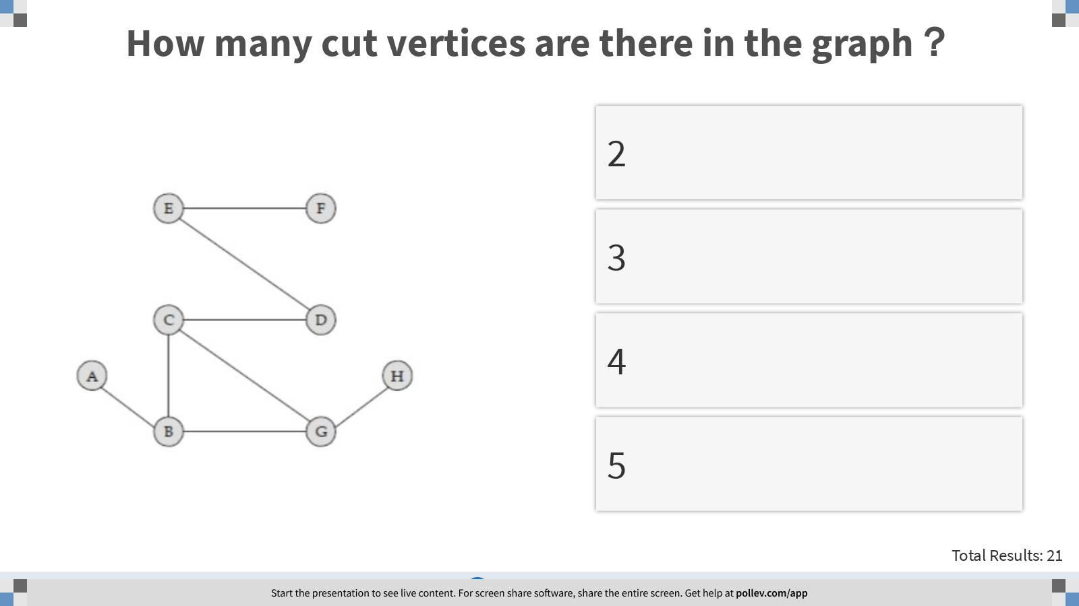
Notes:
How many cut vertices are there in the graph？
https://www.polleverywhere.com/multiple_choice_polls/ed6OvnsKWVJqad3CCk6SA?display_state=instructions&controls=none&onscreen=persist

Slide 5
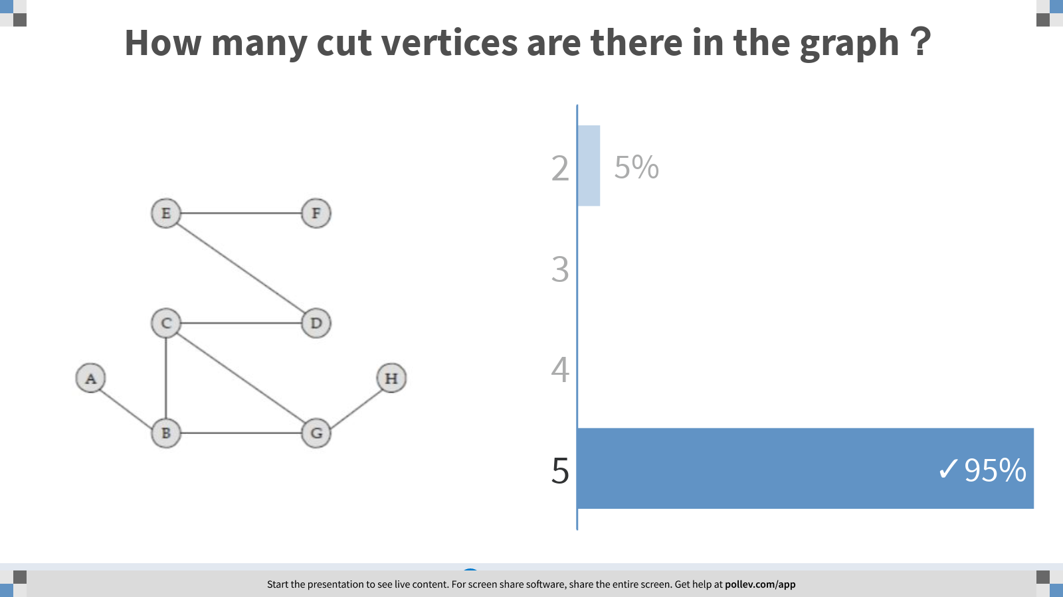
Notes:
How many cut vertices are there in the graph？
https://www.polleverywhere.com/multiple_choice_polls/ed6OvnsKWVJqad3CCk6SA?display_state=chart&display=correctness&controls=none&onscreen=persist

Slide 6
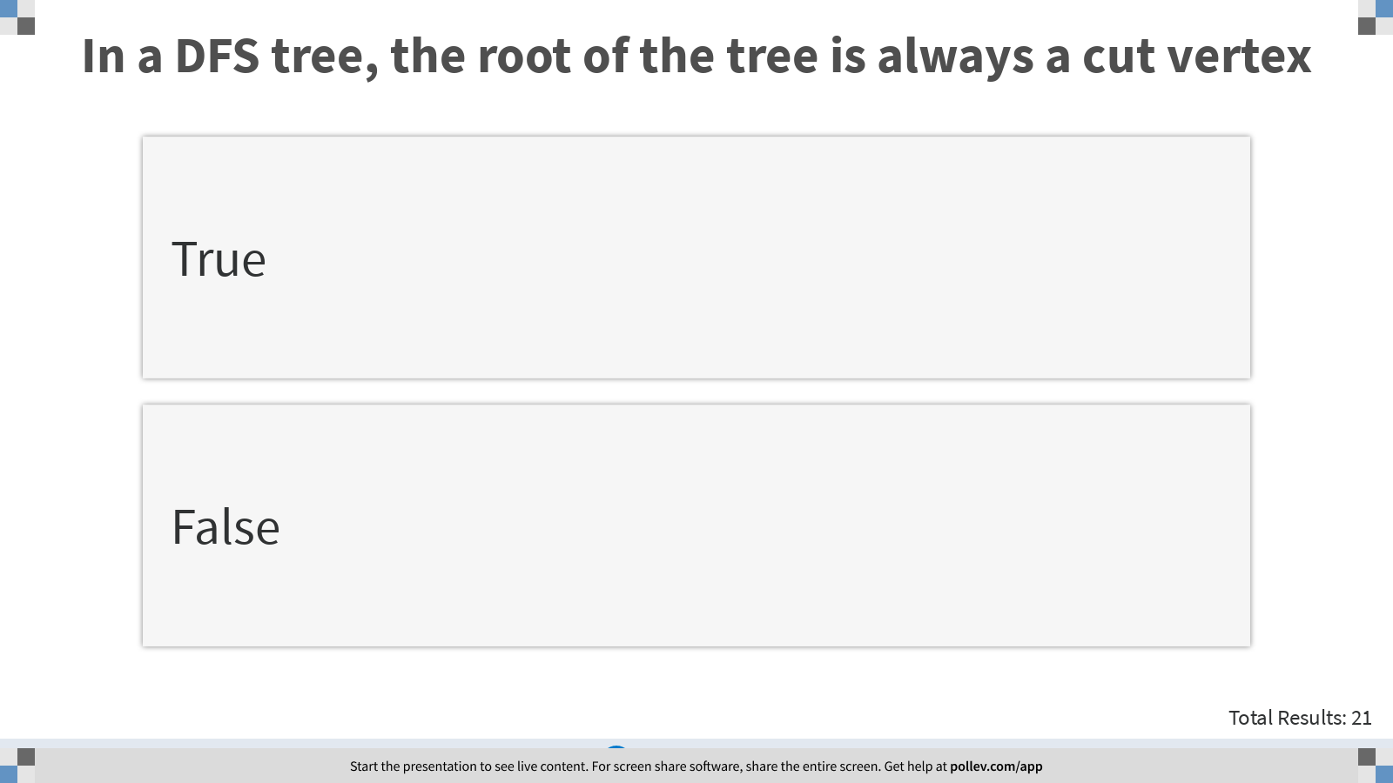
Notes:
In a DFS tree, the root of the tree is always a cut vertex
https://www.polleverywhere.com/multiple_choice_polls/srtoNiKAziLSN8ossOzYY?display_state=instructions&controls=none&onscreen=persist

Slide 7
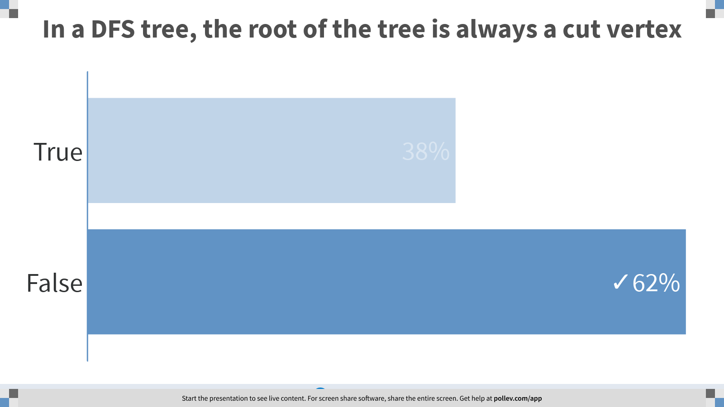
Notes:
In a DFS tree, the root of the tree is always a cut vertex
https://www.polleverywhere.com/multiple_choice_polls/srtoNiKAziLSN8ossOzYY?display_state=chart&display=correctness&controls=none&onscreen=persist

Slide 8
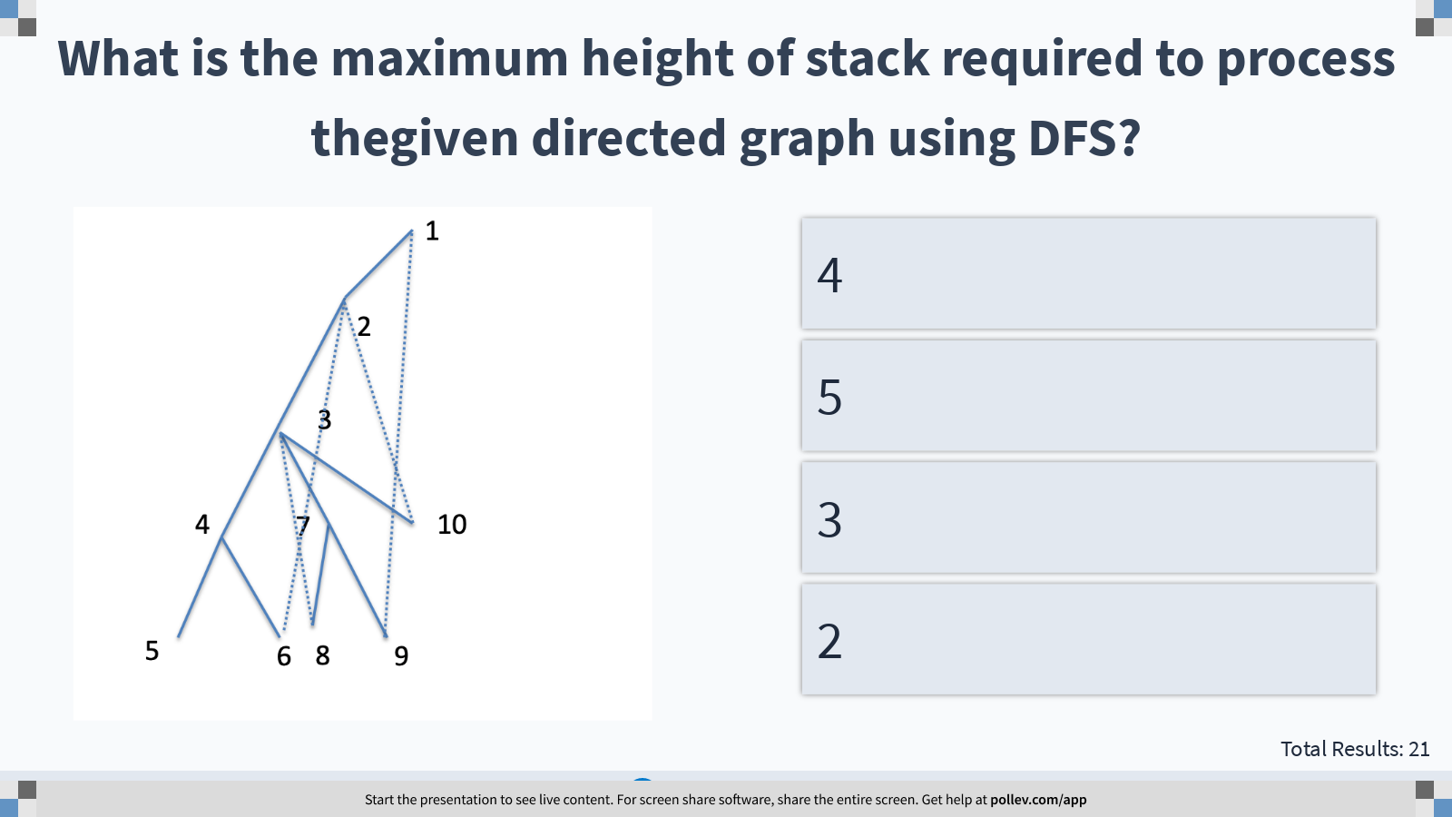
Notes:
What is the maximum height of stack required to process thegiven directed graph using DFS?
https://www.polleverywhere.com/multiple_choice_polls/tNsoNlmIFIOOwlPUepQwA?display_state=instructions&controls=none&onscreen=persist

Slide 9
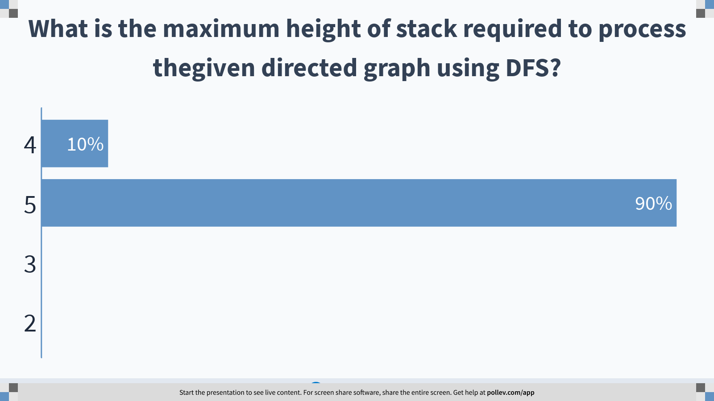
Notes:
What is the maximum height of stack required to process thegiven directed graph using DFS?
https://www.polleverywhere.com/multiple_choice_polls/tNsoNlmIFIOOwlPUepQwA?display_state=chart&display=correctness&controls=none&onscreen=persist

Slide 10
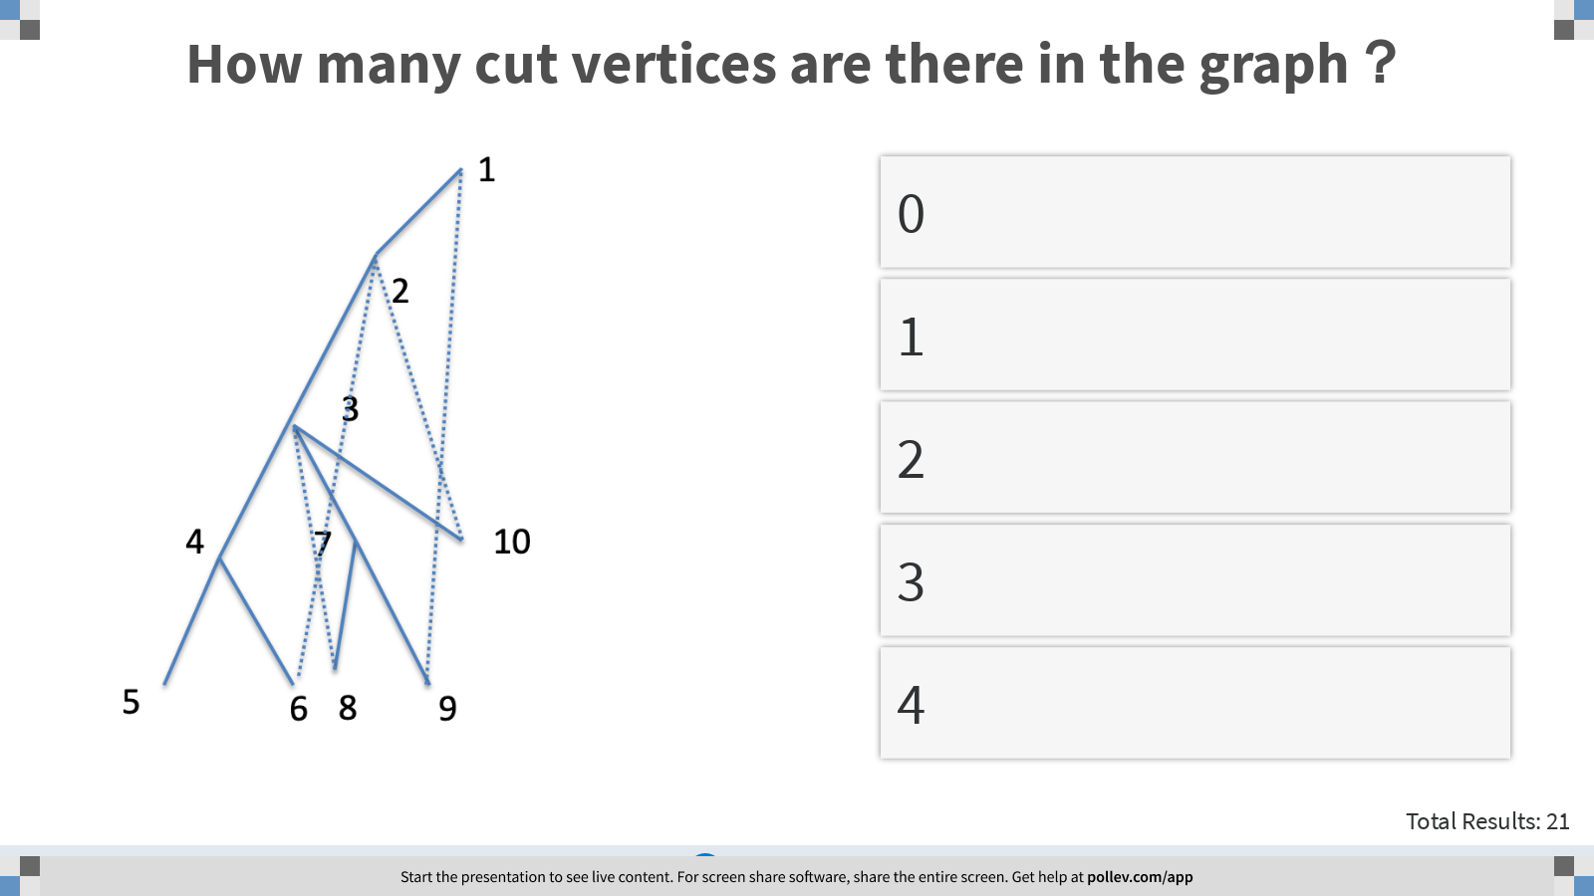
Notes:
How many cut vertices are there in the graph？
https://www.polleverywhere.com/multiple_choice_polls/WCgZs21pt8tbfe8sbqWy2?display_state=instructions&controls=none&onscreen=persist

Slide 11
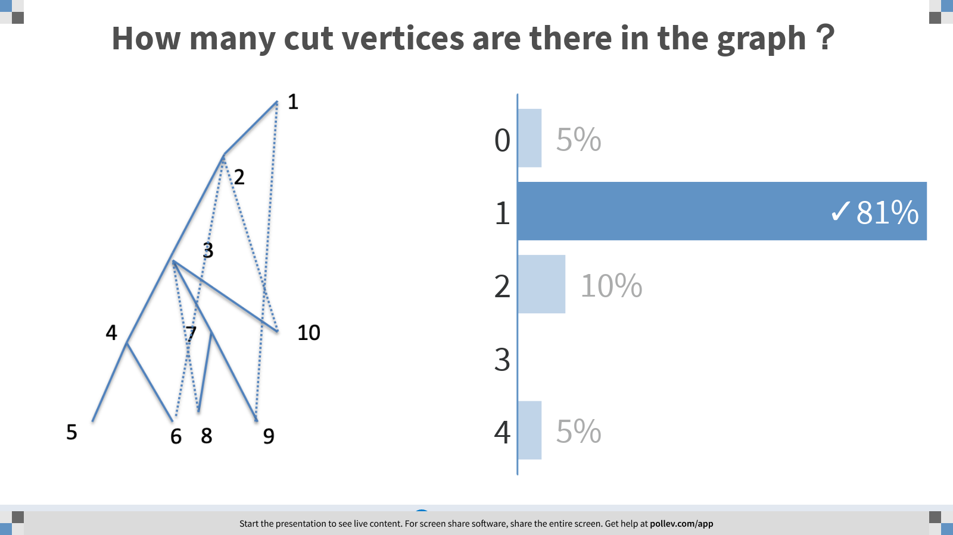
Notes:
How many cut vertices are there in the graph？
https://www.polleverywhere.com/multiple_choice_polls/WCgZs21pt8tbfe8sbqWy2?display_state=chart&display=correctness&controls=none&onscreen=persist

Slide 12
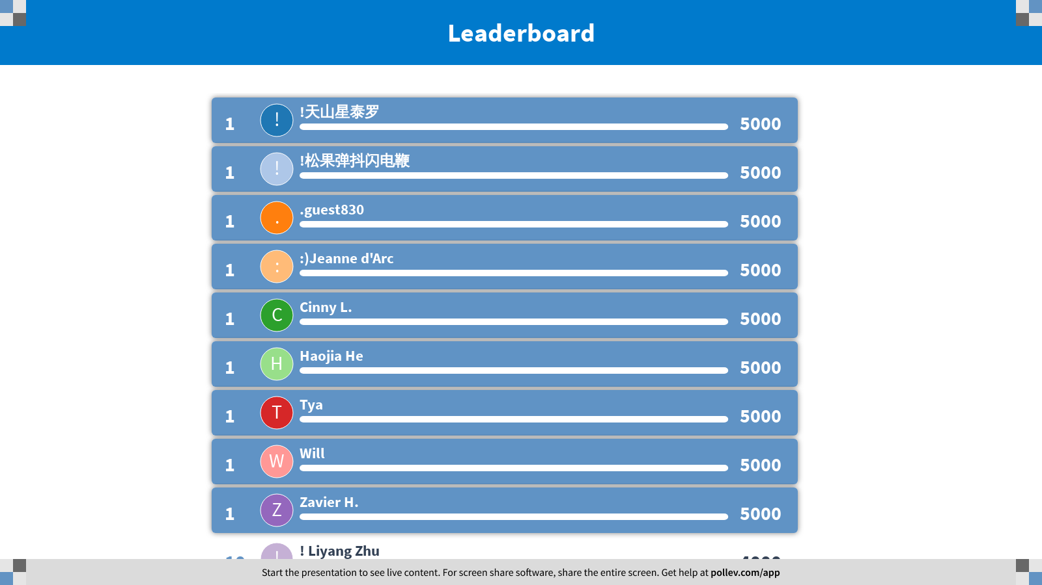
Notes:
DFS II
https://www.polleverywhere.com/competitions/GfdTyDTHpJRtY5bZ17n3N?display_state=finale&onscreen=persist

Slide 13

Notes:
Directed Graphs
https://www.polleverywhere.com/competitions/ZOpdMAaBpy6rEn8gtiIz9?display_state=welcome&controls=none&onscreen=persist

Slide 14
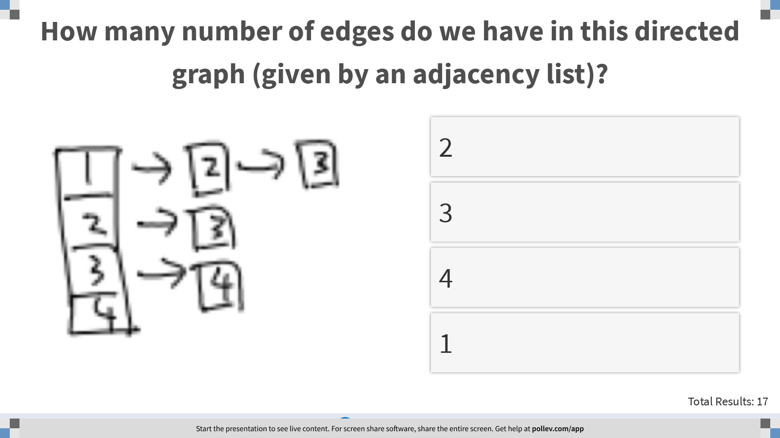
Notes:
How many number of edges do we have in this directed graph (given by an adjacency list)?
https://www.polleverywhere.com/multiple_choice_polls/AUklANju1zJwVS7syyvPI?display_state=instructions&controls=none&onscreen=persist

Slide 15
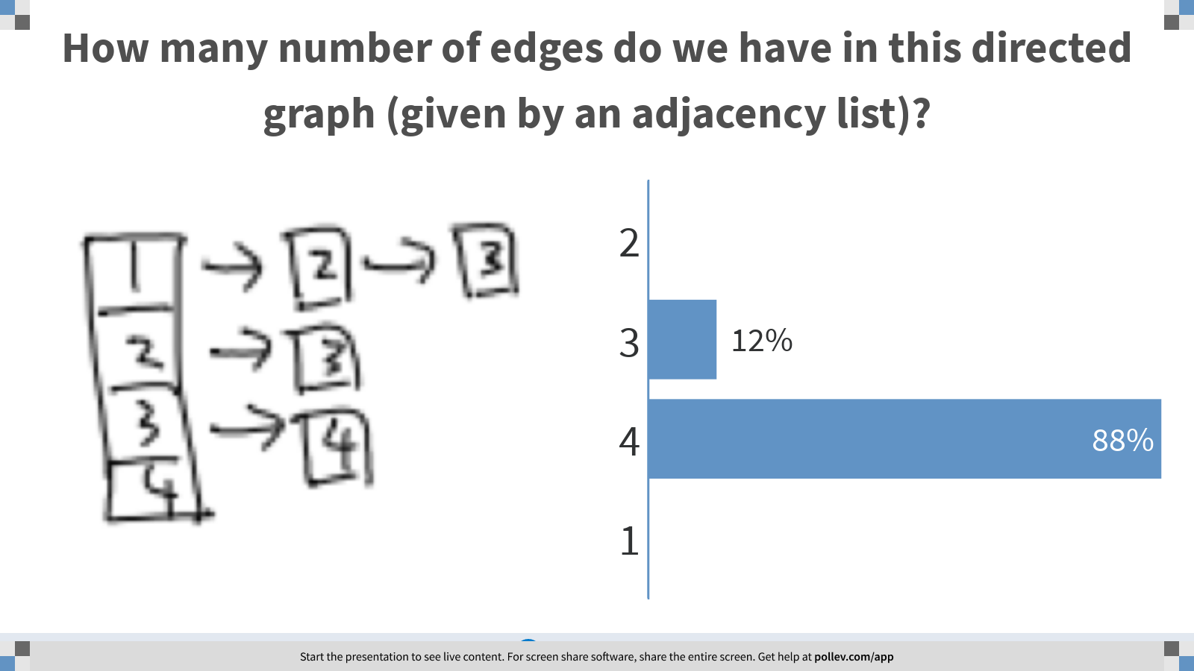
Notes:
How many number of edges do we have in this directed graph (given by an adjacency list)?
https://www.polleverywhere.com/multiple_choice_polls/AUklANju1zJwVS7syyvPI?display_state=chart&display=correctness&controls=none&onscreen=persist

Slide 16
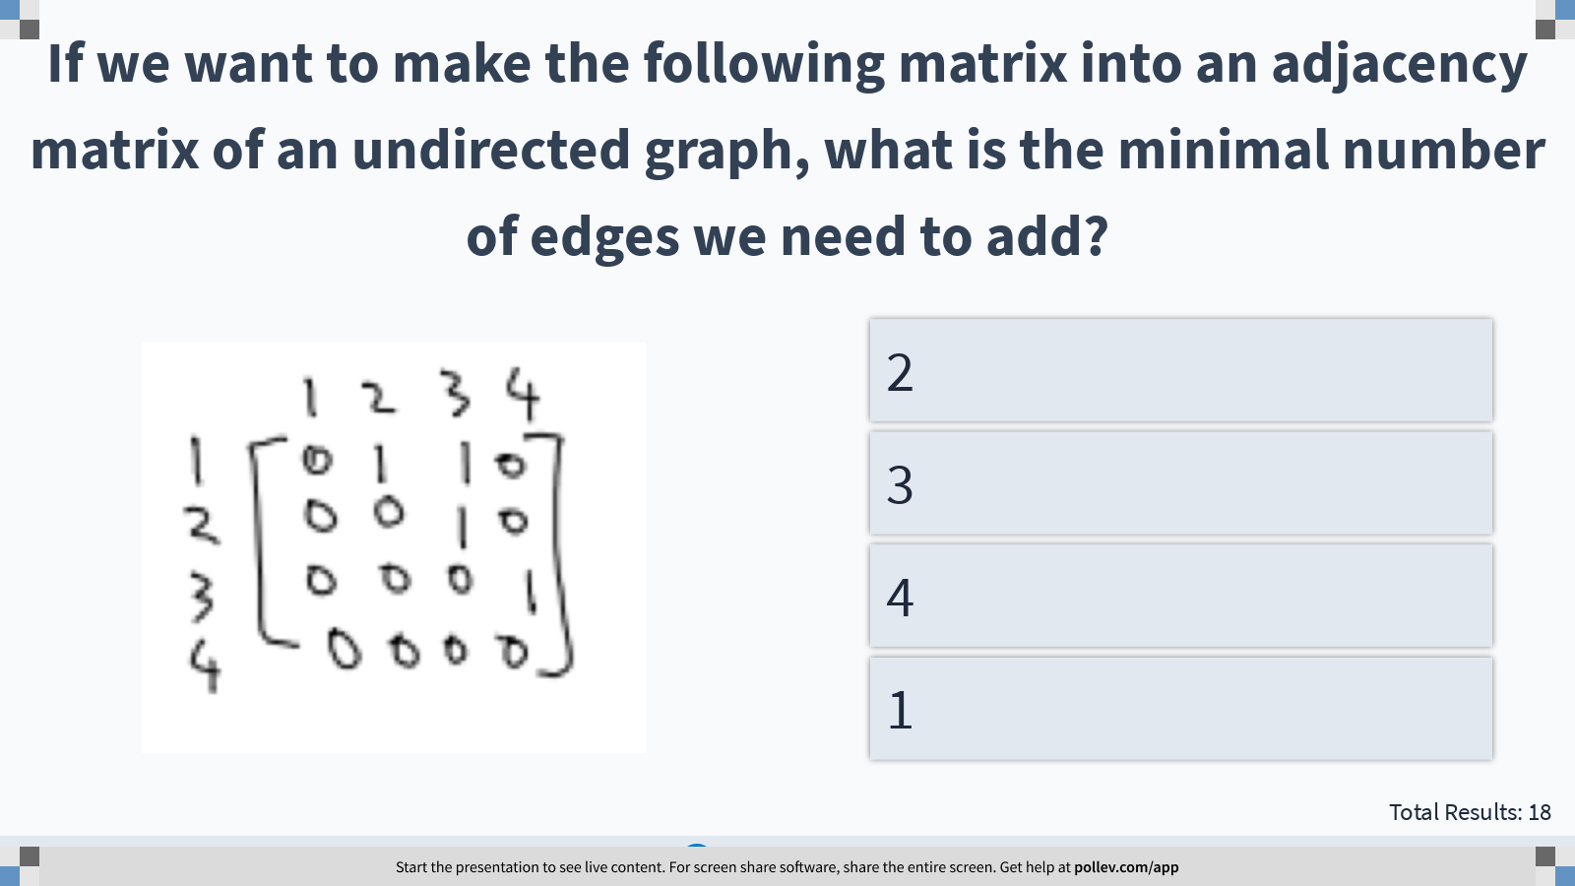
Notes:
If we want to make the following matrix into an adjacency matrix of an undirected graph, what is the minimal number of edges we need to add?
https://www.polleverywhere.com/multiple_choice_polls/FoXSIVOQDXUBuVF2A9KW6?display_state=instructions&controls=none&onscreen=persist

Slide 17
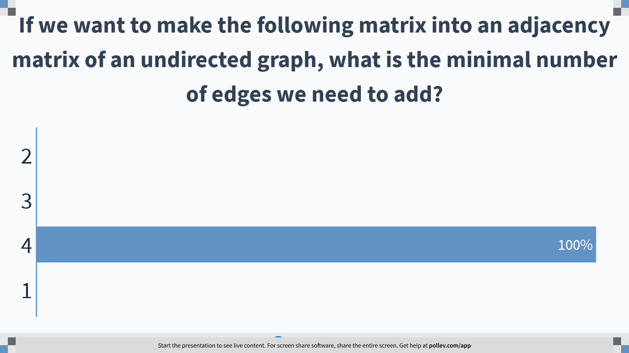
Notes:
If we want to make the following matrix into an adjacency matrix of an undirected graph, what is the minimal number of edges we need to add?
https://www.polleverywhere.com/multiple_choice_polls/FoXSIVOQDXUBuVF2A9KW6?display_state=chart&display=correctness&controls=none&onscreen=persist

Slide 18
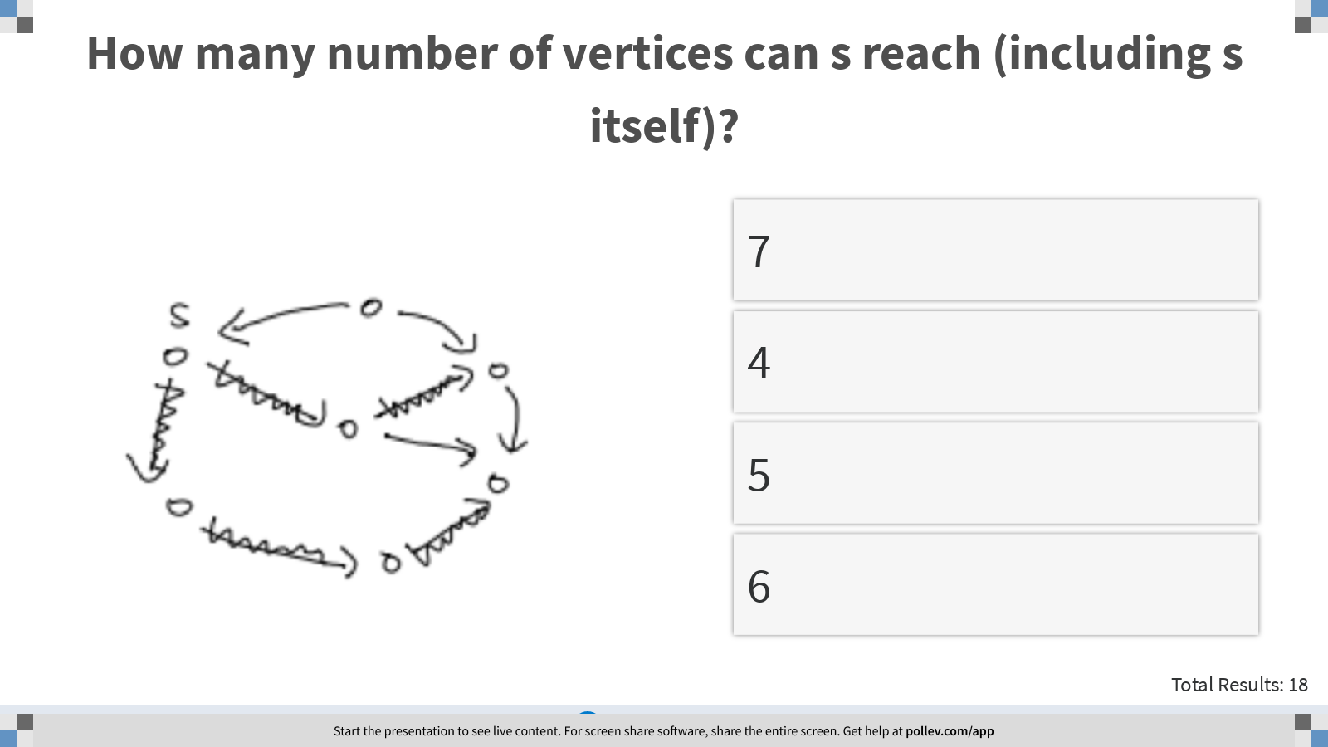
Notes:
How many number of vertices can s reach (including s itself)?
https://www.polleverywhere.com/multiple_choice_polls/ids1PjgRfb3aHYmRHoPXk?display_state=instructions&controls=none&onscreen=persist

Slide 19
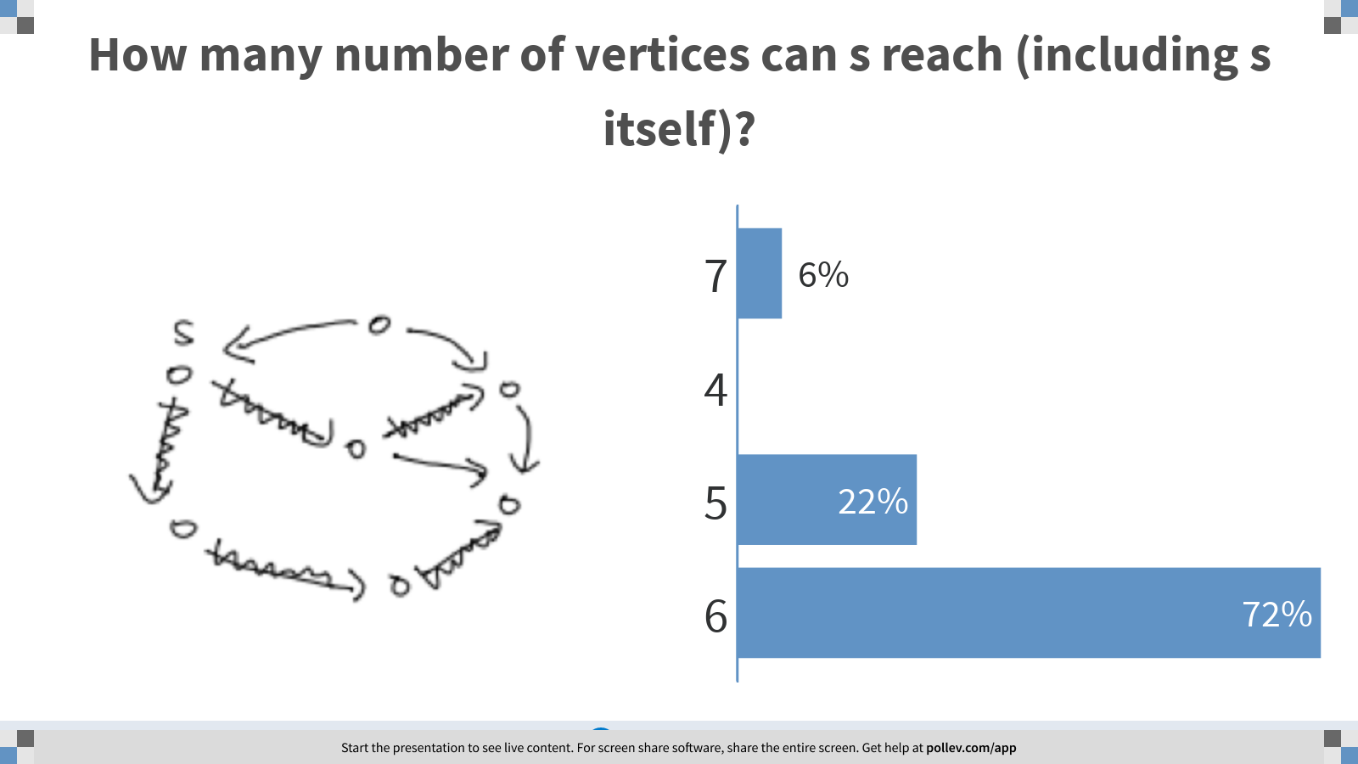
Notes:
How many number of vertices can s reach (including s itself)?
https://www.polleverywhere.com/multiple_choice_polls/ids1PjgRfb3aHYmRHoPXk?display_state=chart&display=correctness&controls=none&onscreen=persist

Slide 20
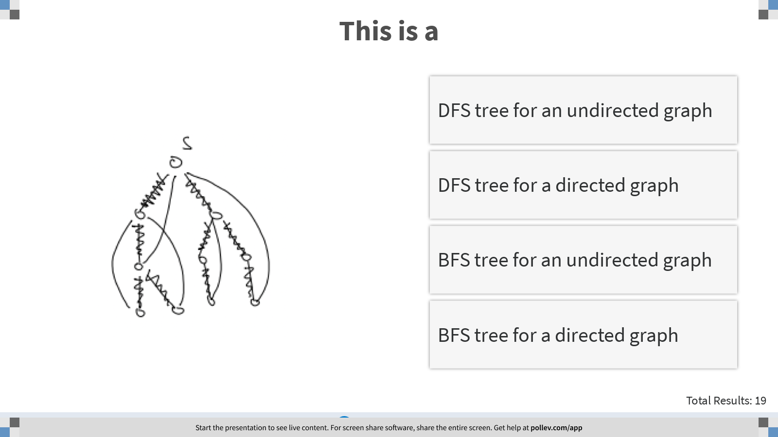
Notes:
This is a
https://www.polleverywhere.com/multiple_choice_polls/Z6sTZD38xrQHYVZ2vUu8q?display_state=instructions&controls=none&onscreen=persist

Slide 21
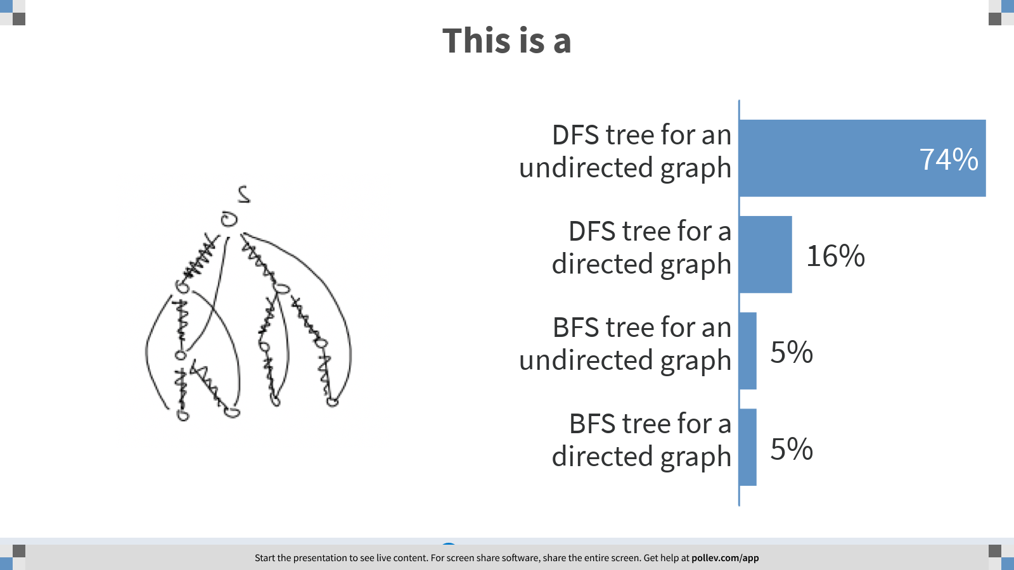
Notes:
This is a
https://www.polleverywhere.com/multiple_choice_polls/Z6sTZD38xrQHYVZ2vUu8q?display_state=chart&display=correctness&controls=none&onscreen=persist

Slide 22
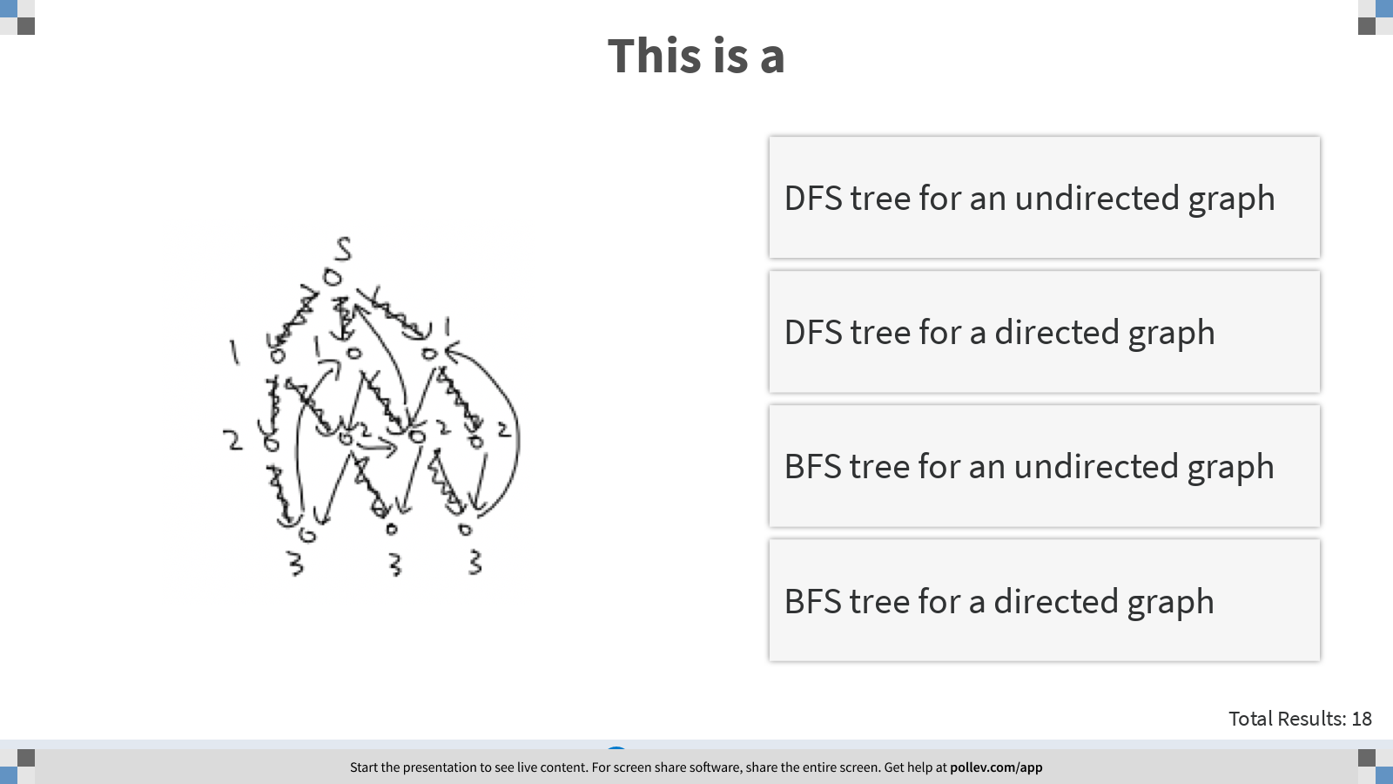
Notes:
This is a
https://www.polleverywhere.com/multiple_choice_polls/Jqk4ay2ZPRx5mEK4mccQs?display_state=instructions&controls=none&onscreen=persist

Slide 23
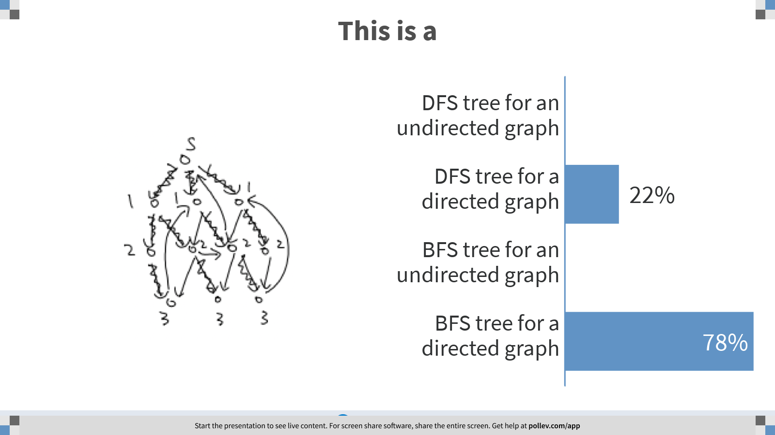
Notes:
This is a
https://www.polleverywhere.com/multiple_choice_polls/Jqk4ay2ZPRx5mEK4mccQs?display_state=chart&display=correctness&controls=none&onscreen=persist

Slide 24
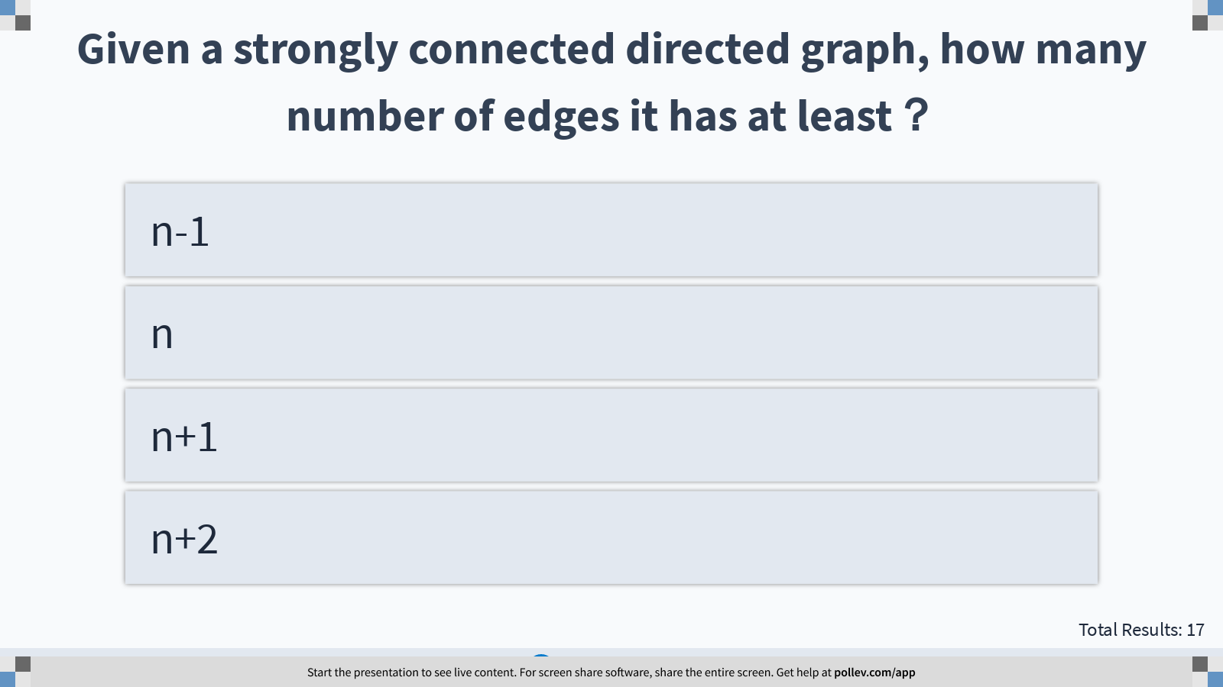
Notes:
Given a strongly connected directed graph, how many number of edges it has at least？
https://www.polleverywhere.com/multiple_choice_polls/dSt2geSzA5pdg18NISVib?display_state=instructions&controls=none&onscreen=persist

Slide 25
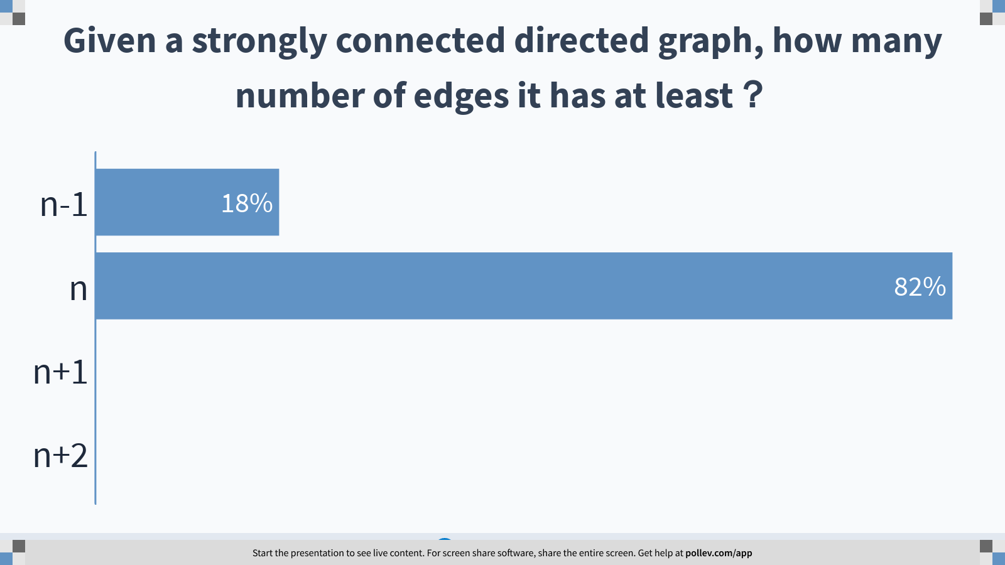
Notes:
Given a strongly connected directed graph, how many number of edges it has at least？
https://www.polleverywhere.com/multiple_choice_polls/dSt2geSzA5pdg18NISVib?display_state=chart&display=correctness&controls=none&onscreen=persist

Slide 26
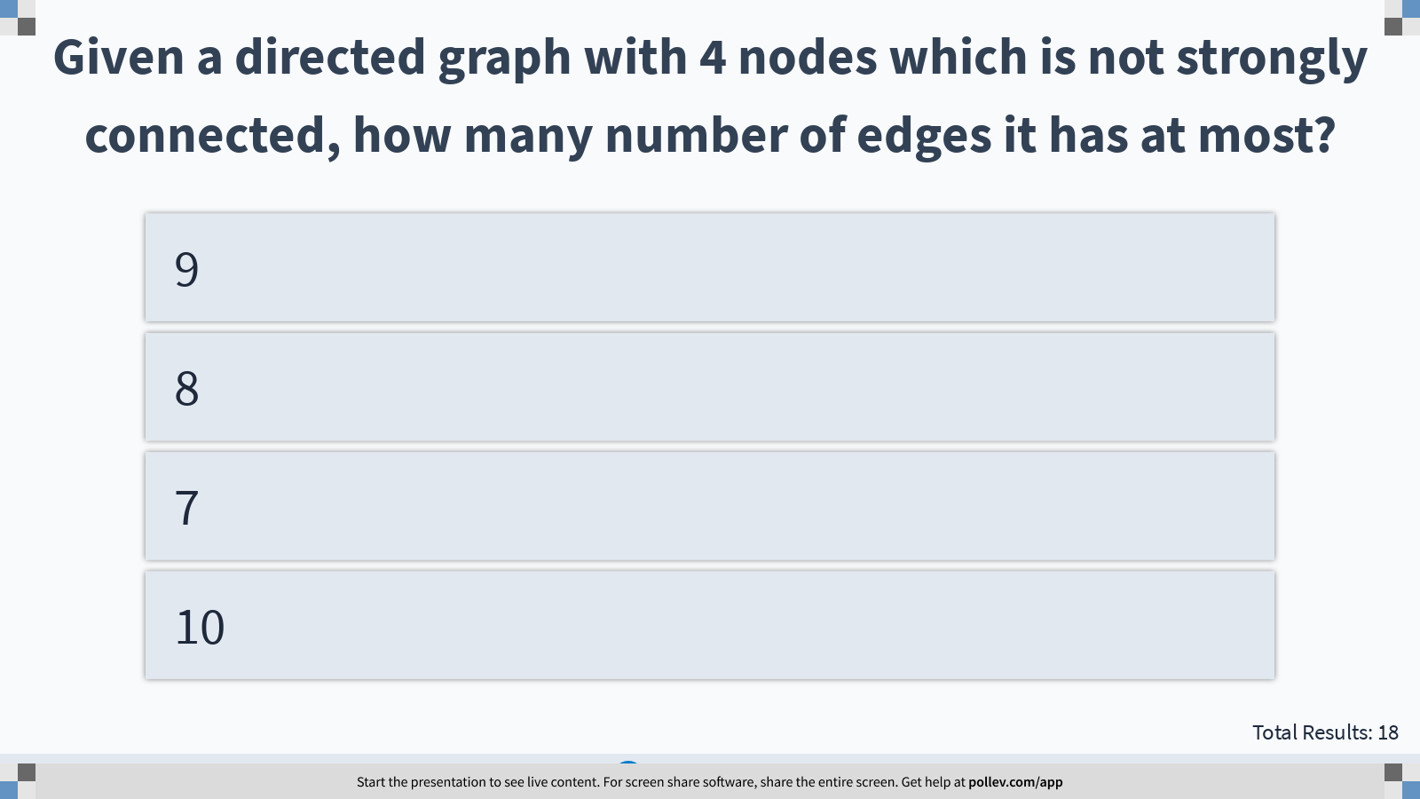
Notes:
Given a directed graph with 4 nodes which is not strongly connected, how many number of edges it has at most?
https://www.polleverywhere.com/multiple_choice_polls/PQDRboHD6Efy0sEjFPuyI?display_state=instructions&controls=none&onscreen=persist

Slide 27
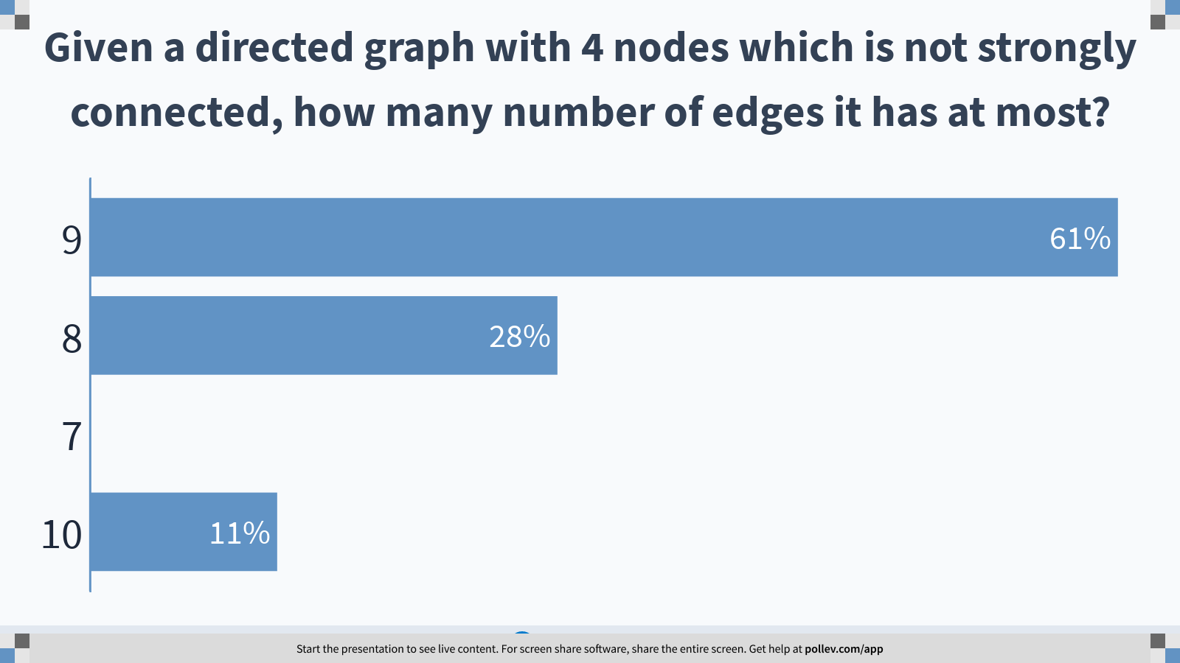
Notes:
Given a directed graph with 4 nodes which is not strongly connected, how many number of edges it has at most?
https://www.polleverywhere.com/multiple_choice_polls/PQDRboHD6Efy0sEjFPuyI?display_state=chart&display=correctness&controls=none&onscreen=persist

Slide 28
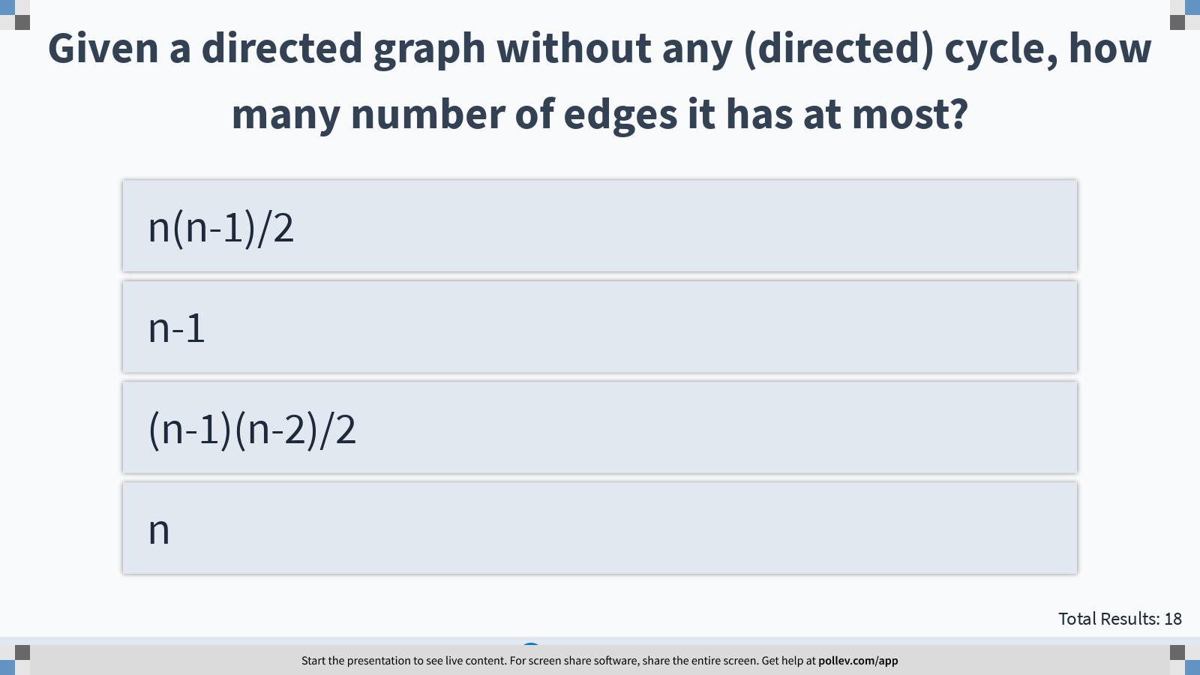
Notes:
Given a directed graph without any (directed) cycle, how many number of edges it has at most?
https://www.polleverywhere.com/multiple_choice_polls/vE6EmxSuEIVMPMYDhMCUj?display_state=instructions&controls=none&onscreen=persist

Slide 29
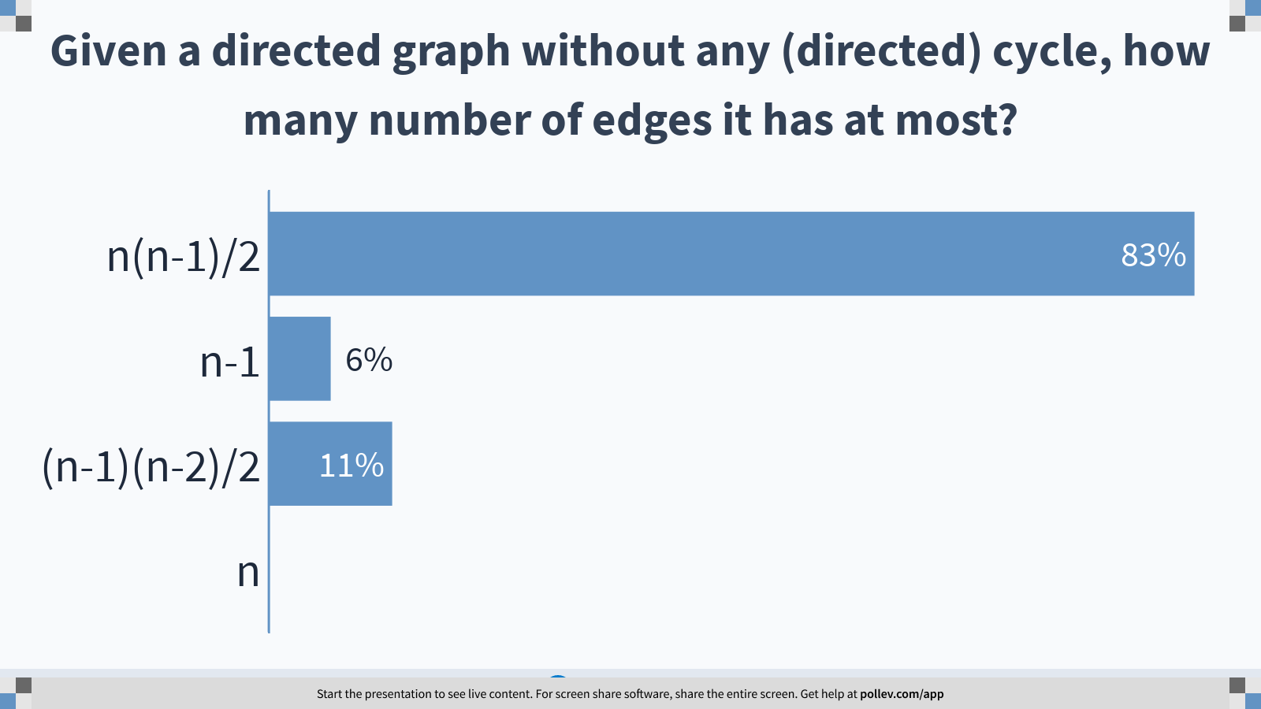
Notes:
Given a directed graph without any (directed) cycle, how many number of edges it has at most?
https://www.polleverywhere.com/multiple_choice_polls/vE6EmxSuEIVMPMYDhMCUj?display_state=chart&display=correctness&controls=none&onscreen=persist

Slide 30
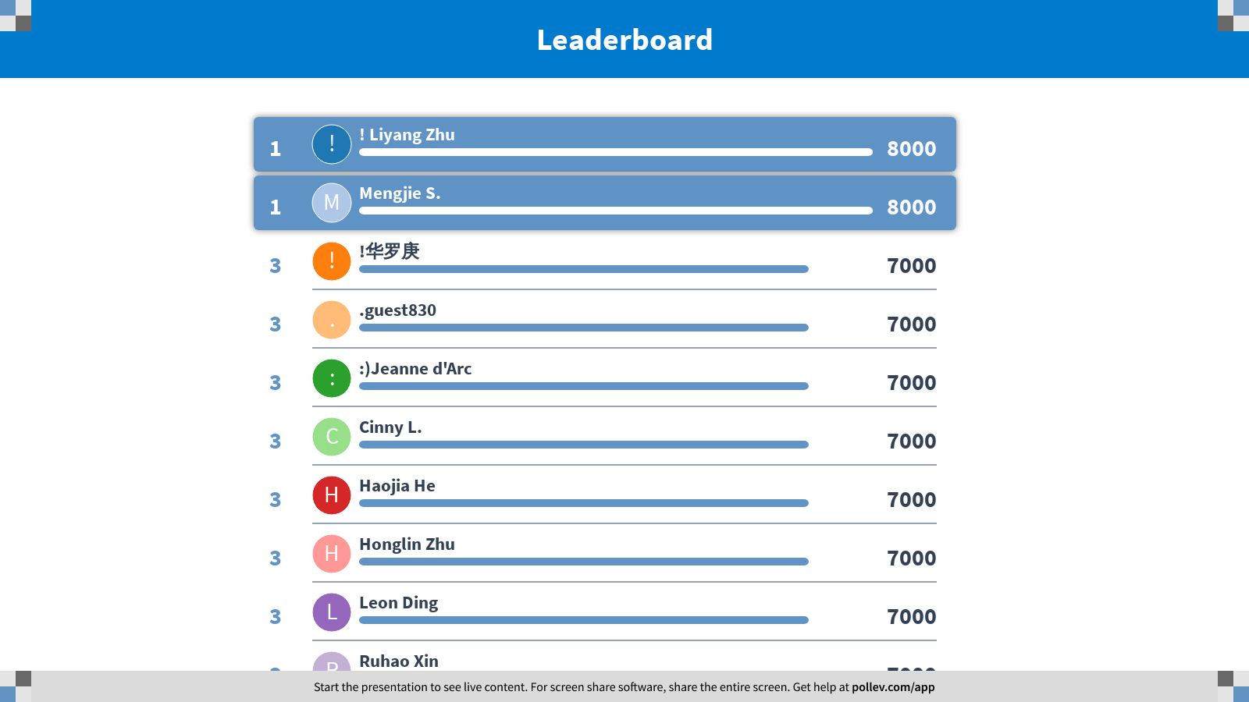
Notes:
Directed Graphs
https://www.polleverywhere.com/competitions/ZOpdMAaBpy6rEn8gtiIz9?display_state=finale&onscreen=persist

