Slide 1

Notes:
Topological Ordering
https://www.polleverywhere.com/competitions/J3TRHbP5vSulsZsUlR1Is?display_state=welcome&controls=none&onscreen=persist

Slide 2
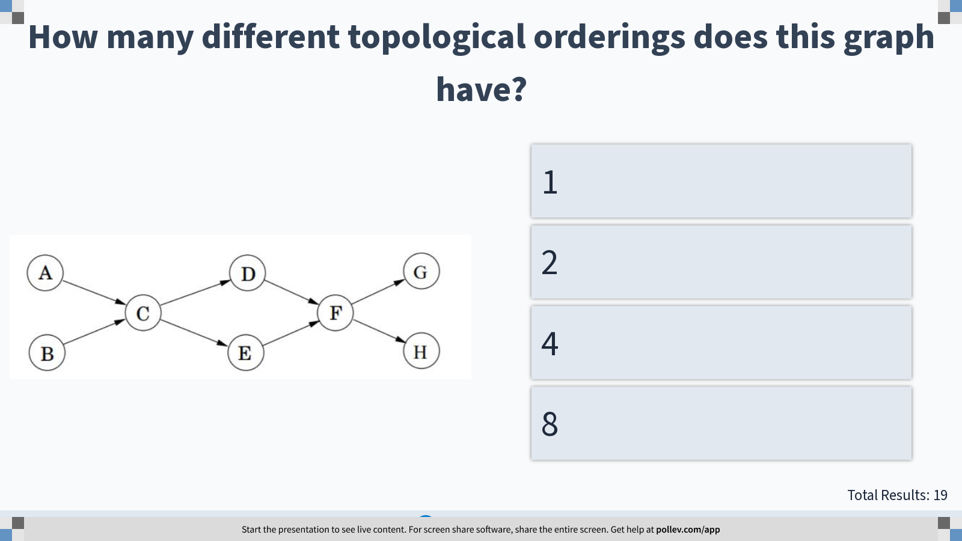
Notes:
How many different topological orderings does this graph have?
https://www.polleverywhere.com/multiple_choice_polls/ATtmMiyFlMxG8Nkr5aFgO?display_state=instructions&controls=none&onscreen=persist

Slide 3
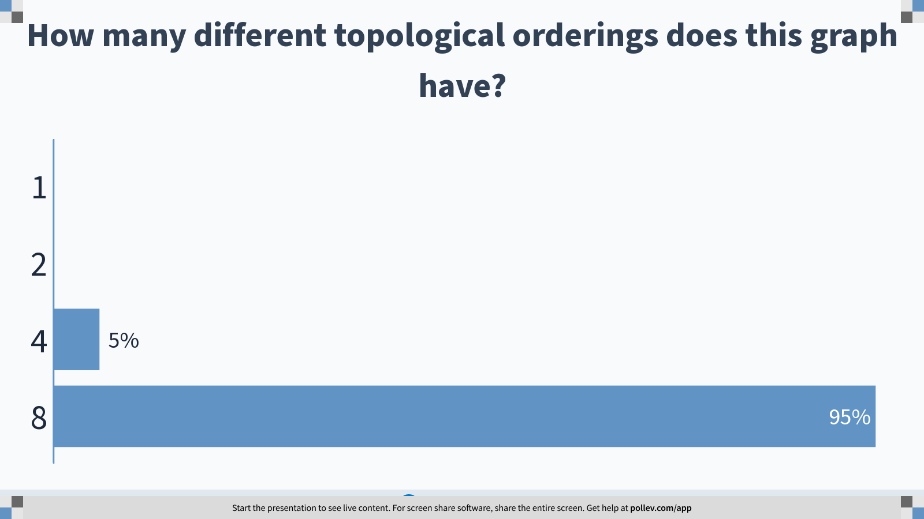
Notes:
How many different topological orderings does this graph have?
https://www.polleverywhere.com/multiple_choice_polls/ATtmMiyFlMxG8Nkr5aFgO?display_state=chart&display=correctness&controls=none&onscreen=persist

Slide 4
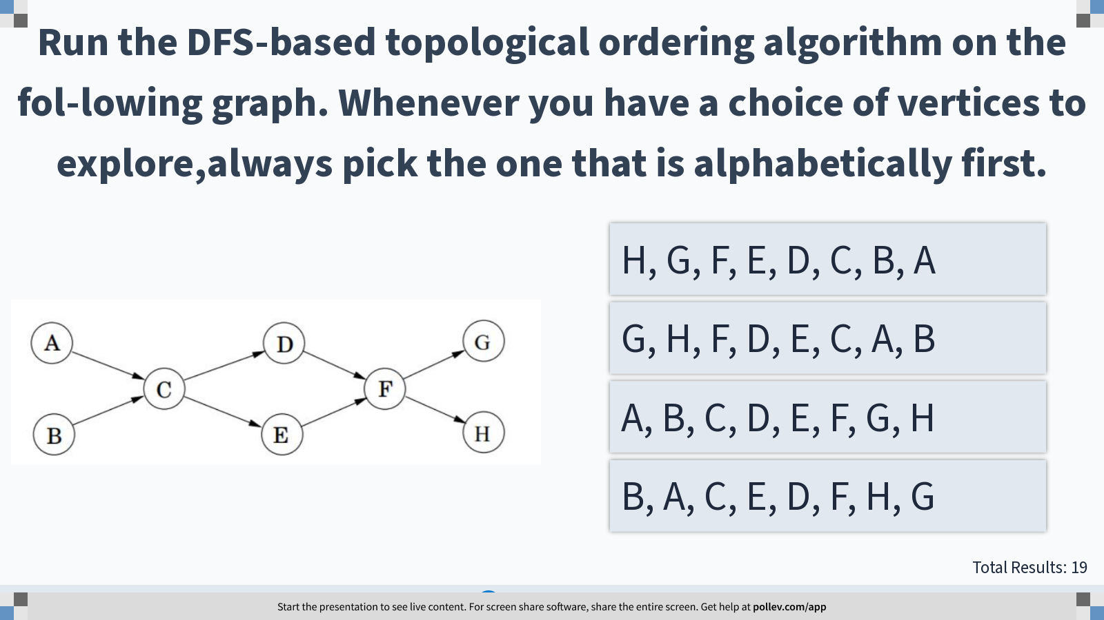
Notes:
Run the DFS-based topological ordering algorithm on the fol-lowing graph. Whenever you have a choice of vertices to explore,always pick the one that is alphabetically first.
https://www.polleverywhere.com/multiple_choice_polls/PUkdu9ZrSEvcSbKC5aRnR?display_state=instructions&controls=none&onscreen=persist

Slide 5
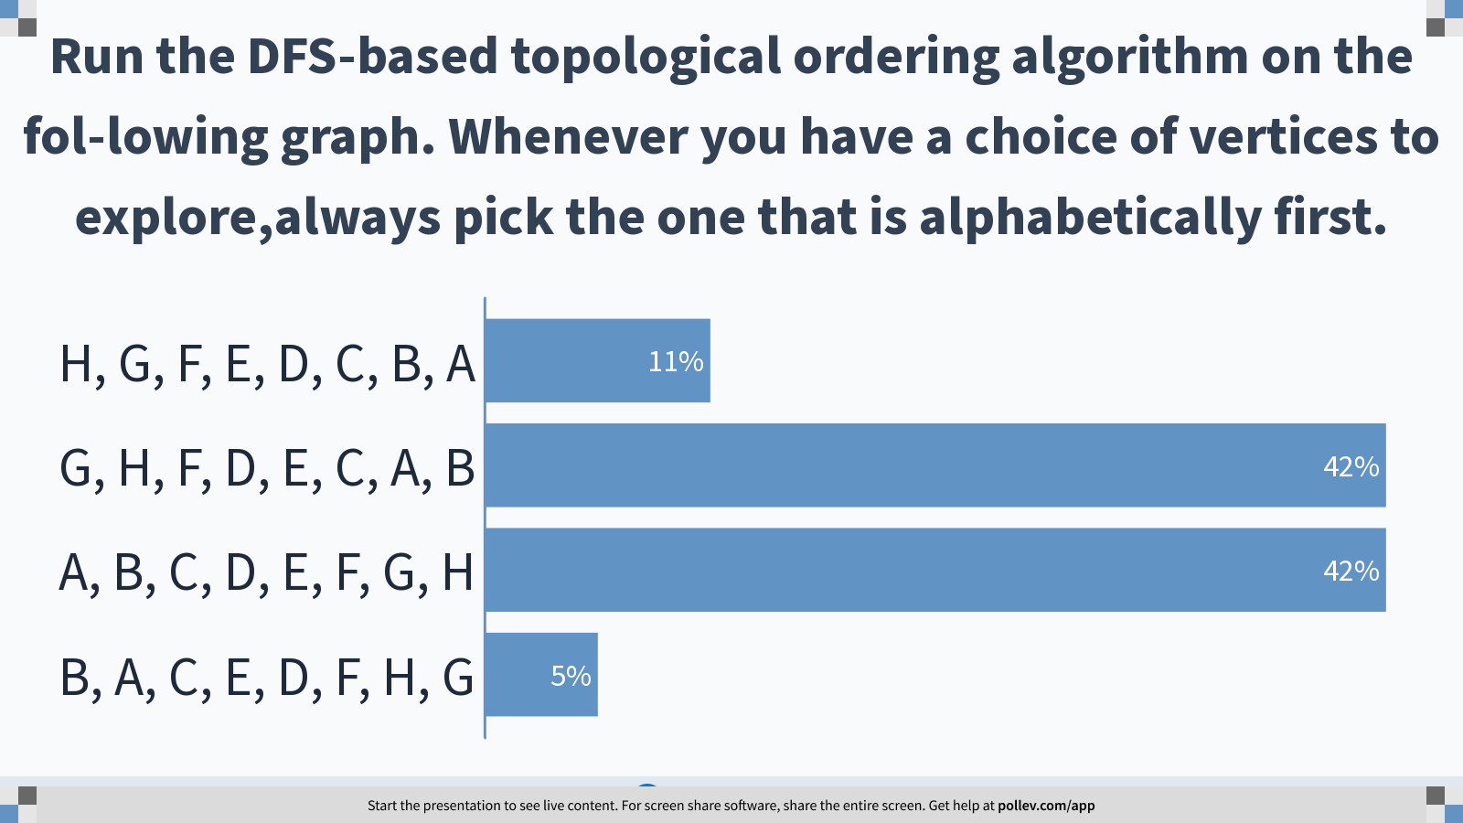
Notes:
Run the DFS-based topological ordering algorithm on the fol-lowing graph. Whenever you have a choice of vertices to explore,always pick the one that is alphabetically first.
https://www.polleverywhere.com/multiple_choice_polls/PUkdu9ZrSEvcSbKC5aRnR?display_state=chart&display=correctness&controls=none&onscreen=persist

Slide 6
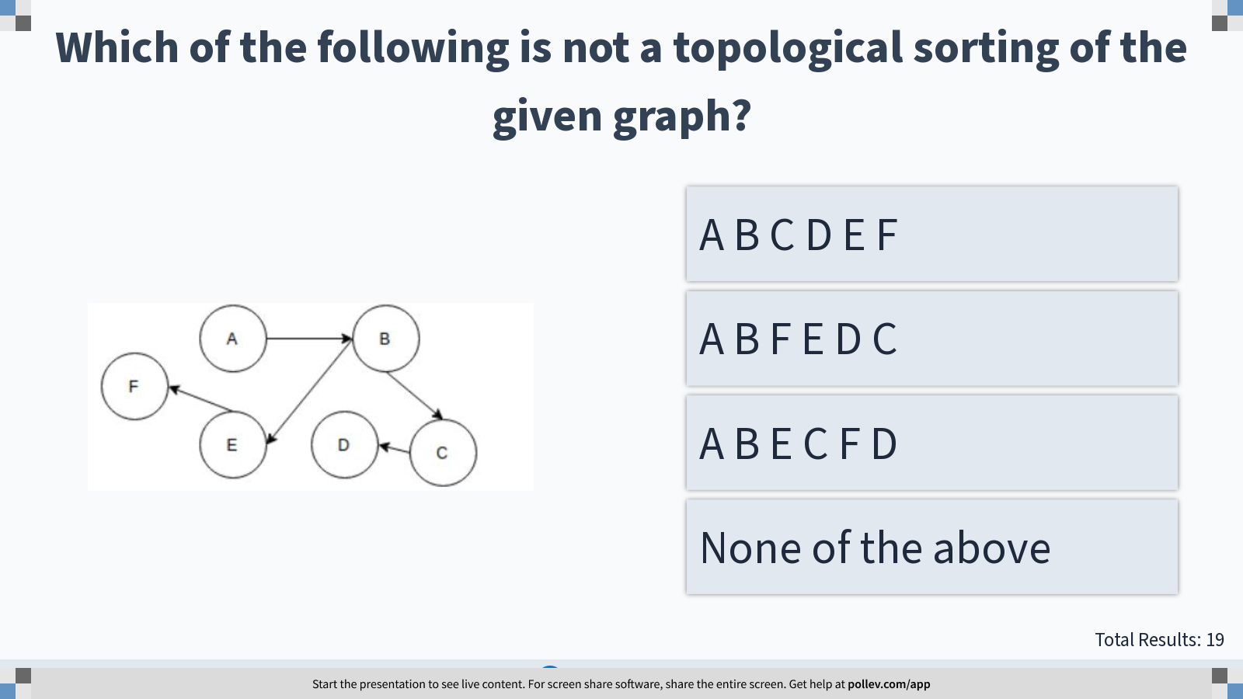
Notes:
Which of the following is not a topological sorting of the given graph?
https://www.polleverywhere.com/multiple_choice_polls/LvvA7gcaS8UP6QdBLdAlk?display_state=instructions&controls=none&onscreen=persist

Slide 7
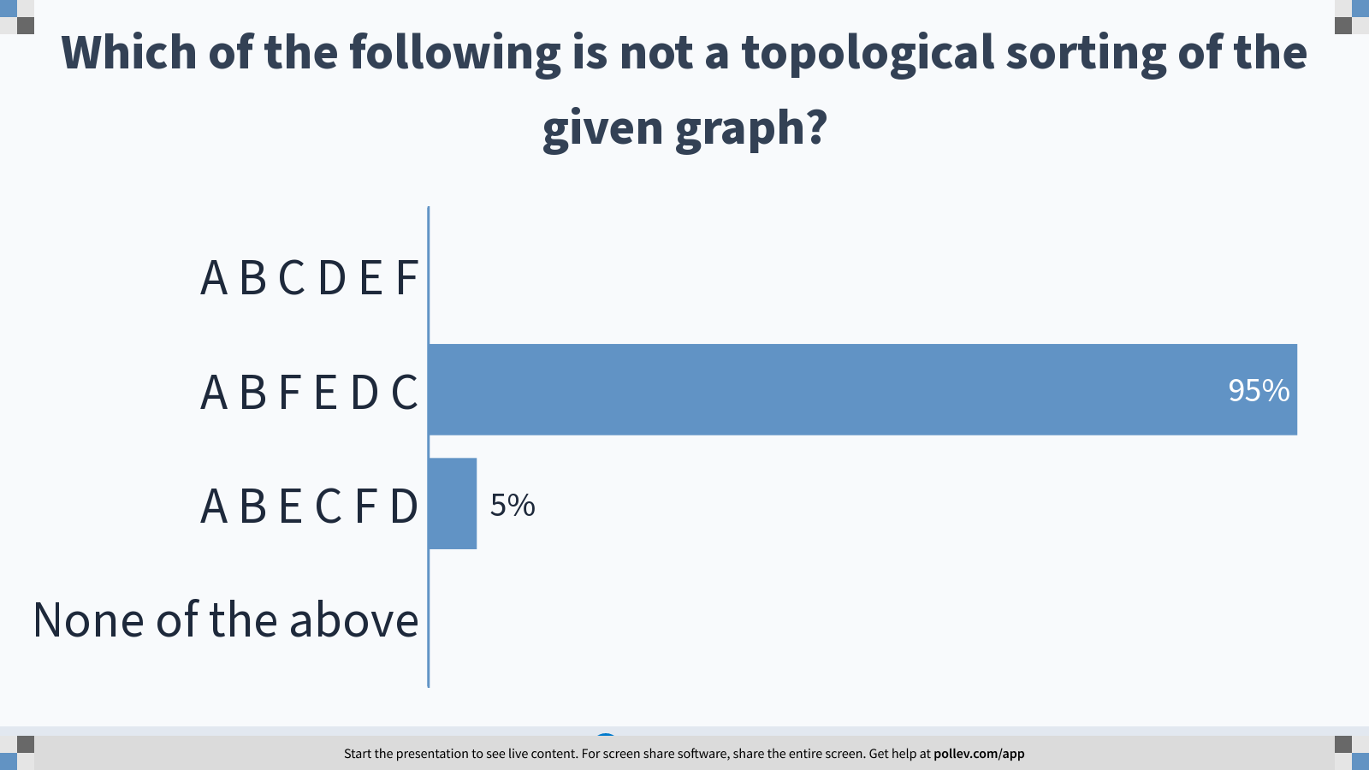
Notes:
Which of the following is not a topological sorting of the given graph?
https://www.polleverywhere.com/multiple_choice_polls/LvvA7gcaS8UP6QdBLdAlk?display_state=chart&display=correctness&controls=none&onscreen=persist

Slide 8
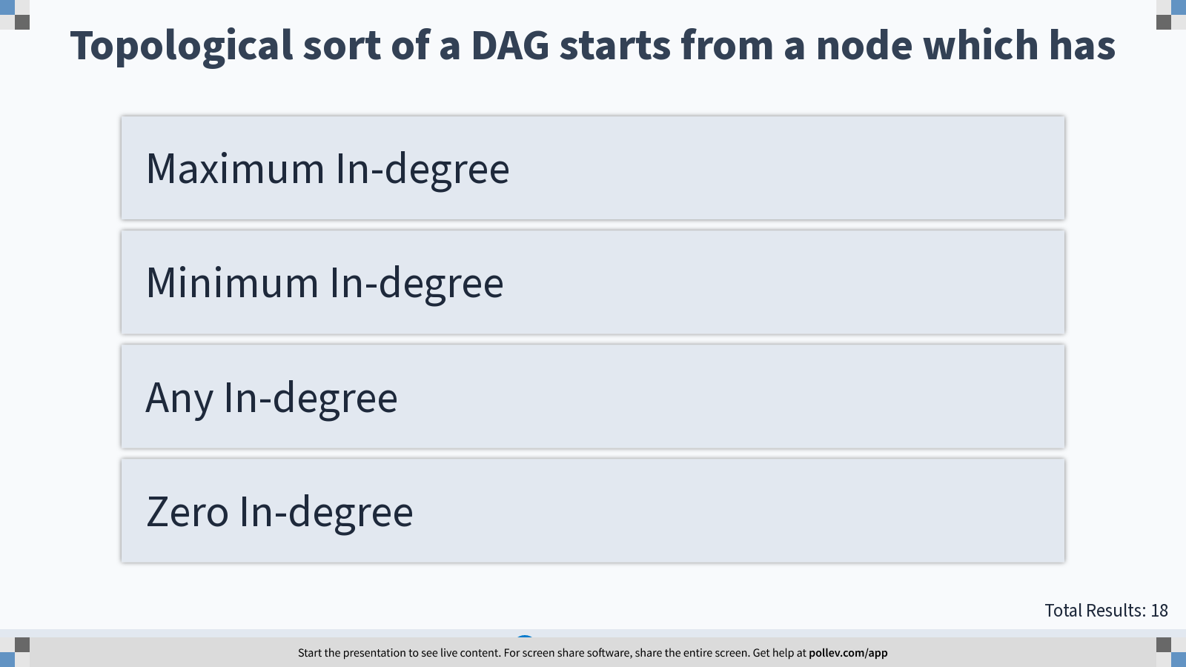
Notes:
Topological sort of a DAG starts from a node which has
https://www.polleverywhere.com/multiple_choice_polls/a2Fq9kKhQ0UyuBltHfnFU?display_state=instructions&controls=none&onscreen=persist

Slide 9
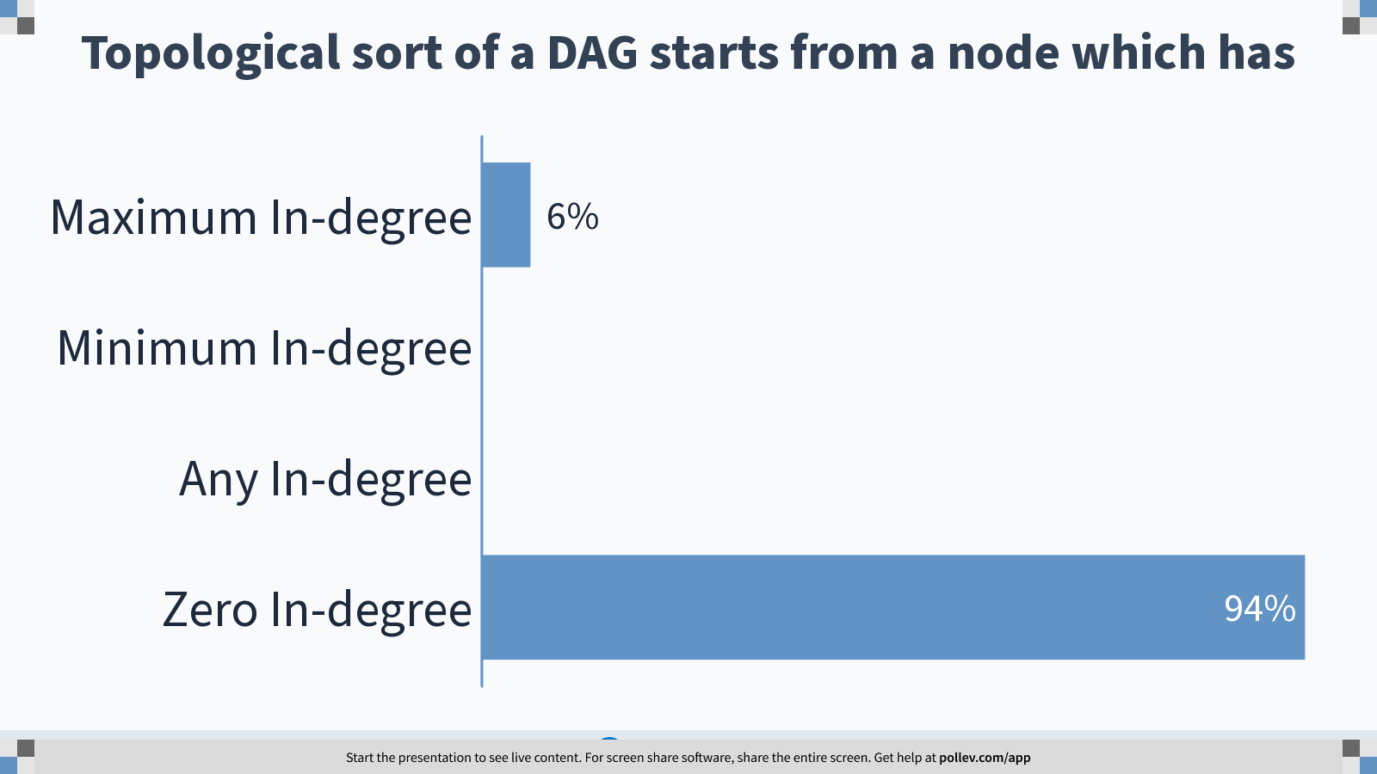
Notes:
Topological sort of a DAG starts from a node which has
https://www.polleverywhere.com/multiple_choice_polls/a2Fq9kKhQ0UyuBltHfnFU?display_state=chart&display=correctness&controls=none&onscreen=persist

Slide 10
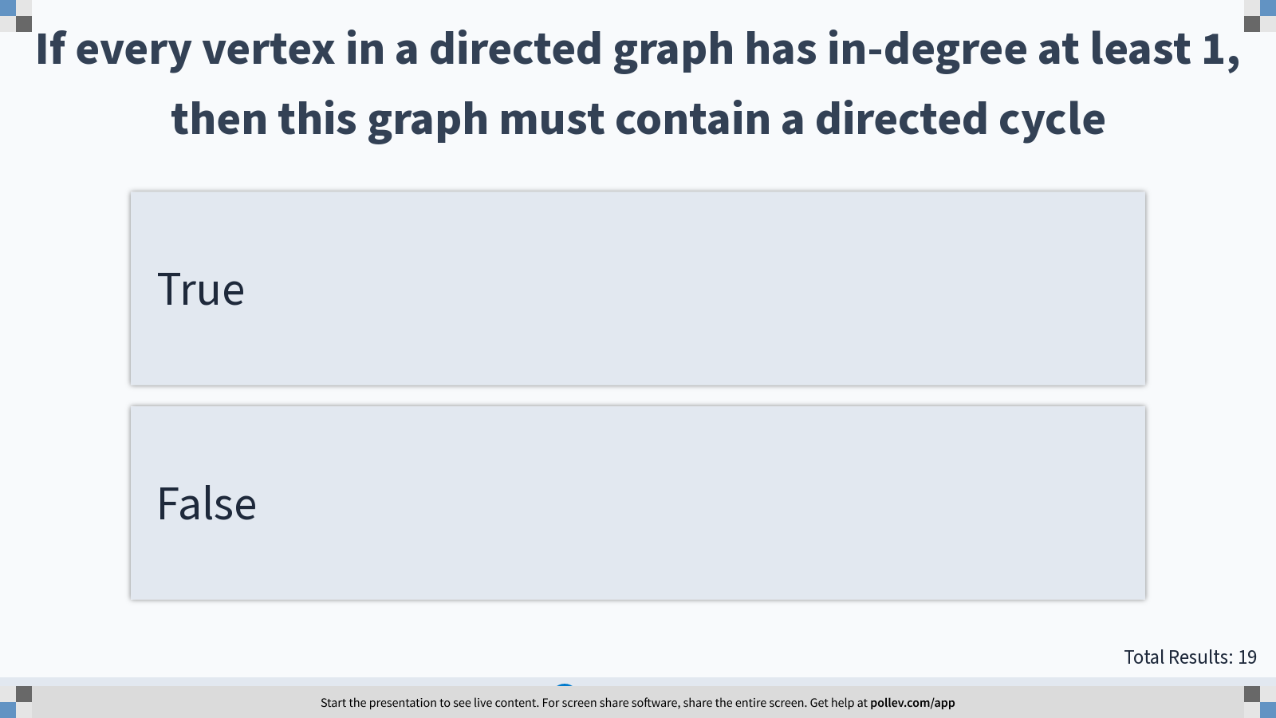
Notes:
If every vertex in a directed graph has in-degree at least 1, then this graph must contain a directed cycle
https://www.polleverywhere.com/multiple_choice_polls/Mr3gacFx4nQKE5e21AqrD?display_state=instructions&controls=none&onscreen=persist

Slide 11
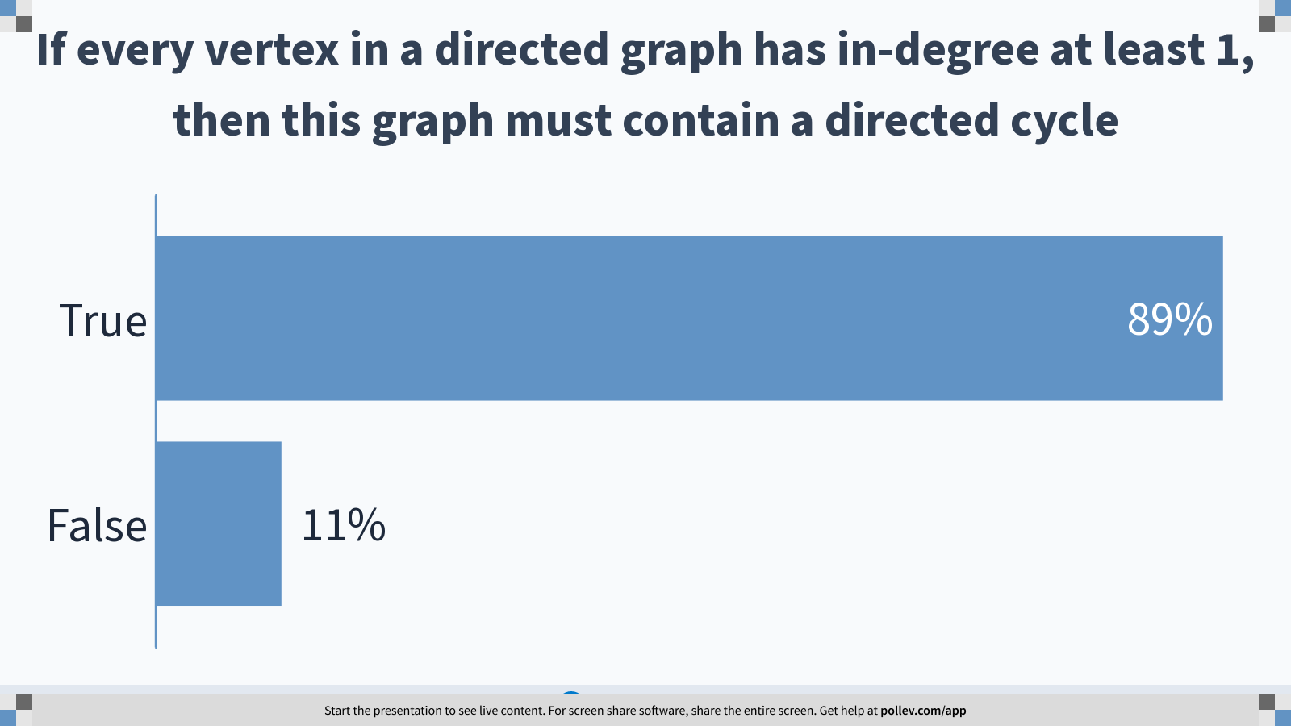
Notes:
If every vertex in a directed graph has in-degree at least 1, then this graph must contain a directed cycle
https://www.polleverywhere.com/multiple_choice_polls/Mr3gacFx4nQKE5e21AqrD?display_state=chart&display=correctness&controls=none&onscreen=persist

Slide 12
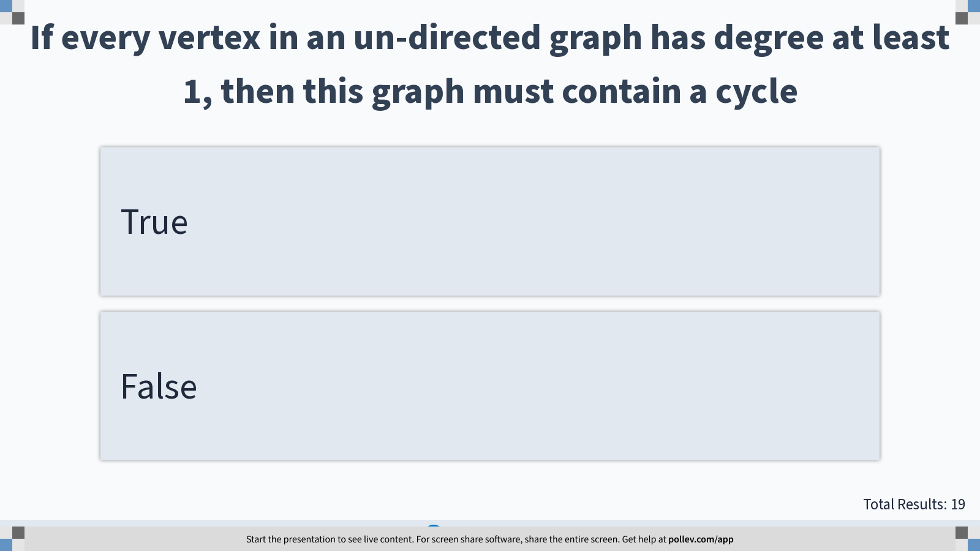
Notes:
If every vertex in an un-directed graph has degree at least 1, then this graph must contain a cycle
https://www.polleverywhere.com/multiple_choice_polls/ptnqbnw0LeWpmEkIZSfzv?display_state=instructions&controls=none&onscreen=persist

Slide 13
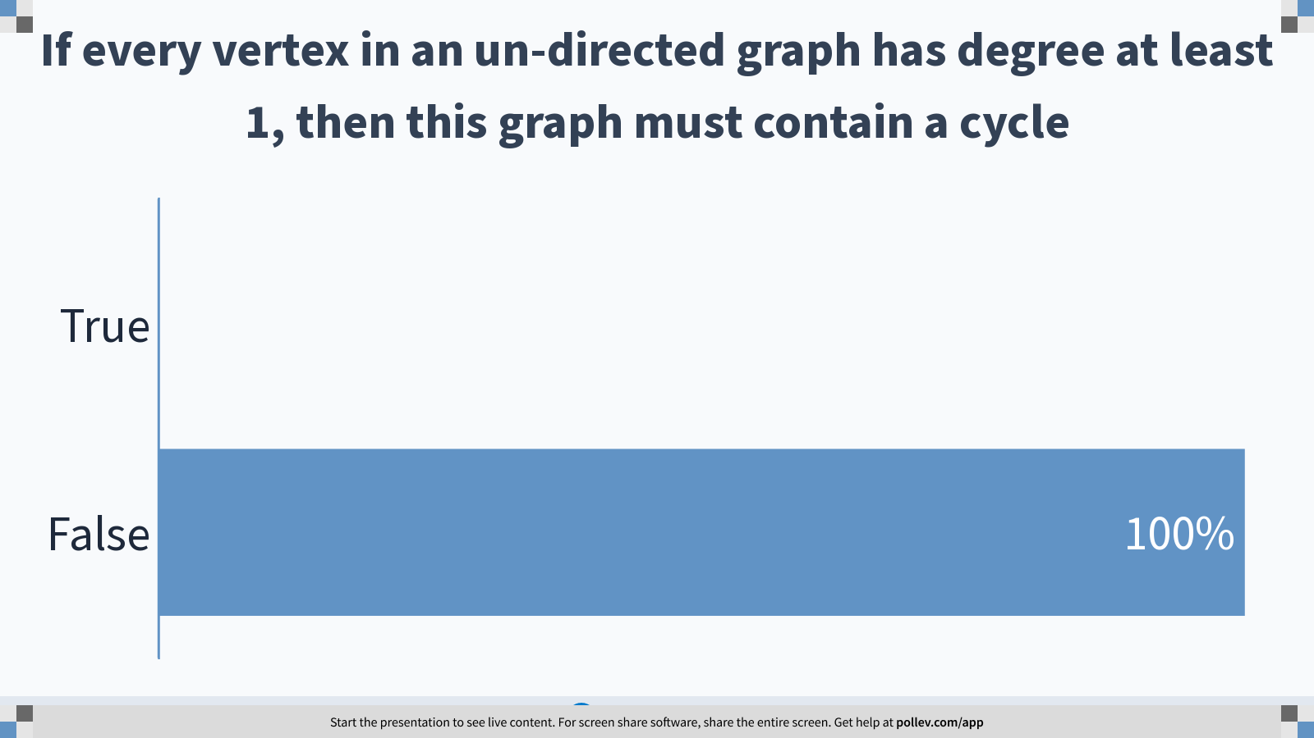
Notes:
If every vertex in an un-directed graph has degree at least 1, then this graph must contain a cycle
https://www.polleverywhere.com/multiple_choice_polls/ptnqbnw0LeWpmEkIZSfzv?display_state=chart&display=correctness&controls=none&onscreen=persist

Slide 14
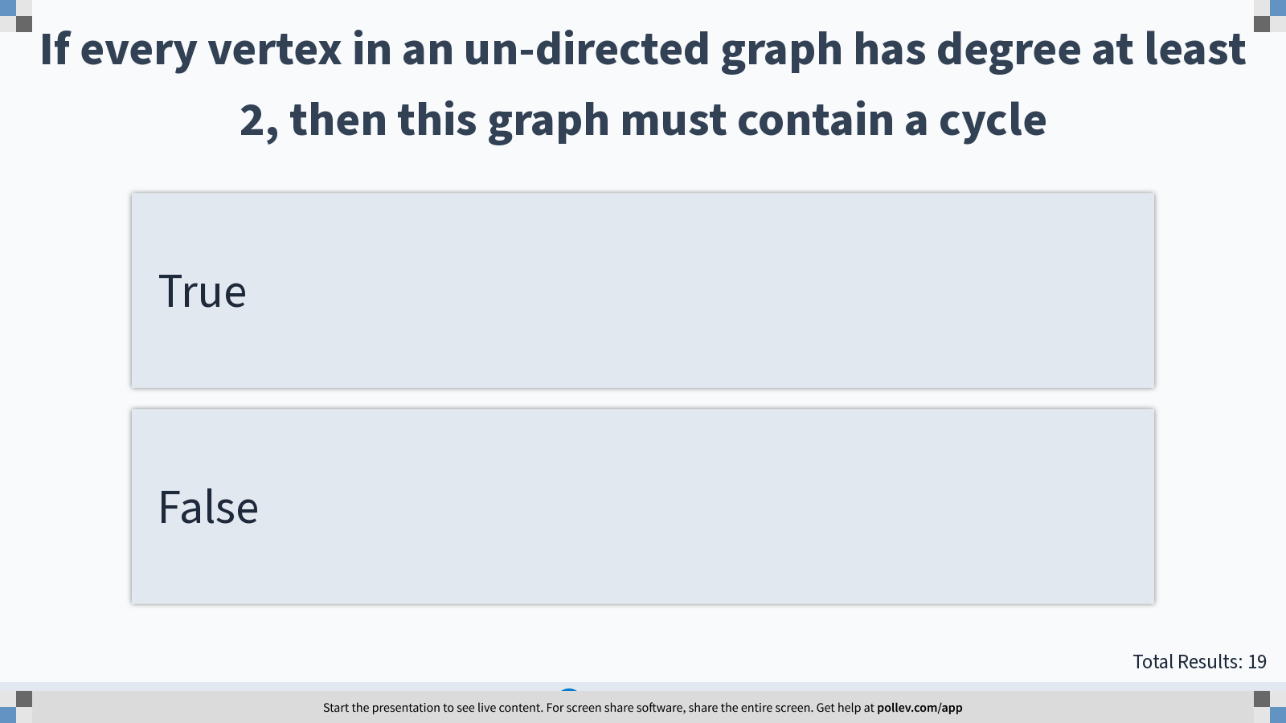
Notes:
If every vertex in an un-directed graph has degree at least 2, then this graph must contain a cycle
https://www.polleverywhere.com/multiple_choice_polls/bi4U1NgleFmgmN7ZITLZW?display_state=instructions&controls=none&onscreen=persist

Slide 15
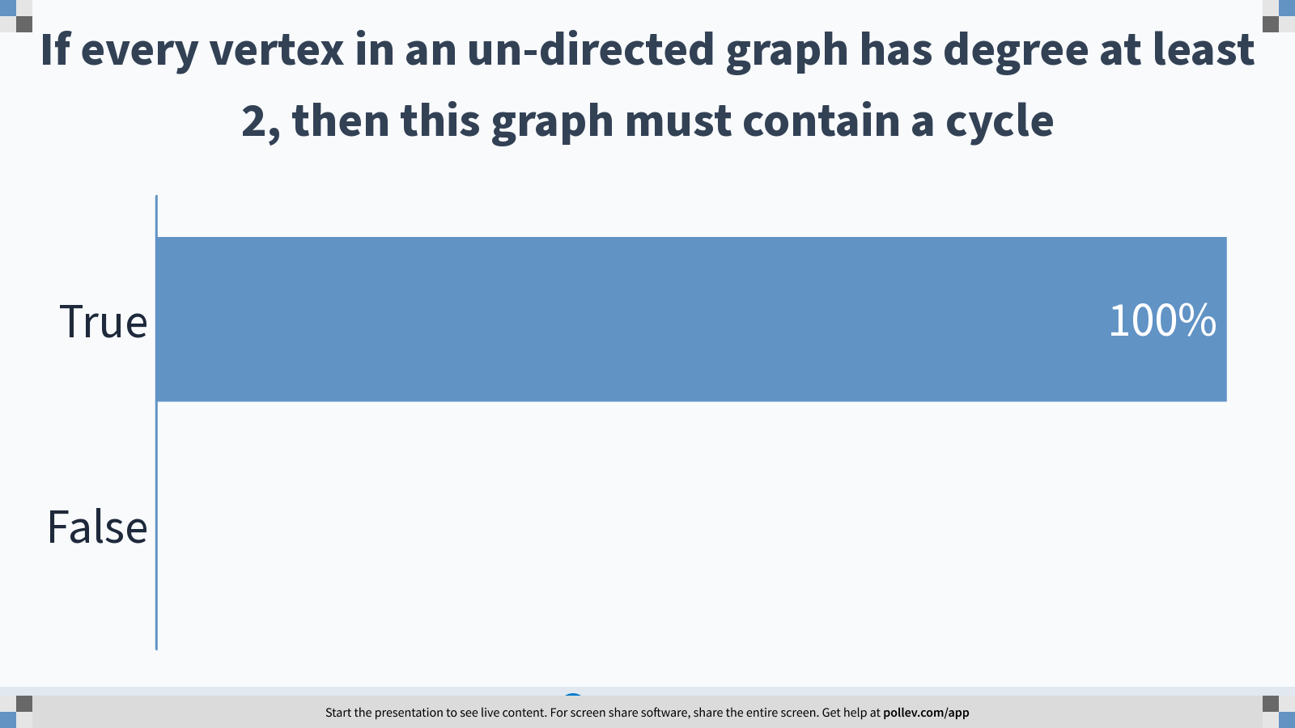
Notes:
If every vertex in an un-directed graph has degree at least 2, then this graph must contain a cycle
https://www.polleverywhere.com/multiple_choice_polls/bi4U1NgleFmgmN7ZITLZW?display_state=chart&display=correctness&controls=none&onscreen=persist

Slide 16
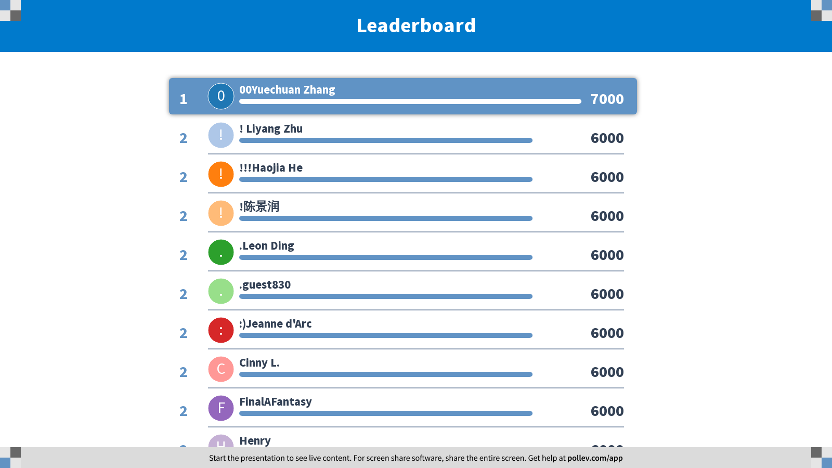
Notes:
Topological Ordering
https://www.polleverywhere.com/competitions/J3TRHbP5vSulsZsUlR1Is?display_state=finale&onscreen=persist

